Slide 1
To Appeal or Not to Appeal, That is the Question Presented
A CLE

Slide 2
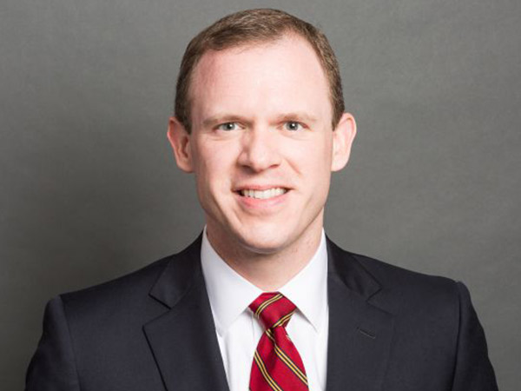
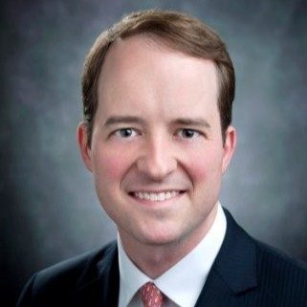
Your Hosts
Walker Humphrey, Willoughby Humphrey & D’Antoni
David Koysza, Boeing
Maggie O’Shields, Willoughby Humphrey & D’Antoni

Slide 3
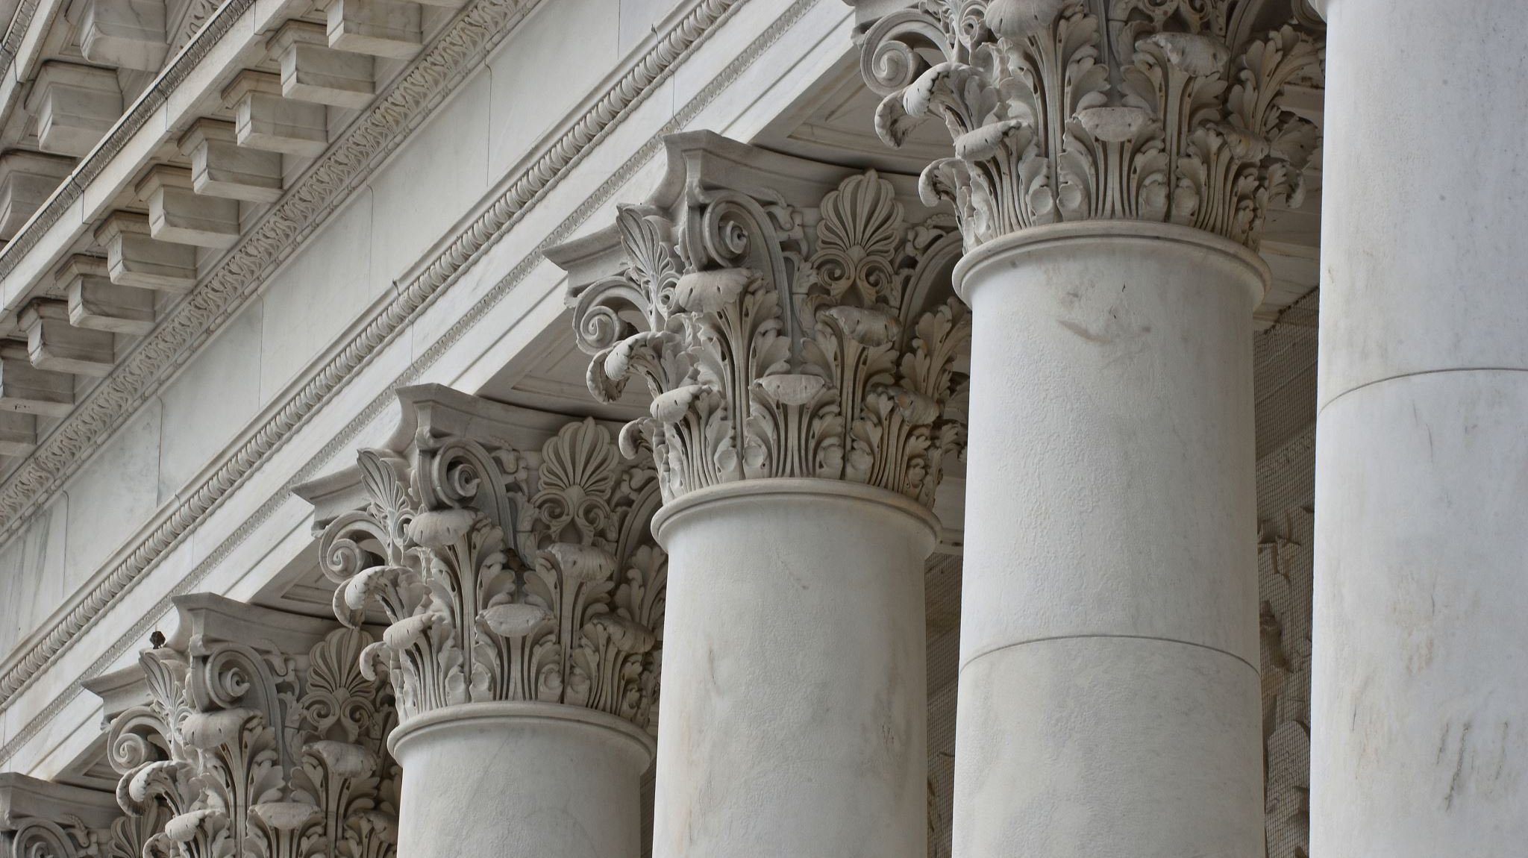
South Carolina’s Court System
Federal Court System
Supreme Court
13 United States Courts of Appeals (12 circuit courts and 1 Court of Appeals for the Federal Circuit)
U.S. District Courts
State Supreme Courts
U.S. Bankruptcy Courts
Administrative Agency Offices and Boards
Supreme Court
Court of Appeals
Circuit Court
Administrative Law Court
Magistrate’s Court

Slide 4
Brief Overview of South Carolina’s Appellate Courts - Court of Appeals
Intermediate-level appellate court.
Became a constitutional court on July 1, 1985.
Jurisdiction over any case in which an appeal is taken from an order, judgment, or decree of the circuit court, family court, a final decision of an agency, a final decision of an administrative law judge, or the final decision of the Workers' Compensation Commission.
One Chief Judge and eight associate judges.
Elected by the General Assembly to staggered terms of six years each. Only state to do this.
The Court sits as three panels of three judges or as a whole (en banc).

Slide 5
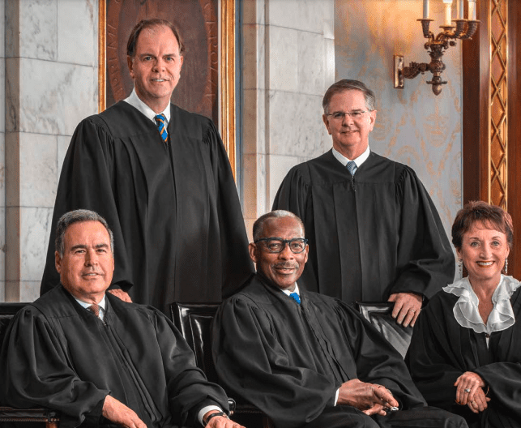
South Carolina Supreme Court – “Nil Ultra”
Exclusive jurisdiction over appeals from the circuit court concerning:
A sentence of death
A circuit court order setting a public utility rate
A judgment involving a constitutional challenge to a state statute or local ordinance
A judgment of the circuit court involving public bonded indebtedness
A judgment of the circuit court pertaining to an election
An order limiting the investigation by a State Grand Jury
An order of the family court relating to an abortion by a minor
Power to certify an appeal pending before the Court of Appeals by its own motion
The Supreme Court otherwise reviews matters by writ of certiorari
(South Carolina Judicial Branch/Twitter)

Slide 6
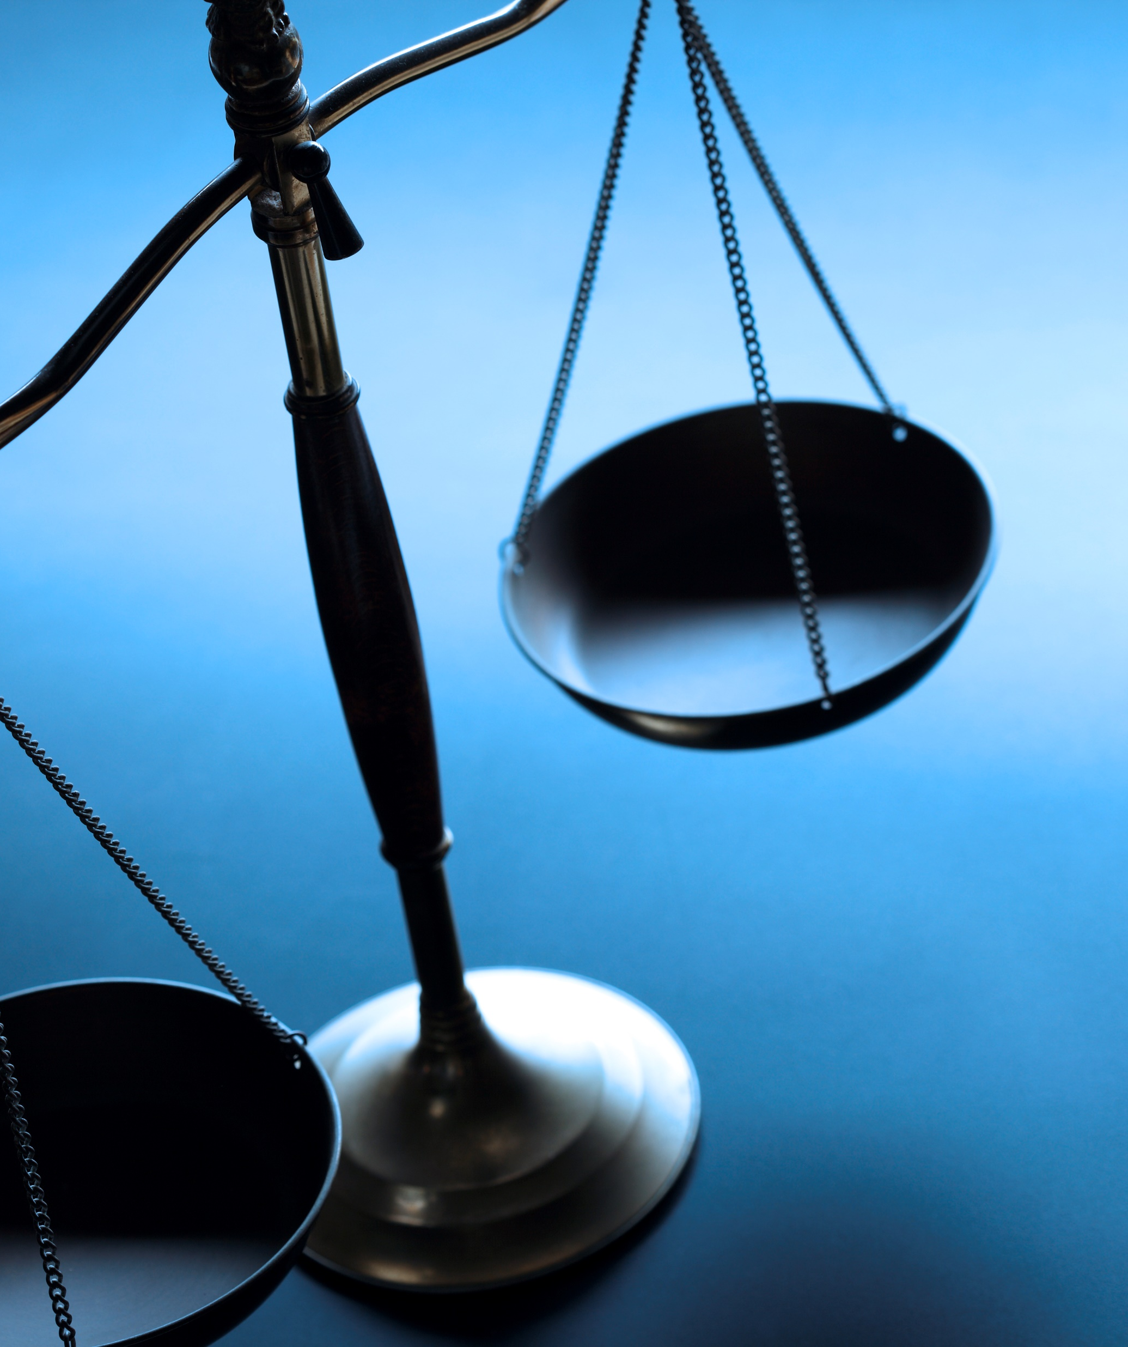
Three General Considerations When Contemplating an Appeal
Time Constraints
Legal Grounds for Appeal / Considerations Governing Review
Cost of the Appellate Process

Slide 7
Time Constraints – SC Court of Appeals
Time for filing notice of appeal is a strict jurisdictional deadline.
Appeals from Court of Common Pleas
Must serve notice within 30 days after receipt of written notice of entry of the complete order or judgment. Rule 203(b)(1), SCACR.
Timely post-judgment motions (Rules 50, 52, and 59, SCRCP) will stay time for appeal.
But successive post-judgment motions might not stay the time for appeal. See Elam v. S.C. Dep’t of Transp., 361 S.C. 9, 20, 602 S.E.2d 772, 778 (2004).
Appeals from General Sessions
Notice of appeal shall be served within 10 days of sentencing or receipt of written notice of entry of judgment. Rule 203(b)(2), SCACR.

Slide 8
Time Constraints – Supreme Court of South Carolina
Must first file a petition for rehearing with the Court of Appeals. The rehearing deadline is 15 days from the date of the opinion. Rule 221(a), SCACR.
You must serve and file your petition for certiorari within 30 days after the petition for rehearing or reinstatement is finally decided by the Court of Appeals. Rule 242(c), SCACR.
Absent extraordinary circumstances, you can only get 20 additional days to file your certiorari briefing. Sup. Ct. Order 2014-07-16-01 (July 16, 2014).

Slide 9
Time Constraints – U.S. Court of Appeals
Notice of appeal in a civil case must be filed:
within 30 days after entry of judgment if the United States, its agency or officer is not a party;
within 60 days after entry of judgment if the United States, its agency or officer is a party; or
within 14 days after the filing of a notice of appeal by any other party. Rule 4(a)(1), FRAP.
Deadline is not jurisdictional
District court can extend time to file by 30 days. Rule 4(a)(5), FRAP.
District court may even reopen the time to file an Appeal. Rule 4(a)(6), FRAP.

Slide 10
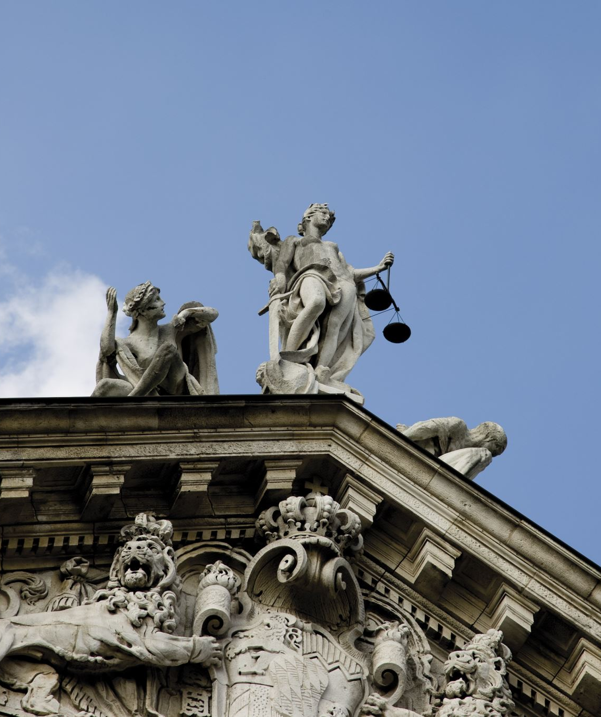
Time Constraints – Supreme Court of the United States
File petition for a writ of certiorari within 90 days from the entry of final judgment or denial of a timely petition for rehearing.
Set aside time to meet the Court’s formatting, printing, and binding guidelines.

Slide 11
Legal Grounds for Appeal / Considerations Governing Review
Appellate courts only review issues of law. Disagreeing with the outcome is not enough.
But South Carolina appellate courts sitting in equity can review factual findings.
Determine the applicable standard of review.
De novo
Abuse of discretion
Plain error (federal only)
Others?

Slide 12
Legal Grounds for Appeal / Considerations Governing Review
“A writ of certiorari is not a matter of right, but of sound judicial discretion, and will only be granted where there are special and important reasons.” Generally need:
(1) Novel questions of law.
(2) Dissent in the decision of the Court of Appeals.
(3) The Court of Appeals conflicts with a prior decision of the Supreme Court.
(4) Substantial constitutional issues directly involved.
(5) A federal question is included and the decision of the Court of Appeals conflicts with a decision of the United States Supreme Court.
Rule 242(b), SCACR; see also Sup. Ct. R. 10.

Slide 13
Cost of the Appellate Process
Appealing a case costs time and money.
It is crucial that you and your client have a full understanding of the cost as well as the chances of success.
Considerations
Administrative Costs
E.g., filing fees, costs of obtaining the clerk’s and reporter’s transcripts, and printing costs.
Potential Bar admission costs
Hard Costs
Costs when lose on appeal. See Rule 222, SCACR.

Slide 14
Remember, the Supreme Court does not have to hear your appeal
Approximate 7,000 to 8,000 new cases are filed to the Supreme Court of the United States each term.
The current court typically grants arguments to around 80 of those.
For the 2021-2022 term, the Court decided 66 cases.

Slide 15
In-House Perspective on Appeals
1. How much more will an appeal cost? (Usually a small percentage of already sunk cost.)
2. How much longer will an appeal take, and is that helpful? (Usually years, and usually yes.)
3. What institutional interests are at stake?
“This will not stand, this aggression against Kuwait.” -- George H.W. Bush, 1990
Does the decision below implicate other contracts, customers?
If you appeal and lose, will you make the situation worse?
4. Is your CEO interested in the topic? (Sustainability, AI, etc.)
This Photo by Unknown Author is licensed under CC BY-SA-NC

Slide 16
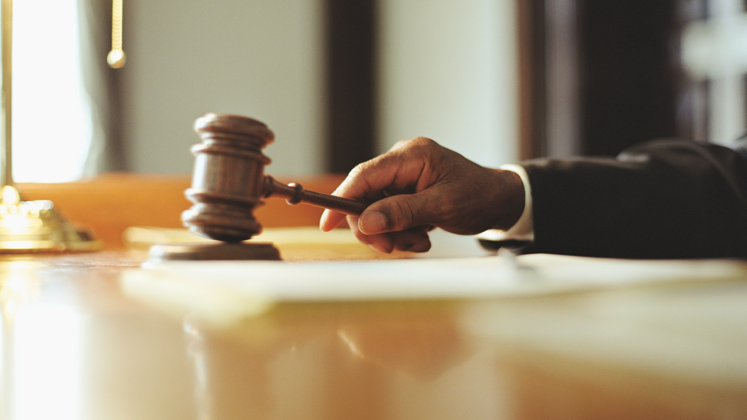
A Postscript: Can you appeal and then settle to make a bad decision go away?

Slide 17
What if your case becomes moot on appeal? Munsingwear Vacatur
Dismissal on appeal can have a preclusive effect if the underlying judgment is not vacated
SCOTUS: “[T]he established practice of the Court in dealing with a civil case from a court in the federal system which has become moot while on its way here or pending our decision on the merits is to reverse or vacate the judgment below and remand with a direction to dismiss.” United States v. Munsingwear, Inc., 340 U.S. 36, 39 (1950).
SC Supreme Court: It would be “inequitable to deny an appellant review of an order because the matter has become moot through no fault of the appellant and yet leave the order in effect.” Byerly v. S.C. Nat. Bank Corp., 313 S.C. 385, 386, 438 S.E.2d 233, 233 (1993).

Slide 18
Does settlement moot your appeal for purposes of Munsingwear vacatur?
Probably not…
Federal courts require “exceptional circumstances” for settlement to moot a lower court’s decision. U.S. Bancorp Mortg. Co. v. Bonner Mall P'ship, 513 U.S. 18, 29 (1994).
But SCOTUS’s use of Munsingwear has increased in recent years. Signaling a change?
South Carolina appellate courts have vacated decisions pending appeal because of settlement without citing Munsingwear. E.g., Harrington v. Blackston, 322 S.C. 470, 473 S.E.2d 47 (1996) (mem.); Lloyd v. S.C. Dep’t of Health & Envtl. Control, 332 S.C. 421, 504 S.E.2d 605 (Ct. App. 1998) (mem.); Gen. Motors Acceptance Corp. v. Carter, 293 S.C. 466, 361 S.E.2d 620 (Ct. App. 1987) (mem.).
Vacatur is an equitable remedy, so you should have a good reason if you want to ask.

Slide 20
Let the Games Begin!
Brought to you by
Willoughby Humphrey & D’Antoni

Slide 21
RULES
This game is designed to be fun and educational.
Questions will consist of true “Jeopardy” style questions.
The timer for each question will appear on the screen. The first to buzz in before time runs out will have the first chance to answer.
Like real Jeopardy, whoever gives the correct “answer” first will select the next questions.
Whoever has the most “money” at the end wins a gift card

Slide 22
HERE ARE TODAY’S CATEGORIES

Slide 23
Potpourri

Slide 24
History Channel

Slide 25
4-Letter Words

Slide 26
Stupid Answers

Slide 27
You better count on it

Slide 28
Potpourri
History Channel
Stupid Answers
You better count on it
4-Letter Words
$100
$100
$100
$100
$100
$200
$200
$200
$200
$200
$300
$300
$300
$300
$300
$400
$400
$400
$400
$400
$500
$500
$500
$500
$500
Final Jeopardy!

Slide 30
If you were successful on appeal, the court likely did what to the lower court’s decision?

Slide 31
What is reversed?

Slide 32
While both are made public, only this type of decision receives wide distribution, is printed in the official reporter, and most significantly, stands as precedent for future decisions.

Slide 33
What is published?

Slide 34
South Carolina is the only state which appoints judges via this method.

Slide 35
What is legislative appointment after selection from a judicial nominating committee?

Slide 36
This type of hearing is generally disfavored and will ordinarily not be ordered except (1) when consideration by the full court is necessary to secure or maintain uniformity of its decisions, or (2) when the proceeding involves a question of exceptional importance.

Slide 37
What is hearing or rehearing en banc?

Slide 38
These hot-button issues permit federal courts to review state and local laws, practices, and court rulings, when an appeal is based on them

Slide 39
What are constitutional issues?

Slide 40
The South Carolina Court of Appeals become a constitutional court on this date.

Slide 41
What is July 1, 1985?

Slide 42
Appellate review in South Carolina can be traced back to when?

Slide 43
What is South Carolina’s colonial period?

Slide 44
The 1868 SC Constitution provided for the state's first Supreme Court, with a Chief Justice and two Associate Justices. It wasn’t until what year did a constitutional amendment provide for the current make up of a Chief Justice and four Associate Justices.

Slide 45
What is 1912?

Slide 46
This Founding Father from Charleston, South Carolina is the first and only Supreme Court Justice to be removed from the Supreme Court.

Slide 47
Who is John Rutledge?

Slide 48
The Court of Appeals is not new to South Carolina and, indeed, can be traced back to what court?

Slide 49
Court of Equity (1808)

Slide 50
Unlike US Supreme Court Justices, South Carolina Supreme Court Justices serve for how long?

Slide 51
What is a renewable ten-year term?

Slide 52
What is one of the things to consider when deciding to appeal?

Slide 53
What is cost?

Slide 54
This word means a form of written command in the name of a court or other legal authority to act, or abstain from acting, in some way.

Slide 55
What is writ?

Slide 56
Don’t forget to brush your teeth before this type of argument.

Slide 57
What is oral argument?

Slide 58
The Court of Appeals established by the Legislature in 1824 met its demise after the case M'Cready v. Hunt in 1834 because M’Cready refused the ___ of allegiance to SC

Slide 59
What is oath?

Slide 60
Appellate courts generally will only review issues of ______.

Slide 61
What is law?

Slide 62
A litigant who files an appeal of a lower court decision is known as a _____.

Slide 63
What is an appellant?

Slide 64
As an appellant, what standard of review will give you de best chance?

Slide 65
What is de novo standard?

Slide 66
If the trial court fails to address your argument, what must you do to amend his error and preserve the issue for appeal?

Slide 67
What is move to alter or amend the judgment within 10 days after receipt of entry?

Slide 68
This tool allows a friend of the court to assist in your appeal.

Slide 69
What is an amicus brief?

Slide 70
The number of federal appellate courts that cover a geographic region.

Slide 71
What is 12?

Slide 72
How many states have intermediate appellate courts?

Slide 73
What is 41?

Slide 74
The odds aren’t really in your favor as the Supreme Court of the Untied States only decided how many cases during the 2021-2022 term?

Slide 75
What is 66?

Slide 76
The number of SC Court of Appeals Judges only increased to nine in 1996. Prior to that there was a ____-member court.

Slide 77
What is six?

Slide 78
DOUBLE JEOPARDY

Slide 79
The most important thing you can do when faced with a decision to appeal?

Slide 80
What is consult with your client?

Slide 81
FINAL JEOPARDY

Slide 82
Potent Potables

Slide 83
In 1920, the Supreme Court unanimously upheld the validity of this amendment which abolished the manufacture, sale, or transportation of intoxicating liquors.

Slide 84
What is the Eighteenth Amendment?

