Slide 1
Preparing for the Asbestos Storm: Prudent Plans for All South Carolina Companies
Angela G. Strickland, Esq.
Managing Partner
Jim Gibson, Esq.
General Counsel & Chief Compliance Officer

Slide 2
Asbestos Litigation in South Carolina
South Carolina = Hot Jurisdiction
Why EVERY Company doing business in South Carolina should care about asbestos litigation
Steps to take to prepare for potential litigation
Steps to take once in litigation
Overview of common tactics
Insurance/Bankruptcy Issues

Slide 3
South Carolina is a HOT Jurisdiction
South Carolina Asbestos Litigation ranked nationally as the #6 “Judicial Hell-Hole” by the American Tort Reform Foundation (ATRF)*
The South Carolina Court of Common Pleas is becoming a preferred jurisdiction for filing asbestos claims
Asbestos filings have increased
Ranking up from #8 last year – 3rd year in the top 10
Severe Discovery Sanctions
Consolidation Of Disparate Claims For Trial
Weak Causation Standard (Substantial Factor Test)
Additur To Jury Verdicts
Large Jury Verdicts
*Source: https://www.judicialhellholes.org

Slide 4
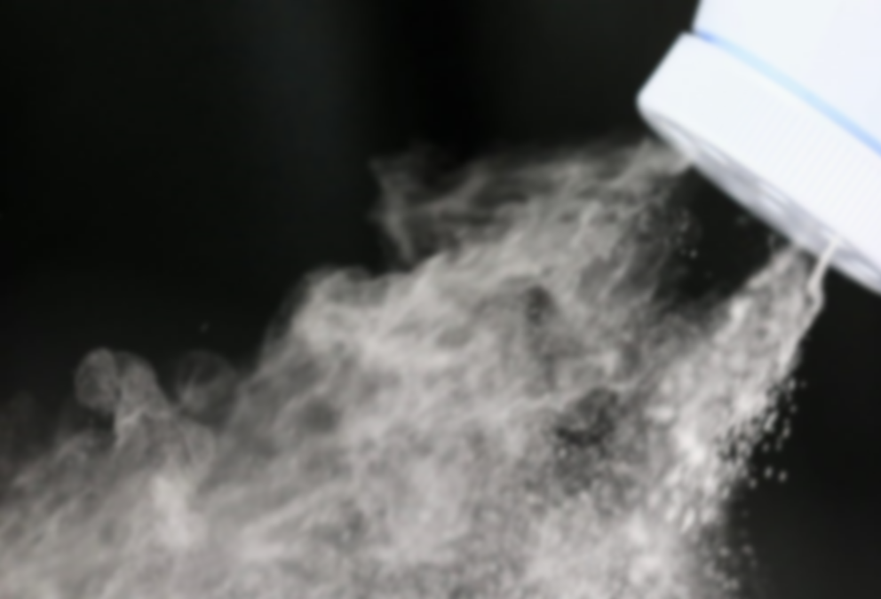
Why You Should Care
Asbestos litigation is not just about “traditional” asbestos-containing products
Cosmetic Talc cases increasing
Manufacturers
Suppliers
Retailers
Premises Issues
Asbestos in your building?
Insurers
Acquiring Companies
Be careful what you purchase

Slide 5
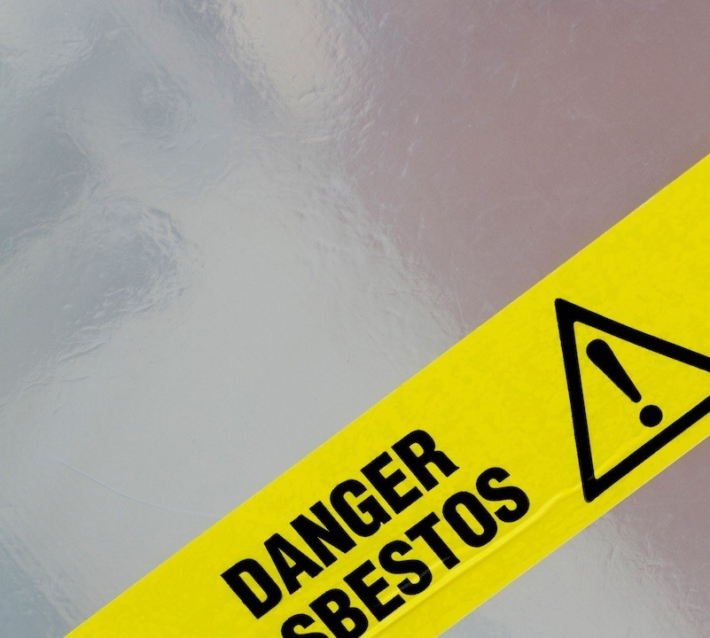
What You Can Do Now
Check insurance policies/exclusions
Understand portfolio of businesses and properties
Both before and after acquisition
Understand (or create if needed) asbestos management plans
Understand any corporate history with asbestos-containing products
Product Portfolio
Log Books
Sales Records
Cultivate Corporate Witness(es)
Retiring/Dying

Slide 6
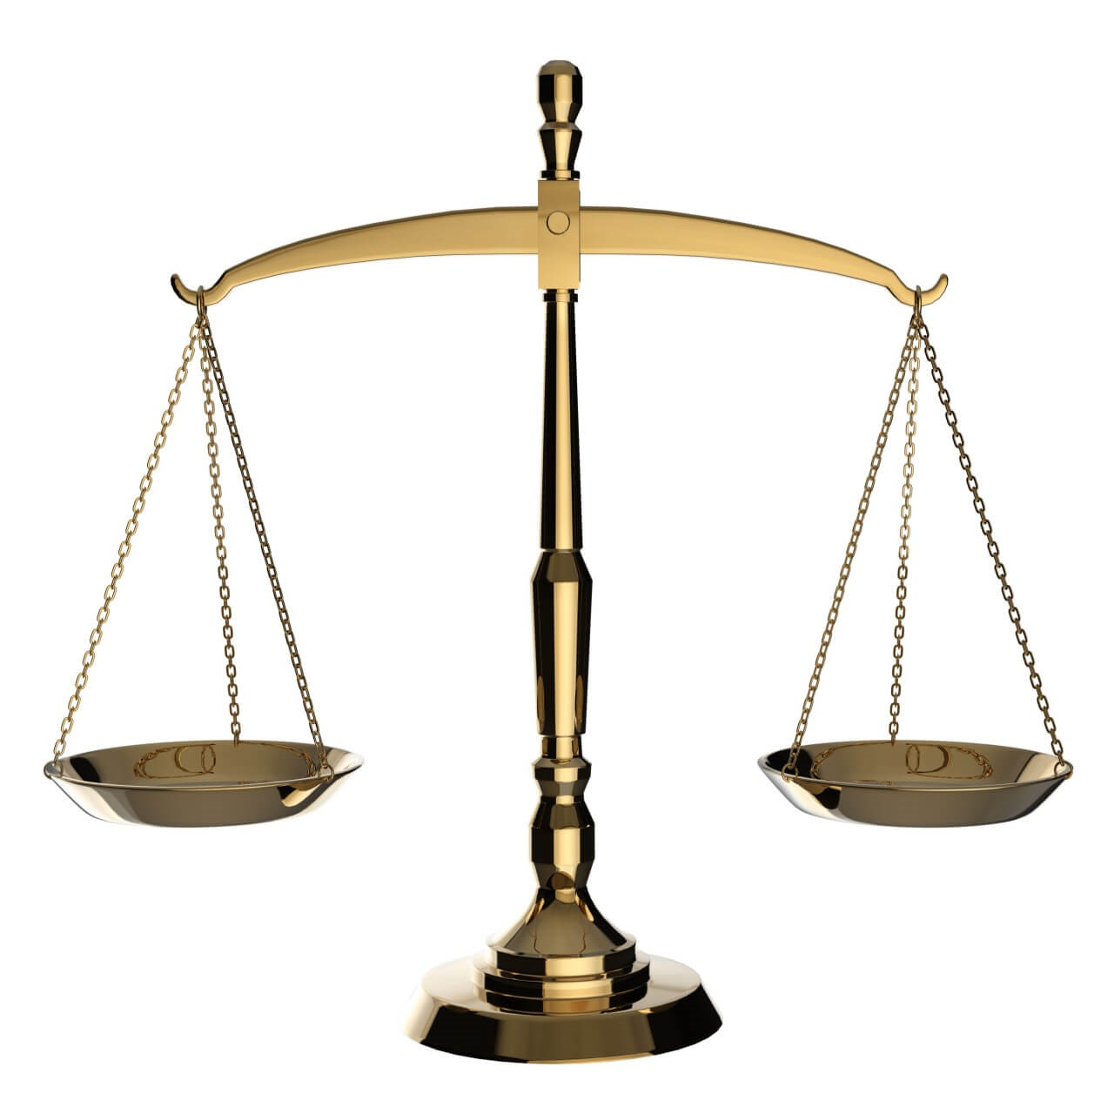
What You Can Do If You Get Sued
Check insurance policies to determine if you have coverage
Retain counsel
Prepare to respond to discovery IMMEDIATELY
Prepare for the inevitable 30(b)(6) deposition
Be ready for the “long haul” (dispositive motions will NOT be heard until the eve of trial)
Be prepared for “short trials” (one week; number of witness will NOT lengthen the duration of trial)

Slide 7
Plaintiffs’ New and Not-So-New Tactics
Receiverships
Naming Successor Companies
Bringing In Out-Of-State Plaintiffs and Defendants
Discovery Battles/Sanctions
Overly Burdensome Discovery Requests
Overly Broad 30(b)(6) Deposition Topics

Slide 8
Insurance/Bankruptcy/Misc. Issues
Litigation over coverage
“Texas Two Step”
Leaving remaining manufacturers to face liability at trial
Johnson & Johnson
Is the dance over?
Recent Third Circuit decision rejecting Johnson & Johnson’s use of the “Texas Two Step” maneuver
Workers’ Compensation
Notice

Slide 9
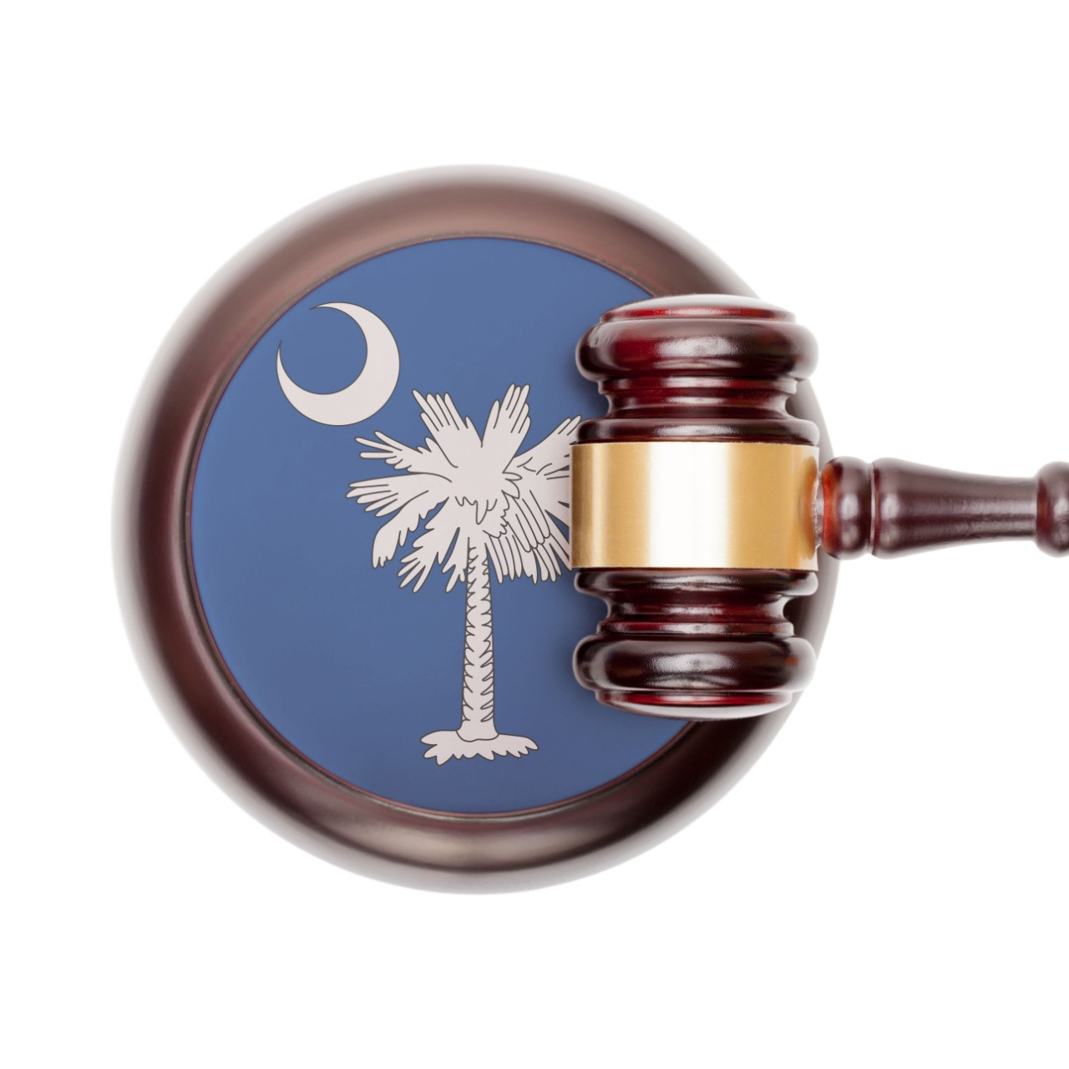
Conclusions
South Carolina Asbestos Litigation is hot, and not in a good way
Take mitigation measures now in anticipation of being a named in an asbestos lawsuit
Move briskly once you are served
Watch for pitfalls and landmines

Slide 10
Questions?
Angela G. Strickland, Esq.
Bowman and Brooke LLP
803.726.7424
angela.strickland@bowmanandbrooke.com
Jim Gibson, Esq.
AstenJohnson
843.202.6224
jim.gibson@astenjohnson.com

Slide 11
Thank You

