Slide 1
Emerging Issues in Labor and Employment Law
February 10, 2023
Stefania Bondurant Michelin North America
Chris Lauderdale Jackson Lewis P.C. Christopher.Lauderdale@jacksonlewis.com
Frank Stern Jackson Lewis P.C. Frank.Stern@jacksonlewis.com

Slide 2
Disclaimer
The presenters have prepared the materials contained in this presentation for the participants’ reference and general information in connection with education seminars. Attendees should consult with counsel before taking any actions that could affect their legal rights and should not consider these materials or discussions about these materials to be legal or other advice regarding any specific matter.

Slide 3
Agenda
Vaccination and the Accommodation Duty
Has the Fourth Circuit Expanded the Definition of “Hostile Work Environment”?
What can we expect from the DOL?
NLRB Activism
More Mischief from the S.C. Supreme Court?
Pay Transparency Laws
Regulating the Use of Artificial Intelligence
Expanded Federal Protection for Pregnant and Nursing Mothers and Paid Family Medical Leave
Cannabis Use Protections
FTC’s Proposed Ban on Noncompete Agreements

Slide 4
Vaccines and the Accommodation Duty

Slide 5
Vaccination & Accommodation
Religious Accommodation:
Sincere religious belief?
Undue hardship?
Sambrano, et al. v. United Airlines Inc. (5th Cir., February 17, 2022)
Doster, et al. v. Kendall (6th Cir., November 29, 2022)
Groff v. DeJoy – Oral Argument – April 18, 2023

Slide 6
Vaccination & Accommodation (cont’d)
Disability Accommodation:
Individual with a Disability
Jorgensen v. Conduent Transp. Sols., Inc. (D. Md., Feb. 2, 2023) (requiring adherence to Covid safety policy does not support inference that plaintiff was regarded as disabled).
Notice of the Disability
Able to perform the essential functions with reasonable accommodation
Kumagah v. Aldersgate United Methodist Retirement Community, Inc. (W.D.N.C, Dec. 27, 2022)
“Work from Home” Accommodations

Slide 7
Fourth Circuit Definition of Hostile Work Environment

Slide 8
Laurent-Workman v. Wormuth, 54 F.4th 201 (4th Cir. 2022)
Three years of employment
Five comments by one supervisor
One very egregious comment by a second supervisor
District Court – “too sporadic”
Fourth Circuit reversed summary judgment on hostile environment claims
“Repeated invectives of an overtly racial tenor”

Slide 9
Developments by the U.S. Department of Labor

Slide 10
OVERTIME RULE
To be exempt from the Fair Labor Standards Act (FLSA), employees must:
Be paid on a salary basis
Be paid the designated minimum weekly salary
Perform certain duties
Notice of Proposed Rulemaking slated for May 2023
Current annual salary threshold: $35,568 ($684 per week) implemented in 2020
Obama administration’s DOL proposed raising the annual salary threshold to $47,476 ($913 per week)
10
Notes:
DOL’s Overtime Rule
A Notice of Proposed Rulemaking is when an agency proposes a new regulation and solicits comments from the public about that proposal.
Originally, the DOL intended to issue a Notice of Proposed Rulemaking in April 2022, but has continued to extend its timeline for announcing the proposed regulation. This month, the DOL stated it intends to issue a Notice of Proposed Rulemaking in May 2023.
The proposed rule would raise the salary threshold employees have to make in order to be exempt from the Fair Labor Standard Act’s minimum wage and overtime requirements.
Of note, the Obama administration’s DOL proposed to raise the threshold to $913 per week ($47,476 annually), but it was struck down in federal court in 2017 because the raise was too high given the purpose of the FLSA to exempt employees holding executive, professional, or administrative positions. The current DOL will likely propose a similar increase.
When the DOL proposes the new rule, businesses should prepare for impacts to payroll structure.
Though we do not know what the DOL will propose, right now employers can take steps in anticipation of the new rule such as identifying positions that may be impacted by a raise in the minimum salary threshold.
Resources:
https://www.hrdive.com/news/dol-may-2023-new-overtime-rule-salary-threshold/639868/
DOL Overtime rule https://www.shrm.org/resourcesandtools/legal-and-compliance/employment-law/pages/dol-is-reviewing-overtime-rule.aspx
29 C.F.R. § 541

Slide 11
INDEPENDENT CONTRACTOR RULE
Not legally entitled to minimum wage, overtime pay, or paid sick leave
New independent contractor classification standards expected in May 2023
Notes:
We also expect changes to the independent contractor rule in 2023.
Independent contractors, in contrast to employees, are not legally entitled to certain protections like minimum wage, overtime pay, and paid sick leave.
The DOL during the Trump administration loosened rules on independent contractor classification. Since then, the Biden administration’s DOL has tried to roll back these changes.
The current DOL plans to release a new Independent Contractor Classification rule in May 2023
Resources: IC Rule: https://www.jacksonlewis.com/publication/what-s-old-new-again-labor-department-flip-flops-independent-contractor-analysis

Slide 12
Developments by the National Labor Relations Board

Slide 13
Current NLRB Initiatives
Expanded Remedies
Providing Increased Employee Access to Employer Email Systems
Prohibiting “Captive Audience” Meetings
Requiring employer to provide financial information during collective bargaining
Scrutinizing employment policies
Expanding union property access
Reviewing the use of electronic surveillance and its impact on employee protected activity

Slide 14
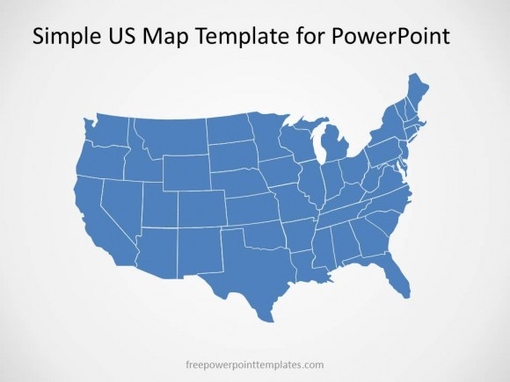
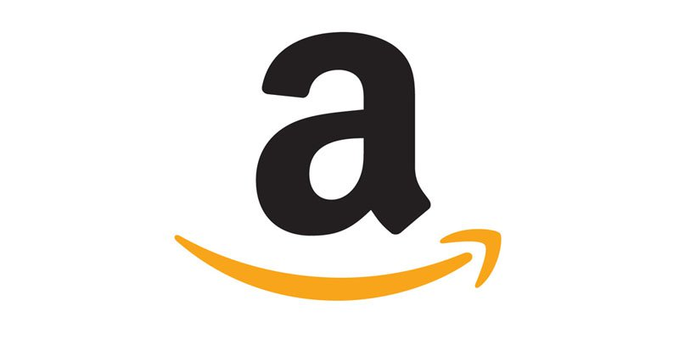
New Organizing Tactics
Industries and geographic areas historically resistant to union organizing efforts are being targeted: Starbucks, Chipotle, Google, Amazon
August 2022 Employees at Trader Joe’s, Chipotle locations voted to unionize
Notes:
Certain industries -- like fast food, craft beer, and technology services – and geographic areas like the south that historically have resisted union organizing efforts are now being targeted to unionize
In August 2022, Minneapolis Trader Joe’s became the country’s second unionized store in a 55-5 vote (second to Massachusetts)

Slide 15
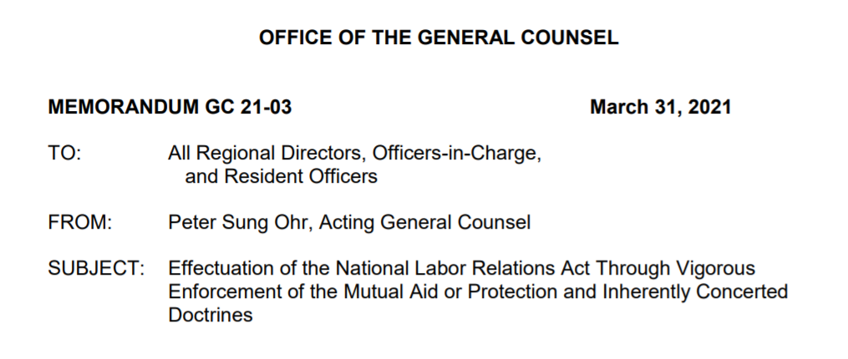
Protected Concerted Activity: Affects All Employers
Section 7 protection does not just apply to union activity and labor organizing.
It also covers “fundamental precursor actions [such as] discussing or protesting wages, hours, and working conditions.”
Employee advocacy need not be explicitly connected to workplace concerns.
It may include “employees’ political and social justice advocacy when the subject matter has a direct nexus to employees’ ‘interests as employees.’”
Notes:
Reference: HEB 2023 Labor Update Power Point slide 7

Slide 16
What Has Changed?
Pent up worker demands, exacerbated by the challenges of the pandemic
Issues driving discontent: voice, respect, work life balance issues, “lack of recognition,” especially with essential workers
Current labor market emboldens employees to speak out and protest
Social media provides immediate communication with colleagues across different geographic areas and easy access
The rise of the “independent” and “local” union.
.
Notes:
Reference: HEB 2023 Labor Update Power Point slide 8

Slide 17
How to Stay Union Free
Assess status of potential supervisors
Train members of management on the art of issue avoidance and how to lawfully and effectively communicate on the issue of labor unions.
Conduct a bargaining unit vulnerability analysis.
Communicate!
Create opportunities for employee input and feedback.
Notes:
What should an employer do in response to concerns about increased organizing? We are here to help employers navigate these issues.
Reference: HEB 2023 Labor Update Power Point slide 26

Slide 18
S.C. Supreme Court – Civil Conspiracy Claim and Effects

Slide 19
Paradis v. Charleston Cty. Sch. Dist. 2021
Prior to Paradis, SC follows the Todd Rule which requires a Plaintiff to plead special damages to assert a civil conspiracy claim
Supreme Court clarifies that “the essential principal Todd intended to address was the need to plead an overt act in furtherance of the agreement, not special damages.”
Effect: lower bar for pleading civil conspiracy
Notes:
SC was the last state to require special damages in a civil conspiracy case

Slide 20
Paradis in Action: Pampu v. Wingo & Cahagan 2022
Defamation
Civil Conspiracy

Slide 21
Pay Transparency Laws

Slide 22
Pay Transparency Laws
Eight states passed and/or expanded pay transparency requirements
(CA, CO, CT, MD, NV, NY, RI, WA)
President Biden issued an executive order in March 2022, promoting pay transparency for federal contractors
Notes:
These are laws that generally require posting salary ranges on job postings
Some apply even if position could be filled by a remote employee in that state
More and more states are moving to require employers to provide candidates with clear salary information.
Since 2019, when Colorado passed the first pay transparency legislation, many states have passed and/or expanded their own legislation in this area. This year California expanded its pay transparency requirements to include wage ranges on job postings. Washington and three cities in New York State also passed legislation pertaining to pay transparency requirements.

Slide 23
Regulating the Use of Artificial Intelligence (A.I.)

Slide 24
A.I. in Employment
Over 80% of employers use A.I. for employment decision-making
A.I. potentially violates the Americans with Disabilities Act (ADA)
Applies even if discrimination is intentional
The Equal Employment Opportunity Commission (EEOC) issued guidance in May 2022 to help employers follow the ADA when using A.I.
Notes:
Many employers use AI and automated hiring tools and at least 16 states have recently introduced bills relating to AI in the workplace.
Some employers use algorithmic decision-making to assist with screening and hiring employees, such as (1) resume scanners that prioritize resumes that use certain keywords, (2) personality tests, or (3) facial analysis tools that evaluate a candidate’s attention span. These tools raise employment concerns. The use of A.I. could lead to unlawful discrimination, even if it is unintentional.
In May 2022, the Equal Employment Opportunity Commission (EEOC) issued guidance to help employers comply with the Americans with Disabilities Act when they use AI tools for workplace decisions. The ADA seeks to remove barriers for people with disabilities in everyday activities, including work. The EEOC is mainly concerned with employers using tools that screen out applicants with disabilities, meaning the technology gives an applicant a lower score that causes the applicant to lose a job opportunity.
An example of violating the ADA when using an AI tool is if video interviewing software lowers an applicant’s score for their speech impediment, or if a chatbot screens out a resume with an employment gap caused by their disability.
References:
https://www.eeoc.gov/laws/guidance/americans-disabilities-act-and-use-software-algorithms-and-artificial-intelligence
https://www.americanbar.org/groups/labor_law/publications/labor_employment_law_news/spring-2022/ai-in-the-workplace/
AI regulations - https://www.disabilityleavelaw.com/2022/05/articles/eeoc-guidance/eeoc-doj-release-expectations-on-employers-use-of-technology-ai-for-employment-decisions/

Slide 25
Tips for Using A.I. in Compliance with the Americans with Disabilities Act
Tell applicants about the type of technology being used before conducting an evaluation
Provide clear instructions for requesting a reasonable accommodation
Do not screen out applicants unless they are unable to perform the job, even when given reasonable accommodations
Notes:
According to the EEOC’s May 2022 guidance on the issue, employers can take steps to comply with the American with Disabilities Act by:
(1) Clearly indicating that reasonable accommodations, including alternative formats and alternative tests, are available to people with disabilities;
(2) Providing clear instructions for requesting reasonable accommodations; and
(3) Try to ensure that no one is screened out unless they are unable to do the job, even when provided with reasonable accommodations. This happens when a program predicts whether applicants under typical working conditions can perform a job without accounting for reasonable accommodations. A promising practice is to only develop and select tools that measure abilities or qualifications that are truly necessary for the job.
Reference: https://www.eeoc.gov/laws/guidance/americans-disabilities-act-and-use-software-algorithms-and-artificial-intelligence

Slide 26
Regulations on the Use of Artificial Intelligence
New York City’s groundbreaking law in effect January 2, 2023
Illinois and Maryland have more limited laws requiring consent to use A.I. in the job application process
The law defines “automated employment decision tools” as any computational process that
Implements machine learning, statistical modeling, data analytics, or artificial intelligence
Issues a score, classification, or recommendation
NOT included in the law: junk email filters, firewalls, antivirus software, data sets
Notes:
So far, New York City is the first to broadly regulate hiring bias based on the use of artificial intelligence. Illinois and Maryland have also promulgated laws regarding A.I. in the workplace, though these laws are much narrower because they only impose consent with respect to AI technology used during the job interview process.
Effective January 2, 2023, New York City’s law bans the use of automated decision-making tools to screen candidates for employment or evaluate current employees for promotion, unless the tool passes a “bias audit.”
With a Democratic majority in the Minnesota legislature that has shown strong support for employee protections in the workplace, it is possible Minnesota or municipalities therein could implement a similar law in 2023.
Reference: https://www.workplaceprivacyreport.com/2021/12/articles/artificial-intelligence/nyc-places-groundbreaking-restrictions-on-ai-use-in-hiring-practices/

Slide 27
Expanded Federal Protections for Pregnant and Nursing Mothers & Paid Family Medical Leave

Slide 28
Expanded Federal Protections for Pregnant and Nursing Mothers
Pregnant Workers Fairness Act (PWFA) effective June 27, 2023
Providing Urgent Maternal Protections for Nursing Mothers Act (PUMP For Nursing Mothers Act) effective April 28, 2023
Pregnancy bias was already illegal

Slide 29
Practical Tips: Complying with New Federal Protections for Pregnant and Nursing Mothers
Train HR and managers
Create a process for requesting a reasonable accommodation.
Think: “How can we make this work?” instead of “This will never work!”
Creativity is key for staffing solutions and private spaces for nursing mothers to express breast milk
Notes:
PWFA Practical Tips
Review and update reasonable accommodation policies
Train HR and managers [emphasize the importance of manager training]
Create and communicate a process for requesting and process accommodations similar to ADA.
When an accommodation request is made the key question should be “How can we make this work?” not “This will never work!” This approach is makes finding a reasonable accommodation that does not impose an undue hardship much more likely.
PUMP for Nursing Mothers Act Practical Tips
Creativity is the key to producing staffing solutions and private spaces for nursing mothers to express breast milk.
Nothing in the law requires employers to maintain a permanent, dedicated space for nursing mothers. A space temporarily created or converted into a space for expressing breast milk and made available when needed by a nursing mother is sufficient if the space is shielded from view and free from intrusion from coworkers and the public. In other words, allowing an employee to use an office with a door that locks would be convenient, but not practical for many worksites. Depending on the workplace settings, privacy screens, curtains, signage, portable pumping stations, and partnerships with other employers to provide private spaces for nursing mothers are all possibilities.

Slide 30
More Cannabis Use Protections

Slide 31
Cannabis Use Protections
States that legalized or expanded legalized marijuana use in 2022
Maryland, Mississippi, Missouri, Puerto Rico, Rhode Island
Federal Government takes steps toward decriminalizing marijuana
California passes legislation prohibiting discrimination of employees and applicants’ use of cannabis outside of work
Notes:
Several states legalized or expanded the legalization of marijuana use and possession in 2022. In addition, the federal government is taking steps toward federal decriminalization by pardoning all simple marijuana related offenses. California which previously legalized the use of marijuana, passed legislation specifically prohibiting discrimination against employees and applicants use of cannabis outside of work, which includes certain requirements pertaining to drug testing.
In light of these trends, we expect to see more states and potentially the federal government move further to decriminalizing use and prohibiting discipline by employers for out of work use.
Resources
https://www.jacksonlewis.com/publication/employers-should-note-post-midterms-state-law-changes
https://www.cnn.com/2022/10/06/politics/marijuana-decriminalization-white-house-joe-biden
https://www.californiaworkplacelawblog.com/2022/09/articles/california/high-times-ahead-for-employers-in-california/
CALIFORNIA: Assembly Bill 2188 – Discrimination: Use of Cannabis
Effective January 1, 2024
Makes it unlawful for an employer to discriminate against a person in hiring, termination, or any term or condition of employment based upon:
A person’s use of cannabis off the job and away from the workplace, except for preemployment drug screening
An employer-required drug screening test that has found the person to have non-psychoactive cannabis metabolites in their hard, blood, urine, r other bodily fluids.
Employers may still prohibit employees to possess, be impaired, or use cannabis on the job.
Law does not preempt state and federal laws requiring testing.
Link to Blog: https://www.californiaworkplacelawblog.com/2022/09/articles/california/high-times-ahead-for-employers-in-california/
Link to Bill: https://leginfo.legislature.ca.gov/faces/billNavClient.xhtml?bill_id=202120220AB2188&firstNav=tracking

Slide 32
Federal Trade Commission’s Proposed Rule Banning Non-Compete Agreements

Slide 33
Federal Trade Commission Banning Non-Compete Agreements
What is in the proposed rule?
Contract terms that prohibit workers from seeking or accepting employment or operating a business after the worker’s current employment concludes
Includes non-disclosure of confidential information terms and training cost repayment terms
Requires employers to rescinds all non-compete clauses
Why does the proposed rule matter? Non-competes protect:
Trade secrets, confidentiality, data
Contracts and customers
Prospects, opportunities, pursuits
Physical property and work product
Notes:
Non-Compete Agreements
What?
On January 5, 2023, the Federal Trade Commission proposed a new rule that – if made final – would effectively prohibit non-compete agreements, except for very limited circumstances.
The rule would supersede all contrary state laws.
Why does the ban matter for employers?
The proposed rule is remarkable for its sweeping definition of “non-compete clauses” that fall within the ban. This means the ban extends to contractual provisions that have the effect of prohibiting workers from seeking or accepting employment or operating a business, even if the clause does not contain the magic words “non-compete.”

Slide 34
Labor Market Challenges
Remember that Antitrust Law Prohibits:
“No Poach” Agreements
Agreement to Fix Wages
Surveys of Wage, Benefit, or Other Dates (Except for Surveys Conducted by a Third Party under Strict Standards)
Notes:
PWFA Practical Tips
Review and update reasonable accommodation policies
Train HR and managers [emphasize the importance of manager training]
Create and communicate a process for requesting and process accommodations similar to ADA.
When an accommodation request is made the key question should be “How can we make this work?” not “This will never work!” This approach is makes finding a reasonable accommodation that does not impose an undue hardship much more likely.
PUMP for Nursing Mothers Act Practical Tips
Creativity is the key to producing staffing solutions and private spaces for nursing mothers to express breast milk.
Nothing in the law requires employers to maintain a permanent, dedicated space for nursing mothers. A space temporarily created or converted into a space for expressing breast milk and made available when needed by a nursing mother is sufficient if the space is shielded from view and free from intrusion from coworkers and the public. In other words, allowing an employee to use an office with a door that locks would be convenient, but not practical for many worksites. Depending on the workplace settings, privacy screens, curtains, signage, portable pumping stations, and partnerships with other employers to provide private spaces for nursing mothers are all possibilities.

Slide 35
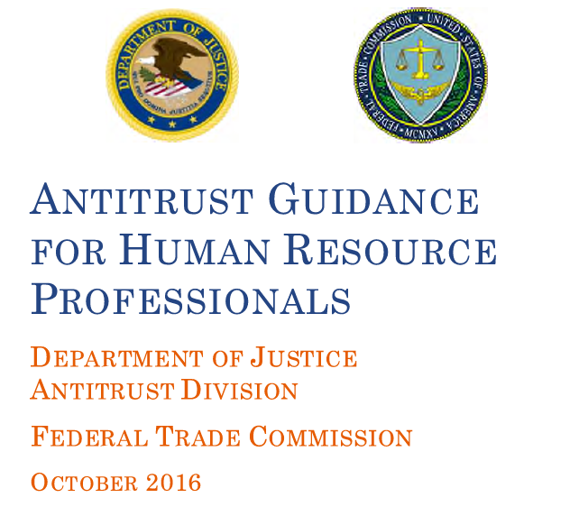

Slide 36
Avoiding the Problem Employment Claim
Long Service Employees
Sympathetic Plaintiffs
Negative or Defamatory Comments
Insufficient Documentation of Performance Issues
Favorable Performance Evaluations
Inconsistent Comparators
Prior Complaints or Reports by Employees
Prior Workers’ Compensation Claim
“Bridge to Retirement” Plaintiff
Your Case is Never Better Than Your Reason!

