Slide 1


  September 16, 2022
Benefits, Leaves, Pay, and Accommodations Post-Dobbs:
Critical Reminders for Employers
Presented by:
Ashley Cuttino (Greenville)
Bill Duda (Columbia)

Slide 2
Agenda
Quick overview of Dobbs
Status of related South Carolina Legislation
What does Dobbs mean for employer health plans?
Medical travel expense considerations
State law issues – aiding and abetting?
Pregnancy Discrimination and Accommodation
Leaves of absence
Pay/wage replacement benefits
Questions

Slide 3
Dobbs v. Jackson Women’s Health Organization (2022)
Overturned Roe v. Wade (1973) and Planned Parenthood of Southeastern Pennsylvania v. Casey (1992)
No federal constitutional right to abortion
States can decide how to regulate – practical impact will vary by state
  Some have retained pre-Roe abortion laws that may again take effect (Texas)
  Some have “trigger laws” effective immediately, within a set time after the Dobbs decision, or upon some action (e.g., certification by state AG) (Louisiana, Kentucky)
  Some have recent restrictions tied to “fetal heartbeat” (Oklahoma, Texas)
  Some are expected to enact new restrictions (Indiana, but see Kansas)
  Some are expected to strengthen protections for abortion (California)

Slide 4
Status of South Carolina Legislation
(*as of 9/9/22)
Prior Law still in effect today limits abortions up to 20 weeks of pregnancy.
BUT
South Carolina Fetal Heartbeat Bill passed in 2021 with trigger provision went into effect immediately upon Dobbs decision
  The law bans abortions once fetal cardiac activity is detected, or about six weeks
  Currently stayed by the S.C. Supreme Court
Active New Legislation
  Began in House as a near total ban on abortion with a provisions that contained an aiding and abetting clause; Aiding and abetting clause did not pass House
  After much debate exceptions for rape/incest and life of the mother included
  Senate went into filibuster on September 8, 2022. Proposed law that passed the Senate:
    Builds on the fetal heartbeat six week law with an exception for sexual assault victims up to 12 weeks.
  Now it goes back to the House for further debate

Slide 5
What does Dobbs mean for employer health plans?
ERISA does not restrict employer-sponsored health plans from covering abortion
ERISA does not require employer-sponsored health plans to cover abortion
  Except Pregnancy Discrimination Act (PDA) requires coverage of abortion where the life of the mother would be endangered if the pregnancy were carried to term (and also for treatment for complications from an abortion)

Slide 6
What does Dobbs mean for employer health plans?
Insured plan will be subject to the law of the state that governs its insurance contract
Self-insured plan can be designed to cover abortion or not, subject to PDA exception
For plans that cover abortion, participants in some states will now have difficulty accessing that benefit
Many employers considering adding medical travel expense benefits

Slide 7
Medical Travel Expense Benefit Considerations
Consider the scope of the benefit
  Access to abortion care only?
  Access to reproductive health care + transgender (or gender affirming) care?
  Access to any medical care restricted by state law?
  Access to any medically necessary care covered by the plan?
Be cautious and measured in communicating related changes

Slide 8
Medical Travel Expense Benefits – Tax Treatment
Internal Revenue Code Section 213(d): the following amounts are treated as “medical care” that is excludable from an employee’s income, if they are “primarily for and essential to” obtaining medical care:
  Transportation expenses (e.g., airfare, mileage, etc.)
  Up to $50 per night of lodging expenses
  The above expenses for a travel companion whose presence is necessary for the patient to obtain medical care
Consider staying with these to ease administration.

Slide 9
Mechanics of Travel Reimbursement Benefits
Programs to reimburse medical expenses are generally group health plans under ERISA
Options would include: medical plan, health reimbursement arrangement (HRA), or employee assistance program (EAP)
Reimbursements limited to those enrolled in your current plan?
Practical reasons to have an outside company administer these arrangements
  Third-party administrator (TPA) or benefits enrollment firm
  Could this be done in-house, at least as a stop-gap?

Slide 10
State Law Considerations
In addition to federal legal considerations (ERISA, MHPAEA, HIPAA privacy)…
13 states have “trigger” laws of one form or another based on the overturn of Roe
Half the states expected to ban or restrict abortions under Dobbs
Typical laws bar abortions after a certain time frames (15 weeks, 6 weeks)

Slide 11
State Laws – What About Aiding and Abetting?
Other types of statutes could include aiding and abetting as a violation
State abortion laws generally focus closely on medical providers
Texas (2021) and Oklahoma (2022) “heartbeat” laws put new twist on this
  Aiding and abetting includes reimbursing for an illegal abortion through insurance
  States are moving fast and others may follow suit
Could covering out-of-state medical expenses under your plan really violate state civil laws?
  Out-of-state abortions v. reimbursements of employees in-state
  Justice Kavanaugh’s take on a related issue
Criminal liability under pre-Roe laws?

Slide 12
How to Manage Aiding and Abetting Risks
ERISA plans, especially self-insured ones, have a good card in their hands – ERISA broadly preempts state laws that “relate to” benefit plans
Good arguments that these laws interfere with uniform administration of plans
Limitations on ERISA preemption include: insurance laws, “generally applicable” criminal laws
Practical considerations to minimize potential exposure now and vigilance about future laws (especially criminal laws)

Slide 13
Quick Note on Medications & State Law
Abortion medications covered under many plans (about half of recent U.S. abortions are by medication)
States often regulate medications specifically
  19 states require presence of doctor to administer (no telehealth)
  A few states ban them completely
As states legislate in this area, they may ban or restrict medications, too
  Again, remain vigilant on changes

Slide 14
Federal and State Pregnancy Discrimination Acts
Federal law protects employees from discrimination/harassment on the basis of . . .
  Pregnancy
  Childbirth
  Related medical conditions
Related medical conditions
  An employee having an abortion
  An employee contemplating having an abortion
South Carolina’s Pregnancy Discrimination Act also requires accommodations for pregnancy, child birth and related medical conditions.
  Other states have similar legislation.

Slide 15

Reasonable Accommodations
In addition to states that require accommodations for pregnancy, childbirth and related medical conditions, the ADA may possibly apply
ADA
  An employer must engage in the interactive process with an employee with a statutory disability
  Pregnancy is not a disability
  Pregnancy-related conditions can be a disability
  Employer must accommodate pregnancy-related restrictions just as it would non-pregnancy-related restrictions
Is ADA likely to apply?

Slide 16
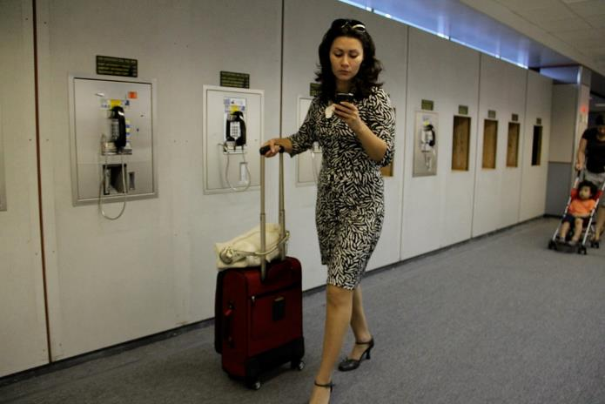
Reasonable Accommodations?
Pregnant employee who travels for business asks not to have to travel to states that restrict abortions
Pregnant employee who works in branch in state that restricts abortions asks to work temporarily at a branch office in a state that does not restrict abortions

Slide 17

Leaves of Absence – FMLA
Employee entitled to abortion-related care if health care
provider certifies employee has a serious health condition
  Serious health condition – continuing treatment and generally more than
  3 consecutive calendar days of incapacity
Elective abortions covered?
  Incapacity due to pregnancy or for prenatal care – minimal amount of incapacity or needed leave sufficient

Slide 18
Leaves of Absence Issue for Multi-state employers
Example: Illinois
Illinois Human Rights Act (IHRA)
requires reasonable accommodation for “any medical condition or common conditions . . . related to pregnancy or childbirth.”
reasonable accommodation includes leave necessitated by pregnancy, childbirth, or medical or common conditions resulting from pregnancy or childbirth
Paid Sick Leave in Chicago and Cook County, Illinois
Child Bereavement Leave Act (CBLA)
requires unpaid bereavement leave (up to 10 days) to attend funeral, make arrangements necessitated by death of a child, or grieve the death of a child
benefits coordinate with FMLA if covered by FMLA

Slide 19
Leaves of Absence – Employer Policies
Employer policies
  Sick leave
  Personal leave
Federal law requires that employers apply the policies evenhandedly
  PDA – no abortion discrimination
    SCPDA too since it is a related medical condition
Even in states that prohibit abortions?
  Likely would be a legitimate, nondiscriminatory reason
  BUT employer would have to know the employee is seeking employer-provided leave for that reason
    What documentation does your company require?

Slide 20

Pay and Wage Replacements
State paid leave benefit – Paid sick leave ordinances
Paid Family Leave States
Employer benefit plan – Short-term disability benefits
  Incapacity duration may not be long enough to qualify for benefits
  Discuss with insurer or TPA if in a state with aiding and abetting law to confirm whether any changes to claim process will be implemented by TPA/insurer
Employer policy – PTO, vacation pay, sick pay
  Employer has control over scope of coverage
  Employer has control over information required to request the benefit
    Key Point: Not clear whether lack of any notice for the reason paid leave is requested would be a sufficient defense to avoid some state penalties. The Texas law confirms the penalty applies when someone “knowingly” aids or abets in obtaining an abortion, regardless of whether the person knew or should have known the abortion would be performed in violation of this state law.

Slide 21

Questions?

Slide 22
Thank you!
Ashley Cuttino
300 North Main Street, Suite 500 | Greenville, SC 29609
Ashley.cuttino@ogletree.com | Phone: 864.240.8302
Bill Duda
First Base Building, 2142 Boyce Street, Suite | Columbia, SC 29201
Bill.Duda@ogletree.com | Phone: 803-227-0845

