Slide 1
Looking Ahead – E-Discovery Trends and the Ethical use of Emerging Tools
September 16, 2022
Anne Marie Hanson, Blue Cross and Blue Shield of SC
Jarrett Coco, Nelson Mullins

Slide 2
Agenda
Ethical Rules
New Data Sources
Emerging Tech

Slide 3
Ethical Use of AI and Emerging Tools
Competence
Communication
Confidentiality
Supervision

Slide 4
Rule 1.1 Attorney Competence
SC Rule of Professional Conduct 1.1:
“A lawyer shall provide competent representation to a client. Competent representation requires the legal knowledge, skill, thoroughness and preparation reasonably necessary for the representation.”
Comment [8]:
“To maintain the requisite knowledge and skill, a lawyer should keep abreast of changes in the law and its practice, including the benefits and risks associated with relevant technology, engage in continuing study and education and comply with all continuing legal education requirements to which the lawyer is subject.” (emphasis added).
As to the “Technology” Revisions to Model Rule 1.1, the ABA has stated:
Competence in using a technology can be a requirement of practicing law. Requirements for technological competence may appear as part of rules for professional conduct, continuing legal education (CLE) programs, and malpractice insurance premium credits.

Slide 5
Rule 1.4 Communication
SC Rule of Professional Conduct 1.4:
(a) A lawyer shall:
(2) reasonably consult with the client about the means by which the client's objectives are to be accomplished
According to Rule 1.4, the ultimate decision on whether to use artificial intelligence for legal services to accomplish clients’ goals should be communicated to the client
Best practices:
Memorialize communications with client in writing
Articulate reasoning behind decision to use or not use AI
Articulate how decision will further clients’ objectives

Slide 6
Rule 1.6 Duty of Confidentiality
(c) A lawyer shall make reasonable efforts to prevent the inadvertent or unauthorized disclosure of, or unauthorized access to, information relating to the representation of a client.
Comment to Model Rule 1.6 amended to include factors to be considered in determining whether lawyer made reasonable efforts and to state that, “[a] client may require the lawyer to implement special security measures not required by this Rule or may give informed consent to forego security measures ***,” and to note that state or federal laws may require lawyer to take additional steps, but that this is “beyond the scope of these Rules.”
Every aspect of the use of AI may intersect with the lawyer’s duty of confidentiality:
Vendor sophistication and data protection
Ownership of information
Protection of confidential information in dealings with vendors
Security measures
Termination of relationship

Slide 7
Rule 5.1 Responsibilities of a Partner or Supervisory Lawyer
“(a) A partner in a law firm, and a lawyer who individually or together with other lawyers possesses comparable managerial authority in a law firm, shall make reasonable efforts to ensure that the firm has in effect measures giving reasonable assurance that all lawyers in the firm conform to the Rules of Professional Conduct.”

Slide 8
Rule 5.3 Responsibilities Regarding Nonlawyer Assistants
“With respect to a nonlawyer employed or retained by or associated with a lawyer:
(a) a partner, and a lawyer who individually or together with other lawyers possesses comparable managerial authority in a law firm shall make reasonable efforts to ensure that the firm has in effect measures giving reasonable assurance that the person's conduct is compatible with the professional obligations of the lawyer;
(b) a lawyer having direct supervisory authority over the nonlawyer shall make reasonable efforts to ensure that the person's conduct is compatible with the professional obligations of the lawyer; and
(c) a lawyer shall be responsible for conduct of such a person that would be a violation of the Rules of Professional Conduct if engaged in by a lawyer if:
(1) the lawyer orders or, with the knowledge of the specific conduct, ratifies the conduct involved; or
(2) the lawyer is a partner or has comparable managerial authority in the law firm in which the person is employed, or has direct supervisory authority over the person, and knows of the conduct at a time when its consequences can be avoided or mitigated but fails to take reasonable remedial action.”

Slide 9
Discovery Process Overview
Processing
Preservation
Information Management
Identification
Review
Production
Presentation
Collection
Analysis
https://edrm.net/edrm-model/

Slide 10
Traditional Data Sources
Email
Computers
Cloud storage
Network
Structured data
Other shared locations
Hard Copy Scanning

Slide 11
New Data Sources
Microsoft 365, Teams, Slack
Zoom, GoTo, Webex, BlueJeans, etc.
Mobile Devices
Social Media
Internet of Things (IoT)

Slide 12
New Sources Increasingly At Issue
Requests for Production in Litigation
Courts Granting Discovery
Regulators Seeking Discovery
Analysis re Discoverability

Slide 13
New Sources, New Challenges
Collection
Security/Encryption
Privacy
Possession/Custody/Control
Analysis/review
Chasing Technology
Production

Slide 14
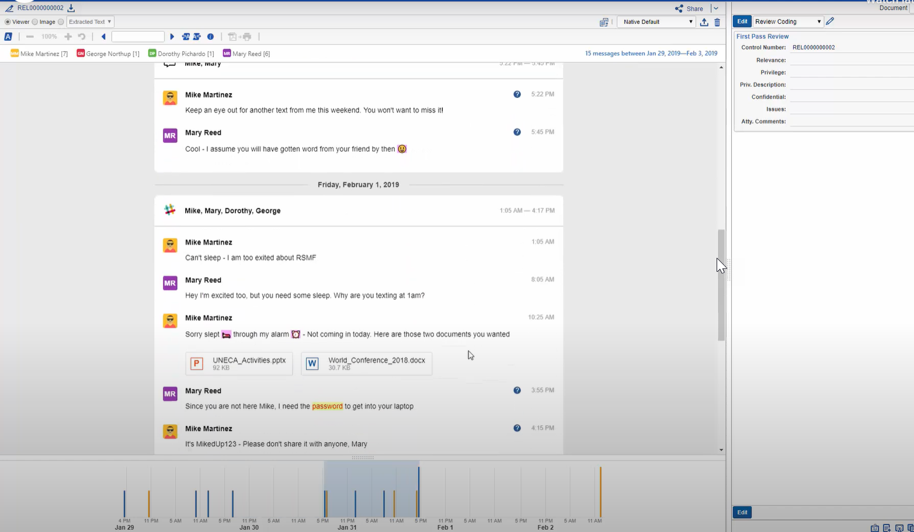

Slide 15
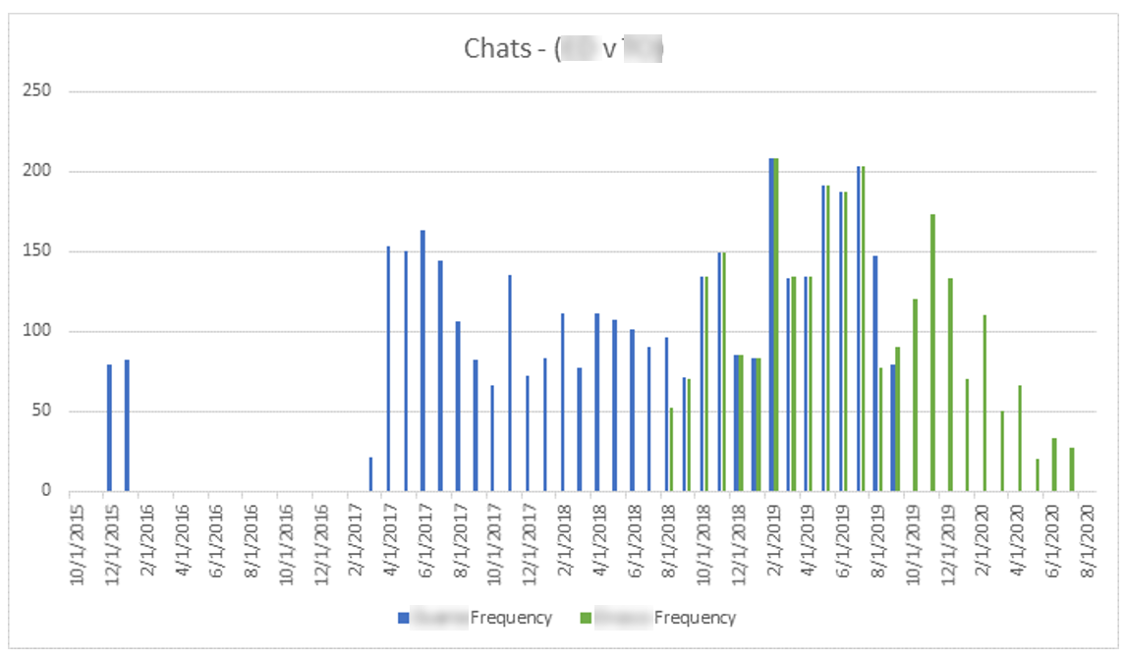
Gap / Comparative Analyses

Slide 16
New Legal Tech Examples
Processing Tools
Contextual Tools
Active AI Tools
Emerging AI Tools

Slide 17
Artificial Intelligence
Artificial Intelligence (“AI”) is the is the simulation of human intelligence processes by machines, especially a computer system. We consider this to include any automated process that classifies, categorizes, summarizes, makes decisions, or provides guidance regarding data and information using statistical, rule-based, or other algorithmic means.

Slide 18
How AI is being used in Legal Applications
Document Review
Legal Research
Assessing Risk/Predicting Legal Outcomes
Identifying and Protecting Data such as PHI and PII

Slide 19
Recent Technology Advances
NexLP StoryEngine/Brainspace
Entity Extraction
MIYLYI Blackout
Automated redactions
Native redactions
Canopy
Initial impact report
Entity normalization
De-duplicated master list of PHI
Relativity/TextIQ
Relativity Redact
TextIQ PII Identification
TCDI
Auto Redact for certain PII (DOB, SSN, etc)

Slide 20
Addressing PHI and PII in Legal Matters
Identification
De-Identification
Normalization

Slide 21
PHI and PII Identification
Often false positives with simple text searches
Searches for certain sequences or patterns of data (e.g., XXX-XX-XXXX) can improve results

Slide 22
PHI and PII Identification
AI Modeling & Contextual Algorithms
Identify additional instances of PHI and PII by analyzing the context in which words are being used within data
Train AI learning models on different instances of PHI and PII

Slide 23
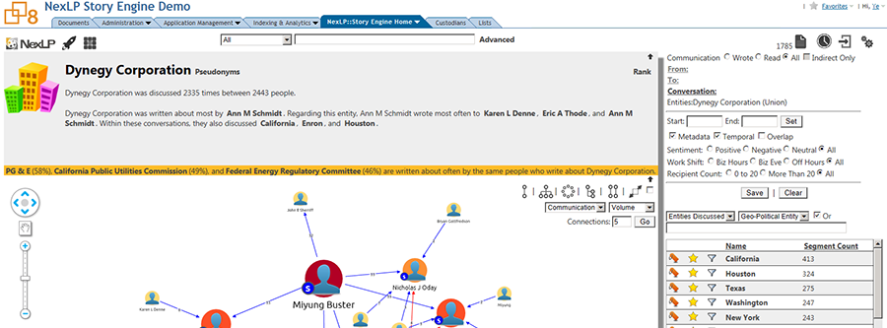
PHI and PII Identification
Entity Extraction – identify people, companies, places, etc.
Screenshot from Story Engine

Slide 24
PHI/PII De-Identification
Anonymization versus Pseudonymization
Mass Redaction/Labeling
PI Level
e.g, all SSN or Credit Card #s
Document Level
e.g., form duplicates

Slide 25
PHI and PII Normalization
Creation of a Master List
Identify and merge name variations
Anomaly detection
Deduplicate entries

Slide 26
Final Thoughts
Competence is a key principle for the reliable use of AI in legal matters.
Technology can greatly assist with an attorney’s duty of confidentiality, but must also be analyzed carefully and used thoughtfully to ensure privacy and security standards are met.
Lawyers are obligated to supervise the work of the AI – know your AI and your team.

Slide 27
Questions?
Contact Information
Anne Marie Hanson
Regulatory & Compliance Counselor
Blue Cross and Blue Shield of South Carolina
anne.marie.hanson@bcbssc.com
(803) 264-3270
Jarrett Coco
Partner
Nelson Mullins Riley & Scarborough
jarrett.coco@nelsonmullins.com
803.255.5536

