Slide 1
Is that Remotely Possible? Spotting and Solving Issues with Remote and Hybrid Work
Randy Moody and Chase Samples
Randy.Moody@jacksonlewis.com | Chase.Samples@jacksonlewis.com
Jackson Lewis P.C. | Greenville
Katie Deuben
World Acceptance Corporation | Greenville

Slide 2
Disclaimer
The presenters have prepared the materials contained in this presentation for the participants’ reference and general information in connection with education seminars. Attendees should consult with counsel before taking any actions that could affect their legal rights and should not consider these materials or discussions about these materials to be legal or other advice regarding any specific matter.

Slide 3
  Current State of Remote Work

Slide 4
Approximately 56% of full-time employees in the U.S. – more than 70 million workers – say their job can be done working remotely from home. We call them "remote-capable employees.“
Current work location for remote-capable workers as of June 2022:
five in 10 are working hybrid (part of their week at home and part on-site)
three in 10 are exclusively working remotely
two in 10 are entirely on-site

Slide 5
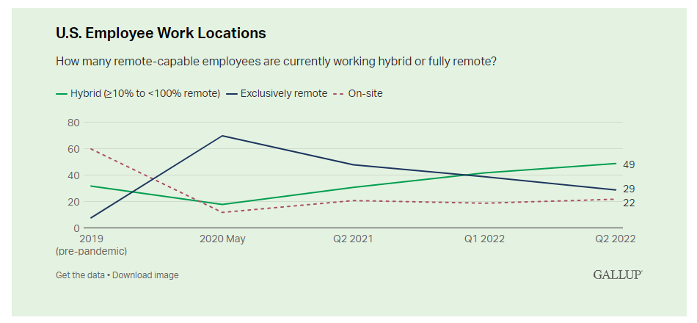

Slide 6
Where do remote-capable employees expect to work long term and where would they prefer to work?
Hybrid Work
Fully Remote Work
On-Site Work
Hybrid work has increased in 2022 (from 42% in February to 49% in June) and is expected to further increase to 55% of remote-capable workers by the end of 2022 and beyond.
This shift aligns closely with the preferences of many remote-capable workers, as 60% want a long-term hybrid work arrangement.
Fully remote work arrangements are expected to continue decreasing from three in 10 remote-capable employees in June, down to two in 10 for the long term, despite 34% wanting to permanently work from home.
Nonetheless, long-term, fully remote work arrangements are expected to nearly triple compared to 2019 figures. Whether this shift satisfies employees with a strong affinity for permanently working from home is yet to be determined.
Fully on-site work is expected to remain a relic of the past with only two in 10 remote-capable employees currently working entirely on-site and about the same number expecting to be entirely on-site in the future – down from a whopping 60% in 2019.
A mere 6%want to work entirely on-site going forward. Doesn't it seem that traditional management and workplace practices are broken if more than 90% of 70 million employees say they don't want to come back to the office full time?

Slide 7
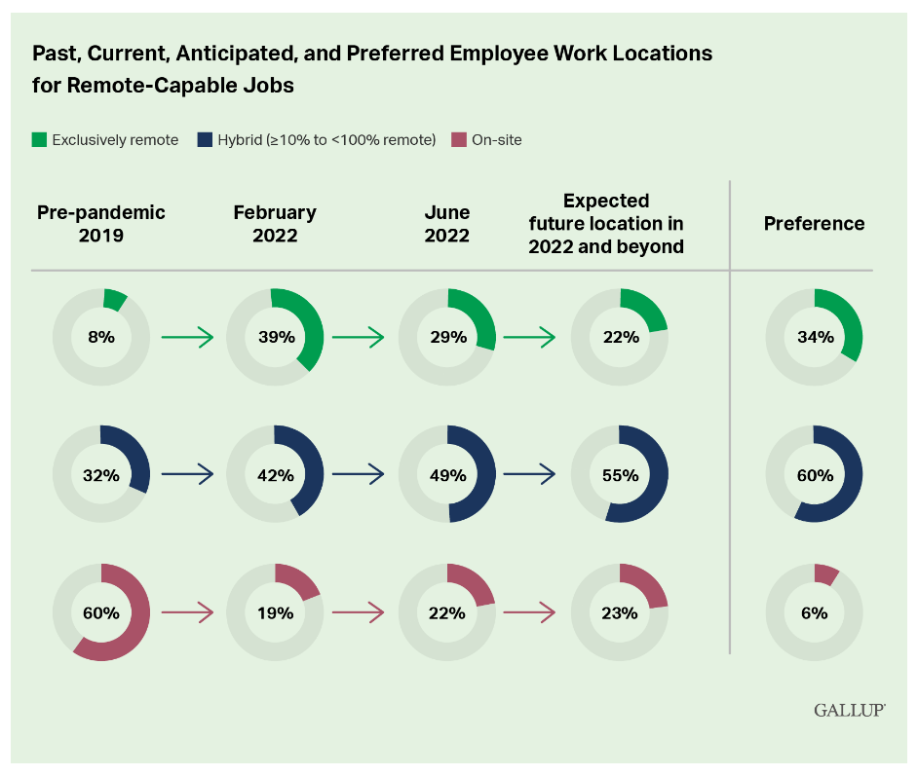

Slide 8
The Endowment Effect
The endowment effect: Behavioral economics teaches us that people do not like to give up things they have acquired – we are loss-averse by nature. Similarly, many employees working hybrid or fully remote have come to expect permanent remote flexibility.
  6 in 10 exclusively remote employees are "extremely likely to change companies" if not offered remote flexibility
  3 in 10 hybrid employees are "extremely likely to change companies" if not offered remote flexibility
  the demand for long-term remote flexibility has substantially increased since June 2021

Slide 9
What happens when remote-capable, on-site employees do not work in their preferred location(s)?

Slide 10
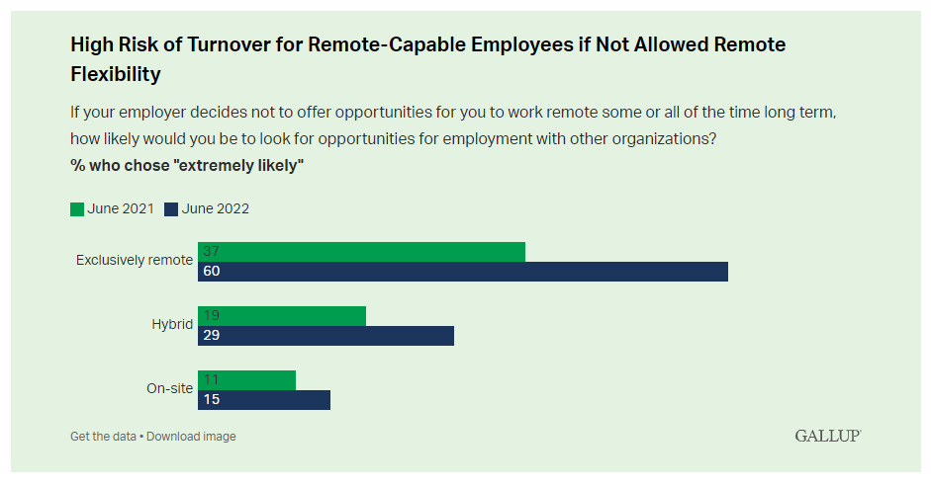

Slide 11
  Remote Work Issue Spotting

Slide 12
Warm Up Hypos
One of our supervisors has found a top-level candidate for an accounting position and made her a job offer. She lives in Minnesota. The Company has no other employees in Minnesota. Was it a mistake to make that job offer?
One of our long-term employees was clearly intoxicated on a Teams call with customers yesterday. We asked her to go in for an alcohol screening and ordered an Uber to take her. She refused the Uber but drove herself and had a .2 BAC. Can we terminate her?
We have an employee here on a temporary work visa who we are sponsoring for a green card. She has asked to return home to India to care for her ailing mother and we want to accommodate her because she is a great employee. Can we continue to employ her from India? What about her green card status? How long can she stay? Do we have to pay taxes to Indian authorities?

Slide 13
Tales from the trenches
Doing business in a new state
Moving around within a single state
Working in another country
Do your employees prefer remote/hybrid work?
Is there a gender or racial divide among those preferences?
What issues are you currently seeing with remote workers?

Slide 14
State/Local Challenges

Slide 15
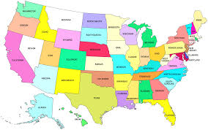
Which Law Applies?
Unique requirements under state law
Determine what state law applies to remote worker
City/county laws

Slide 16
Which State’s Laws Apply?
Minimum wage rate
Minimum salary threshold for salaried exempt
State overtime exemption requirements
Additional overtime (daily, Sunday, 7th day)
De minimis rule
Paystub information
Required meal and rest breaks
Business expense reimbursement
Advance notice of pay changes
Final pay requirement
Required frequency of pay
Garnishments
PTO/vacation forfeiture rules
Predictive scheduling
Employment application requirements
Background check form requirements
State E-Verify and related requirements
Privacy and data security mandates
Protected characteristics
New hire notices and posters
Wage-theft notice requirements
Termination notice requirements
Paid sick leave
Paid family medical leave

Slide 17
Must Employers Pay
Remote Employees’ Expenses?
Federal law (FLSA): In most cases any work-related expense incurred by an employee that would bring the employee’s pay below the minimum wage (or cut into overtime pay) must be reimbursed
State Law: Many states may mandate:
  Business expenses – CA, IL, IA, MT, NH, ND, SD
  Travel or commute expenses – CT, D.C., MA, MN

Slide 18

Posting Requirements
Many state and federal requirements to post information to employees
Postings can be relied upon in defense of claims
Need to be able to show employee has seen postings
Consider including all postings on intranet or in separate handbook for remote workers; at minimum provide via email or mail in a manner that can be tracked and recorded
Notes:
DOL guidance early 2021
Employers may satisfy one-time notice requirements by e-mail delivery if employees customarily receive e-mails from the employer
For continuous-posting requirements, the guidance makes a distinction between employers with only some remote employees and employers with an entirely remote workforce
For employers with some remote workers, physical posters are required for onsite employees, and the DOL encourages electronic posting for the teleworking employees
Employers with an entirely remote workforce may satisfy continuous-posting obligations using electronic-only means if all employees exclusively work remotely, customarily receive information from the employer via electronic means and have readily available access to the electronic posting at all times
Being readily available means that employees can access the notice without having to request permission via an internal or external website or a shared network drive or file system.
Employers must inform employees of where and how to access the notices electronically.
Posting a notice on a company website or intranet is not sufficient unless the employer already posts similar postings in such a manner on a regular basis
Posting on an unknown or little-known website is the equivalent of posting a hard-copy poster in an inconspicuous location and fails to meet the federal requirements

Slide 19
California – required interactive training for managers and employees
Connecticut – required interactive training for supervisors
Delaware, New York – required interactive training for all employees
D.C. – required training for all employees of employer of tipped employees
Illinois, Maine, Washington – required training for all employees
State Training Requirements

Slide 20
State and Local Taxes – Employer Withholding
State
  Generally NOT linked to Company office or facility
  Depends on employee’s residence and any other state in which the employee may work, even if the employer has no physical presence in the work state
  Increasingly states are taking the position that mere payment of any wages to an employee for work in the state is sufficient to trigger employer registration and withholding requirements
Local/Municipal
Tax compliance review
  Every time an employer allows remote work from a new location for an employee
  Detailed study of both the state and local laws governing withholding and registration requirements in the employee’s residence state and the work state(s)
Set employee expectations, get employee agreement
Notes:
Further, employers need to consider what impact, if any, the presence of a remote employee in a new state has on the employer from business taxation and licensing perspectives.
A remote employee’s commencement of work in a new state also requires reevaluation of the state in which unemployment taxes must be paid under the Department of Labor’s multistate rules. This reevaluation also often identifies the need to change or add payroll taxes for other state-sponsored benefits.
Therefore, the employer has important cost and compliance considerations when weighing the pros and cons of any proposed virtual office arrangement—although some of these compliance considerations may be obviated if the employee will be working virtually in the same state of the employee’s office location. Setting employee expectations, imposing employee communication responsibilities related to taxation requirements, and gaining internal controls over compliance in the new work locations are crucial. Normally, employers would need to establish or revise an existing remote work or telecommuting policy to address tax issues. Related remote work agreements with employees also may be desirable.
ADD OH LAW

Slide 21
Tracking Compensable Time

Slide 22
DOL Guidance on Tracking Work Hours
Fair Labor Standards Act (“FLSA”) applies to all work at home arrangements
August 24, 2020 – DOL issued guidance clarifying employers’ obligations to track compensable work hours for remote employees
Employers must compensate employees for all hours worked, including work not requested but allowed, and work performed at home – where the employer knows or has reason to believe the employee is working
  Actual knowledge – employee’s regularly scheduled hours
  Constructive knowledge – employee reports, off-hours communications or access to electronic devices, etc.
Notes:
Generally, exempt employees are paid a salary that covers any work they have performed for the organization, regardless of whether they are working onsite or remotely. However, ensuring non-exempt remote employees are properly compensated is trickier. Because non-exempt employees must be paid for all the time they actually work, as well as overtime premiums, employers must ensure remote employees accurately record compensable work time and that the proper state wage and hour tangents are applied.

Slide 23

Non-Exempt Employees
Accurate recording of all hours worked
Must be paid overtime for all hours worked in accordance with federal and state law
“Off the clock” work strictly prohibited
  Email/Texting
Is occasional commuting time to office compensable?
Notes:
Additionally, if a non-exempt employee must go into the office for a mid-day meeting, there is an argument that the travel time into the office would be compensable if the employee started his or her work-day in the remote location prior to the travel into the office. There are two general rules that cover these situations.
First, normal commuting to and from work is not compensable. So, if an employee is working at home part of the week (e.g., 2 days) and in the office part of the week (e.g., 3 days), the three days commuting to and from the office is not compensable.
Second, if the employee starts their day working at home, then immediately comes to the office for a meeting and later returns home to continue working, then the travel time is compensable. That is similar to travel that is all in a day’s work such as when an employer sends an employee to go visit a client or an employee goes from one office location to another office location during the workday. The travel time is hours worked and it is compensable. Keep in mind that if the travel time is compensable, the employer will have to pay for this compensable travel time regardless of whether the manager told the employee to come in for the meeting or the employee just thought the manager would want the employee to come in for the meeting, though the employee can be counseled on proper use of time. Note, if the employee chooses to telework part of the day for the employee’s own convenience (e.g., leaving work early to attend a parent-teacher conference, and then continuing to perform work later at home) then the DOL has stated such travel time is not compensable. See WH Opinion Letter FLSA 2020-19.

Slide 24
Best Practices for Tracking Compensable Time
Reiterate written timekeeping policies/practices – including OT policies
  Include instructions to report unscheduled hours of work
  Get signed acknowledgment
Establish schedules and hours of work
  Employees should record time in, time out, and meal breaks and, as appropriate, rest breaks
Provide an easily accessible system for employees to report hours and tasks
  Ask non-exempt employees to send their manager a list at the end of each day that confirms their work times and lists their tasks

Slide 25
Best Practices for Tracking Compensable Time (Con’t)
Make sure employees know what constitutes off-the-clock work (working during meal breaks, off-hours checking/responding to emails)
Prohibit off-the-clock/unscheduled work that is not recorded as time worked, include disciplinary consequences for violation
  Employees must be paid even for unauthorized unscheduled work
Train Managers
  Managers should be vigilant in ensuring that non-exempt employees are recording their hours
  Avoid making requests at the end of the day that may encourage a conscientious employee to perform work that is not recorded
  Avoid email communication with non-exempt employees outside regularly scheduled hours
Prohibit managers/supervisors from requesting/permitting off-the-clock work

Slide 26
FMLA, Accommodation and Benefits

Slide 27
FMLA
ABC Company employs 49 workers who are based and work out of its Greenville, SC headquarters. ABC also employs Sally, who works from home in Orlando, Florida. Sally receives her assignments from her manager who works at the company’s Greenville headquarters.
Where is Sally’s worksite for FMLA purposes?
Notes:
Under the FMLA, Sally’s worksite is Atlanta. Consequently, if Sally had worked for the company for at least 12 months and had performed at least 1,250 hours of work in the 12 months before leave was to begin, she would be eligible to take FMLA leave for a qualifying reason.
An employer cannot argue that the employee is ineligible based solely on their stand-alone remote workplace
The requirement that an employee work at a site with 50 employees within 75 miles can be confusing for remote workers. That’s because an employee’s personal residence is not considered a worksite for purposes of employee eligibility for FMLA leave. Instead, for employees who work from home, their worksite is the office to which they report and from which assignments are made. As such, a remote employee’s worksite generally will be a location where they do not physically work. Furthermore, the distance of the remote employee from the worksite is immaterial
While the regulations were drafted well-before the influx of remote workers and remote work space, we think there is a good argument that if the employer is paying for a remote work space (such as a We Work space), that it would qualify as a “worksite” the same as a physical office location that the employer rents for use by employees. The trickier part (and the part not addressed by the guidance or caselaw), is what to do if no one in the employee’s chain of supervision or the chain of work assignments works at one of the employer’s office locations, has a designated office at one of the employer’s office locations, or has a designated remote work space paid for by the employer. Courts have looked at the address on a remote employee’s business card to help this analysis. There is also likely an argument that the address on the employee’s paystub may constitute the worksite if there is no other way to assign a worksite

Slide 28
Accommodations
Obligations still apply
Per usual, make individualized determinations, engage in interactive process
Determine if an effective reasonable accommodation exists that allows employee to perform essential functions of job
Consider more employee friendly state and local laws
  Different definitions of disability
  Different interactive process obligations
  Different definitions of undue hardship
Notes:
How should employers address accommodation requests related to the home work environment?
Employers must remember that the ADA will continue to apply even for employees working remotely. In addition, employers may become subject to more onerous state and local laws regarding accommodations, depending on the location where the employee works/lives. This means requests for accommodation will still trigger the interactive process under both the ADA and any local law (as well as possible state law notice requirements), and require employers to evaluate potential reasonable accommodations to enable an employee to perform the essential functions of the employee’s job and of course do not impose an undue hardship or a risk of harm to the employee or others.

Slide 29

Accommodations
Telecommuting may be deemed
reasonable accommodation
Depends upon essential job functions – is attendance in office essential function?
Undue hardship
  Supervision
  Cost
  Face-to-face contact/interaction
  Poor performer
  Do others work remotely?
Notes:
D.15. Assume that an employer grants telework to employees for the purpose of slowing or stopping the spread of COVID-19. When an employer reopens the workplace and recalls employees to the worksite, does the employer automatically have to grant telework as a reasonable accommodation to every employee with a disability who requests to continue this arrangement as an ADA/Rehabilitation Act accommodation? (9/8/20; adapted from 3/27/20 Webinar Question 21)
No. Any time an employee requests a reasonable accommodation, the employer is entitled to understand the disability-related limitation that necessitates an accommodation. If there is no disability-related limitation that requires teleworking, then the employer does not have to provide telework as an accommodation. Or, if there is a disability-related limitation but the employer can effectively address the need with another form of reasonable accommodation at the workplace, then the employer can choose that alternative to telework.
To the extent that an employer is permitting telework to employees because of COVID-19 and is choosing to excuse an employee from performing one or more essential functions, then a request—after the workplace reopens—to continue telework as a reasonable accommodation does not have to be granted if it requires continuing to excuse the employee from performing an essential function. The ADA never requires an employer to eliminate an essential function as an accommodation for an individual with a disability.
The fact that an employer temporarily excused performance of one or more essential functions when it closed the workplace and enabled employees to telework for the purpose of protecting their safety from COVID-19, or otherwise chose to permit telework, does not mean that the employer permanently changed a job’s essential functions, that telework is always a feasible accommodation, or that it does not pose an undue hardship. These are fact-specific determinations. The employer has no obligation under the ADA to refrain from restoring all of an employee’s essential duties at such time as it chooses to restore the prior work arrangement, and then evaluating any requests for continued or new accommodations under the usual ADA rules.

Slide 30
Benefits
Generally, little impact on employer-sponsored employee benefits other than the need to alter the method of distributing plan materials, conducting open enrollment, and educating employees about the benefit offerings
Core benefit offerings normally are not affected
BUT . . .
  Remote work can significantly affect group health plans and provider networks
  For example, if the employer contracts for coverage using a network focused on providers in the Northeast, but permits employees to work from Oregon, the employee working from Oregon will lose access to in-network care, increasing the cost of medical services
  Employers adopting remote work or hybrid work models should review their group health plan coverage options and determine if plan design, provider or network adjustments are needed or are even feasible

Slide 31
Maintaining a Respectful Remote Workplace

Slide 32
Employers’ Continuing Obligation
Harassment and discrimination may and does occur in virtual workplace
Most harassment and discrimination claims involve electronic communication
Company has obligation to eradicate improper conduct (even when it originates outside of physical workplace)

Slide 33
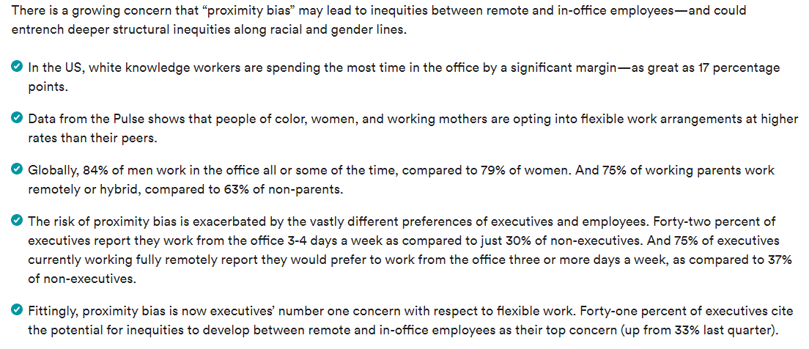
Beware of Inequities Ahead
According to a global survey by Future Forum:

Slide 34
Beware of Inequities Ahead
According to Harris Poll:
Executives are nearly three times as likely to want to work in person as employees
Sociologists fear that hybrid workplaces will be two-tiered, with leadership and white male employees interacting at the office, while teleworking women and people of color are left behind

Slide 35
Best Practices
Redistributing Equal Employment Opportunity Policies, Anti-Discrimination and Anti-Harassment Policies and Open-Door Policies to ensure employees are familiar with the policy and aware of reporting procedures should an issue arise
Conducting separate trainings for supervisors and subordinates on anti-discrimination and anti-harassment
Conducting separate trainings for supervisors and subordinates on diversity and inclusion which addresses unconscious bias and microaggressions
Conducting pay equity audits to ensure that employees are being paid based equitably

Slide 36
OSHA
Employer obligation to provide safe working environment
OSHA will not conduct home inspections
  Reversal of position
Does not expect employers to inspect employees’ homes
May informally advise employer of reported complaint
Home-based business: employer responsible for hazards caused by materials, equipment, work processes, etc.
OSHA reporting requirements still apply
Notes:
federal OSHA has issued guidance indicating that an employer’s potential liability for an employee’s home work space is limited. The federal agency’s guidance, in fact, states that “OSHA will not conduct inspections of employees’ home offices,” and “OSHA will not hold employers liable for employees’ home offices.” See OSHA Directive No. CPL 2-0.125, available at https://www.osha.gov/enforcement/directives/cpl-02-00-125. Further, OSHA states that it “does not expect employers to inspect the home offices of their employees.” See id. The guidance notes, however, that employers will be responsible for hazards at home worksites that are caused by materials, equipment, or work processes that the employer provides, or which the employer requires to be used in an employee’s home. See id. An employer could, for example, face potential liability for hazards created by a machine it sets up in the employee’s home workspace or chemicals that it requires the employee to use in the workspace.
Although potential risks of regulatory and OSHA related liabilities for ergonomic hazards in a home office are low, having employees complete a form or checklist identifying potential hazards at the home can help minimize some of this risk. Using a standard checklist or form can also help identify any areas where equipment or resources are truly needed and assist with prioritization of equipment needs. An example checklist is available here: https://www.telework.gov/federal-community/telework-employees/safety-checklist/.

Slide 37

Employment Eligibility and Immigration
How will Form I-9 Employment Eligibility Verification
requirements be met?
Will employees have to travel to an office location to complete necessary forms or will employer designate, hire or contract with an authorized representative to complete the I-9 on the company’s behalf?
During COVID-19 has been some flexibility to review some I-9 documents electronically but unsure if that will last.
Remote work may also impact an employee’s visa and
immigration status, including green card sponsorship applications
  Important to evaluate steps to be taken and the expense
  involved before any changes to the terms and conditions
  of employment are undertaken

Slide 38

Data Privacy
How will the company ensure data privacy and confidentiality concerns are addressed?
  Remote and work from home arrangements triggered a substantial increase in the number of data breaches during the pandemic.
  A lack of technical controls, administrative safeguards, limited training, among other measures, contributed to this result.
  Consider, review and assess regulatory mandates, contractual obligations, risk tolerance, and other factors to develop a set of minimally acceptable administrative, physical and technical safeguards for any remote and/or work from home arrangement and provide appropriate guidance to employees.
  Be mindful of the growing array of data privacy laws (e.g., California, Virginia, Colorado).
  Consider business risk of losing control of the organization’s data.

Slide 39
Make Key Strategic Decisions
What does the Company’s remote work arrangement look like:
Minimum or maximum for all?
Remote or hybrid or both? Who decides?
Geographic-based pay?
Look and feel of employee handbook, policies?
Start regionally and expand?

Slide 40
How Do We Get There?
Divide and Conquer:
Establish working groups to do deep dives into respective areas and bring back recommendations. For example:
  Handbook and policies – HR
  Wage withholding and unemployment tax – payroll
  Employee benefit plan design, options – benefits
  Technological and privacy considerations – IT
Start with policy/handbook development
Allow related areas (e.g., wage withholding, unemployment tax) to educate policy development
THEN communicate

Slide 41
What else does the Company need to consider?
Organizational Impact of Strategy
Culture
Remote onboarding and employment processes
Vendor, HR, payroll support
Communication style and strategy
Recruiting and retention

Slide 42
Remember: This is Not a One and Done
Internal Controls are Key
Create a process for monitoring changes in the law and employee counts
Task working groups
Watch for and respond to employee movement
Prepare for complaints and dispute resolution outside of the principal office state
Develop management and oversight strategy

Slide 44
About Jackson Lewis P.C.

Slide 45
Strategically located to serve employers’ needs
63
Locations Nationwide
950
+
Attorneys

Slide 46




National recognition
Recognized for excellence and ranked as a Tier 1 National “Best Law Firm” by U.S. News — Best Lawyers® for:
Employment Law – Management;
Labor Law – Management; and
Litigation – Labor & Employment.
More than 70% of Jackson Lewis’ firm locations also received a Tier 1 Metropolitan designation in various labor and employment categories.
Recommended in The Legal 500 United States 2019 for:
Employee Benefits, Executive Compensation and Retirement Plans: Design;
Immigration; Labor and Employment Disputes (including collective actions): Defense;
Labor-Management Relations; and
Workplace and Employment Counseling.
72 attorneys have been recognized in the 2019 edition of Chambers USA: America’s Leading Lawyers for Business. More than 200 attorneys were selected for inclusion in the 2019 edition of The Best Lawyers
in America©.
Designated as a “Powerhouse” in Everyday Employment Litigation in Complex Employment Litigation in BTI Litigation Outlook 2019: Changes, Trends and Opportunities for Law Firms.

Slide 47

Advice and Counsel
Affirmative Action,
OFCCP and Government Contract Compliance
Class Actions and
Complex Litigation
Corporate Diversity Counseling
Corporate Governance and
Internal Investigations
Disability, Leave and
Health Management
Employee Benefits
ERISA Complex Litigation
Immigration
International Employment
Labor Relations
Litigation
Privacy, Data and Cybersecurity
Restrictive Covenants, Trade Secrets and Unfair Competition
Trials and Appeals
Wage and Hour
Workplace Safety and Health
Practices

