Slide 1

Internal Corporate Investigations
Insert logo here OR delete this text box and the ruled line below
Best Practices
Speakers:
Rhett DeHart | Of Counsel, Womble Bond Dickinson
Shawan Gillians | Of Counsel, Womble Bond Dickinson
Former In-House, Santee Cooper

Slide 2
When to Consider an Internal Investigation
Government Investigations
  Receipt of Subpoena
  Law Enforcement Interviews Employee
  Search Executed

Slide 3
When to Consider an Internal Investigation
Certain Civil Lawsuits
  False Claims Act
  Securities Litigation

Slide 4
When to Consider an Internal Investigation
High-Profile/Executive Personnel Matters
    *University of Michigan President

Slide 5
Goals of Internal Investigations
Learn the Facts – ASAP
  Assess Civil or Criminal Liability before Discovery
Issue a Report of Findings and Recommendations
  Outline Facts
  Recommendations

Slide 6
Advantages to Outside Counsel
Increases Attorney-Client Privilege
Lessens Your Workload
More Objective
Eases Coordination with Regulators and Prosecutors

Slide 7
Best Practices
Establish Privileges at Outset
One Company Liaison with Outside Counsel
Document Retention
2-Person Interview Teams
Upjohn Warnings: 449 U.S. 383 (1981)

Slide 8
Upjohn Warnings
We serve as counsel to the company only. We are not your attorney and cannot give you legal advice.
Your communications with us are confidential and protected by the attorney-client privilege.
The company may waive the attorney-client privilege and disclose our communications.

Slide 9
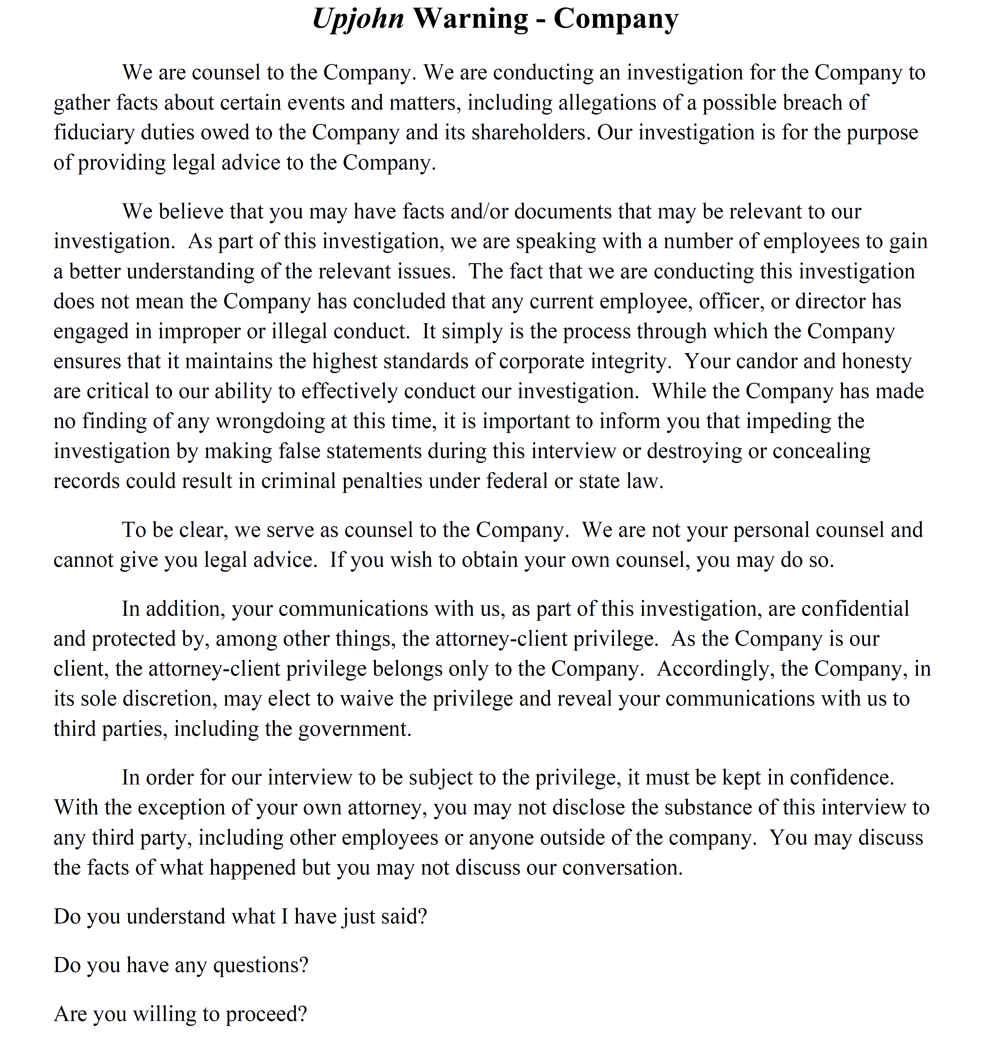

Slide 10
What are the benefits of a well-run investigation?
Relevant facts are provided to management ASAP
Demonstrates company’s good-faith response
Insulates company against some claims and may avoid criminal prosecution if early self-disclosure and full cooperation

Slide 11
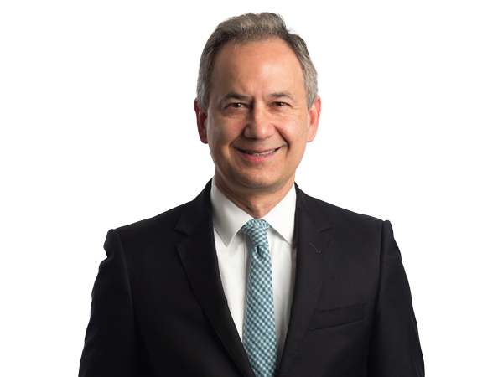
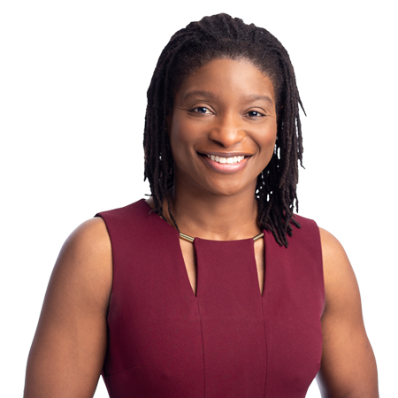
Thank you | Contact Information
Rhett DeHart
Shawan Gillians
Of Counsel
Of Counsel
Charleston, SC
Charleston, SC
843.720.4665
843.720.4620
rhett.dehart@wbd-us.com
shawan.gillians@wbd-us.com

Slide 12
