Slide 1

Association of Corporate Counsel – South Carolina
Annual Meeting
Presentation
September 16, 2022
Central Energy
2030 Gregg Street, Columbia, SC 29201
David H. Conaway Partner Shumaker, Loop & Kendrick, LLP | Kasel Knight General Counsel Milliken & Company | Lindsey Livingston SVP, Assistant Corporate Counsel South State Bank | Phil Padgett Chief Financial Officer South Carolina Ports Authority | Edward Sanz Managing Partner ABTV
The Perfect Storm: Inflation, Commodity Prices,
Interest Rates: Will Insolvencies Follow?

Slide 2
The Perfect Storm
Inflation
  May 2022
  inflation 8.6%
  Highest since 1981
  July 2022 9.1%
  August 2022 8.5%
Interest Rates
  May 2022 – 50 bps increase
  June 2022 – 75 bps increase
  July 2022 – 75 bps increase

Slide 3
The Perfect Storm
  Bank of England
    August 2022 - 50 bps increase
  European Central Bank
    July 2022 - 50 bps increase
    September 2022 - 75 bps ? (Goldman Sachs)
Supply Chain Disruption
  Closed or Crowded Ports
  Shipping/Logistics Prices and Capacity
    Slide, page 30 – China to West Coast – pre-pandemic $3.5k/20 ft. container – peaked at $22k, now $10k

Slide 4
The Perfect Storm
Tight Oil Market*
Ukraine**
Labor Shortages
Unprecedented Demand for Goods
Lean Manufacturing Trends
Slowing Global Economy
*WSJ June 15, 2022: IEA forecasts demand for crude 2023 102 million bpd, above pre-pandemic levels by 2.2 million bpd, mostly due to demand from China’s lockdown emergence.
**Ukraine makes more than 90% of high-grade neon in lasers to make semiconductors. A byproduct of Russian steel purified in Ukraine.

Slide 5
The Perfect Storm’s Impact
Delayed Shipping
Lost Sales
Canceled Orders
Extended Payment Terms
Longer Cash Conversion Cycle
  Slide, page 43
Buildup of Inventory
  Slide, page 41
Difficulty with Forecasting and Planning Sales

Slide 6
The Perfect Storm’s Impact
Falling Profitability
  Fewer Revenues
  Increased Cost of Goods Sold
  Increased SG&A Expenses
Loan Covenant Violations
Lenders or Private Equity Sponsors may reduce liquidity

Slide 7
The Perfect Storm’s Impact
Lower working capital availability based on aging inventory and accounts receivable
  How are Lenders reacting?
  Funding the gap?
  Triggering Defaults?

Slide 8
Weathering the Storm
Increase pricing to customers
Extended payment terms to suppliers
Supply Chain Management
  Moving away from single source suppliers
  Opportunity for vendors to grow customer case and market share

Slide 9
Weathering the Storm
Buffering Operations
  Increasing inventory
  Reduction of orders accepted
  Increasing delivery timelines
  Surcharging for materials, fuel and shipping

Slide 10
What Companies Should Expect
Customer will request:
  Extended credit terms
  Acceleration of rebate payments or “pre-bates”
Customers may seek cancellation of:
  Purchase Orders
  Contracts

Slide 11
What Companies Should Expect
Suppliers may seek:
  Price increases
  Shortened payment terms or cash before delivery
  Security for payment
  Additional financial information
    Reliability?
  Cancellation of Purchase Orders
  Cancellation of Contracts

Slide 12
A Flexible Approach with Customers and Suppliers,
Companies Should Consider the Following in Contract Discussions:
Just say “no”
Ongoing financial transparency as a condition of discussions
Interest upon default
Payment of attorneys’ fees
Elimination reduction or suspension of rebates or other sales incentives
Commitments for additional business (for viable customers)
Setoff of existing rebates against existing invoices owed
Waiver of any claims and indemnification for all losses arising from concessions

Slide 13
A Flexible Approach with Customers and Suppliers,
Companies Should Consider the Following in Contract Discussions:
    Drafting tips.
      Any changes should be memorialized in a temporary concessions addendum, not as an amendment to an existing contract.
      Concessions should automatically expire on a date certain, subject to extension if warranted.
      Addendum should expressly recite the customer concession request as a result of market crisis, and the company’s agreement.
      Strict compliance with revised payment terms, which automatically revert to original terms upon a default in payment.
      Include a “hell or high water” clause, which requires performance regardless of any adverse circumstances, for any extended terms granted.

Slide 14
Uniform Commercial Code as a Tool
Buyer’s Remedies
  2-711 – General
  2-712 – Cover
  2-713 – Breach damages:
    Market vs. contract differential
  2-715 – Incidental and Consequential Damages
Seller’s Remedies
  2-703 – Withhold delivery
  2-706 – Seller’s resale, recovery contract vs. resale price differential
  2-709 – Action for the price
  2-710 – Incidental damages

Slide 15
Zone of Insolvency
Entering the Zone of Insolvency
  Lenders and private equity sponsors of customers and suppliers may restrict cash and liquidity.
  Customers and suppliers may linger in the “zone of insolvency” without a formal declaration of insolvency or Chapter 11 filing.
  Some customers and suppliers will remain viable but challenged, others will enter into the zone of insolvency and some will file Chapter 11.
  Note that companies’ normal business counterparts very likely have restricted or nominal decision-making authority, as lenders, private equity or restructuring officers are likely making or participating in key decisions.

Slide 16
Zone of Insolvency
  Customers’ and suppliers’ financial statements and projections may not be reliable.
  Customers and suppliers are more likely to meet the “insolvency” requirement of the U.S. Bankruptcy Code, precipitating more Chapter 11 filings.
    Insolvency occurs when liabilities exceed assets (balance sheet test), unreasonably small capital (cash flow test) or there is an inability to pay debts as they come due in ordinary course.

Slide 17
Zone of Insolvency
UCC Remedies in the Zone of Insolvency
  UCC 2-609. Uniform Commercial Code (UCC) Article 2 (sale of goods).
  Section 2-609 allows a seller of goods who has reasonable grounds of the customer’s ability to perform, may demand written assurances of performance not exceeding 30 days and pending receipt of assurances, suspend the seller’s performance obligations.
  UCC 2-609 is an effective tool to promote quick communication with customers, in addition to a pause in performance to mitigate risk.
  Given the unprecedented circumstances, sellers should demand assurances in 2-3 days.
  UCC 2-609 may be utilized even if the customer is current in payment.

Slide 18
Zone of Insolvency
UCC Remedies in the Zone of Insolvency
  UCC 2-702(1). Cash before Delivery upon Insolvency.
  UCC 2-702(1) allows a seller, upon learning that a customer is insolvent, to ship goods only on a cash before delivery basis, regardless of a contract that provides for credit terms.
  A Chapter 11 filing is not required to establish insolvency.
  UCC 2-702(2). Reclamation.
  Upon learning that a customer received goods on credit while insolvent, a seller may reclaim such goods upon 10-day demand.
  UCC 2-705. Stoppage of Delivery.
  Upon learning of the customer’s insolvency, a seller may stop delivery of goods in transit.

Slide 19
Doing Business with a Chapter 11 Debtor
    Credit Risk.
      Selling to a Chapter 11 debtor is a high credit risk, analysis of which goes beyond normal credit risk analysis. Rather, many “first day” motions, including for debtor-in-possession (DIP) financing, “pre-packaged” Section 363 sales or plans of reorganization, materially limit vendors’ rights and the ability to be paid.
      It is very important for vendors to review, and possibly object to, “first day” motions.
    Administrative Expense Priority Claim.
      Post-petition sales to a Chapter 11 debtor can have administrative expense priority.

Slide 20
Doing Business with a Chapter 11 Debtor
      To qualify, post-petition shipments must arise under a post-petition contract and goods or services must be delivered post-petition.
      If there are pre-petition purchase orders, they will need to be re-issued post-petition or, the debtor must obtain a court order addressing this issue.
      Where lenders have liens on all assets and proceeds, debtors may not use cash unless there is a court order approving DIP financing or use of cash collateral.
      Payments to vendors without such court order may be disgorged as unauthorized post-petition transfers.
      Transactions with a debtor must be in the ordinary course of business, or have court approval.

Slide 21
Doing Business with a Chapter 11 Debtor
      If there is no sales or supply agreement, rather sales are on a purchase order and invoice basis, a vendor is not required to sell or extend credit terms to a Chapter 11 debtor.
    Executory Contracts.
      Executory Contract is the Bankruptcy Code term given to essentially any contract between a debtor and a non-debtor party where both parties owe performance to the other. A promissory note would NOT be an executory contract since the holder of the note has no performance obligation. However, a supply contract or other sales agreement would almost always meet the requirements of an executory contract under the Bankruptcy Code. The Bankruptcy Code Rules for rejecting executory contracts are debtor-friendly which is often incentive for Chapter 11 filings.

Slide 22
Doing Business with a Chapter 11 Debtor
      The Bankruptcy Code provides debtors the unfettered right to assume or reject executory contracts and leases. If a debtor rejects an executory contract, the non-debtor party receives a general unsecured claim for damages arising from the debtor’s “breach” of contract. Thus, a debtor escapes the contract with little cost. On the other hand, the debtor also has the right to assume or assign a contract. In this instance, the Bankruptcy Code requires that the debtor “cure” the contract by paying existing defaults. Presumably, debtors would assume contracts that they deem to be valuable either because they insure an uninterrupted supply of goods or contain favorable pricing or terms. For a creditor who is a party to an executory contract, the assumption of such contract can be an effective vehicle to obtain payment of pre-petition debt.

Slide 23
Doing Business with a Chapter 11 Debtor
      Debtors in Chapter 11 must assume an executory contract before or in conjunction with the confirmation of the Chapter 11 Plan. The non-debtor party to the contract can ask the court to set a shorter time if it will be harmed by the delay in the debtor’s decision.
      The Bankruptcy Code requires that the non-debtor party to an executory contract must continue to perform its obligations under the contract pending the debtor’s decision to assume or reject such contract, and provided that the debtor is in fact performing its obligations of the contract post-petition.
      Generally, the obligation to continue performance is subject to a seller’s UCC Article 2 rights including UCC 2-609 and UCC 2-702, though Chapter 11 debtors often challenge this (usually at the behest of their financiers).
      A supply agreement impacts a creditor’s rights as a critical vendor since the leverage of not shipping is arguably eliminated in the context of an executory contract.

Slide 24
Chapter 11 Claims/Remedies
    20 Day Administrative Claim.
      Under Section 503(b)(9) of the Bankruptcy Code, sellers of goods are entitled to an administrative expense priority claim for the value of goods delivered to and received by a debtor within 20 days prior to the bankruptcy filing.
      In cases where the debtor’s Chapter 11 proceeding is “administratively insolvent”, the likelihood of payment of administrative expense priority claims is compromised.

Slide 25
Chapter 11 Claims/Remedies
    Critical Vendor.
      Critical vendor is a creditor remedy based on a theory that a particular vendor is so essential to a debtor’s ability to continue operating that without the uninterrupted flow of the seller’s goods, the debtor cannot continue to operate and thus has no realistic chance of a successful reorganization. A bankruptcy court has broad authority to order relief that facilitates a successful reorganization.
      Only a debtor can made the determination that a particular vendor is critical and seek court approval of same. A creditor cannot independently impose its critical vendor status on a debtor.

Slide 26
Chapter 11 Claims/Remedies
      Some jurisdictions refuse to entertain critical vendor motions. However, Delaware and New York continue to be jurisdictions where critical vendor payments can be approved in appropriate circumstances.
      Vendors who are truly critical to a debtor-customer should continue to seek critical vendor status as a means of getting paid. In doing so, vendors should be careful to not violate the automatic stay by conditioning future business on payment of pre-petition debt. Moreover, vendors should be aware that getting paid as a critical vendor will likely be conditioned on providing normal lines of credit, pricing and terms, or other “customary trade procedures.”

Slide 27
Chapter 11 Claims/Remedies
    Setoff and Recoupment.
      An often overlooked remedy, setoff arises from the settlement of mutual debts or accounts owed between a debtor and a creditor. Simply, if A owes B $100 and B owes A $50, then the debts can be resolved as follows: $100 - $50 = $50, so A pays B $50 and the accounts are settled. The Bankruptcy Code codifies this common law remedy and in fact provides that the creditor has a secured claim to the extent of the value of its setoff claim.
      The debts owing must be owed to and from precisely the same legal entities and the debts must arise either both pre-petition or both post-petition. The debts do not, however, have to arise out of the same transaction.

Slide 28
Chapter 11 Claims/Remedies
      The exercise of a setoff remedy requires relief from the automatic stay from the Bankruptcy Court. Moreover, there are somewhat complicated rules regarding exercise of setoff during the 90 days prior to the bankruptcy filing, which if not followed, could result in preference exposure.
      Recoupment is similar to setoff, except that the mutual debts must arise from the same transaction.
    Sale of Claims.
      A possible opportunity to monetize claims early.

Slide 29
Chapter 11 Claims/Remedies
      There has been a vigorous market for the purchase of bankruptcy debt, particularly in larger bankruptcy cases. The purchasers are usually private equity or hedge funds that are in essence seeking to purchase claims at a discount in hopes that the ultimate dividend, whether in the form of cash payments or stock in the reorganized entity, will provide a return on such investment.
      Claim purchasers will only purchase claims that are not disputed or contingent as to liability. Claim purchasers will usually agree to buy claims based on the debtor’s schedules of assets and liabilities. However, purchasers will not buy claims based on a creditors’ proof of claim if it is materially greater than the claim listed on the debtor’s schedules, at least until the claim is resolved in the claims reconciliation process.
      Creditors who sell claims should carefully review the claims assignment contract for pitfalls and potential risks.

Slide 30
  EXHIBITS

Slide 31
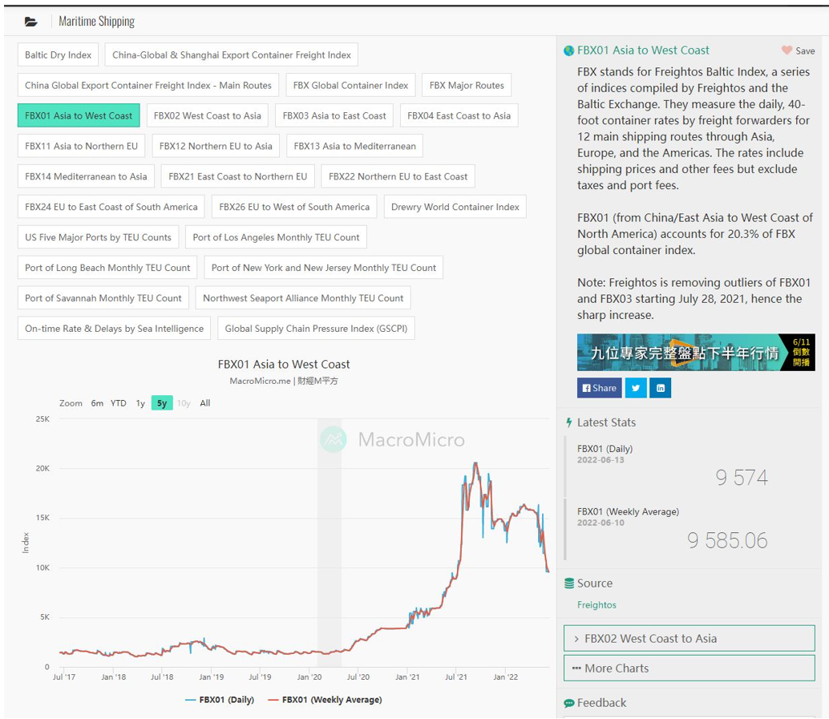

Slide 32
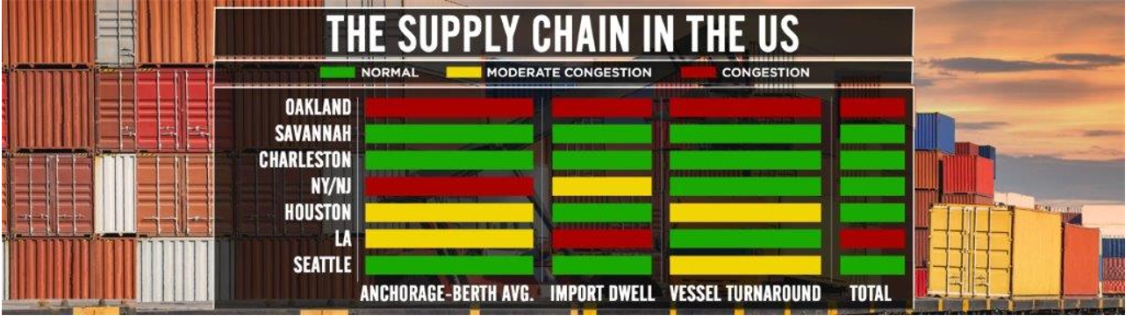

Slide 33


Slide 34
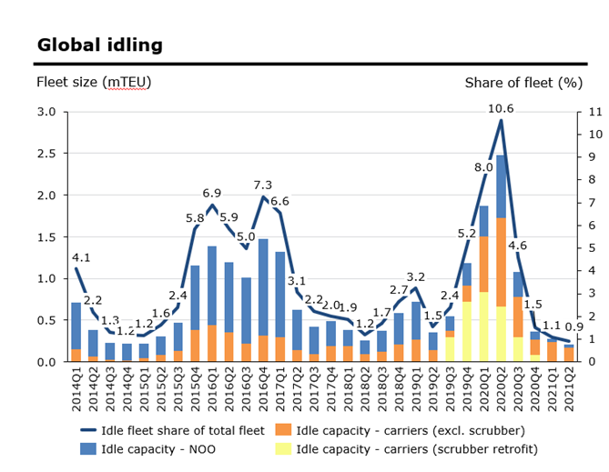
Global transportation demand has peaked due to inventory backlogs and new consumptions habits (exacerbated by stimulus packages from Governments). In response to this, all vessels are sailing…
US goods consumption (2019 Index)
Recreational goods and vehicles (includes electronics)
34
Source: Bureau of Economic Analysis
Source: Alphaliner
.
Notes:
Key Points:
Demand rebound from initial Covid shutdown has been dramatic, driven by pent up consumer demand and government stimulus
All ships are sailing – carriers are holding nothing back
Drivers behind surge in containerdemand:
Transpacific has been driven by a surge in US goods consumption, especially durable goodsconsumption
In April total goods consumption was 16.6% higher than the Q4 2019 average level, and durable goods consumption was almost 31% higher than the Q4 2019level
“Motor Vehicles” and “Recreational goods and vehicles” (which includes electronics) stand out in particular (+35%)
Increased demand tiedto:
Pent-up personal saving, amounting to 12% of US GDP
Massive income support from the US government in the form of direct cash payments
A compositional shift in consumer spending as parts of the service sector remain under restrictions and money is partly being spent on goods instead

Slide 35
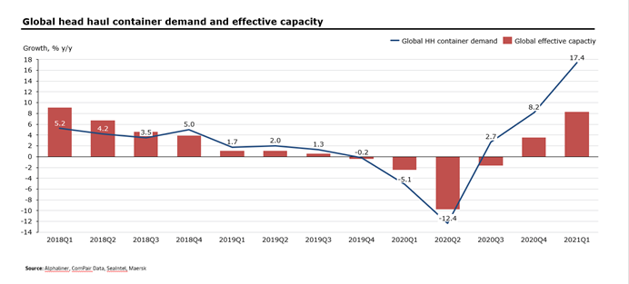
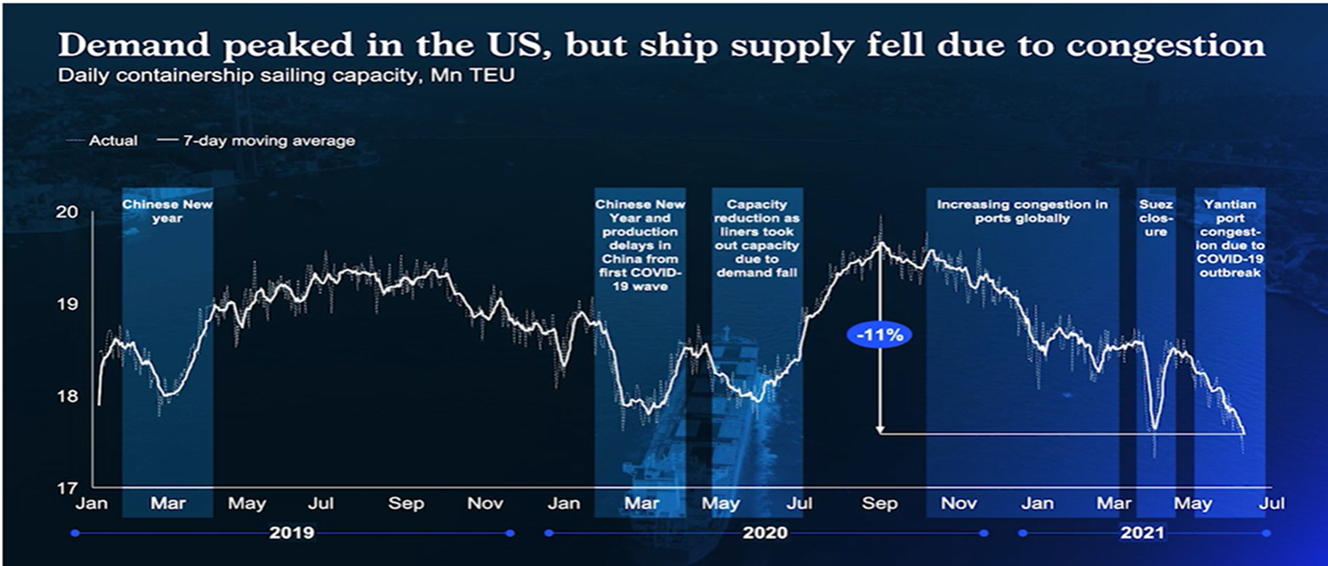
Despite all vessel capacity being deployed, effective vessel capacity is severely limited by congestions in ports and other parts of the supply chain
Source: McKinsey
N.B: Effective capacity has reduced by 10-25% due to port congestions, according to experts*
*https://lloydslist.maritimeintelligence.informa.com/LL1137754/Container-lines-fighting-losing-battle-on-capacity
https://splash247.com/container-congestion-registered-in-every-corner-of-the-planet/
35
Notes:
Key Points:
While the oceans are wide, the ports are not. Each port has a limited number of berths and a limited speed of container transfer
The total capacity of global shipping is inherently limited by the loading/unloading/storage potential of the global port infrastructure
Container ships are the cars, not the highway
Like a highway, ports have a total capacity per hour. This is a function of the available lanes (berths) and the maximum speed limit (maximum pace of loading and unloading boxes, number of workers, storage capacity, inland transport, etc.). When a highway comes to a hault from too much traffic, you can’t fix it by simply adding more cars ...
It is estimated that congestion reduces effective capacity of the global fleet by 10-25 % because each ship takes significantly longer to complete its journey (Lloyd’s list and Splash 247).

Slide 36
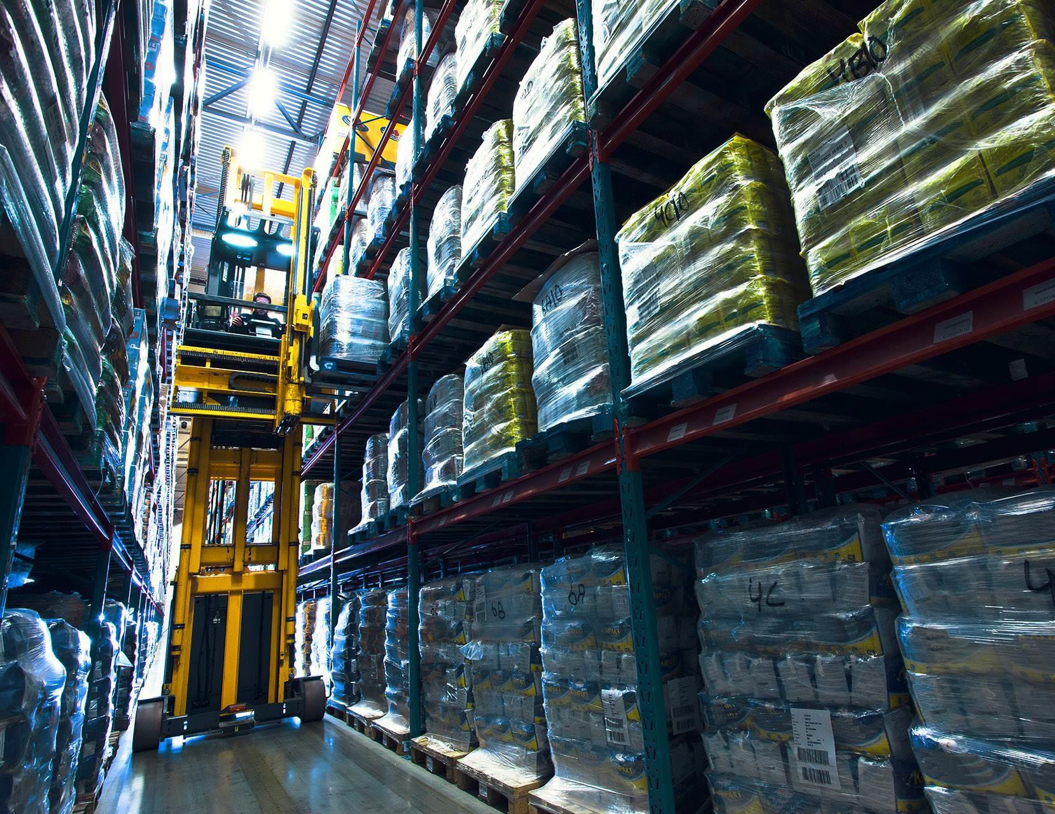
Inland bottlenecks are driving increased dwell time and further reducing practical/effective capacity
Inland bottlenecks are having knock-on effects
Warehousing
As consumers are increasingly buying through e- commerce, warehouses are having issues handling the increased volumes
As a result of warehouse constraints, companies are leaving the goods in the containers and using the boxes for storage and even on chassis
Containers and chassis dwell for longer, adding further delays to the entire global supply chain
Terminals
Companies use terminals for storage, only picking up the “hottest” containers, i.e. well-paying or otherwise important containers
Trucking
Turn time for a trucker at ports has increased by 90-120 minutes in some locations
Truck prices often prohibitively expensive to divert containers to different ports
Truck driver capacity reduced due to COVID infections
Trucking capacity, appointments, and chassis availability extremely tight exacerbated by missed truck appointments due to delayed cargo
Rail
Off-dock rail ramp connections experiencing delays as a result of reduced chassis and trucking capacity
Rail capacity is not flexible enough to divert large volumes from one port to another
Restrictions on the volume of traffic accepted daily enacted to reduce congestion, rail dwell time has increased to 11.2 days on US West Coast
Notes:
Key Points:
The same forces that have swamped ocean freight have also impacted inland freight exacerbating the effects
Warehousing, terminals, trucking, and rail all appear overwhelmed by pent-up demand and Covid-related constraints
The result of the inland bottleneck is a reduction in the effective or practical capacity of global container equipment, both dry and reefer
Container manufacturing is at an all time high
Dry container factories are more or less fully booked through Q3. YTD production reached 2.4 million TEU dry containers vs 690k during the first five months of 2020
All empty containers at factories are either owned or booked by shipping lines / leasing companies pending pick-up

Slide 37
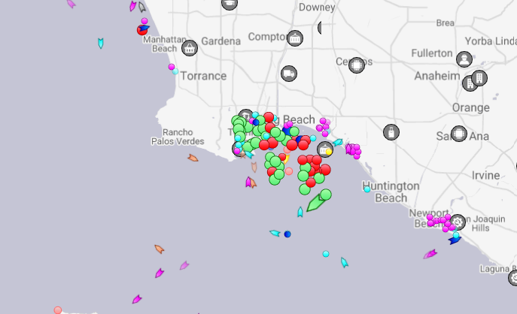
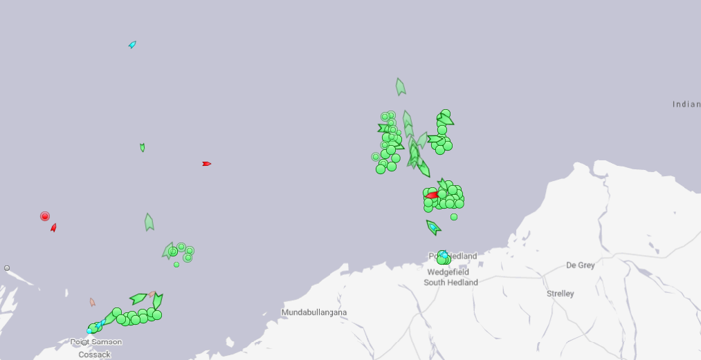
Resulting container shortage is further exacerbated due to ”trapped” containers
Empty containers are not being recirculated
Ports cannot evacuate empty containers - at some ports, empty container stock levels are up to 3 times above target levels due to:
Increased inspections
Increased COVID inspection requirements resulting in delays and port congestions, eg.:
  Increased inspection of reefers by customs due to a fear that COVID can be transported on perishable goods
  Government authorities taking longer time than usual to release abandoned and/or cargo under customs hold
Labor shortages
Lack of labor in depots, including due to COVID travel restrictions limiting foreign workers across the globe
  Lack of labor has hampered depot productivity resulting in slower turns of containers to meet demand
Labor strikes in the form of ”go slows” or complete stop works for fixed periods in certain ports
Snapshot of vessels waiting outside the port of Los Angeles, USA on 16/06/2021
Port congestion
Vessel delays due to long waiting times outside the port have caused moves to be restricted at terminals to decrease a vessel’s time at port, resulting in empty containers not having enough moves to balance the flow of inbound vs outbound
  Eg., In Sydney, Australia, imports are so strong that they discharge more than they are loading within the allowable move counts, meaning that there is no time to load empties back on vessel
Snapshot of vessels waiting outside the port of Hedland, Australia on 16/06/2021
Source: Marine Traffic
37
Notes:
Key Points:
In order to clear vessel congestion, ports must strictly limit time in port
Containers are delayed both in transition to inland transportation and on return
Because of congestion, ports are unable to reintroduce empty containers into service at a normal rate, further reducing practical capacity
Without systemic congestion inland and at the ports, existing container equipment would be sufficient to handle current demand

Slide 38
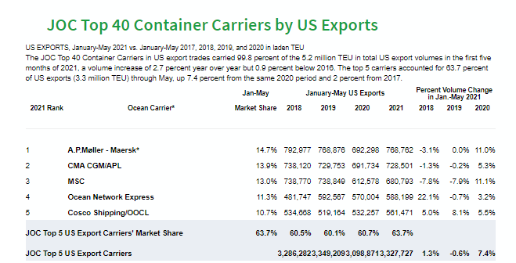
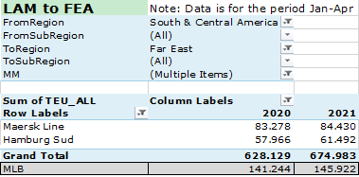
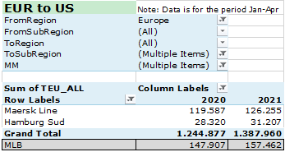
Despite current constraints, exports have increased
Source: CTS
38
Notes:
Key Points:
Port and inland congestion issues are severe, but goods and containers are still moving robustly
Carriers have every incentive to maximize backhaul and return empty containers to primary export locations

Slide 39






There are numerous efforts already being made across the supply chain to solve bottlenecks, and further initiatives ongoing...
Past and ongoing actions within carriers’ control:
Deploy all idle capacity, including deploying extra loaders – new capacity continues to be infleeted at speed
Using other modes of transportation such as barges, block-trains, feeder services
Repositioning of vessels from trades and optimizing our network where our vessels are most effectively utilized
Speed up of reposition of all possible empty containers (at increased costs)
Infleeting outdated (destroyed and aged) containers and increase repair and maintenance costs (at increased costs)
Focus on long-term contract to better service customers and limit the impact of increased short-term freight rates
39
Notes:
Key Points:
All the ships that can sail are sailing
Vessels used on under-utilized trades are being redeployed on trades where demand is high, and routes are constantly optimized in response to congestion
Carriers are making investments to maintain and repair outdated containers to maximize the amount of equipment available

Slide 40



...but solving bottlenecks is highly complex and interlinked across supply chains and governments with several levers outside of carriers’ control
Actions out of carriers’ control:
Total availability of vessels, now operating at significantly lower effective capacity due to port congestion – congestion-induced missed/void sailings (as opposed to blank sailings) is estimated to reduce effective capacity by 10-25% (Lloyd’s list and Splash 247)
Port congestion and infrastructure issues constraining the efficient repositioning of empty containers back to export economies. Containers that would ordinarily make 5 trips per year now making 3, resulting in significant decrease in effective container capacity
Port congestion due to labor shortages, increased customs inspections and ports closing due to COVID outbreaks thus creating challenges to have operational crews at all time
Inland capacity (trucking, warehousing and depots) has not increased despite the peak in demand for transport
The number of terminals worldwide has not increased to process the augmented demand globally
40
Notes:
Key Points:
Port congestions and infrastructure issues prevent the efficient repositioning of empty containers, reduce overall effective or practical capacity, and result in missed sailings
Combined with port delays, inland transportation constraints result in a large number of trapped containers, which are not returning promptly to the ocean supply chain
Carriers are doing what they can, but the current logistical constraints are largely external to ocean shipping ...

Slide 41
Looking forward – we expect this extreme situation to persist through 2021, then progressively revert to normal
Vessels
Containers
Demand
Expected net increase in vessel capacity of 22% based on the current orderbook. Delivery is scheduled between 2021 and 2025.
Container shortages being resolved
by 2 initiatives:
Newly manufactured containers introduced
Existing empties that have been trapped in ports and with customers again coming into circulation following the expectation that COVID restrictions will be lifted as the COVID vaccines start to come into circulation
Volumes are predicted to remain at current levels in H2 2021, and to grow 2-4% in 2022.
Accordingly, we do expect the unusual and unprecedented situation to normalize
41
Notes:
Key Points:
While we expect the current situation to come to an end, it seems clear from this event that certain ports and inland transportation infrastructures lack the flexibility to acommodate a systemwide shock like Covid
Policy makers might consider whether infrastructure investment should be undertaken to create a more robust capacity as there will continue to come disruptions in global supply chains of smaller or bigger nature (eg. Suez situation and climate related disruptions)
Government agencies might also consider increasing support for industry initiatives to build flexibility and resilience into the global trade system
[This concludes the market update portion of the presentation, with the last point serving as transition to Maersk initiatives to increase resilience]

Slide 42
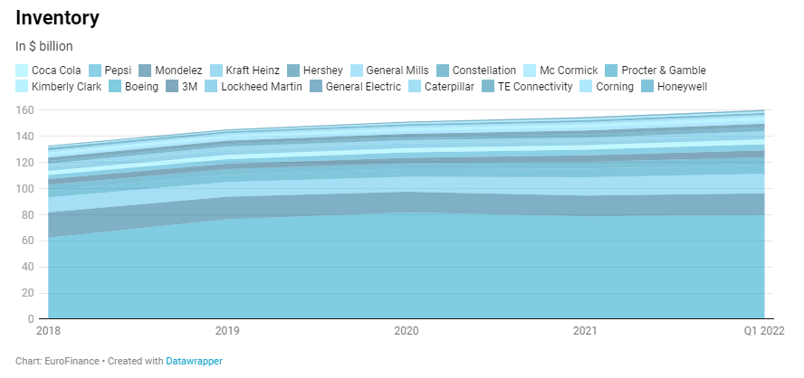

Slide 43
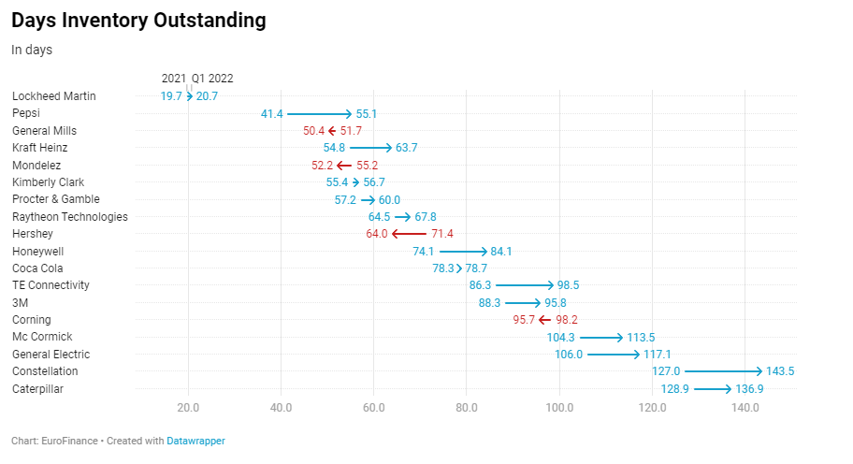

Slide 44
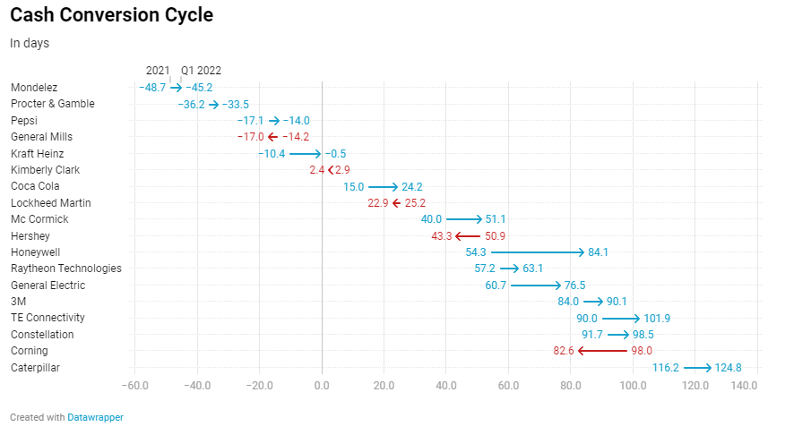

Slide 45
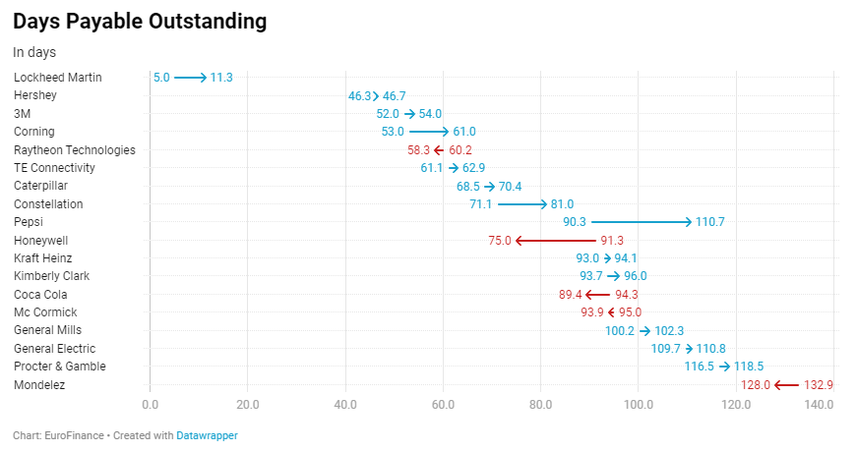

Slide 46
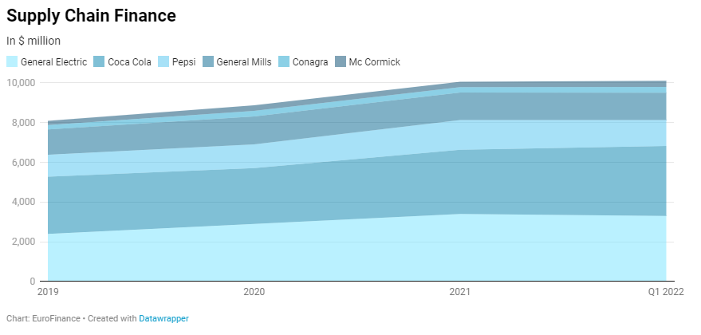

Slide 47
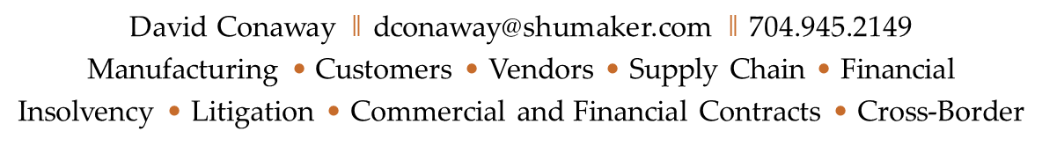
Thank you for your attendance.

