Slide 1
Diversity, Equity, and Inclusion –
Charting a course for
organizational success
Chris Gantt-Sorenson and Demetrius Pyburn
Haynsworth Sinkler Boyd, P.A.

Slide 2
ABOUT HSB
HSB is a full-service law firm with offices in Charleston, Columbia, Florence, Greenville, and Raleigh.
Subscribe to our blog: www.scemployersblog.com.
Ask questions at any time.
Disclaimer: This presentation is provided for information only and not to be taken as legal advice. All situations are different and you should speak with legal counsel for specific advice.

Slide 3
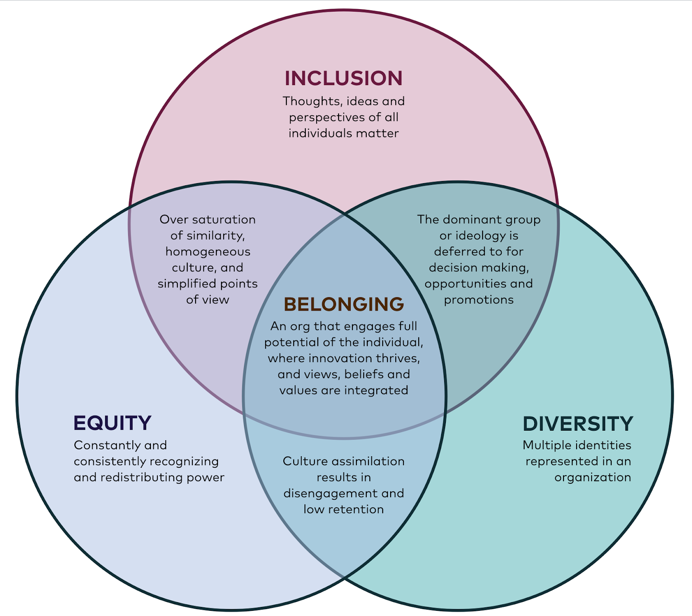
Diversity, equity, inclusion, and belonging
Source: Turner Consulting Group.

Slide 4
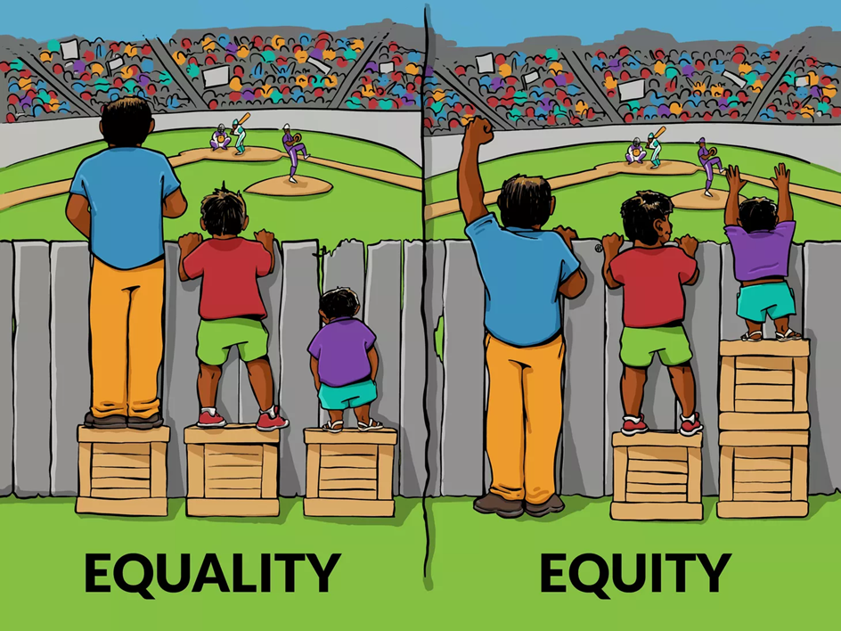
Equity vs. equality

Slide 5
Demographics in this presentation
We Will Discuss:
Race
Gender
People with Disabilities
LGBTQ
Not Discussed:
Military Status
Religious Beliefs
Age
Other

Slide 6
What are the facts (According to the u.s. Census bureau)?
American Population
Gender: 50.8% Woman, 49.2% men
Race: 60% non-Hispanic white, 40% people of color
White (76.3%: 60.1% alone; 16.2% with Latino)
Black (13.4%)
Hispanic (18.5%)
Asian (5.9%)
2 or More Races (2.8%)
American Indian (1.3%)
Pacific Islander (.2%)

Slide 7
The Workforce Is changing
In recent years, many companies have increased their efforts to have a more diverse workforce, and in 2020 racial justice became a higher priority for corporate America.
Although many industries hire and employ a diverse group of people at all levels of an organization, statistics show many do not.
When defending employment claims before the Equal Employment Opportunity Commission, the EEOC looks for diversity at all levels of employment and, statistically, women of color and women in general are underrepresented as management levels increase.

Slide 8
race in the workplace

Slide 9
What are the facts?
According to the U.S. Bureau of Labor Statistics
Overall, 81 percent of the workforce is white, but there are 33 occupations in the U.S. that are more than 90 percent white.
When it comes to professions with outsized shares of minorities:
Blacks are over-represented in community and social-service occupations, and are also over-represented as barbers and postal-service clerks.
Asians make up a large share of computer workers, medical scientists, and personal appearance workers—a category that includes manicurists, makeup artists, and facialists.
Hispanics are over-represented in construction, maintenance, and agricultural work.

Slide 10
What are the facts?
Notable White-Dominated Occupations
Veterinarians – 96.5%
Farmers – 95.8%
Construction Supervisors and Managers – 91.8%
Architects – 91.3%
Other Installation/Repair – 91.2%
Carpenters – 90.8%
Environmental Scientist – 90.5%
Electricians – 90%
Source: Looking at America's Segregated Workforce. Zippia November 17, 2017. https://www.zippia.com/advice/job-diversity/looking-at-Americas-segregated-workforce
Looking over this list, you might have noticed that many of the occupations are skilled construction jobs, such as electricians and carpenters. That's not a coincidence. Trade unions have had a complicated, and often ugly, history with race that's helped shut Blacks and Hispanics out of these highly coveted lines of work.

Slide 11
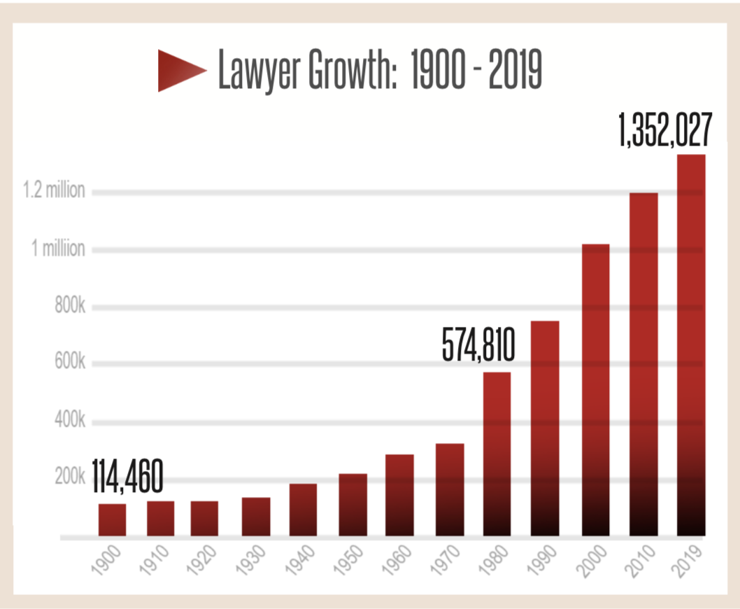
The legal profession is growing
The number of lawyers in the U.S. has grown at a faster rate than the nation's population since 2010.
According to the U.S. Census Bureau, the population grew by 6.3% from 2010 to 2020.
During that time, the number of active lawyers in the US grew 10.4%.
Source: ABA National Lawyer Population Survey

Slide 12
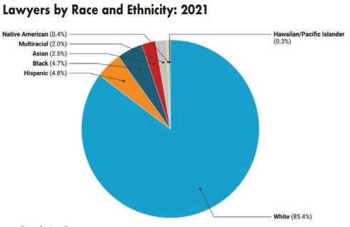
…But still not enough diversity
The percentage of lawyers of color grew slowly over the past decade, from 11.4% of all lawyers in 2010 to 14.1% of all lawyers in 2020.
Whites in population (60%) and in the profession (86%)
Hispanics in population (18.5%) and in the legal profession (5%)
Asians in population (5.9%) and in the legal profession (2%)
Blacks in population (13.4%) and in the legal profession (5%)
Source: ABA National Lawyer Population Survey

Slide 13
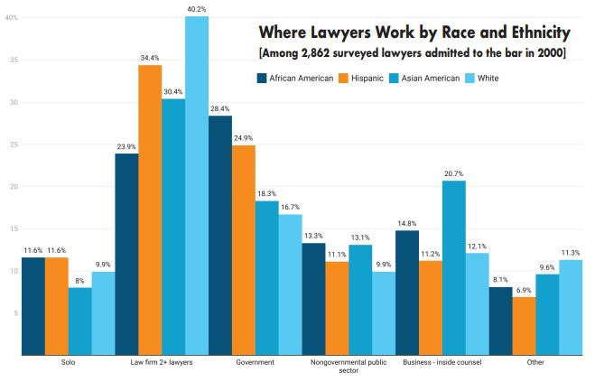

Where Lawyers Work by Race and Ethnicity
Lawyers of color are less likely to work at law firms and more likely to work in the government than lawyers who are white.
White lawyers are more likely to be found in law firms (40%) than lawyers who are Hispanic (34%), Asian American (30%), Black (24%) or Native American (20%).
Black and Hispanic lawyers are more likely to work for government (28% and 25%, respectively) than lawyers who are Asian American (18%), white (17%) or Native American (11%).

Slide 14
Where Lawyers Work by Race and Ethnicity
Asian-American lawyers are more likely to be found as in-house counsels in businesses (21%) than lawyers who are Black (15%), Hispanic (11%), white (12%) or Native American (1%).
A plurality of Native American lawyers (22%) work in the tribal sector, followed by law firms (20%), government (11%) and the nonprofit sector (8%).
Black and Hispanic lawyers are most likely to be solo practitioners (12% of each), followed by lawyers who are white (10%), Asian American (8%) and Native American (7%).

Slide 15
Why minority attorneys leave their employment
Isolation
Lack of Mentorship
Lack of Opportunity/Stereotypes about abilities

Slide 16
Women in the workplace

Slide 17
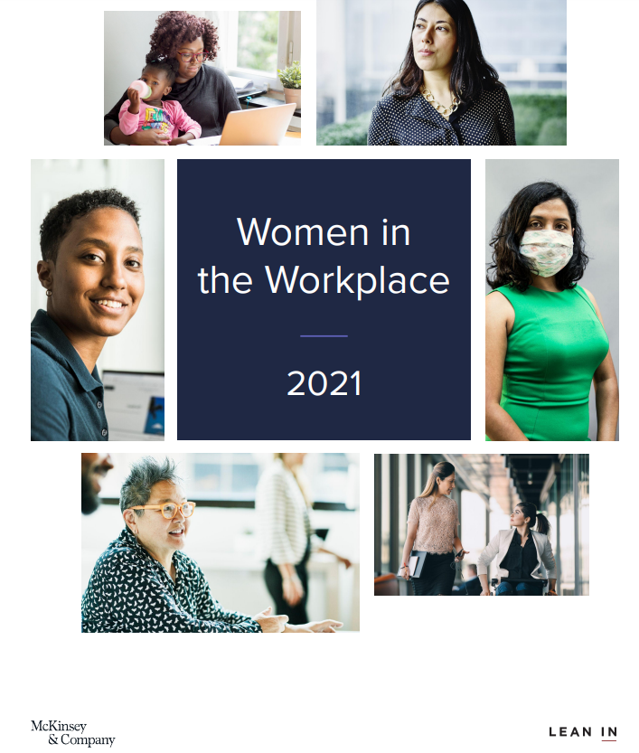
McKinsey and Lean in 2021 Report on Women in the Workplace
423 organizations employing 12 million people
Surveyed 65,000 employees
Interviewed women of varying diversities and women of color, LGBTQ+ women and women with disabilities

Slide 18
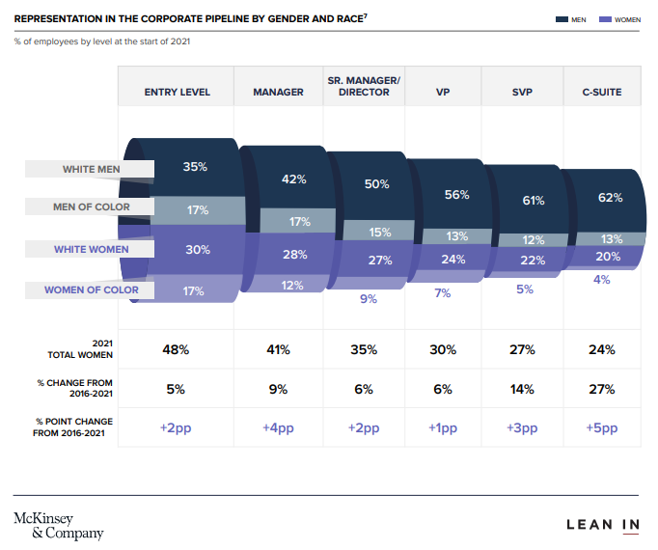
State of women in Corporate America
Women still underrepresented, especially in positions of management
Women still hindered by "broken rung" – first set up to manager
Especially applicable to Women of Color

Slide 19
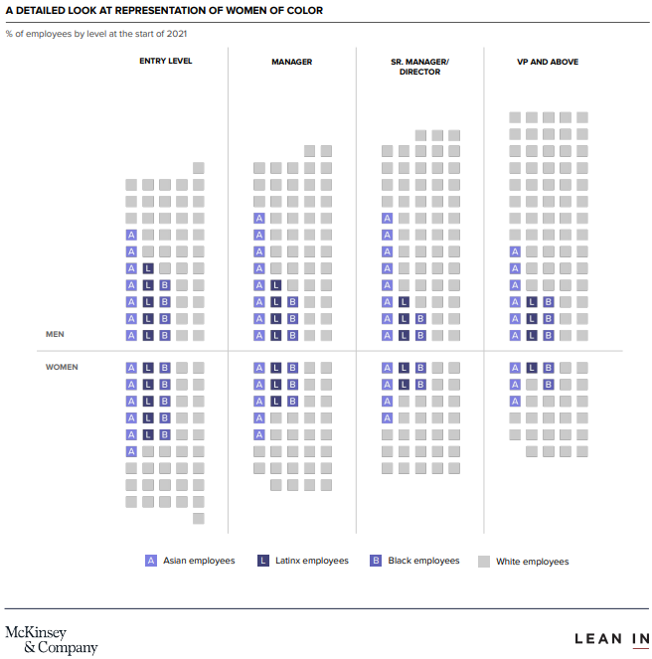
Black Women face disproportionately high barriers in the workplace
Face a wider range of microaggressions, disrespect, and discrimination at work
Receive less support and continue to lose ground at every job level
Allies of women of color unlikely to speak out against discrimination, mentor or sponsor women of color, or take actions to advocate for them
There is a disconnect between companies' growing commitment to racial equity and the lack of improvement of the day-to-day experiences of women of color

Slide 20
And yet, Women are setting a new standard for Leadership
The events leading up to, and including, 2020 triggered a reckoning on diversity, equity and inclusion.
"Women are rising to the moment as stronger leaders but their work is going unrecognized."
Women managers more focused on providing emotional support, checking in on employee's well being, managing employee's workload and taking actions to prevent or manage burnout.
Senior-level women are twice as likely to spend more time on DEI work that falls outside of their normal job responsibilities.
This critical work is at risk of being relegated to "office housework."
And yet, these efforts drive better outcomes for businesses.
"Work that contributes to the business but isn't taken into account in performance reviews doesn't lead to advancement and isn't compensated."

Slide 21
Women in law school
For the past 5 years, law schools have enrolled more women than men. In 2020, ABA-approved law schools enrolled 54.09% women and 45.70% men.*
"Other" increased from 149 students (.13%) in 2019 to 232 (.20%) in 2020.
Men still outnumber women in the legal profession.
Source: Law school Ranking by Female Enrollment (2020) https://www.enjuris.com/students/law-school-women-enrollment-2020.html

Slide 22
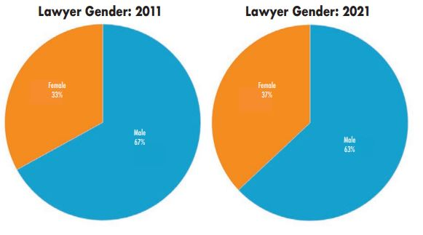
Women in the legal sector
Over the past decade, the percentage of female lawyers increased slowly, according to the ABA and ALM Intelligence.
The gender numbers have changed drastically over the past half-century. From 1950 to 1970, only 3% of all lawyers were women. The percentage has edged up gradually since then – 8% in 1980, 20% in 1991, 27% in 2000, 37% in 2021.
Source: ABA National Lawyer Population Survey

Slide 23
"Walking out the door," an October 2019 study published by the aba and alm intelligence
Male and female lawyers strongly disagree on how well their law firms foster long-term careers for women.
That is one conclusion from the study exploring why experienced female lawyers are leaving law firms. The report includes results from a survey of more than 1,200 senior lawyers at the nation’s biggest private law firms.
Generally, men thought their law firms treated women fairly, but women disagreed.

Slide 24
Why do women attorneys leave?
Lingering dominance of male behavioral norms
Work/Life Balance
Few senior female role models and mentors
Relevance of practice area

Slide 25
Differently abled employees in the workplace

Slide 26
Differently abled employees in the workplace
According to the U.S. DOL, in 2021, 19.1 percent of differently abled people were employed, up from 17.9 percent in 2020.
Across all age groups, persons with disabilities were much less likely to be employed than those with no disabilities.
In 2021, 29 percent of workers with a disability were employed part time, compared with 16 percent for those with no disability.
Employed differently abled people were more likely to be self-employed than those with no disability.
U.S. Department of Labor Bureau of Labor Statistics, Persons with a Disability: Labor Force Characteristics – 2021. USDL-22-0317. https://www.bls.gov/news.release/pdf/disabl.pdf

Slide 27
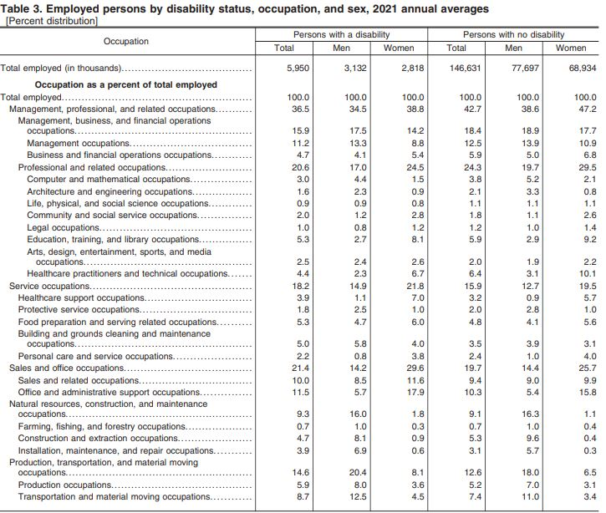
differently abled people in the workplace
In 2021, differently abled people were more likely to work in service occupations than those with no disability (18.2 percent, compared with 15.9 percent).
Workers with a disability were also more likely than those with no disability to work in production, transportation, and material moving occupations (14.6 percent, compared with 12.6 percent) and sales and office occupations (21.4 percent, compared with 19.7 percent).
Differently abled people were less likely to work in management, professional, and related occupations than those without a disability (36.5 percent, compared with 42.7 percent).

Slide 28
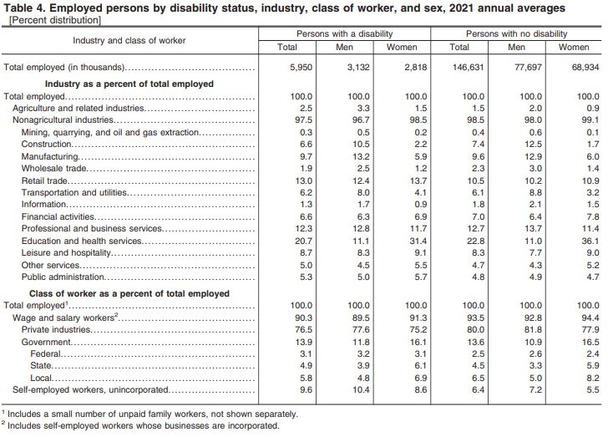
differently abled people in the workplace
A larger share of workers with a disability were self-employed in 2021 than were those with no disability (9.6 percent versus 6.4 percent).
In contrast, a smaller share of workers with a disability were private wage and salary workers (76.5 percent) than were those without a disability (80.0 percent).
The proportion of persons employed in government was about the same for both differently abled people and persons without a disability (13.9 percent and 13.6 percent, respectively).

Slide 29
The Truth behind the reporting
Out of the 50 states in the U.S., only 26 states saw more people with disabilities entering the workforce in 2020.*
Issues with discrimination, leading to workers with disabilities leaving the workforce.
Artificial-intelligence algorithms, which are used in screening potential job candidates.
Sarah Kim, "The Disappointing Truth About Employment Climate for Disabled Workers," Forbes, February 25, 2020, https://www.forbes.com/sites/sarahkim/2020/02/25/employment-statistics-disabled-workers/?sh=344699b46492.

Slide 30
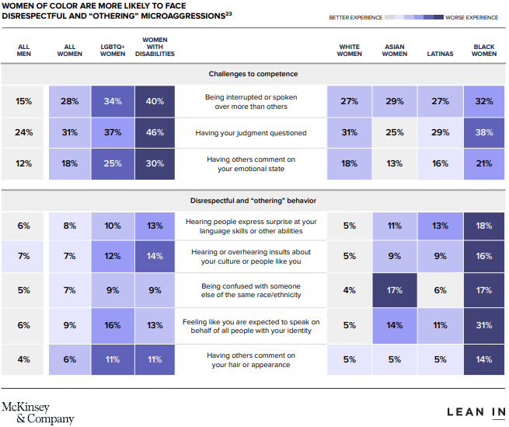
Intersectional experiences
Women intersected with race, disabilities, and LGBTQ+ women have additional unique issues to each intersection group

Slide 31
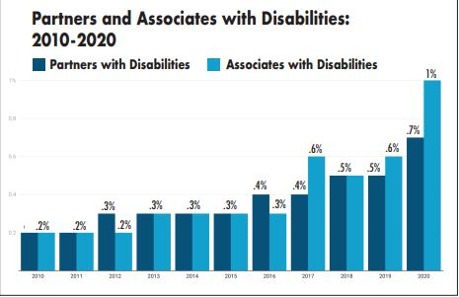
Lawyers with Disabilities
The number of lawyers at American law firms who report having disabilities remains small – slightly less than 1% of all lawyers.
Source: ABA National Lawyer Population Survey

Slide 32
Lgbtq in the workplace

Slide 33
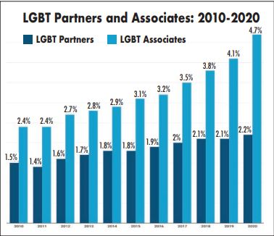
Lgbt lawyers
The number of openly lesbian, gay, bisexual, and transgender (LGBT) lawyers at American law firms continues to grow slowly, according to an annual survey by the National Association for Law Placement.

Slide 34
The problem with finding statistics on lgbtq in the workplace
Lack of data prevents analysis of the true health of the labor market, especially regarding the LGBTQ community, according to American Progress.org.
Conscious or unconscious bias against LGBTQ applicants can prevent them from getting hired.
In a 2017 study conducted for National Public Radio*, 1 in 5 LGBTQ people reported being discriminated against because of their sexual orientation or gender identity (SOGI) in regard to equal pay and/or consideration for promotion.
Based on our research, federal employment surveys such as the Current Population Survey (CPS) and the Current Employment Statistics Program, also known as the establishment survey, do not collect information about workers’ SOGI.
* Harvard School of Public Health, "Poll finds a majority of LGBTQ Americans report violence, threats, or sexual harassment related to sexual orientation or gender identity; one-third report bathroom harassment," November 17, 2017, https://www.hsph.harvard.edu/news/press-releases/poll-lgbtq-americans-discrimination/.

Slide 35
Current wave of diversity

Slide 36
In-house legal department perspective
In-House Legal Departments face the same challenges that law firms face in developing diverse teams: Recruiting, Work Allocation, Retention, Culture & Integration, and Business Demand.*
Generally, as compared to law firms, companies are under more intense pressure from a wide variety of stakeholders to improve our teams: Customers, Community, Government, Team Members, and Investors.
*Law.com, "5 Challenges That Legal Departments Face While Promoting Diversity," Corporate Counsel, January 14, 2021, https://www.law.com/corpcounsel/2021/01/14/5-challenges-that-legal-departments-face-while-promoting-diversity/?slreturn=20220409215727

Slide 37
Pressure from consumers
75% of Gen Z consumers will boycott companies that discriminate in reference to race and sexuality across advertisement campaigns, according to a McKinsey study.
Unlike previous generations, which were less willing to embrace difference, younger consumer groups crave uniqueness and individuality. They want the brands they support to reflect these qualities.
According to a new global report by Exasol, a substantial majority (68%) of consumers will consider demanding data-backed evidence to prove that companies are making beneficial steps towards addressing global warming, diversity and inclusion (DEI), as well as ethical and sustainable business practices in the next 36 months.
‘McKinsey.com, "True Gen’: Generation Z and its implications for companies," November 18, 2021, https://www.mckinsey.com/industries/consumer-packaged-goods/our-insights/true-gen-generation-z-and-its-implications-for-companies.
Venture.beat.com, "Why AI can’t move forward without diversity, equity, and inclusion" November 12, 2020. https://venturebeat.com/2020/11/12/why-ai-cant-move-forward-without-diversity-equity-and-inclusion/.

Slide 38
Pressure from clients
Corporate executives are facing increased demands from investors, customers and employees to ensure that their workforces -- particularly in senior management -- reflect the overall diversity of the U.S. population.
Companies, as part of their internal diversity initiatives, have placed pressure on other industries to improve diversity in the workplace.
A record 30 resolutions focusing on diversity, equity, and inclusion will be on the ballots at upcoming annual company meetings, according to data compiled by Bloomberg Intelligence.
Bloomberg.com, "Investors Pressure Corporate America With Record Diversity Push", April 22, 2021. https://www.bloomberg.com/news/articles/2021-04-22/investors-pressure-corporate-america-with-record-diversity-push.

Slide 39
Pressure from third-party legal organizations
ABA's Model Diversity Survey
Mansfield Rule
Vault
Minority Corporate Counsel Association (MCCA)
Human Rights Campaign Foundation
Women in Law Empowerment Forum (WILEF)

Slide 40
Other trends
An evolving remote workforce
Enabling diverse gender identity and gender expression
Multigenerational workforce
Eliminating unconscious bias in the workplace
Hiring diversity professionals
Increased transparency in goals
Supporting employees' mental health

Slide 41
Recommendations

Slide 42
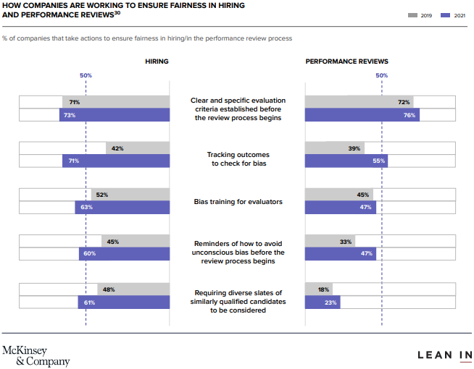
Recommendations for hiring and retaining top talent and for boosting competitiveness
Track diversity metrics by gender, race/ethnicity and intersection of the two
Hold senior leaders accountable for progress on diversity goals with financial incentives and penalties
Minimize gender bias in performance reviews, hiring, and promotions
Provide mentorship and sponsorship – meaning new opportunities - for women of color
Enhance a sustainable workplace culture by adjusting policies, systems, and norms

Slide 43
What you can do
Put DEI on the agenda for team meetings.
Make it personal – why does it matter to you?
Be alert to bias; notice patterns and act on them, especially in reference to team outings, work allocation, social time, etc.
Consider diversity when forming teams.
Challenge bad behavior – it undermines us all.
The more we get to know people as individuals, the less we rely on stereotypes.

Slide 44
What you can do
Participate in reverse mentorship to build your DEI acumen.
Mentor someone different from you to build a diverse talent pipeline.
Sponsor diverse talent to the point of success.
Map out your network and diversity it.
Always ask for diverse perspectives.
Be an ally.

Slide 45
Resources
April Simpkins,"Five Reasons Why DEI Initiatives Fail," PEO Insider https://www.napeo.org/peo-resources/publications-products/peo-insider/issue/december-2021-january-2022/five-reasons-why-dei-initiatives-fail
McKinsey and Lean In 2021 Report on Women in the Workplace
SC WREN Power Up Series
WREN 2021 Women in the Workforce Report
https://turnerconsultinggroup.weebly.com/blog-tana-turner/winning-at-the-intersection-of-equity-diversity-inclusion

Slide 46
Resources
U.S. Bureau of Labor Statistics, Persons with a Disability: Labor Force Characteristics – 2021: https://www.bls.gov/news.release/pdf/disabl.pdf
Sarah Kim, The Disappointing Truth About Employment Climate For Disabled Workers. Forbes.
https://www.bloomberg.com/news/articles/2021-04-22/investors-pressure-corporate-america-with-record-diversity-push
Discrimination in America: EXPERIENCES AND VIEWS OF LGBTQ AMERICANS
The State of the LGBTQ Community in the Labor Market: Pre-June 2018 Jobs Day Release. https://www.americanprogress.org/article/state-lgbtq-community-labor-market-pre-june-2018-jobs-day-release/

Slide 47
Resources
https://www.americanbar.org/about_the_aba/profession_statistics/
Harvard Business Review, "Women Do More to Fight Burnout – and its Burning Them Out," (October 22, 2021)
https://www.nalp.org/diversity
https://www.americanbar.org/groups/diversity/

Slide 48
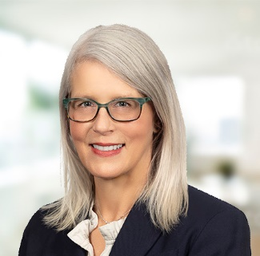

CHRIS GANTT-SORENSON
Shareholder, Employment Team Leader
csorenson@hsblawfirm.com
P 864.240.3282
DEMETRIUS PYBURN
Associate
dpyburn@hsblawfirm.com
P 864.240.3290

