Slide 1
Protecting Your Company From Insurance Landmines.
ACC Annual Meeting
September 16, 2022

Slide 2

Panelists
Tosh Saio, Willis Towers Watson, PLC
Jordan Dinos, Resurgent Capital Services
Stephen Groves, Butler Snow LLP
Brad Waring, Butler Snow LLP
Robert Sumner, Butler Snow LLP

Slide 3
Strategies for Insurance Buyers
1. Start early, at minimum request a budget at 120 days before expiration.
2. Expect constant change in market appetite and turnover in underwriters and brokers.
3. Be patient with underwriters – request for information can seem endless.
4. Demand underwriters quantify the exposure specific to your risk.
5. Establish a relationship with your key underwriters in person during the policy year.
6. Make decisions in separate buckets (e.g. Cyber first and remaining portfolio later).

Slide 4

Reducing policy limits to save premium
Be honest about risk exposure
Weigh incremental savings versus potential liability
Don’t be penny wise, pound foolish

Slide 5

Cyber Insurance
Cannot depend on a policy that is silent on cyber to provide full coverage.
New exclusions and limitations on liability.
Cyber underwriting and pricing.
Ransomware coverages.
Third-Party Vendors.

Slide 6

Insurability of Punitive damages
Exclusions
Most policies are silent
If true exposure, obtain separate stand-alone policy

Slide 7
Additional Insured Provisions
Coverage is based on contract requirement, not policy limit.
Not all coverages allow for AI—make sure contract doesn’t require this where it’s not available.
Keep these requirements as simple as possible—avoid special language that makes no substantive difference.

Slide 8

Forever Chemicals (PFAS)
MDL in Charleston
New “forever chemical” exclusions”

Slide 9

How long to keep insurance policies
FOREVER
WITH endorsements
Dangers of destroying policies (asbestos)

Slide 10
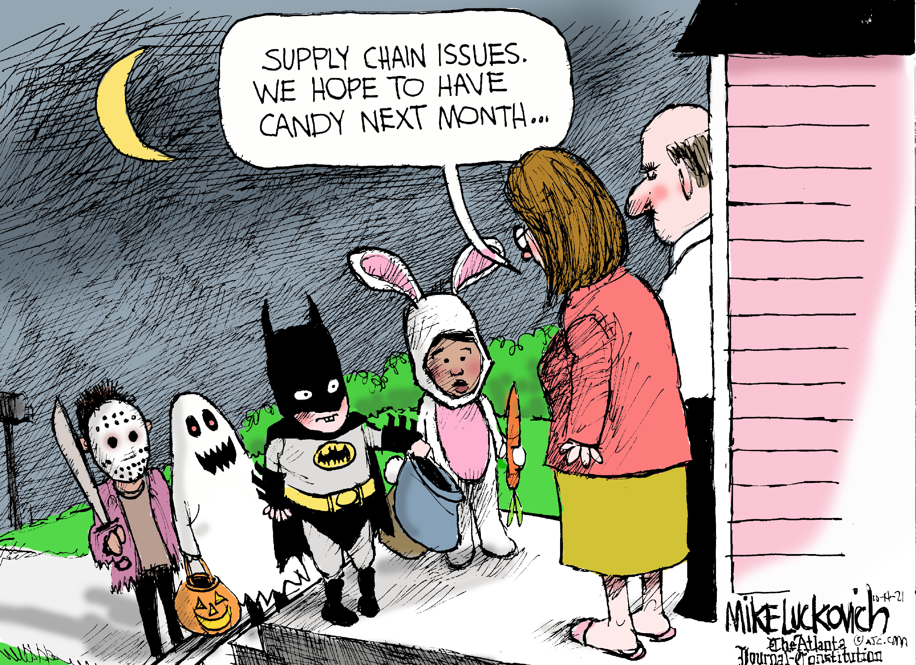
Supply Chain and Inflation
New pressures on underwriting
Asset values must be closely evaluated
Policy limits must be closely evaluated.

Slide 11
Coverage for Abuse and Molestation
Catholic Church litigation.
Difficult coverage to obtain.
Beware of exclusions, sublimits, and limitations.
Need for excess coverage.

Slide 12

Change of Control of Policyholder
Policy assignments (PCS Nitrogen, Inc. v. Continental Casualty Company, 436 S.C. 254, 871 S.E.2d 590 (2022))
Run-off provisions
Key issues in mergers & acquisitions

Slide 13

Communicable diseases
Total exclusions on all policies
Workers compensations exception

Slide 14

Importance of incoming certificates of insurance
Essential for subrogation of claims and reduction of premiums.
Where are these kept?
Who verifies compliance with contractual or other requirements?

Slide 15
Importance of outgoing certificates of insurance
Perform at least annual clean up, have a tracking system in place.
Carefully review contracts for requirements and make sure they make sense for the specified coverages.
Keep these requirements as simple as possible.
Other sources of COI requirement: regulatory/licensing, leases, etc.

Slide 16

Threats of Active Shooters and Workplace Violence
Social issue has resulted in a new market for this coverage.
Products available to provide coverage
Assist with security assessment
Provide additional security for a threat
Venues, churches, schools

Slide 17

Special Events
Company parties and functions
To charge or not to charge (for drinks)

Slide 18

Emergence of ESG Compliance
(Environmental Social Governance)
Social Responsibilities
Expect new wave of underwriting questions

Slide 19

Parametric Insurance
Major sporting events
Objective triggers
SEC Basketball Tournament

Slide 20
Increased cost of claim preparation expenses
Sublimits for forensic and accounting expenses for claim preparations

Slide 21
Thank You

