Slide 1



Employment Law Hot Topics
Association of Corporate Counsel
Hannah D. Stetson
hstetson@turnerpadget.com
September 16, 2022

Slide 2
Overview
Wage and Hour
LBGTQ+ Issues
Service Animals
NLRB/NLRA Issues

Slide 3

Wage and Hour

Slide 4
Independent Contractor
January 7, 2021: DOL Final Rule from Trump Administration issued, to take effect March 8, 2021
March 12, 2021: Biden Administration DOL issued a NPRM “withdrawing” the Independent Contractor Final Rule
March 14, 2022: US District Court for the Eastern District of Texas vacated the Withdrawal Rule and restored the Trump Administration Rule effective March 8, 2021 (ruling that DOL violated the APA)
June 3, 2022: DOL announces developing its own proposed rule

Slide 5
Independent Contractor
Core Factors:
Nature and degree of control over the work
Extent to which worker exercised substantial control over key aspects of performance of the work
Worker’s opportunity for profit and loss
Extent to which worker has opportunity to earn profits or incur losses based on exercise of initiative or management of investments in or capital expenses on, for example, helpers or equipment

Slide 6
Independent Contractor
Biden Administration
Supports the “ABC test”
A worker is not an independent contractor unless: (1) the worker is free from the control and direction of the employer in performing work (both contractually and in reality); (2) the worker performs work outside the usual course of the employer’s business; and (3) the worker is customarily engaged in an independently established business or trade of the same nature as the work being performed
“Aggressively pursue employers who violate labor laws, participate in wage theft, or cheat on their taxes by intentionally misclassifying employees as independent contractors”

Slide 7
Lactation
Must provide “reasonable break time” for employee to express milk
One (1) year after child’s birth
Only applicable to non-exempt employee
Must provide a location shielded from view and free from intrusion
Bathroom is NOT a permissible location
Frequency of breaks needed and duration of breaks will vary
Not required to compensate for breaks taken for the purpose of expressing milk (unless employer already provides compensated breaks)
The employee must be completely relieved from duty or will be compensated as work time

Slide 8
South Carolina Lactation Support Act
Effective July 25, 2020
Covers all employers with 1 or more employees
Reasonable unpaid or paid break time to express milk
Exempt and Non-Exempt employees qualify
Break time must, if possible, run concurrently with regular breaks
Reasonable effort to provide room or other location, other than toilet stall, close to the work area
No discrimination or retaliation
Undue hardship exception
Employer not required to build a room
SCHAC administers
Employers must post Notice provided on SCHAC’s website

Slide 9

LGBTQ+ Issues

Slide 10
Title VII
Bostock case / U.S. Supreme Court
Title VII covers LGBTQ / sexual orientation

Slide 11
ADA
Williams v. Kincaid, No. 21-2030 (4th Cir. Aug. 16, 2022)
Transgender female with gender dysphoria who alleged amongst other things, that the treatment she received while she was detained in the Fairfax County Adult Detention Center violated the ADA
The Fourth Circuit held that gender dysphoria is NOT a “gender identity disorder,” as that term is used in the ADA
Finds that gender dysphoria is a disability protected by the ADA (Title II)

Slide 12
Gender Dysphoria
The Fourth Circuit held that gender dysphoria is a disability under the ADA’s familiar definition of a “physical or mental impairment that substantially limits one or more major life activities.”
The substantial advancement in medical and psychiatric knowledge, the ADA’s 1990 amendment excluding “gender identity disorder” as a disability could not be construed to also include the modern diagnosis of “gender dysphoria.”
Congressional mandate to broadly define disability.

Slide 13
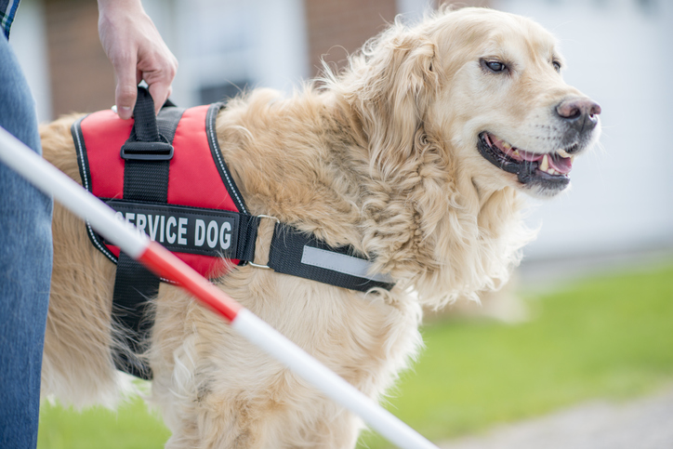
Service Animals

Slide 14
Americans with Disabilities Act
Title I -- Employment
Title II – Services / Programs / State and Local Government
Title III – Public Accommodation

Slide 15
ADA – Title I
Qualified individual with a disability
Reasonable accommodation
A reasonable accommodation is a change, exception, or adjustment to a rule, policy, practice, or service that may be necessary for a person with a disability to have equal opportunity to use and enjoy a dwelling, including public and common use spaces.
Interactive process
Employer may ultimately choose the accommodation

Slide 16
ADA – Title I
What is a service animal?
Under the ADA, a service animal is defined as a dog that has been individually trained to do work or perform tasks for an individual with a disability.
The task(s) performed by the dog must be directly related to the person's disability.
What does "do work or perform tasks" mean?
The dog must be trained to take a specific action when needed to assist the person with a disability.

Slide 17
ADA – Title I
A person with diabetes may have a dog that is trained to alert him when his blood sugar reaches high or low levels.
A person with depression may have a dog that is trained to remind her to take her medication.
A person who has epilepsy may have a dog that is trained to detect the onset of a seizure and then help the person remain safe during the seizure.

Slide 18

ADA – Title I
Emotional support, therapy, comfort, or companion animals are NOT considered service animals under the ADA.
These terms are used to describe animals that provide comfort just by being with a person.
Because they have not been trained to perform a specific job or task, they do not qualify as service animals under the ADA.

Slide 19
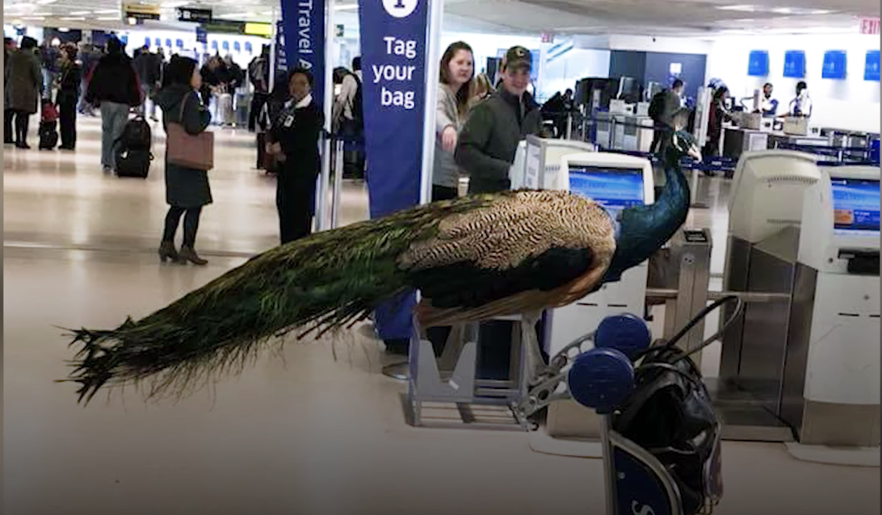
ADA – Title I
Focus on Training:
Distinction between psychiatric service animals and emotional support animals.
If the dog has been trained to sense that an anxiety attack is about to happen and take a specific action to help avoid the attack or lessen its impact, that would qualify as a service animal.
If the dog's mere presence provides comfort, that would not be considered a service animal under the ADA.

Slide 20
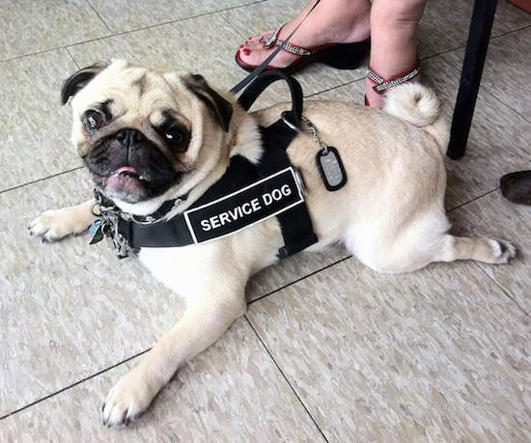
ADA – Title I
No absolute right to a service dog
Standard reasonable accommodation analysis
Undue hardship/direct threat

Slide 21

ADA – Titles II and III
Generally, Title II and Title III entities must permit service animals to accompany disabled individuals in all areas where members of the public are allowed to go.

Slide 22
ADA – Titles II and III
The ADA does not require that service animals be professionally trained.
A disabled individual may train his/her service animal.
Service animals “in training” are not covered by the ADA.

Slide 23
ADA – Titles II and III
When it is not obvious what service an animal provides, the entity may ask:
(1) whether the dog is a service animal required because of a disability, and
(2) what work or task has the dog been trained to perform.
Staff may NOT ask about the person’s disability, require medical documentation, require a special identification card or training documentation for the dog, or ask that the dog demonstrate its ability to perform the work or task.

Slide 24
ADA – Titles II and III
Entity may not ask a disabled individual to remove his service animal from the premises unless:
(1) the dog is out of control and the handler does not take effective action to control it, or
(2) the dog is not housebroken. When there is a legitimate reason to ask that a service animal be removed, staff must offer the person with the disability the opportunity to obtain goods or services without the animal’s presence

Slide 25
ADA – Titles II and III
Allergies and fear of dogs are not valid reasons for denying access or refusing service to people using service animals.
When a person who is allergic to dog dander and a person who uses a service animal must spend time in the same room or facility, for example, in a school classroom or at a homeless shelter, they both should be accommodated by assigning them, if possible, to different locations within the room or different rooms in the facility.

Slide 26

ADA – Titles II and III
Disabled individuals are entitled to use more than one service animal if their disabilities require such.
No interactive process.
Breed discrimination is illegal.

Slide 27
ADA – Titles II and III
Municipalities that prohibit specific breeds of dogs must make an exception for a service animal of a prohibited breed, unless the dog poses a direct threat to the health or safety of others.
Local jurisdictions need to determine, on a case-by-case basis, whether a particular service animal can be excluded based on that particular animal’s actual behavior or history, but they may not exclude a service animal because of fears or generalizations about how an animal or breed might behave.

Slide 28
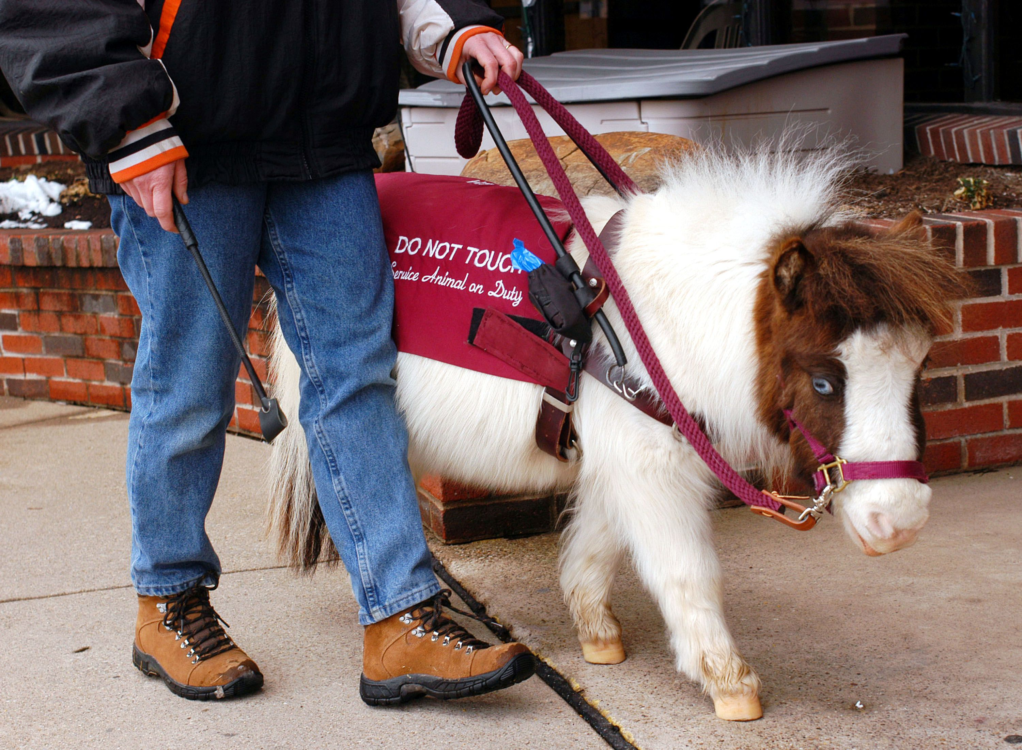
ADA – Titles II and III
Entities must permit miniature horses where reasonable, based on whether:
the miniature horse is housebroken;
(2) the miniature horse is under the owner’s control;
(3) the facility can accommodate the miniature horse’s type, size, and weight; and
(4) the miniature horse’s presence will not compromise legitimate safety requirements necessary for safe operation of the facility.

Slide 29
Suggestions
Provide written notice of best practices regarding service animals.
Provide written notice to handlers of their responsibilities.
Train staff.
Do not retaliate.
Remove animals that are out of control, not housebroken, or that pose a direct threat.
Be prepared for emotional reactions.
Stay flexible.

Slide 30
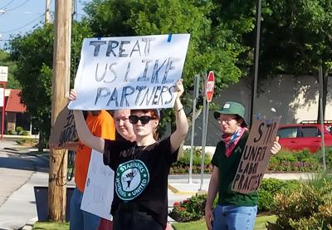
NLRA/NLRB ISSUES

Slide 31
National Labor Relations Act
“Employees shall have the RIGHT to self-organization, to form, or assist labor organizations, to bargain collectively through representatives of their choosing and to engage in other concerted activities for the purpose of collective bargaining or other mutual aid or protection, and shall also have the RIGHT TO REFRAIN from any or all activities…”—section 7 of the NLRA

Slide 32
Employee Rights (Section 7)
To unionize or not to unionize
To bargain collectively
To engage in other concerted activities (strikes, complaints, criticisms, etc.)

Slide 33
Protected / Concerted Activities
Discussing or complaining about working conditions, wages, hours, safety, discrimination, harassment, or a supervisor’s conduct;
Supporting a co-worker’s complaints;
Seeking to replace company management;
Criticizing management; and
Forming or attempting to form a union, discussing a union, or engaging in union-related activities.

Slide 34
Violate the NLRA
Interfere with, restrain, or “chill” employees’ rights to engage in protected concerted activity.
A workplace rule will violate the NLRA if: (1) employees would reasonably construe the rule's language to prohibit their protected concerted activity; (2) the employer promulgated the rule in response to union-related activity; or (3) the employer applied the rule to restrict employees’ exercise of protected concerted activities.

Slide 35
Unlawful Conduct Policies
Board protects any form of protected, concerted activity, except physical violence and threats of physical violence.
NLRB and 2nd Circuit Court of Appeals ruled the following Facebook posting lawful:
“Bob is such a NASTY MOTHER F**KER don't know how to talk to people!!!!!! F**k his mother and his entire f**king family!!!! What a LOSER!!!! Vote YES for the UNION!!!!!!!”
NLRB v. Pier Sixty, LLC, 2017 U.S. App. LEXIS 6974 (2d Cir. Apr. 21, 2017).

Slide 36
Lawful Conduct Policies
Employers have legitimate business interests in having and may require employees to act respectfully or professionally to, co-workers, clients, business partners and other third parties, but not to the employer or management.
"No rudeness or unprofessional behavior toward a customer, or anyone in contact with the company."
"Employees will not be discourteous or disrespectful to a customer or any member of the public while in the course and scope of company business.“
"Each employee is expected to abide by Company policies and to cooperate fully in any investigation that the Company may undertake."
"Being insubordinate, threatening, intimidating, disrespectful or assaulting a manager/supervisor, coworker, customer or vendor will result in discipline."

Slide 37
NLRA Does Not Cover Supervisors
Supervisors are any individual with authority to:
hire, transfer, suspend, lay-off, recall promote, discharge, assign, reward, or discipline other employees;
direct employees;
adjust grievances;
recommend such action; or
exercise independent judgment.

Slide 38
Good Supervisors Prevent Unions
Listen
Loyal
Competent
Consistent
Follow policies and procedures
Require satisfactory performance / conduct / attendance
Follow the law
Communicate

Slide 39
Building Trust and Respect
Show genuine interest
Honest / transparent
Listen more than you talk
Open door
Solicit / Act on feedback
Walk the floor
Give credit / recognition and show appreciation
Help people grow / develop
Have empathy
Empower through delegating / autonomy
Show enthusiasm
Embrace diversity and inclusivity
Expect / Accept Criticism

