Slide 1


What Every In-House Attorney Needs to Know About E-Discovery
Records & E-Discovery (RED)
June 23, 2022

Slide 2


Today’s Speakers
David Cohen
Partner
Reed Smith
Michelle Mantine
Partner
Reed Smith

Slide 3
Disclaimer
This presentation is informational in nature and may not be relied upon as legal advice.

Slide 4
Disclaimer
This presentation is informational in nature and may not be relied upon as legal advice.
This presentation is not age appropriate for children, senior citizens, or those with high blood pressure or a history of heart conditions. All stunts are performed by professionals. Do not try these at home.

Slide 5
What We Will Cover
Basics About E-Discovery
The “Dirty Dozen”: Pitfalls to Avoid in Working with E-Discovery Service Providers
Available E-Discovery Resources

Slide 6
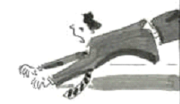

Slide 11
Why E-Discovery is a “Big Deal”
Data is Proliferating
Everything is Discoverable
E-Discovery is Evolving
E-Discovery Can Be Complicated
E-Discovery Can Be Expensive
E-Discovery Mistakes Lead to Sanctions

Slide 12
The Proliferation of Data
“Go through the files and image everything over 10 years old…but make copies first!”

Slide 13

Basics About E-Discovery

Slide 14
8 Basics That In-House Counsel Should Know
Basic Stages of E-Discovery
Rules of Thumb
Legal Hold Best Practices
New Data Sources and Collections
Non-Waiver Orders
Predictive Coding and Other Technology
Production Considerations
Cross-Border Discovery and GDPR

Slide 15
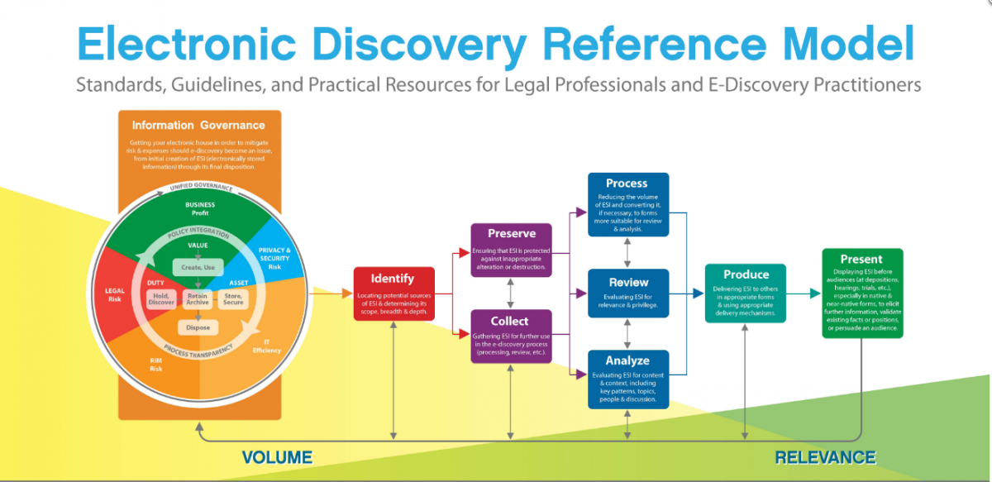
Basic Stages of E-Discovery

Slide 16

Rules of Thumb
One Gigabyte averages about 35,000 pages (about 100 banker’s boxes)
Not unusual for a single custodian to have 50 Gbs of emails and other ESI
If you have to collect from 10 custodians, you could have 500 Gb = 17.5 million pages
One Terabyte = 1,024 Gb = 35+ million pages

Slide 17




Everything is Discoverable
File Folders
A “record” may mean different things to different people but, in general – the records we care about contain information in a fixed form, regardless of medium or format, that have value to an organization, including:
hard copy paper documents,
electronically stored information,
and even audio and video files.
Home &
Office Laptops
File Cabinets
The
Cloud
Cell Phones
i-Pads & Tablets
CDs & DVDs
Network Servers

Slide 18

Translation…
The Discovery process can be one of the most expensive and risky phases of a litigation or investigation!

Slide 19
The Scope of Discovery
Rule 26(b)(1):
Scope in General. Unless otherwise limited by court order, the scope of discovery is as follows: Parties may obtain discovery regarding any nonprivileged matter that is relevant to any party’s claim or defense and proportional to the needs of the case, considering the importance of the issues at stake in the action, the amount in controversy, the parties’ relative access to relevant information, the parties’ resources, the importance of the discovery in resolving the issues, and whether the burden or expense of the proposed discovery outweighs its likely benefit. Information within this scope of discovery need not be admissible in evidence to be discoverable.

Slide 20
Preservation
Give attention immediately to preserving all potential relevant ESI and paper documents – issue a Legal Hold!
Preservation in place used increasingly instead of preservation through collection
Turning off automatic deletion for custodians
Proportionality comes to preservation
See FRCP 26(b)(1) and comments to 37(e)
Special care required for ephemeral data sources
Texts, other cell data, VMs, Slack, Yammer, etc.
Cast the preservation net broadly
Ronnie Van Zant opinion and others…

Slide 21
Rule 37(e)
Failure To Preserve Electronically Stored Information.
If ESI that should have been preserved in the anticipation or conduct of litigation is lost because a party failed to take reasonable steps to preserve the information, and the information cannot be restored or replaced through additional discovery, the court may:
Upon a finding of prejudice to another party from loss of the information, order measures no greater than necessary to cure the prejudice;
(2) Only upon a finding that the party acted with the intent to deprive another party of the information’s use in the litigation,
(a) presume that the lost information was unfavorable to the party;
(b) instruct the jury that it may or must presume the information was unfavorable to the party; or
(c) dismiss the action or enter a default judgment.

Slide 22
Rule 37(e) Advisory Committee Notes
“Another factor in evaluating the reasonableness of preservation efforts is proportionality. The court should be sensitive to party resources; aggressive preservation efforts can be extremely costly, and parties (including governmental parties) may have limited staff and resources to devote to those efforts. … A party urging that preservation requests are disproportionate may need to provide specifics about these matters in order to enable meaningful discussion of the appropriate preservation regime.”

Slide 23


The Daily Standard
June 23, 2022 $1.50
High 87 Low 73
Classified E1-5 Crossword B2 Dear Abby C4 Comics B7 Lotteries A3 Movies B9 Obituaries A7 Local C8-10 World C1-7 Stocks B2 Sports D1
D1 Pirates take series from Cubs!
JUDGE IMPOSES HEAVY SANCTIONS FOR LEGAL HOLD FAILURES
ANYTOWN, USA Yesterday a local judge handed down the largest sanction ever imposed in this county for failure to adequately preserve, process and produce electronic records potentially relevant to their pending litigation. The Judge explained
that preservation and production of records potentially relevant to pending or anticipated litigation is the duty of every party in a dispute, and outside law firms have an independent duty to take reasonable steps to ensure compliance by their clients.
See Sanctions A3
YOUR
PICTURE
HERE!
“They did not seem to understand their duties with regard to electronic evidence.”

Slide 24
When is a Legal Hold Required?
Litigation is “Foreseeable”
Litigation is “Reasonably Anticipated”
Litigation is “Likely”
Litigation is “Pending or Probable”
A B C D
The Correct Answer is… ?

Slide 25
When is a Legal Hold Required?
Litigation is “Foreseeable”
Litigation is “Reasonably Anticipated”
Litigation is “Likely”
Litigation is “Pending or Probable”
A B C D
The Correct Answer is… ?
D. Cianci v. Phoenixville Area Sch. Dist., No. 20-4749, 2022 BL 92338, at *8 (E.D. Pa. Mar. 18, 2022)

Slide 26
When is a Legal Hold Required?
Litigation is “Foreseeable”
Litigation is “Reasonably Anticipated”
Litigation is “Likely”
Litigation is “Pending or Probable”
A B C D
The Correct Answer is… ?
D. Cianci v. Phoenixville Area Sch. Dist., No. 20-4749, 2022 BL 92338, at *8 (E.D. Pa. Mar. 18, 2022)
C. 2015 Advisory Committee Notes to Fed. R. Civ. P. 37(e)

Slide 27
When is a Legal Hold Required?
Litigation is “Foreseeable”
Litigation is “Reasonably Anticipated”
Litigation is “Likely”
Litigation is “Pending or Probable”
A B C D
The Correct Answer is… ?
D. Cianci v. Phoenixville Area Sch. Dist., No. 20-4749, 2022 BL 92338, at *8 (E.D. Pa. Mar. 18, 2022)
C. 2015 Advisory Committee Notes to Fed. R. Civ. P. 37(e)
B. Bistrian v. Levi, 448 F. Supp. 3d 454, 473 (E.D. Pa. 2020)

Slide 28
When is a Legal Hold Required?
Litigation is “Foreseeable”
Litigation is “Reasonably Anticipated”
Litigation is “Likely”
Litigation is “Pending or Probable”
A B C D
The Correct Answer is… ?
D. Cianci v. Phoenixville Area Sch. Dist., No. 20-4749, 2022 BL 92338, at *8 (E.D. Pa. Mar. 18, 2022)
C. 2015 Advisory Committee Notes to Fed. R. Civ. P. 37(e)
B. Bistrian v. Levi, 448 F. Supp. 3d 454, 473 (E.D. Pa. 2020)
A. Victor v. Moss, No. 1:20-CV-425, 2021 BL 208403, at *7 (M.D. Pa. June 4, 2021)

Slide 29
When is a Legal Hold Required?
Litigation is “Foreseeable”
Litigation is “Reasonably Anticipated”
Litigation is “Likely”
Litigation is “Pending or Probable”
A B C D
The Correct Answer is… ?
E. All of the Above!

Slide 30

Legal Hold Basics
Adopt legal hold policies and procedures before litigation hits!
Initiate a legal hold notice as soon as practicable
Don’t over-preserve
Don’t follow a “fear-based” strategy
Track all legal holds
Use a consistent process
Software or spreadsheet system
Promptly lift legal holds when matters end
Return to existing practices for retaining/deleting data

Slide 31

Adopt Best Practices for Legal Holds
Have a plan – preferably in a written policy!
Standard hold notice templates are drafted and ready to go
Process in place for notifying IT staff to stop Auto-Delete
Be aware of non-custodial data sources
Issue prompt written notices to all potential custodians
Sufficiently broad distribution
Include all relevant data sources
Current employees
Former and departing employees
Third parties
Non-custodial data sources
Include all relevant data types
Don’t forget text and Teams messages

Slide 32
Custodian Interviews
Document all steps
Use fully developed collection templates to help act as a guide
Consult with IT to ensure that you are aware of all potential ESI sources in which to discuss with custodians
If a vendor is collecting, ensure they are aware of all types of data that will need to be collected and introduce them to custodians
In the age of remote work, were private devices/accounts used?

Slide 33
New Data Sources: Texts/Teams/Zoom
Rise in velocity, variety, and volume
Greater volumes of email and chat data and videoconference recordings
New collaboration tools increase the types and amount of discoverable data
Courts may require the production of data from collaboration tools such as Slack (Benebone LLC v. Pet Qwerks, Inc., et al., WL 831025, at 3 (C.D. Cal. 2021))
Regulatory attention: Recent FINRA guidance specifically recognizes Teams Polling, Whiteboards, and other interactive features as charts which can be considered correspondence/communications and subject to retention/supervision and subject to the regulations

Slide 34
Collections – Forensic vs Active Data
When is a forensic collection needed?
Chance of deleted/altered data
Is cost a factor?
Who is best situated to make collections?
Vendor
In-house IT
Custodian
Law Firm
Can a custodian self collect?
Will anything be lost?
Will original metadata be preserved?

Slide 35

Federal Rule of Evidence 502(d)
(d) CONTROLLING EFFECT OF A COURT ORDER. A federal court may order that the privilege or protection is not waived by disclosure connected with the litigation pending before the court—in which event the disclosure is also not a waiver in any other federal or state proceeding.

Slide 36
Rule 502(d) Order
Explicitly incorporate Rule 502(d) language into any case-specific protective order regarding non-waiver
Explicitly remove inadvertence and reasonableness analysis under Rule 502(b) – Irth Solutions, LLC v. Windstream Commc’ns LLC, No. 2:16-cv-219 (S.D. Ohio Aug. 2, 2017)
Use broad non-waiver language to include any production of documents, not just an “inadvertent” production – incorporate “quick peek” reviews if appropriate
Also prepare clawback provisions to instruct as to procedures if a privileged document has been produced, inadvertently or otherwise

Slide 37
Leveraging Advanced Technology
Early Case Assessment (ECA): using advanced technology to cull documents and identify key evidence
Email Threading
Predictive Coding a.k.a. Technology Assisted Review a.k.a. TAR
TAR 1.0: Seed Sets and Training the System
TAR 2.0: Continuous Active Learning
Automated Privilege Detection
Automated Redaction Tools
This Technology Saves Substantial Time and Money

Slide 38
Why Predictive Coding?
Cost savings
Time savings
Reduced risk of errors (?)
Greater objectivity in classifications
Sometimes volume of documents and/or value of case makes 100% human review impractical

Slide 39

Production Considerations
Production specifications may be negotiated or even included in a formal protocol discussed and agreed to with the opponent
Important information found in the specifications includes:
Format of production
Bates numbering
Acceptable production media
Required metadata
Non-waiver order

Slide 40
Cross-Border Discovery and GDPR
The European General Data Protection Regulation (GDPR) prohibits “processing” or “transfer” of “personal data” of European data subjects
Penalties for violations are severe: up to the greater of 20 million Euro or 4% of worldwide annual revenue
Accordingly, do not transfer documents from Europe to the U.S. for discovery without first discussing these issues with us
We are also seeing increased attention to privacy in other jurisdictions outside the U.S., including jurisdictions in Asia and Australia

Slide 41

The “Dirty Dozen”: Pitfalls to Avoid in Working with E-Discovery Service Providers

Slide 42
The “Dirty Dozen”: Pitfalls to Avoid in Working With E-Discovery Service Providers
When comparing provider processing and hosting pricing, be sure to compare “apples-to-apples”
When comparing provider review pricing, be sure to compare “apples-to-apples”
Not all ECA/culling is alike
When contracting with providers, be sure to adequately consider data security issues
When contracting with providers, be sure that the contract covers all applicable charges (including data export charges) and that there are no reviewer charges during supplier database downtime
Not all deduping is alike
Not all email threading is alike
Avoid use of too many issue tags (preferably 10 or fewer)
Not all predictive coding is alike
Drill down on your provider’s primary review process
Drill down on your provider’s quality control (QC) process
Ensure that knowledgeable outside counsel oversees the document review and performs quality assurance

Slide 43

The “Dirty Dozen”: Pitfalls to Avoid in Working With E-Discovery Service Providers
When comparing provider processing and hosting pricing, be sure to compare “apples-to-apples”
Beware of “free” processing or hosting offers – the vendor will need to make up those costs with other charges (e.g. data export)
If the provider is charging by the gigabyte, find out if they are charging based on the original volume or the “unpacked” volume where compressed data has been decompressed
The decompressed volume can increase the total volume by 1.2-2.0 times – and therefore the cost by a corresponding percentage
Many providers include hourly personnel charges in their per-GB processing quotes, but others charge hourly in addition to the per-GB charges

Slide 44
The “Dirty Dozen”: Pitfalls to Avoid in Working With E-Discovery Service Providers
When comparing provider review pricing, be sure to compare “apples-to-apples”
In addition to comparing primary reviewer hourly pricing, be sure to also account for the charges of quality control and project management personnel
Per document pricing can be advantageous to making “apples-to-apples” comparisons, incentivizing providers to be efficient in reviews, and offering greater certainty in budgeting
Not all ECA/culling is alike
All service providers say that they offer early case assessment and culling, but few are proactive about its use – When applied properly, these techniques can substantially reduce review volumes, time, and costs
Rely on knowledgeable discovery counsel to cull databases with ECA/analytics tools
Rely on knowledgeable discovery counsel to help devise search terms, including multiple iterations informed by “hit-by-term” reports and sampling

Slide 45
The “Dirty Dozen”: Pitfalls to Avoid in Working With E-Discovery Service Providers
When contracting with providers, be sure to adequately consider data security issues
Consider background checks and conflict checks for all reviewers
Consider requiring all reviewers to sign confidentiality agreements
Conduct due diligence on provider’s data security – major providers (and law firms) have recently been victims of data breaches and/or ransomware attacks
If permitting remote review, what extra data security measures and/or security software are being implemented?
When contracting with providers, be sure that the contract covers all applicable charges (including data export charges) and that there are no reviewer charges during supplier database downtime
Include provisions that hosting/license charges will not continue when databases become inactive – the provider should be required check back with you after any significant period of inactivity

Slide 46
The “Dirty Dozen”: Pitfalls to Avoid in Working With E-Discovery Service Providers
Not all deduping is alike
Be sure that deduping occurs not just within custodians but also across custodians
Be careful – once deduping occurs, custodians cannot be removed
Not all email threading is alike
Ensure that your provider is using threading to remove duplicative emails from repetitive review
Some providers only use threading to group the emails together (while still charging you hourly or per document to review the duplicates) or, even worse, some only use for QC to ensure consistent coding
Avoid use of too many issue tags (preferably 10 or fewer)
Issue tags slow down the review
Most provider reviewers are very inconsistent in using them (especially if there are many)
Automated tagging (through targeted searching) is a much less costly (and more consistent/reliable) substitute for many issue tags

Slide 47

The “Dirty Dozen”: Pitfalls to Avoid in Working With E-Discovery Service Providers
Not all predictive coding is alike
Every vendor says they offer predictive coding
Few are proactive about suggesting it and using it to substantially reduce review volumes and costs
Experienced legal judgment, and often negotiations with opposing parties/courts, can be required as part of the process, so rely on knowledgeable legal counsel to advise on use of predictive coding
Consideration of predictive coding starts at the very outset of the case: it impacts the language of discovery protocols, the breadth of search terms, and other issues, so be sure that you are avoiding barriers from the start
Drill down on your provider’s primary review process
Ensure that privilege terms are pre-highlighted to improve accuracy of privilege determinations
Reviewers do not need to make privilege determinations on non-responsive documents

Slide 48
The “Dirty Dozen”: Pitfalls to Avoid in Working With E-Discovery Service Providers
Drill down on your provider’s quality control (QC) process
QC should occur promptly after primary review so that ongoing mistakes can be corrected before they are repeated on numerous additional documents
In addition to some random sampling, QC should be targeted to the most likely mistakes, e.g. with the benefit of TAR scoring
Make sure that all of the combined QC does not exceed what is reasonable and necessary
Ensure that knowledgeable outside counsel oversees the document review and performs quality assurance
This is not just an ethical requirement – it is important for quality
Competent counsel will almost always catch significant provider errors
Improve quality and reduce cost of counsel oversight by relying on e-discovery lawyers who are more experienced, at lower rates than associates

Slide 49
Optimize Communication with Discovery Providers
Have designated points of contact for the provider, your company, and your outside counsel
Schedule regular calls/meetings at least weekly to address ongoing issues and decisions
Keep detailed agendas/to-do lists, including assignments of responsibility, to ensure that required tasks are accomplished
Arrange to obtain a progress report, at least weekly, to keep track of overall progress and compare to any applicable deadlines
Ensure that progress tracking goes beyond primary review to also cover QC, productions, etc.
Always allow extra time for unanticipated complications, newly discovery data sources, etc.

Slide 50

Available E-Discovery Resources

Slide 51

Get the App!

Slide 52
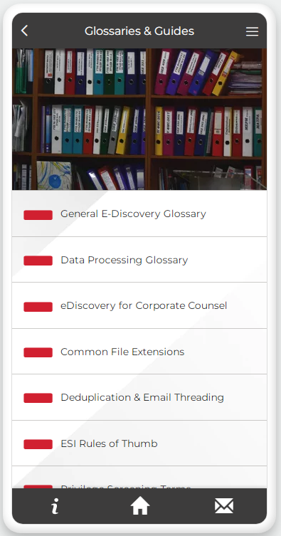
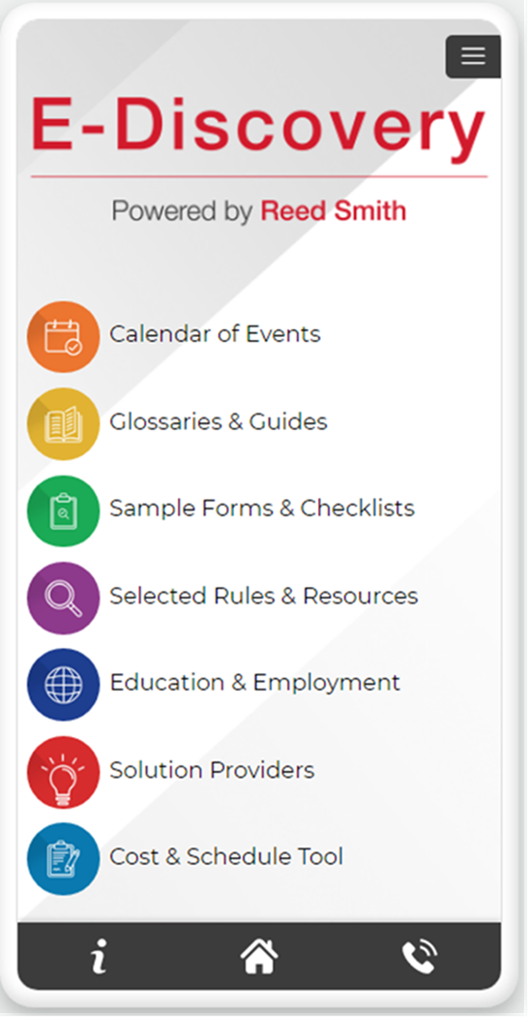
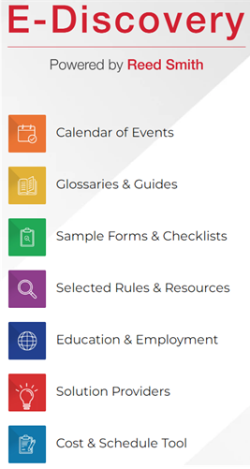
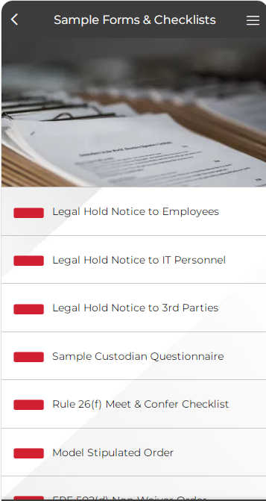


Slide 53
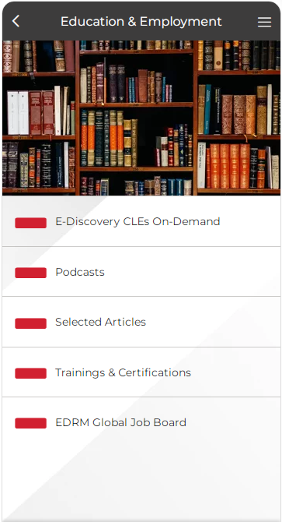
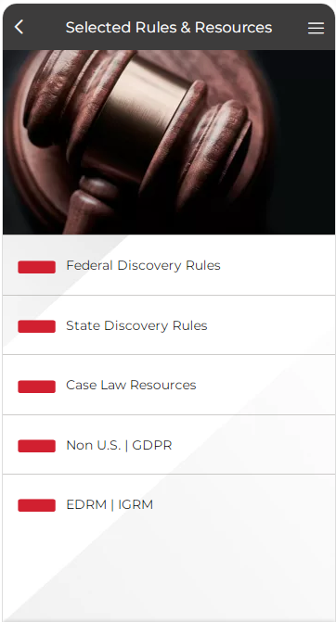

Slide 54
National/Special E-Discovery Counsel
Consistent and defensible processes across cases
Cost minimization through reduced pricing
Advance attention to litigation readiness, including data minimization and optimizing legal holds
Implementing streamlined and efficient identification, collection, processing, review, and production procedures
Focused attention on e-discovery issues
Minimizing risks and maximizing clout in e-discovery battles
Developing and maintaining credibility with judges and regulators
Encompass e-discovery practice as part of a cost-effective and winning discovery and litigation strategy

Slide 55
Thank You!
David Cohen
drcohen@reedsmith.com
412-288-1098
Michelle Mantine
mmantine@reedsmith.com
412-288-4268
Please feel free to reach out with any questions!

