Slide 1
The Future of Restrictive Covenants:
How the Landscape of Non-Compete Agreements is Changing in Today’s Economy
February 18, 2022

Slide 2




Presented by
Bill Foster
Katie Walter Deuben
Katie Towery
Shareholder
Littler Greenville
bfoster@littler.com
Assistant General Counsel
ScanSource
Attorney
Littler Greenville
ktowery@littler.com

Slide 3
Why Do Restrictive Covenants Matter?
The current labor shortage
Impacts on your company’s hiring practices
The costs of not having them
  Roughly 16-18% of American workers are subject to non-compete agreements
  $5 trillion = value of trade secrets to American business
  $160-$480 billion = cost of trade secret theft
    79% in finance, marketing, and sales
    56% of perpetrators did not believe they did anything criminal

Slide 4

Are Your Agreements Worth the Paper They’re Written On?
Remember the goals
  Deterrence
  Protection
  Conciliation
Interests to be protected
  Unfair competitive advantage
  Company strategies
  Customers and good will
  Confidential information/trade secrets

Slide 5
What are “Trade Secrets”?
S.C. Code Ann. § 39-8-20(5)
  “Information including, but not limited to, a formula, pattern, compilation, program, device, method, technique, product, system, or process, design, prototype, procedure, or code that:
  derives independent economic value, actual or potential, from not being generally known to, and not being readily ascertainable by proper means by the public or any other person who can obtain economic value from its disclosure or use, and
  is the subject of efforts that are reasonable under the circumstances to maintain its secrecy
  A trade secret may consist of a simple fact, item, or procedure, or a series or sequence of items or procedures which, although individually could be perceived as relatively minor or simple, collectively can make a substantial difference in the efficiency of a process or the production of a product, or may be the basis of a marketing or commercial strategy. The collective effect of the items and procedures must be considered in any analysis of whether a trade secret exists and not the general knowledge of each individual item or procedure.”

Slide 6
What Are “Trade Secrets”?
Common law “six factors” for determining trade secret status
(usually also part of UTSA / SCTSA analysis):
  The extent to which the information is known outside the business
  The extent to which the information is known by employees and others involved
  in the business
  The extent of measures taken to guard the secrecy of the information
  The value of the information to the business and to competitors
  The amount of effort or money expended in developing the information
  The ease or difficulty with which the information could be properly acquired or duplicated by others

Slide 7
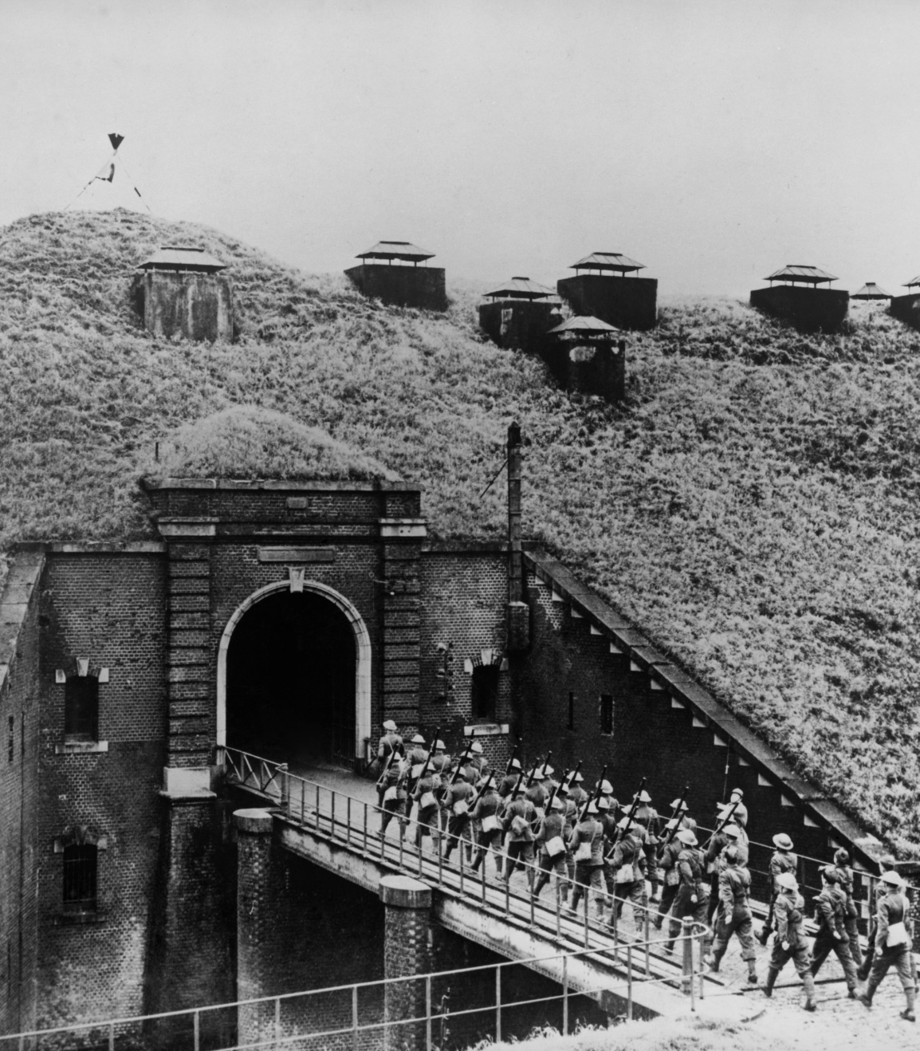
Multiple Lines of Defense
It’s all about deterrence
What are you trying to protect?
How many ways can you protect it?

Slide 8
How to Prepare an Enforceable Non-Compete
One size does not fit all
Consideration
Scope (deterrence vs. enforceability)
  Geographic reach
  Temporal duration
  Activities prohibited
State-specific reformation options are a key consideration
Forum and choice of law
How and when to present to employees

Slide 9

Non-Disclosure Agreements
What makes an effective NDA?
  Specificity
  Affirmative obligations to return information
  Surrender of devices for inspection
Hugely valuable in litigation

Slide 10

Non-Solicitation Agreements
Comparative advantages:
  Path of lesser resistance in litigation
  Better-positioned for enforcement for
  longer duration
  Align most closely with protection
  objectives in service sector
Strategic drafting:
  Should define specifically what actions
  are prohibited
  Tailor to clients that employee did business with or received confidential information about

Slide 11
Tips for Handling Departing Employees
Conduct exit interview
Return all confidential and proprietary information, computers, mobile devices and other Company property
As appropriate, conduct forensic review of computer and e-devices
Special challenges when confidential / proprietary information is stored on personal computer
  Determine best method for obtaining computer and electronic devices
  Conduct review through IT department or consultant
  Generally allow any personal data to be removed & kept by employee
  If information is removed or deleted by employee, verify by inspection and/or obtain written statement of compliance
  Note: can be especially challenging if involuntary discharge, and even more challenging if a remote employee
Remind employee of confidentiality agreement or policy, and any noncompete or other restrictive
covenant obligations
  Provide employee with copy

Slide 12

Current Trends
President Biden’s Executive Order
  Encourages the Federal Trade Commission to “curtail the unfair use of non-compete clauses and other clauses or agreements that may unfairly limit worker mobility”
  Little immediate impact on workers

Slide 13
Current Trends
State actions
  Illinois: Non-competes banned for workers earning less than $13/hour
  Utah: One-year max duration on most non-competes
  Alabama: Presumptive limits of 18 months on non-solicitations / 2 years for
  non-competes
  California: Prohibits other-state forum selection provisions for California employees
  Massachusetts: Statutory temporal limitations
At least 15 states have passed legislation limiting the use of
non-compete agreements in some way

Slide 14

Implications for Multi-State Operations
Ensuring enforceability across all company locations
Choice of Law
Forum Selection

