Slide 1
ACC SOUTH CAROLINA CHAPTER ANNUAL MEETING
SEPTEMBER 16, 2021

Slide 2
Witness Preparation

Slide 3
Two fundamental Truths
Decision-Makers Judge Witness Credibility
It’s Not Just What We Say…
It’s HOW We Say It

Slide 4
SC MODEL Charge
CREDIBILITY OF WITNESSES
It is your duty under your sworn obligation as jurors to pay close attention to these witnesses, to observe these witnesses, to listen to these witnesses.

Slide 5
SC MODEL CHarge
Continued
It is imperative that you should at all times listen and observe carefully what you hear and see.

Slide 6
SC MODEL CHARGE (Experts)
Their opinions and deductions from the evidence before you and their judgments and opinions do not preclude yours.

Slide 7
It’s not just what We say
Q: Honey, does this dress make me look fat?
A. Umm…

Slide 8
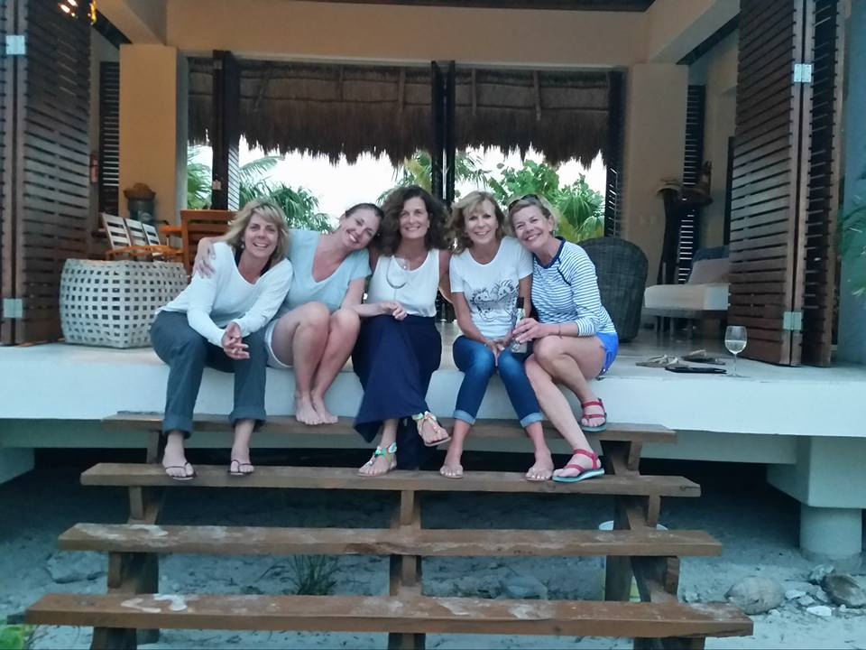
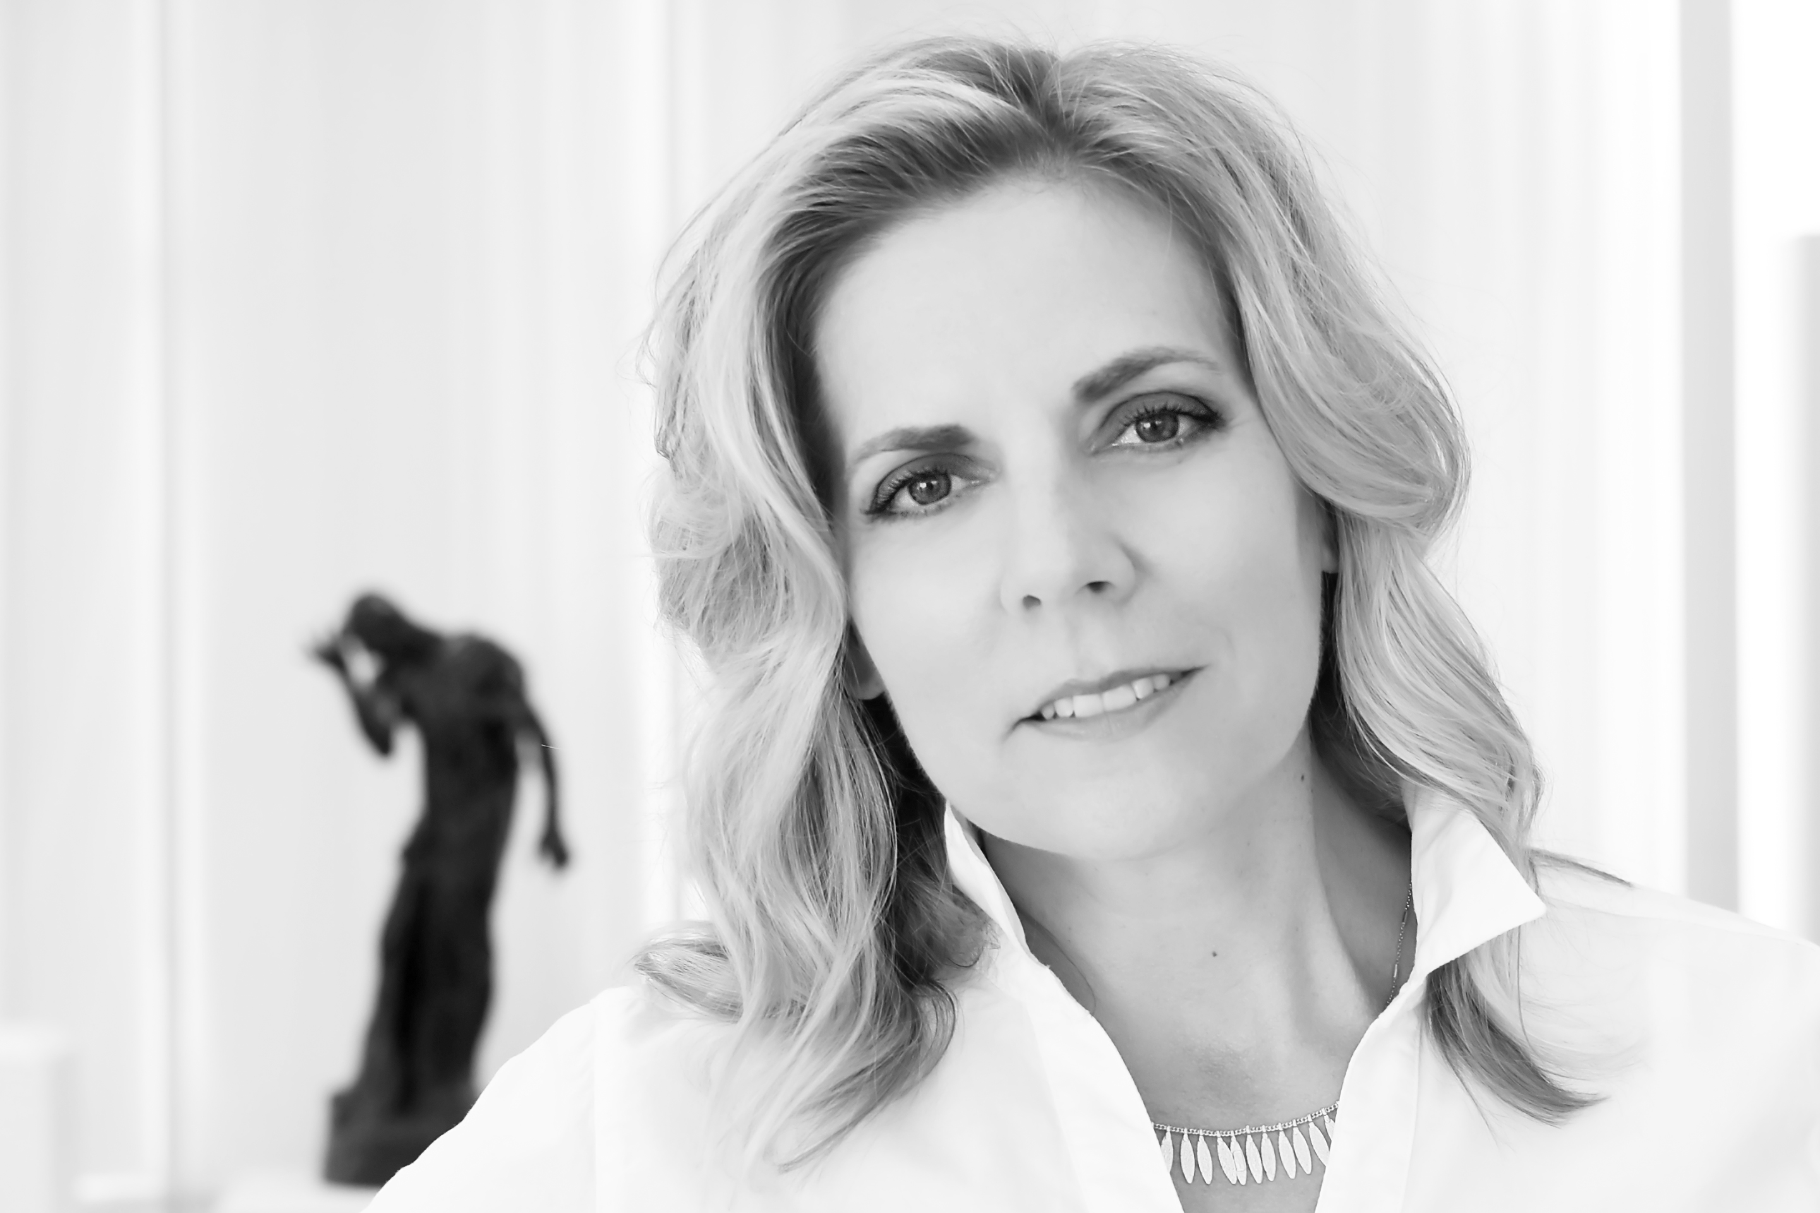
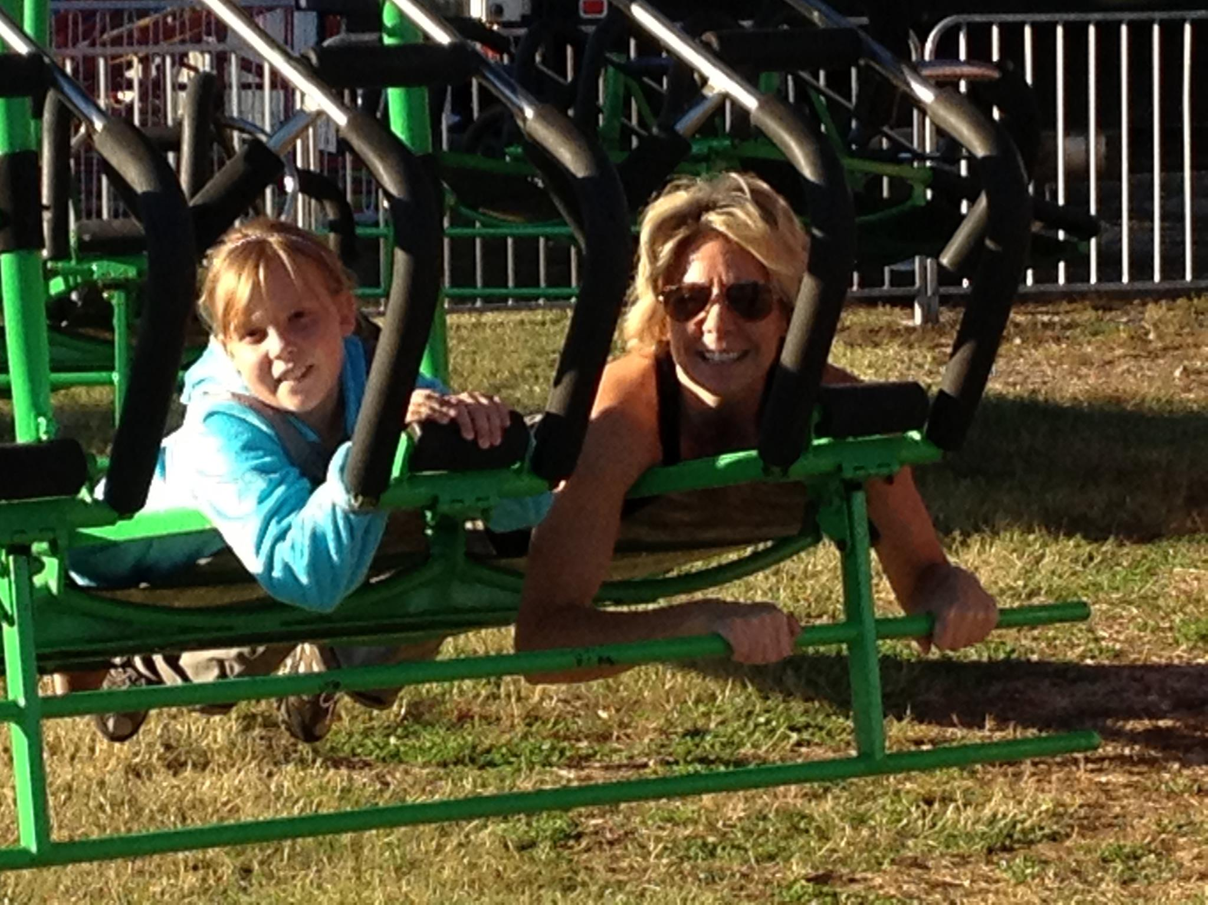
The Worst advice…
Relax…
Be Yourself

Slide 9
Relax, Be Yourself…
“You asked me that question earlier.”
“That is immaterial and irrelevant.”
“What did I just say? Holy Mackerel, Man!”
“Object to form.”

Slide 10
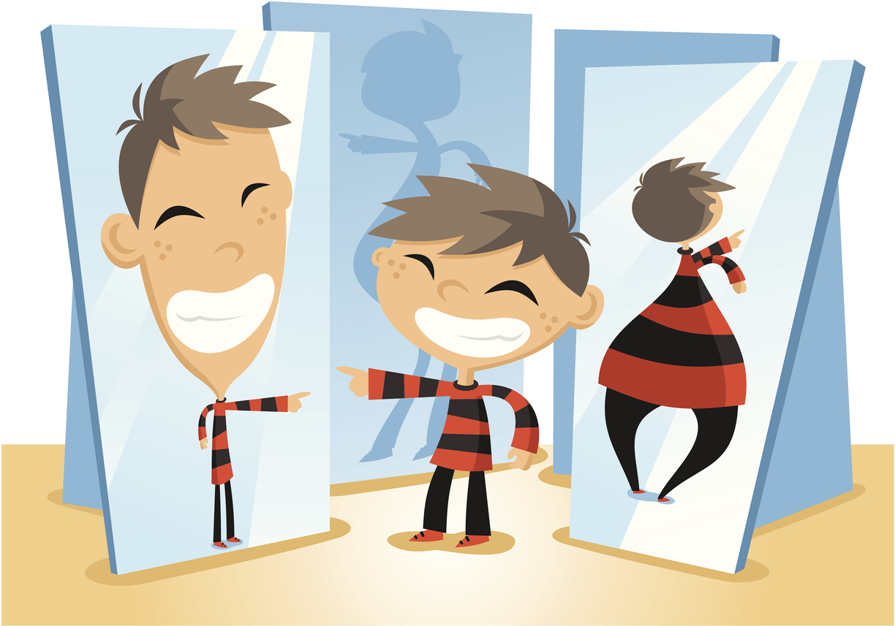
More Bad advice…
ALL
YOU HAVE TO DO…is tell the truth

Slide 11

Key Components of credibility
Trustworthy: Reliable, Reasonable, Consistent, Objective, Fair, Helpful
Competence: Expertise, Knowledge, Credentials, Acheivement, Experience, Authority
Likeability: Teaching Skills, Warmth, Manners, Listening Skills, Temper, Humor, Empathy
Trustworthiness
Competence
Likeability
?

Slide 12
The Real Killer?
INCONSISTENCY

Slide 13
Impression Formation

Slide 14
Back it up: Unpacking the witness
Key Questions to Ask/Consider:
Tell me about your previous experience as a witness.
What do you consider your role in this case to be? How do you compare to other witnesses?
What are your strengths?
What are your weaknesses?
What are your fears about testifying?

Slide 15
Back it up: unpacking the witness
Key Questions to Ask Your Witness:
What do you most want to teach or explain to the jury?
What do you most want the jury to know about you?
What do you have to say that will help the case?
What do you have to say that will hurt the case?
What kind of help do you need or want from your attorney?

Slide 16
GivE Your WITNESS Feedback
Practice in Q&A Mode
Be specific
Ask witness what he/she needs from you
Give homework

Slide 17
Jury Research
Decision-Maker
⋀
Focus Groups / Mock trials

Slide 18
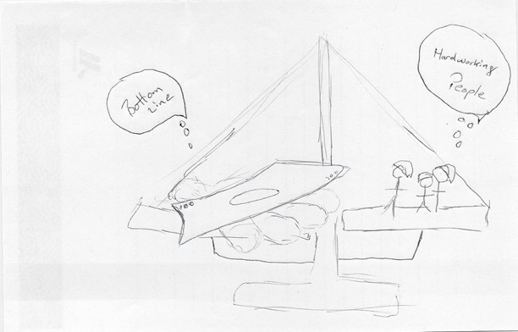
What Is this Case About?

Slide 19
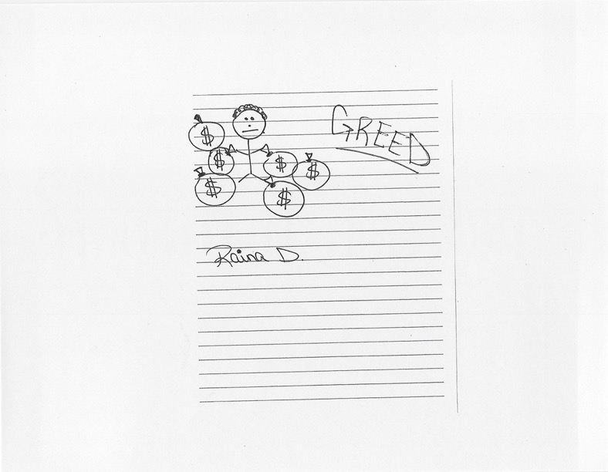
What Is this Case About?

Slide 20
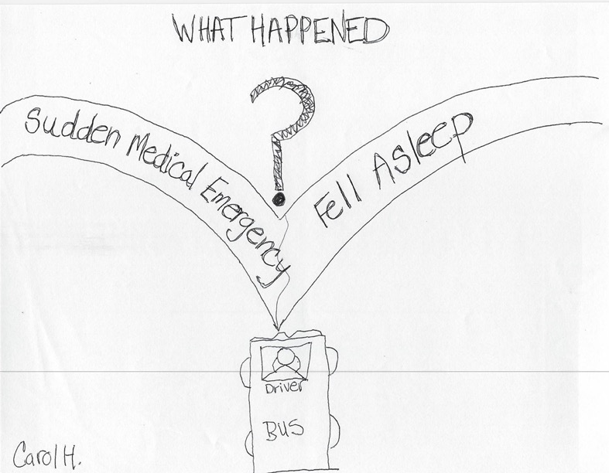
What Is this Case About?

Slide 21
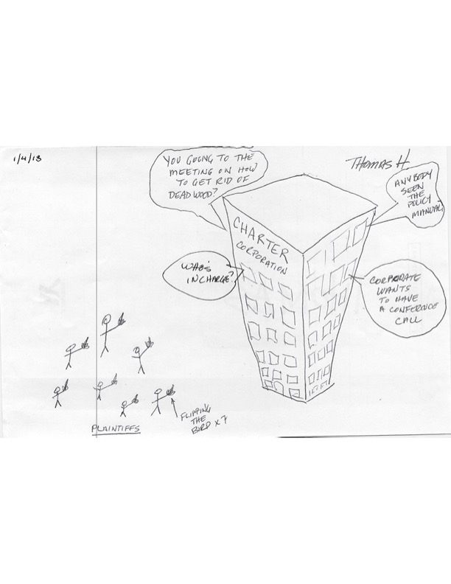
What Is this Case About?

Slide 22
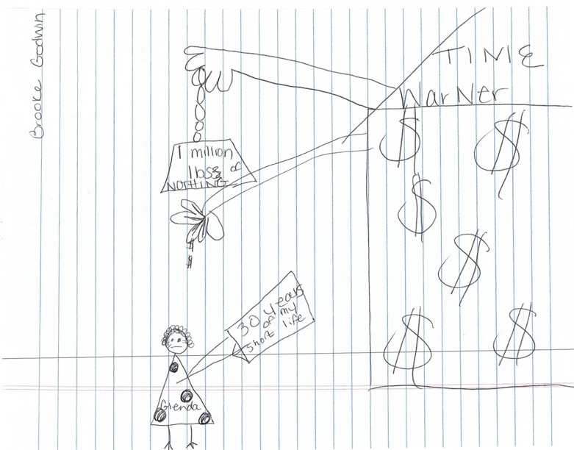
What Is this Case About?
Company

Slide 24
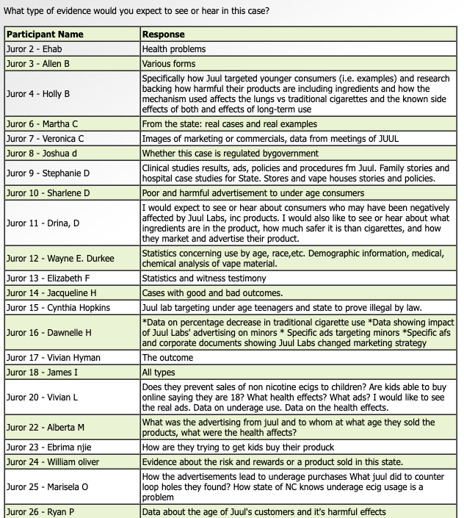
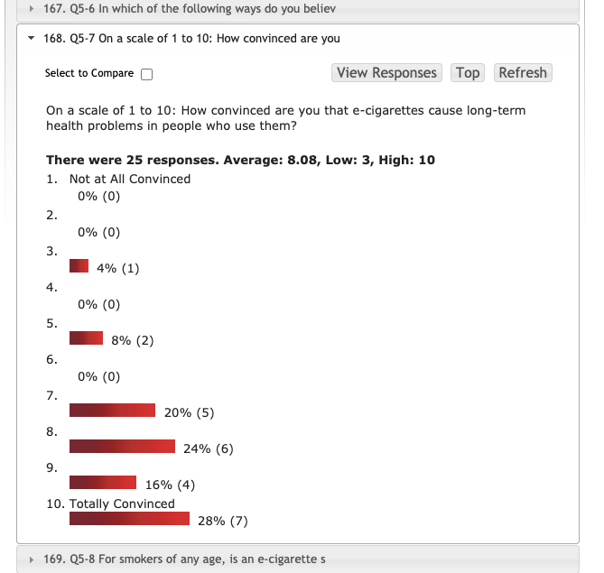
Real-Time Results

Slide 25
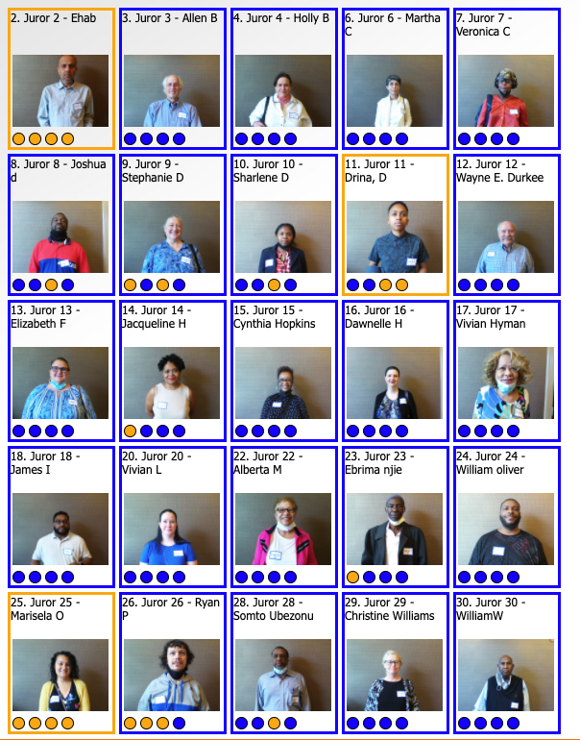
Real-Time Results

Slide 26
Results: Liability

Slide 27
Results: Damages

Slide 28
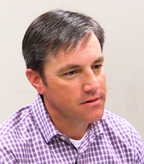
Results: Witness Evaluations
business-like | racist, ageist (from quotes), honest about Anne's character, pays employees ridiculously well, and rewards success in the company |  | cocky; do you think Ms. G wanted your job?
seems to be saying what he needs to say | seems honest and open | nice guy | fair, honest, level-minded
son in law of D, respectable | protective of company and his position | stretch the truth, one man for himself; why do you think it was okay to call women girls, why do you think Ms. G wasn't terminated sooner?
modest, honest, simple | good witness | nice, can't be honest because of family | even, straight-forward
stand-up guy? | honest, calm, open, he seems to be answering the questions completely | nervous, mindful of self and surroundings, generally normal guy | arrogant, seemed laid back, didn't say a lot felt like he was owed something
Straight-forward, presents himself well, positive | honest (in the middle) | appears to be open, forthcoming | unfair
neutral | relaxed and forthcoming | serious, energetic, lively, talkative, expressive, intelligent, jittery. B and D do a lot of "ums" and he looks away a lot, not very trustworthy. Has a very personal stake in the case that I can't fully view his statements as unbiased; he's got a nice smile and he's handsome but I'm unsure if he can be trusted
Jonathan B
What is your first impression of Jonathan B?

Slide 29
Results: Witness Evaluations
What is the overall effect of Jonathan B’s testimony in this case?
Helps Plaintiff |  |  |  |  | Helps Defense
3 | 2 | 1 | 0.2 | 1 | 2 | 3
How would you rate Jonathan B on each of the following qualities: Circle one number in each row: 1 = Very Low / 5=Very High
a. Competence (Knowledge, Training, Experience, etc.) |  |  |  | 3.8
b. Trustworthiness (Reliable, Fair, Honest, etc.) |  |  | 3.4
c. Likability (Warmth, Humor, etc.) |  |  | 3.4

Slide 30
Results: Witness Evaluations
What three words would you use to describe Jonathan B:
entitled, protected, homey | liar, unfair, unlikeable | easy-going, simple | no conclusion
believable, clean-cut | likeable, fair | business savvy, ageist, excellent speaker | open
good witness for plaintiff | smooth, responsive, slick | believable | talkative, energetic
yes-man, committed to D, company man | successful thankful, surprised, tired | friendly reluctant, reserved, specific | very p.c., president, unfair, non-trusting
loyal | truthful, collected, competent | professional (2) | honest (5)
fake, no eye contact, sexist, hypocrite | non-chalant, unemotional, matter-of-fact | calm, relaxed, articulate | embarrassed
forthcoming | smart (4) | arrogant (3)

Slide 31
Report & RecomMendations
Case-Specific Strategies for:
Themes
Jury Selection
Opening Statement / Order of Proof
Witness Examinations (Direct & Cross)
Witness Preparation
Demonstrative Exhibits

