Slide 1
Class Actions and Overlap with Regulatory Compliance
16th Annual Nutrition Law Symposium
Rend Al-Mondhiry, Partner
Matthew Orr, Partner
Amin Talati Wasserman, LLP

Slide 2

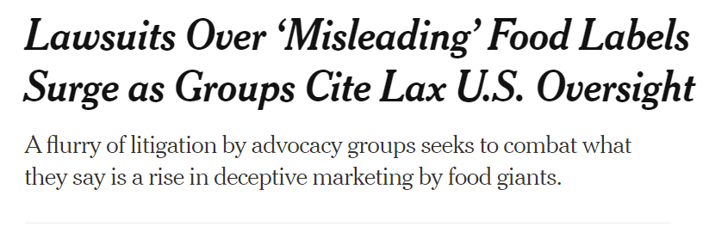
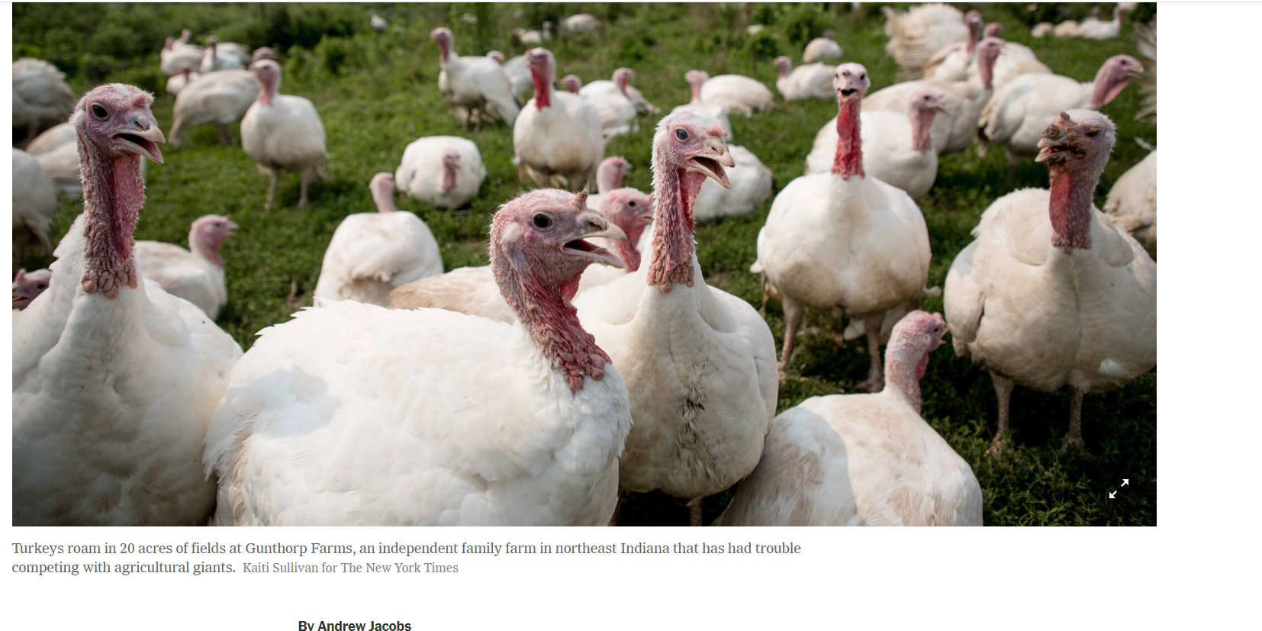
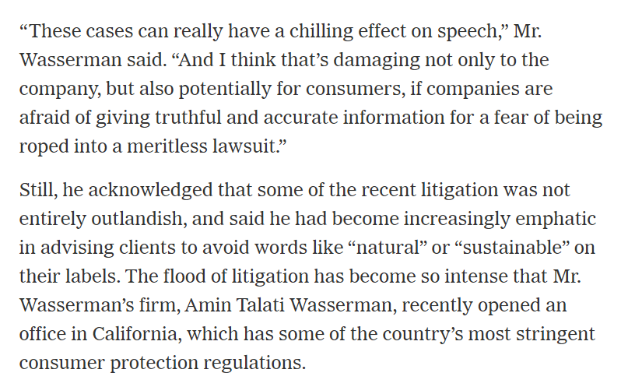


Slide 3



Class Actions Implicating
Regulatory Compliance
Rise in cases, especially those implicating FD&C Act compliance
Even where labeling is compliant, claims may still be misleading
“Reasonable consumer” standard must be considered

Slide 4
Reasonable Consumer Standard
Moore v. Trader Joe’s Co., No. 19-16618 (9th Cir. July 15, 2021).
“100%” in the “100% New Zealand Manuka Honey” label could be read in multiple ways: “100% could be a claim that the product was 100% Manuka honey, that its contents were 100% derived from the Manuka flower, or even that 100% of the honey was from New Zealand.”
In order to state a claim, plaintiffs must prove "more than a mere possibility that the seller's label might conceivably be misunderstood by some few consumers viewing it in an unreasonable manner. Rather, the reasonable consumer standard requires a probability that a significant portion of the general consuming public or of targeted consumers, acting reasonably in the circumstances, could be misled.“
The Court reinforced the importance of considering context:
  (1) the impossibility of making a honey that is 100% derived from one floral source;
  (2) the low price of Trader Joe’s Manuka Honey; and
  (3) the presence of the “10+” on the label.

Slide 5
Reasonable Consumer Standard
Moore v. Trader Joe’s Co., No. 19-16618 (9th Cir. July 15, 2021).
Key Takeaways:
  Consumers do not interpret labels to mean the impossible;
  Consumers must consider all the information available to them, including context; and
  FDA guidelines can support a “literally true” defense
“[W]here plaintiffs base deceptive advertising claims on unreasonable or fanciful interpretations of labels or other advertising, dismissal on the pleadings may well be justified.”

Slide 6
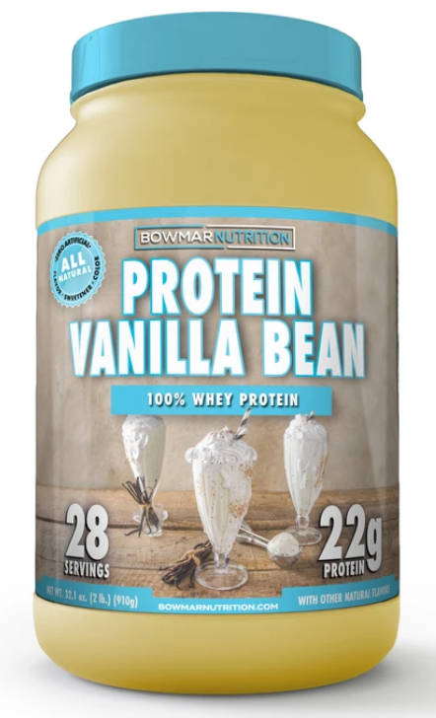
Nutrient Content Claims
Specific regulatory requirements must be met in order to make nutrient content claim;
  21 CFR Part 101, Subpart D
  Are consumers actually deceived?
“Zero” and “No Added Sugar” claims
  Challenges where label lacked mandatory disclosure that product is not a low-calorie food
  No harm, no foul? Context may matter.
Protein claims
  Challenges to protein content claims, alleging claims are false and misleading
  Based on use of nitrogen method grams vs. PDCAAS corrected grams; FDA regs allow both

Slide 7
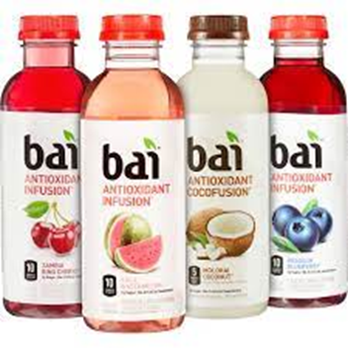

Flavor & Color Claims
Other Nutrient Claims
  FDA composite sampling requirements 21 C.F.R. 101.9(g)(2)
  Pleading v. Proving
“No artificial flavor”
  Primary targets: malic acid, citric acid; added for technical function but may still affect flavor
Vanilla
  Complaints allege “vanilla” is misleading unless product complies with FDA’s standard of identity
  Largely unsuccessful

Slide 8
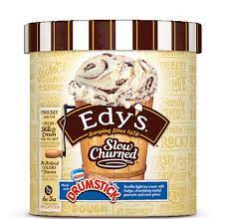
Flavor & Color Claims
Fruit flavor claims
  Variant on Vanilla suits
  Recent Celsius case gets past pleading stage
“No artificial colors”
  CPG Sect. 587.100: regardless of source, added color is “artificial”
  FDA: “…beet juice, paprika, turmeric, and saffron are not artificial colors per se.” 38 Fed. Reg. 20718, 20719-20 (Aug. 2, 1973)

Slide 9
Ingredient Permissibility &
Product Classification
Products are not “dietary supplements” where no NDIN was filed for the ingredient
  Rosas v. Hi-Tech Pharmaceuticals, No. CV 20-00433-DOC-DFM, 202 U.S. Dist. LEXIS 164565 (C.D. Cal. July 29, 2020)
CBD supplement/food challenges
  Ex. Dasilva v. Infinite Product Co., No. 2:19-cv-10148 (C.D. Cal. Mar. 3, 2021)
Cases dismissed, or stayed, on primary jurisdiction grounds
  Other CBD suits based on failure to meet label content claims proceeding; ex. Miguel Rodriguez v. Just Brands USA, Inc., et al., 2:20-cv-04829 (C.D. Cal. Sept. 24, 2020).

Slide 10
Structure/Function Claims
Allegation that claims such as “support cardiovascular health,” “promote heart health” violate false advertising laws
  Dachauer v. NBTY, Inc., 913 F.3d 844 (9th Cir. 2019)
  Struck down on preemption grounds: “Plaintiff disagrees with the federal statutory scheme for dietary supplements, but we cannot accept his invitation to upend it”
More recently, attacks on placement of DSHEA disclaimer
  Ex. Barnes v. Iovate Health Sciences U.S.A. Inc., No. 5:21-cv-04978 (N.D. Cal. June 28, 2021)
  Citing non-compliance with 21 CFR 101.93(d)

Slide 11
Structure/Function Claims
Greenberg v. Target Corp., No. 19-16699, 2021 WL 116537 (9th Cir. Jan. 13, 2021)
Allegation: “helps support healthy hair and skin” claim for biotin supplement misleading, because majority of population obtains enough biotin from diet
Ninth Circuit affirmed summary judgment in favor of defendant
  Plaintiff did not dispute biotin supports healthy hair and skin
Similar to Dachauer, plaintiff cannot impose a higher standard on s/f claims
  “Simply put, manufacturers may make structure/function claims about a nutrient’s general role on the human body without disclosing whether the product will provide a health benefit to each consumer”

Slide 12
Mitigating Risk
Review labeling and marketing materials from the vantage point of the “reasonable consumer”
  Not merely technical compliance
Are all implied claims or messages substantiated?
  Consider all possible interpretations of the product labeling as a whole
Where FDA has not made a final determination, primary jurisdiction and preemption arguments may be useful

Slide 13
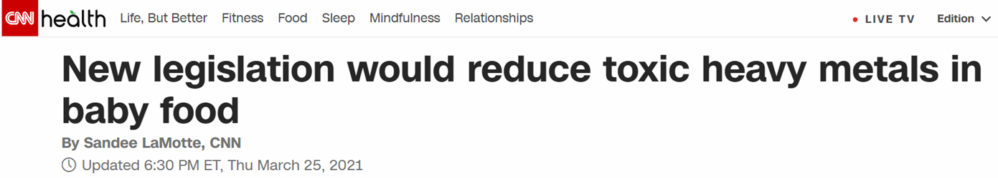
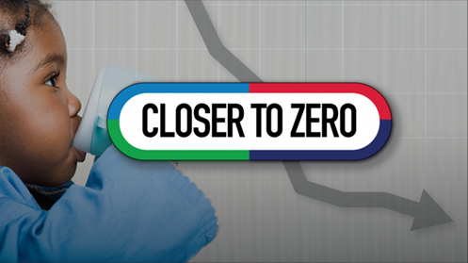

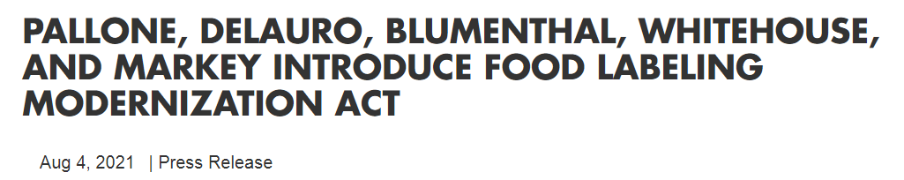
Federal Legislation

Slide 14
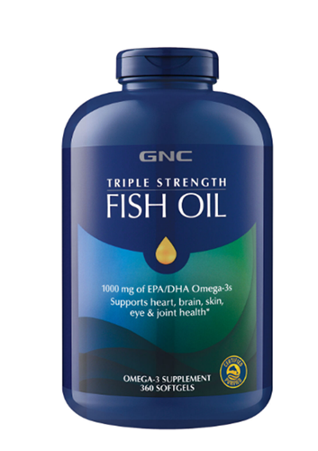


Class Action Trends to Watch
Trans-esterified “fish oil” not actually “fish oil”
  “Irrevocably transformed”
Geographic origin claims
Slack Fill Litigation
Continued focus on “green” claims
  Sustainability, recycling claims
  FTC updates to Green Guides?
More attacks on dietary supplement claims

Slide 15
Thank You!
Rend Al-Mondhiry
Rend@AminTalati.com
202.918.7852
Matthew Orr
Matt@AminTalati.com
213.985.7219

