Slide 1

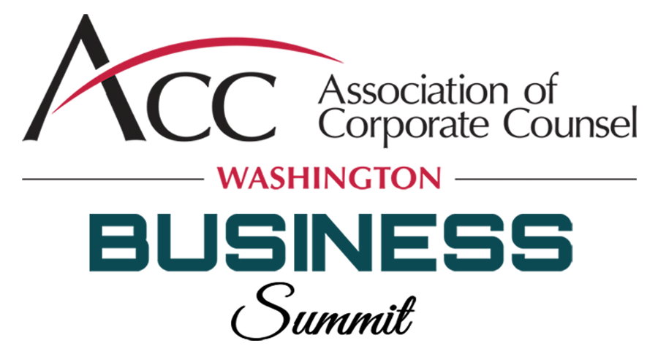
High Risk Compliance Pitfalls in Federal Government Contracts: How to Spot, Avoid, and Mitigate
September 23, 2021

Slide 2


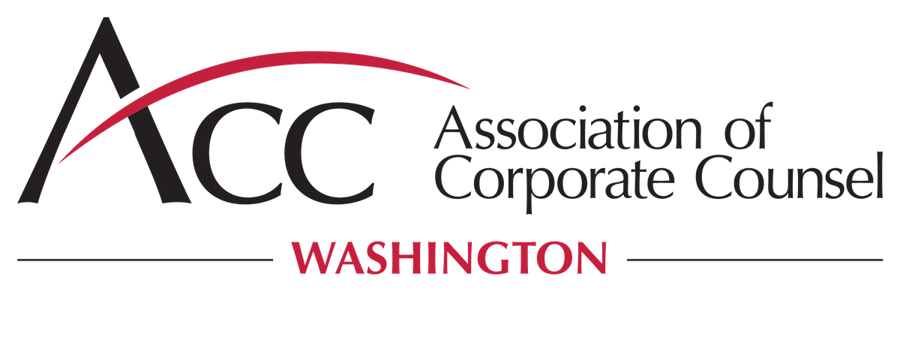
Speakers
Adam Lasky Kelli Hooke
Partner & Co-Chair Senior Corporate Counsel, Legal Compliance
Government Contracts Public Sector Compliance
Seyfarth Shaw LLP T-Mobile

Slide 3
Agenda
Vexing and High-Risk Compliance Problems
  Service Contract Act
  Supply chain
  Cybersecurity
  Mergers & Acquisitions
Actions Once Non-Compliance is Reported or Suspected
  Mandatory disclosures
  Internal investigations
  Responding to SDOs

Slide 4
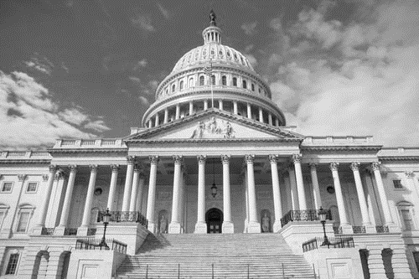
Service Contract Act

Slide 5
What’s Service Contract Act
Service Contract Labor Standards Act
  aka McNamara-O'Hara Service Contract Act or SCA
Prevailing wage law applicable to federal service contracts
  Contract predominantly performed by service employees
  Wages
  Benefits

Slide 6
Why is SCA High Risk?
Amongst the most complex statutory/regulatory scheme in GovCon
Unlike construction contractors, service contractors aren’t used to prevailing wage laws in state/local government contracting
Fluctuating levels of enforcement based on White House political party and some rules are counter-intuitive
Small violations can have enormous penalties
Risk of major contract financial losses if bidding without understand SCA
Much higher suspension & debarment risk
  “Present responsibility” not a viable defense
False Claims Act risk

Slide 7
Common SCA Pitfalls
What to Watch Out For
Not recognizing that the contract is covered by SCA
  Or not objecting pre-bid to inclusion of SCA clause to a services contract that shouldn’t be covered by SCA
Using incorrect WD or incorrect WD job classifications
Counting fringe payments that aren’t “bona fide” fringe (many health and pension plans don’t meet SCA requirements, or must receive specific DOL approval)
Failing to cash out remaining vacation at end of year
Overpayment of H&W benefits (for work above 40/2080 hours)
Failing to flow-down SCA requirements to subcontractors (joint/several liability)
Not adequately/tracking segregation of employee time between SCA and Non-SCA covered work
Failure to understand or account for successor-in-interest CBA rules
Failure to price multi-year option contract labor in accordance with SCA principles
WD inaccurate and workforce not unionized

Slide 8
Supply Chain
Best Practices and NIST Standards
A Multi-Disciplinary Endeavor
Notes:
What is it?
Why is it high risk?
Penalties
Why is it more likely to go wrong
Common Pitfalls

Slide 9
Supply Chain
Threat Groups
Counterfeit Parts/Tampering. Insertion of counterfeits or tampering with supplier components, products, or services in the supply chain.
Cybersecurity. External attacks on suppliers’ operations and capabilities, exploit vulnerabilities, or plant malware.
Internal Security Ops & Controls. Weaknesses in internal supplier processes lead to weaknesses in basic cyber hygiene, user awareness, mishandling of information.
End-to-End. Environmental, geographical, regulatory compliance, workforce, and other vulnerabilities to the confidentiality, integrity, or availability of supplier information, products, or services.
Insider Threat. Vulnerability of the supplier to attack from trusted staff and partners within the organization.
Economic. Issues with financial viability of suppliers and potential impact to supply chain integrity resulting from failure of key supplier.
Notes:
What is Supply Chain or Supply chain risk management? Well it is what it sounds like. It is the managing of all the things that could go wrong with your supplies. And it can create compliance risks for government contractors in that the government often has a say on what vendors you use, what countries you source from, and how you ensure the goods that end up in the government’s hands have not been tampered with.
The supply chain are all those things that you procure in order to supply goods and services to your customer. They can be hardware, software, services, or any combination of the above.
Increasing recognition of the risks to the supply chain (and new evolving risks) has led to the emergence of groups like the Dept. of Homeland Security’s ICT task force, which T-Mobile was a part of. Knowing these common threats allows companies to proactively take steps to mitigate risks.
And as you can see SCRM is a multi-disciplinary practice.

Slide 10
Risk: A Lot to
Manage
Type of Labor
  Combating trafficking in persons
  Certification regarding knowledge of child labor for listed end products
Type of Equipment
  Prohibition on contracting for hardware, software, and services developed or provided by Kaspersky Lab
  Sec. 889 prohibition on covered Telecom
Type of Vendor
  Prohibition on using suspended or debarred companies
  Bonus: The always complicated BAA and TAA requirements
Notes:
The Federal Acquisition Regulation also has a lot to say about supply chain and the vastness of the subject matter can make it complicated. Some of the FAR rules will be very familiar, and others are new and have caused significant waves in the supply chain.
Why is it high risk?
Having a strong supply chain is good for business, but what makes it high risk for government contracting. Mainly it is because the government not only cares that it is getting the requirement met, but that it is being met by a good/service in the manner they dictated.
Penalties
The “implied false certification theory,” providing that when a defendant submits a claim it impliedly certifies compliance with all conditions of payment, can be a basis for liability under the False Claims Act (FCA), at least where two conditions are satisfied: (1) the claim does not merely request payment, but also makes specific representations about the goods or services provided; and (2) the defendant’s failure to disclose noncompliance with material statutory, regulatory, or contractual requirements makes those representations misleading half-truths; abrogating U.S. v. Sanford–Brown, Ltd., 788 F.3d 696. 31 U.S.C.A. § 3729(a)(1)(A).
FCA can be civil and criminal
Why is it more likely to go wrong
Supply chain matters are more likely to go wrong than others because it is too easy to make assumptions. A lot of the requirements go after very specific types of bad acts that you may assume your vendor would not do. However, you need to have made a reasonable effort to know before you certify for your company.
The Federal Acquisition Regulation also has a lot to say about supply chain and the vastness of the subject matter can make it complicated.
Here are some examples of FAR compliance requirements that are common in even commercial items contracts.
There are specific requirements with in the FAR that not only prohibit certain actions but require an affirmative action by the company. Combating Trafficking in Persons is one of them. All solicitations and contracts are required to have 52.222-50 which state: that the contractor will notify its employees of the prohibition, that appropriate actions will be taken against employees or agents that violate the rule. And actually take action for known violations to include notice to the CO and OIG.
And there is an alternative clause for when the contract will be performed outside of the united states and the CO has notice of specific directives or notices regarding combating trafficking of persons. Additionally, 52.222-56 requires an actual compliance plan if it is possible that at least $550,000 of the value of the contract will be performed outside the US and it is not for COTS.
Another is important for those receiving supplies or work with OEMs overseas. There are locations that the Gov considers high risk for child labor making identified products. There is a SAM certification that you may choose to certify in your registration or you can certify with each contract that either 1) you do not supply identified products that have this concern, or that you supply those products AND the company “has made a good faith effort to determine … and is not aware of any such use of child labor”.
Then, there are products that you just cannot use. Contractors cannot provide any hardware, software, or services developed or provided, in whole or in part, by Kaspersky Labs. And Sec 889 gives a wider prohibition with a larger selection of Chinese telecom equipment (Huawei and ZTE and all the affiliates). This prohibition is not only on the provision to the federal government; it prohibits use anywhere in its company. The term “use” is not defined and the rule requires a reasonable inquiry into whether there is use. There are exceptions (roaming and backhaul) but they are quite limited. Sec 889 was like a giant earthquake in federal government compliance. Though the government had been talking about it for a while, many were not expecting such a wide sweeping prohibition and were caught scrambling.
The last two items I am highlighting on this list concern knowing where your goods are coming from. Do you know whether your supplier is “responsible” ? Are you permitted to use them in supporting government contracts? How do you know? Are you running diligence searches? Asking for self certification? How do you periodically check?
And do you know the BAA or TAA requirements for your contract? There were updates and statements by the Trump administration saying this aspect of government contracting was going to become more strict. And that has not changed with the Biden administration. There will be more efforts to bring manufacturing to the US, or at least to the Americas.
Common Pitfalls
Not conducting due diligence on potential vendors
Assuming your vendor would not conduct these activities. We want to believe that modern slavery is not a thing or at least at least believe we are not contributing to it. And when you are a government contractor, you may be required to have a plan to combat it.
Thinking a certification or a contract clause of “vendor shall not” is enough. Maybe it is for certain vendors, but this needs to be a risk based assessment that has demonstrable facts.
In the FAR there are plenty of requirements for cyber security and prohibitions from using software and hardware from particular companies. Thus, the FAR has ICT supply chain requirements. It also has requirements around non-cyber related SCRM activities.

Slide 11
National Institute of Standards & Technology
Special Publication 800-161
SCRM Practices for Federal Information Systems and Organizations
ICT guidance on supply chain risk management
  19 Control Facilities
  250 Security Controls
NIST SP 800-161 Security Control Families
Access Control (AC) |  | Physical and Environmental Protection (PE)
Awareness and Training (AT) |  | Planning (PL)
Audit and Accountability (AU) |  | Program Management (PM)
Security Assessment and Authorization (CA) |  | Personnel Security (PS)
Configuration Management (CM) |  | Provenance (PV)
Contingency Planning (CP) |  | Risk Assessment (RA)
Identification and Authentication (IA) |  | System and Services Acquisition (SA)
Incident Response (IR) |  | System and Communications Protection (SC)
Maintenance (MA) |  | System Information Integrity (SI)
Media Protection (MP)
Notes:
The federal government is becoming even more interested in the larger system of supply chain risk management – especially when it comes to supplies with a cyber element. The National Institute of Standards and Technology has created, and recently revised a voluntary standard that sets up best practices for companies. And some government agencies are starting to require a SCRM plan based on this standard during the RFP process. Using some of this guidance can be helpful in creating policies and processes that mitigate the risks of non compliance
The key actor in standardizing ICT SC approaches is the National Institute of Standards and Technology. In particular, SP 800-161 provides guidance to ICT organizations, on identifying, assessing, and mitigating ICT supply chain risks at all levels of their organizations. The document contains 250 security controls, broken into 19 families, and are globally recognized best practices.

Slide 12
Cybersecurity
Notes:
What is it?
Why is it high risk?
Penalties
Why is it more likely to go wrong
Common Pitfalls

Slide 13




Threat Events Across the ICT Life Cycle
Threat Source + Vulnerability = Threat Event
Development & Production
Acquisition & Deployment
Disposal
Tampered components are inserted during production leading to system failure and spread of malware
Counterfeits sold to customers; counterfeit components sold to companies that are then inserted into products
Improper security and cyber sanitation processes cause sensitive data loss
Design
Distribution
Operation & Maintenance
Unintentional design flaws lead to vulnerable mobile devices and data loss
Products tampered with or stolen during transport, leading to counterfeits and potential installation of malware
External actors attack security software and insert malicious code, which is then distributed to customers
Notes:
Information and communications technology has all the supply chain challenges mentioned earler and adds the complexity of cyber security. Putting ICT into the supply chain context reveals a complex, interconnected system that encompasses the entire life cycle of products, software, and services and includes a wide range of entities—including third-party vendors, suppliers, service providers, and contractors.
Cyber security is more than the buzzword of the day. The threat of hackers, insiders, and state actors disrupting your operations due to a cyber action is real. Cyber security is hard because it is both technical, and personal. It is about having the right technology solutions and technical people on your team. AND it is also about having basic cyber hygiene like your people choosing a password that is not 12345678 or ‘admin’.

Slide 14
Industry & Government Standards
NIST Standards
  800-53
  800-171
FAR and DFARS
Cyber Maturity Model Certification
Good old fashion cyber hygiene
Notes:
You may have heard of Cyber Maturity Model Certification (CMMC) and if you have, you are likely working toward one of the levels. I’m not going to tell you how to comply. But the challenge with complying in the cyber security space is that there are a lot of standards. There are various NIST standards that basically all feed of NIST 800-53 and there are all the FAR clauses that lean heavily on industry best practices and NIST standards. And then there is the CMMC; the DoD has not yet been able to get this program going at the pace it had hoped, but it, or something like it is coming. It is difficult to comply with because it is expensive. It is complicated. It requires a team effort.
Included in all these standards are controls ranging from how your building access is managed to how you ensure your SaaS vendors are complying with their own cyber security.

Slide 15
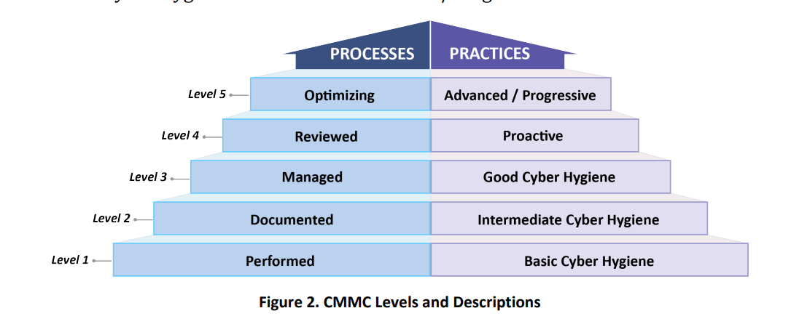
Cyber Maturity Model Certification
Notes:
Here, the risk of noncompliance could be a False Claims Act violation, like all the other certifications discussed earlier. If you have a clause that says your company will operate at a certain level of cyber security, not complying could be seen as a FCA violation. Multiple government agencies have come out strongly on this topic.
More dangerously, your operations could be shut down and business lost. It could be lost for the time you cannot operate, and your company's reputation could be harmed to the extent that you lose your customer’s trust.
And what can easily trip up your company is getting complacent in good old fashion cyber hygiene.
The primary pitfall I perceive in cyber security is complacency. People get tired of complex passwords. Are you scanning your network to see: what doesn’t belong there (software or hardware)? Are you exercising Least Privileged access? Or is it easier to just give the whole team access?

Slide 16
Mergers & Acquisitions
Buying or Selling a Government Contractor
Notes:
What is it?
Why is it high risk?
Penalties
Why is it more likely to go wrong
Common Pitfalls

Slide 17
Why is GovCon M&A High Risk?
Many GovCon M&A transactions require pre-approval or notice to the Government
Government officials charged with approval are slow and sometimes don’t understand approval rules
Some M&A attorneys don’t know the specific GovCon M&A rules (and very few know the SBA GovCon specific M&A rules)
Non-compliance can result in:
  termination of contracts
  ineligibility for future contracts
  disqualification from procurements with pending proposals
  bid protest risk
  False Claims Act liability
  Suspension or Debarment (including affiliates)
Purchasing a government contractor may turn your entire family of companies into a “government contractor” for certain regulatory compliance purposes
Rule of thumb for buyers – don’t assume the seller knows what is required

Slide 18
Novations
Anti-Assignment Act
Asset Sale (buyer purchases all or some of seller’s assets)
  Novation required
Stock Sale (seller is stockholder, and buyer purchases seller’s stock and sold company continues to exist under new ownership)
  Novation not required (though some Gov’t customers will dispute this)
  Notice (potential pre-approval if seller is status-based small business)
Merger (two entities combine into buying entity, the selling-entity dissolves --- seller’s contracts must be transferred “by operation of law”)
  Novation may be required
    Case law says Anti-Assignment Act doesn’t apply to mergers
    But the FAR says otherwise
      specifically lists “transfer of … assets incident to a merger or corporate consolidation” as a transaction requiring a novation agreement

Slide 19
Buying or Selling a Gov’t Contractor Involved In SBA Programs
Double the Red Tape
Affiliation/Certification rules
Present Effect Rule
Special Rules for Unrestricted MACs & Joint Ventures
Status-Held Small Businesses – Extra Restrictions
  Governing Agency Approval of Transaction
    8(a) Program Participants (or former Participants' still holding an 8(a) contract)
      SBA Pre-Approval [13 CFR 124.515]
      Contract transfers require SBA waiver – very limited authority to grant
    SDVOSB (CVE) – VA Post-Approval, 30 days [38 CFR 74.3]
  Direct Ownership (SDVOSB, WOSB, 8(a))

Slide 20
Impact on Pending Proposals
Procurement agency must consider “imminent and essentially certain” transactions in procurement evaluation that occur before award
Material Misrepresentation doctrine
May create a notice obligation
May create a basis/obligation for agency to eliminate proposal
Bid protest risk
Loss of standing to protest

Slide 21
Mandatory Disclosures
Notes:
What is it?
Why is it high risk?
Penalties
Why is it more likely to go wrong
Common Pitfalls

Slide 22
FAR 52.2003-13
The Contractor shall –
  Exercise due diligence to prevent and detect criminal conduct; and
  Otherwise promote an organizational culture that encourages ethical conduct and a commitment to compliance with the law
  The Contractor shall timely disclose, in writing, to the agency, Office of the Inspector General (OIG), with a copy to the Contracting Officer, whenever, in connection with the award, performance, or closeout of this contract or any subcontract thereunder, the Contractor has credible evidence that a principal, employee, agent, or subcontractor of the Contractor has committed –
      A violation of Federal criminal law involving fraud, conflict of interest, bribery, or gratuity violations found in Title 18 of the United States code; or
      A violation of the civil False Claims Act (31 U.S.C. 3729-3733)

Slide 23
Why Disclose?
The relevant regulation or law states you must report
Prevent an allegation of a False Claim Act violation by an intervenor or other party
Voluntary Disclosures?
To whom: the appropriate government authorities
  Law enforcement
  Program officials
  Regulators
Notes:
I have read that a several years ago, the State Department’s Director of Defense Trade Controls (DDTC) explained that, when a company engaged in substantial exporting makes no voluntary disclosures of export control violations, something is wrong. The lack of reporting worried him because every company is made up of human beings—and human beings make mistakes, so every company doing lots of exporting must have at least some violations. Adam and I have quickly highlighted some areas where keeping up with the compliance requirements can be tricky. And given that you are likely to have humans in your organization, you may also have some mistakes around along the way.
And to some government agencies, a lack of disclosures does not communicate that all is well. They may believe it means either the contractor is not catching the violations, or that it’s choosing not to disclose them. There are reasons to not disclose every violation or potential violation. Maybe it was small and quickly remedied. Maybe, though a violation, there was no harm, to either the government or others.
So how do you decide on whether to disclose. Sometimes those decisions are made for you and you will see in either the FAR clause or other regulation that disclosure is mandatory (see Combating Trafficking in Persons example above and:
FAR: “timely disclose, in writing, to the Office of the Inspector General (OIG), with a copy to the Contracting Officer, whenever, in connection with the award, performance, or closeout of this contract or any subcontract thereunder, the
Contractor has credible evidence that a principal, employee, agent, or subcontractor of the Contractor [employee or agent] has committed:
A violation of federal criminal law involving fraud, conflict of interest, bribery, or gratuity violations found in Title 18 of the United States Code; or
A violation of the civil False Claims Act (31 U.S.C. 3729-3733). See FAR 52.203-13.
Failure to disclose can result in Suspension or Debarment. Worse yet, failure to disclose could indicate that the company does not have an effective C&E program and if caught, the ramifications could be great.
And for all, you can look to the Federal Sentencing Guidelines which gives a great indication on what the DOJ thinks is important about disclosures.
The fourth Principle of the sentencing of organizations is:
“Fourth, probation is an appropriate sentence for an organizational defendant when needed to ensure that another sanction will be fully implemented, or to ensure that steps will be taken within the organization to reduce the likelihood of future criminal conduct. These guidelines offer incentives to organizations to reduce and ultimately eliminate criminal conduct by providing a structural foundation from which an organization may self-police its own conduct through an effective compliance and ethics program. The prevention and detection of criminal conduct, as facilitated by an effective compliance and ethics program, will assist an organization in encouraging ethical conduct and in complying fully with all applicable laws.”
Having an effective Compliance and Ethics program can be a mitigating factor considered by the Federal sentencing guidelines. However, if the company “unreasonably delayed” in reporting the offence, the mitigation is removed.
“Subsection (f)(1) shall not apply if, after becoming aware of an offense, the organization unreasonably delayed reporting the offense to appropriate governmental authorities.”
Conversely “promptly report[ing] the offense” to the appropriate agencies is a mitigating factor.
(g) SELF-REPORTING, COOPERATION, AND ACCEPTANCE OF RESPONSIBILITY If more than one applies, use the greatest:
If the organization (A) prior to an imminent threat of disclosure or government investigation; and (B) within a reasonably prompt time after becoming aware of the offense, reported the offense to appropriate governmental authorities, fully cooperated in the investigation, and clearly demonstrated recognition and affirmative acceptance of responsibility for its criminal conduct, subtract 5 points; or
If the organization fully cooperated in the investigation and clearly demonstrated recognition and affirmative acceptance of responsibility for its criminal conduct, subtract 2 points; or
If the organization clearly demonstrated recognition and affirmative acceptance of responsibility for its criminal conduct, subtract 1 point.
“Appropriate governmental authorities,” as used in subsections (f) and (g)(1), means the federal or state law enforcement, regulatory, or program officials having jurisdiction over such matter. To qualify for a reduction under subsection (g)(1), the report to appropriate governmental authorities must be made under the direction of the organization.
And keep in mind, cooperation must be both timely and thorough to count.
We know now that there are both mandatory and voluntary disclosures … But how do you even know that there was a violation?

Slide 24
Internal Investigations
Notes:
What is it?
Why is it high risk?
Penalties
Why is it more likely to go wrong
Common Pitfalls

Slide 25
Why Investigate?
To address alleged misconduct
  Hotline call
  Employee talks to management
  Receive information a vendor has not complied
Demonstrate an effective compliance and ethics program
Prevent False Claims Act actions
Notes:
If I never know that there is credible evidence of a criminal act or a violation of the FCA, then I don’t have to disclose?
We can look to the Federal Sentencing guidelines for that answer.
“An individual was “willfully ignorant of the offense” if the individual did not investigate the possible occurrence of unlawful conduct despite knowledge of circumstances that would lead a reasonable person to investigate whether unlawful conduct had occurred.”
- Willful ignorance can negate mitigation of having a C&E program.
Sentencing consideration is whether there is an effective Compliance and Ethics program (see Sec 8B2.1
Organization shall:
(1) exercise due diligence to prevent and detect criminal conduct; and
(2) otherwise promote an organizational culture that encourages ethical conduct and a commitment to compliance with the law.
Such compliance and ethics program shall be reasonably designed, implemented, and enforced so that the program is generally effective in preventing and detecting criminal conduct. The failure to prevent or detect the instant offense does not necessarily mean that the program is not generally effective in preventing and detecting criminal conduct.
Taking the appropriate steps to respond to misconduct:
First, the organization should respond appropriately to the criminal conduct. The organization should take reasonable steps, as warranted under the circumstances, to remedy the harm resulting from the criminal conduct. These steps may include, where appropriate, providing restitution to identifiable victims, as well as other forms of remediation. Other reasonable steps to respond appropriately to the criminal conduct may include self-reporting and cooperation with authorities.
Second, the organization should act appropriately to prevent further similar criminal conduct, including assessing the compliance and ethics program and making modifications necessary to ensure the program is effective. The steps taken should be consistent with subsections (b)(5) and (c) and may include the use of an outside professional advisor to ensure adequate assessment and implementation of any modifications.
To demonstrate due diligence to prevent, detect, and respond to misconduct, an investigation is often necessary. The investigation can enable gathering relevant facts to both confirm there was a violation and to respond to the violation … not to mention being able to respond to any outside inquiries. Investigations can also be used to demonstrate the company’s effort to respond to a concern and can eliminate bad conduct – either by removing offenders or by adjusting systems to encourage right behavior.
Most whistle blowers (studies have shown over 80%) first go to their manager or report through a hotline their concerns. And when they do not feel that their voice was heard, it is then that they go to outside parties – plaintiff’s counsel or government regulators. Conducting and investigation upon receiving an allegation can calm those potential whistleblowers as they see their concern(s) being addressed through action by the company and then later remediation.

Slide 26
How to Investigate?
Key considerations:
  Inside or outside counsel
  Maintain privileged
  Upjohn for everyone
Follow with remediation
Refer to Mandatory Disclosures discussion
Notes:
Your investigation team: You can use your own internal legal assets or hire outside counsel. What you do will depend on the nature of the alleged misconduct. If the situation appears to be complex or pervasive, outside counsel may be the way to go. Regardless, you want a team that has sufficient expertise and the skills to conduct a thorough investigation.
Preserve Privilege- I’m not going to go into this topic but having an investigation under privilege can be very helpful … it can protect many of the communications during the investigation. What it cannot protect are the underlying facts and you cannot hide behind privilege to keep from reporting misconduct.
Litigation holds – Again, this is not a presentation on how to conduct investigations. But if you are going to retain any hope of credit from a sentencing agency, avoiding document destruction will be key. And you will need evidence of all your good facts to be retained too!
After your investigation has concluded, if you discover that there has been a reportable event, we are back up to disclosures. You will want to choose what substance of the investigation to add into your disclosure. You will want enough information to
1) demonstrate that you recognized the violation
2) demonstrate sufficient corrective actions were taken – which means admitting to some flaws and showing where remediation has occurred or is ongoing.

Slide 27
Suspension & Debarment
Responding to SDOs

Slide 28
What is S&D
The government contracts “corporate death penalty”
Suspension
  a temporary (indefinite) disqualification of a contractor from government contracting
Proposed debarment
  occurs when an agency debarring official issues a notice of proposed debarment, and lasts until the debarring official makes the decision on whether or not to debar for a specified period
Debarment
  an exclusion of a contractor from government contracting for a specified period after debarment procedures have been followed (generally not exceed 6 years)
S&D actions can be taken against offending company’s affiliates
Federal-wide debarment
  And covers most subcontracting
Cross-debarment
Usually starts w/ letter from SDO

Slide 29
Pre-emptive steps to reduce S&D risk from future misconduct
Implement formal “values-based” ethics program
  review and control procedures
  training
  encourages employees to “do the right thing.”
  Company-wide commitment to the ethics program
    senior management commitment and involvement with program
Designated company ethics officer
Notes:
should misconduct occur, the fact that the contractor already has these measures in place will greatly reduce the chances that the contractor will ultimately be debarred

Slide 30
How to avoid S&D after misconduct has occurred
Choose your adventure – Contest vs Acknowledge/Mitigate
Understand before you choose:
  Understand the “present responsibility” test (except SCA)
  Understand limits on judicial review
  Understand the difficulty in obtaining judicial relief
  Business disruption and collateral liability risks of Acknowledge/Mitigate approach
Notes:
Cant play it both ways

Slide 31
How to avoid S&D after misconduct has occurred
Acknowledge/Mitigate Approach – Key factors that SDO will consider in present responsibility analysis
  Effective standards in control in place (or adopted)
  Self-disclosure and degree of cooperation
  Prompt payment of all fines/sanctions or other monetary obligations
  Appropriate disciplinary action against individuals involved
  Implementation of effective remedial measures (and time since offence)
  Acknowledgment of responsibility and recognition of seriousness of the misconduct
  Administrative agreements
Don’t wait until you receive a letter from the SDO

Slide 32
Questions?
Notes:
What is it?
Why is it high risk?
Penalties
Why is it more likely to go wrong
Common Pitfalls

Slide 33
Speaker Contact
Adam Lasky Kelli Hooke
Partner & Co-Chair Senior Corporate Counsel, Legal Compliance
Government Contracts Public Sector Compliance
Seyfarth Shaw LLP T-Mobile
(206) 946-4945 (425) 624-3036
alasky@seyfarth.com Kelli.Hooke2@t-mobile.com

