Slide 1

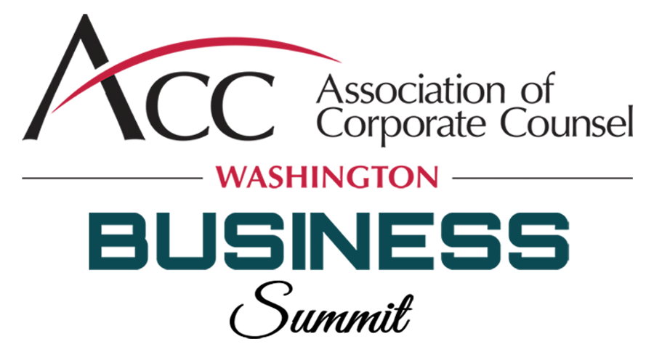
What Every In-House Counsel Needs to Know About Delaware Law
Presented by Chris Koa, Paul Loh, and Jason Wilson
September 23, 2021

Slide 2



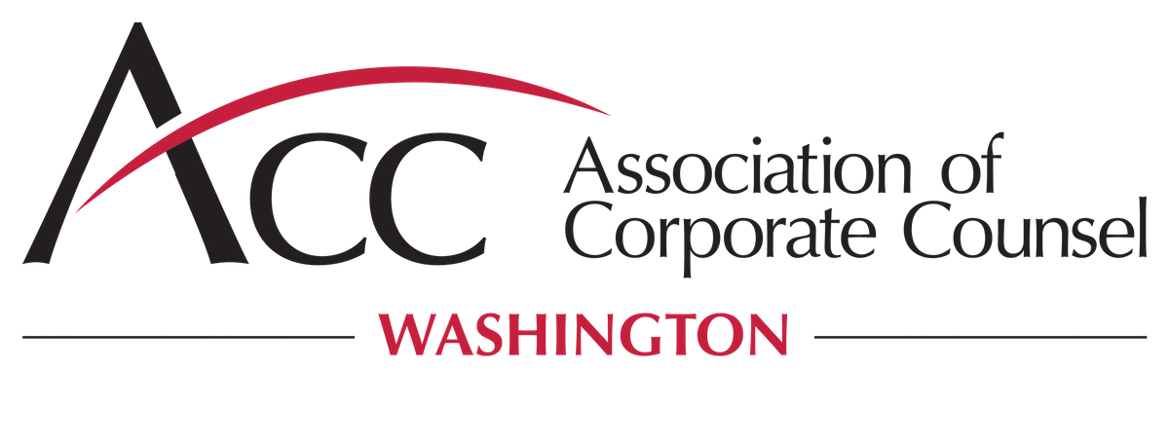
Today’s Speakers
Chris Koa
Paul Loh
Jason Wilson
DataEsque Law Group
Willenken LLP
Willenken LLP
Fractional In-House/General Counsel, Privacy Officer & Chief Legal Officer
Partner
Partner

Slide 3

Today’s Agenda
Why Knowing the Basics of Delaware Law Is Important
How Did Delaware Become So Important In Corporate Matters?
Why Incorporate in Delaware?
Litigating in Chancery Court
Contract Considerations: Delaware Choice of Law and Venue
Key Takeaways
Questions

Slide 4
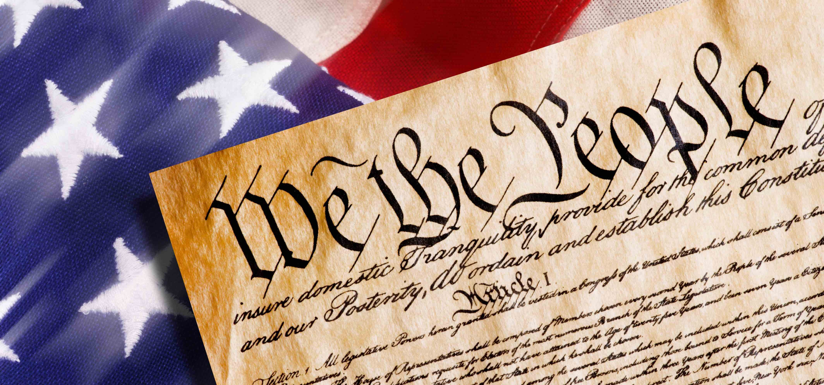

Fun Facts About Delaware
Bob Marley lived for a time in Wilmington, Delaware.
Delaware was the first state to ratify the Constitution on December 7, 1787.

Slide 5

Wilmington, Delaware

Slide 6
Why Delaware Law Is Important
Over 60% of Fortune 500 companies are incorporated in Delaware.
Over 1 million businesses are incorporated in Delaware.
Incorporation in Delaware increases the chances of being drawn into Delaware court for litigation.
Delaware is a popular venue choice among sophisticated parties.
Delaware is a less popular choice for incorporation in Washington. Washington has 18 companies on the Fortune 1000: 7 are incorporated in Delaware (including Amazon, Paccar, Expedia and Alaska Air); while the other 11 (including Costco, Microsoft, Starbucks and Nordstrom) are incorporated in Washington.

Slide 7
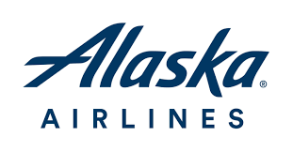



Examples of Washington Companies Incorporated in Delaware

Slide 8
Delaware Wasn’t Always the Leader For Incorporation
In the 1890s, New Jersey was the “mecca” for corporations. By 1902, New Jersey was earning so much money in corporate filing fees, and franchise taxes that it was able to abolish all property taxes and pay off the state debt.
Delaware decided to enter the fray for incorporation work in 1899 and it undercut New Jersey’s fee structure. Ultimately, in the 1910s, Delaware cemented its place as the primary place for incorporation because New Jersey enacted corporate law reforms which were considered not business friendly.

Slide 9
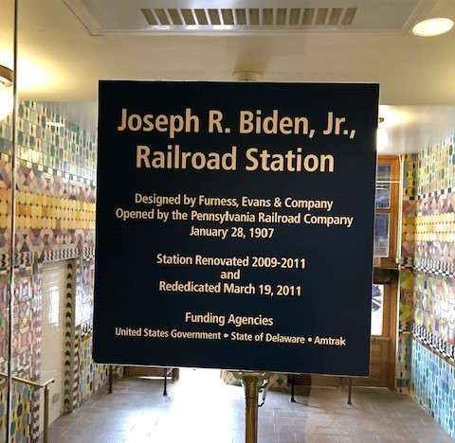
Why Incorporate In Delaware?

Slide 10
Why Incorporate In Delaware
Corporate law statute
Court system
Corporate case law
Specialized bar
Flexible secretary of state office
Venture capital investors
IPOs

Slide 11
Delaware Corporate Law Statute
The Delaware General Corporate Law (DGCL) is the foundation statute for corporate law in Delaware.
The DGCL has few mandatory requirements and emphasizes flexibility in how to structure your corporation and your board. For example, just one person can be the shareholder, director and officer of a corporation.
Delaware law requires a supermajority of the legislature to change the incorporation statute so there is predictability over time.
Delaware’s statute has been shaped by corporate law experts.
The Delaware legislature proactively reviews the DGCL so it addresses current issues.

Slide 12
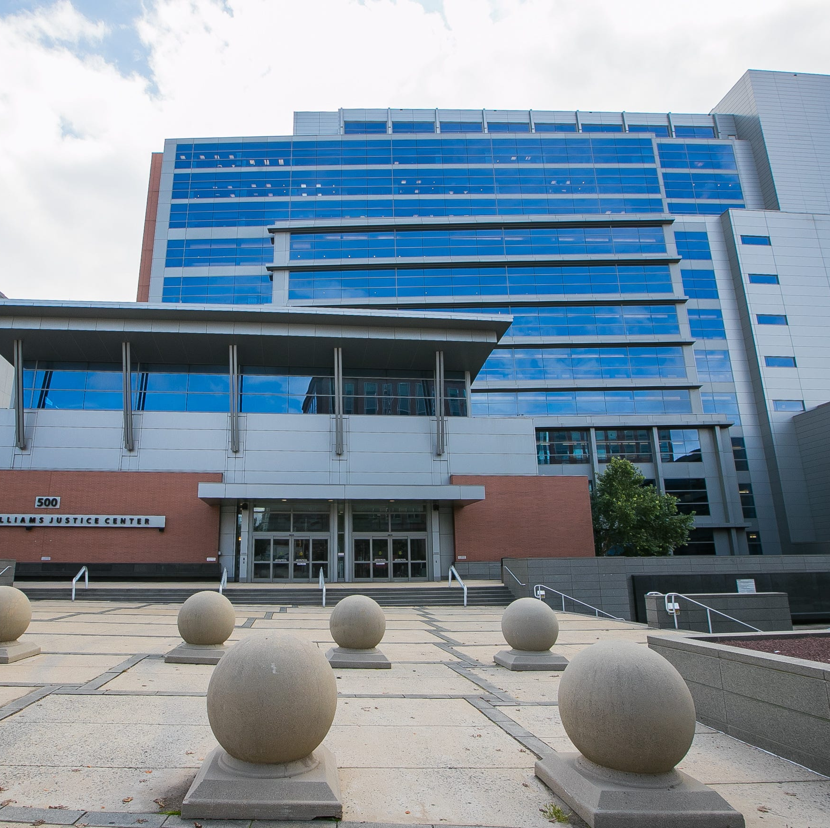
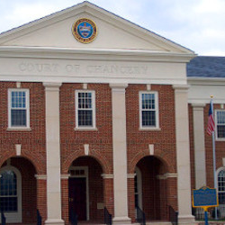
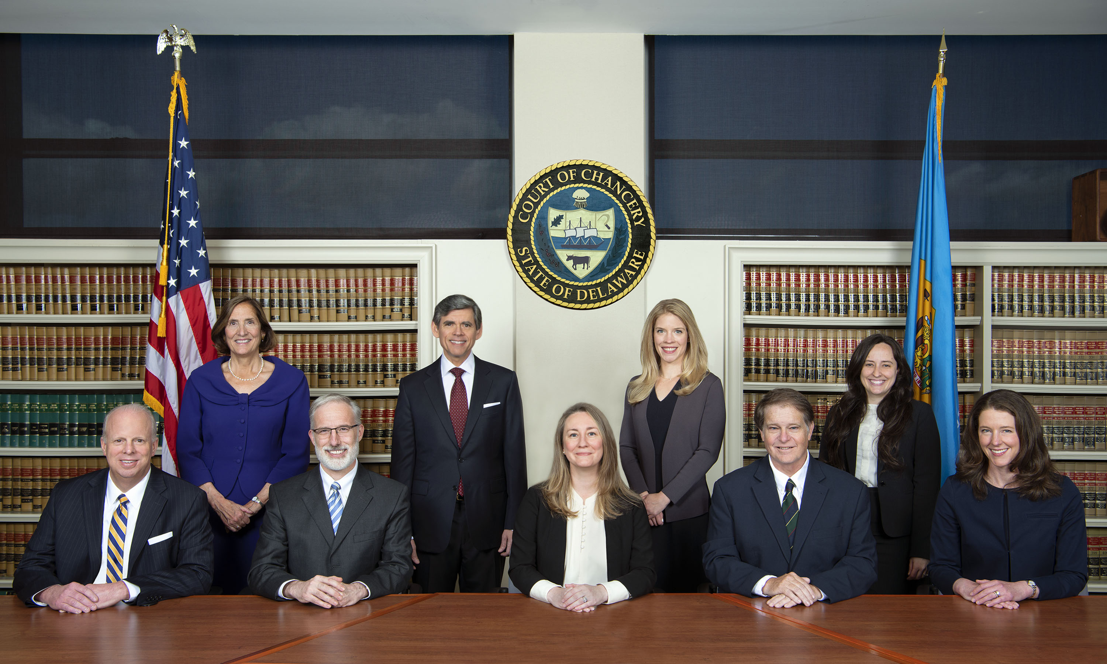
Delaware Court of Chancery

Slide 13
Delaware Court of Chancery
Delaware is known worldwide for its judicial system. Especially, for its Court of Chancery, which is a highly regarded court.
The Court of Chancery is a specialized court of equity with specific jurisdiction over corporate matters. The Court also has jurisdiction over commercial and contractual matters in general.
The judges on the Court of Chancery are known for their expertise in significant corporate matters. There is a Chancellor, Six Vice Chancellors, and two Masters.
Appointments are merit based and bipartisan and are based on a twelve-year term.
There is no jury.
The Court tries equity cases, but related legal claims can be heard in certain circumstances.
The Court of Chancery is flexible and used to expedite matters.

Slide 14
Delaware Supreme Court
Parties can appeal unfavorable results in Delaware Court of Chancery to the Delaware Supreme Court.
Delaware Supreme Court has considerable expertise in corporate law.

Slide 15
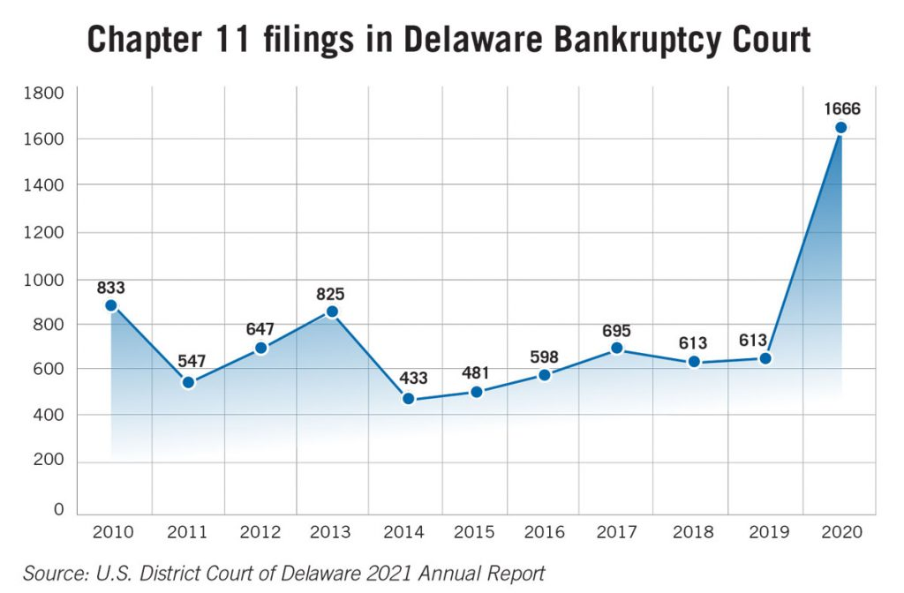
Delaware Bankruptcy Court

Slide 16
Delaware Case Law
Both the Court of Chancery and the Supreme Court have a tradition of issuing reasoned legal opinions.
There is a significant body of precedent on major corporate law issues that has accumulated over the years.
Delaware case law is especially well developed with respect to the business judgement rule.

Slide 17
Delaware Has A Specialized Corporate Bar
Because of the prominence of corporate law in Delaware, many Delaware practitioners have developed a strong corporate governance practice.
Delaware’s corporate governance practitioners are highly sophisticated.

Slide 18
Delaware’s Secretary of State Office Is Business Friendly
Open long hours.
Offers expedited services.
Can accommodate filings from around the world.

Slide 19
Delaware Is the Incorporation State of Choice for Certain Groups
Start-up investors
Investment bankers
These groups like Delaware, because
they are familiar with Delaware corporate law.

Slide 20
The Negatives of Incorporating in Delaware
Delaware’s filing fees are significantly higher than other states.
You must pay Delaware franchise tax based upon the shares’ value—even if you do not do business in the state.
You still must meet your own state’s requirements for conducting business. So, you need to do the work twice.
You need a Delaware registered agent.
You face the possibility of legal disputes in Delaware.

Slide 21
Litigating in Delaware Chancery Court: It Is Different
The Court of Chancery can move at warp speed if it believes a matter should be on a short track.
Local practice is different: for example, opposing counsel can ask about what you said to the witness during deposition breaks.
Objections are not made at trial (it is the court of equity).
There are no opening statements or closing statements, but elaborate opening and closing briefs.
Local counsel plays an important role, especially for insights into what makes your judge tick.

Slide 22
Recent Chancery Court Cases/Issues
Elon Musk participated in a trial this summer in which the allegation was that he exercised undue influence on Tesla’s purchase of Solar City.
The Chancery Court signaled that it would crack down on defendants who act in bad faith in Section 220 litigation.
Disputes related to a shareholder’s right to inspect books and records.
Valuation issues are common in Chancery Court.
For example, in a notable recent case, the Court determined that there was no material adverse effect for a party balking at a merger due to COVID-19.

Slide 23
What About Legal Claims in Chancery Court
“The Court of Chancery is a court of ‘limited jurisdiction’; it acquires subject matter jurisdiction ‘only when (1) the complaint states a claim for relief that is equitable in character, (2) the complaint requests an equitable remedy when there is no adequate remedy at law or (3) Chancery is vested with jurisdiction by statute.’” Plaintiff bears the burden of establishing a basis for subject matter jurisdiction “as of the time the complaint is filed.” Jurisdiction should remain “unaffected by post-complaint developments.” FirstString Rsch., Inc. v. JSS Med. Rsch. Inc., No. CV 2020-0332-KSJM, 2021 WL 2182829, at *4 (Del. Ch. May 28, 2021) (citations omitted, quotations omitted)

Slide 24
Legal Claims (Clean Up Doctrine)
Chancery Court will assert jurisdiction over legal claims at its discretion under the “clean up” doctrine:
“Some of the reasons why equity, once having acquired jurisdiction over part of a controversy, will, in the Court’s discretion, continue to exercise jurisdiction over the entire controversy, even over those portions where there is an adequate remedy at law are: to resolve a factual issue which must be determined in the proceedings; to avoid multiplicity of suits; to promote judicial efficiency; to do full justice; to avoid great expense; to afford complete relief in one action; and to overcome insufficient modes of procedure at law.”
FirstString Rsch., Inc. v. JSS Med. Rsch. Inc., No. CV 2020-0332-KSJM, 2021 WL 2182829, at *6 (Del. Ch. May 28, 2021)

Slide 25
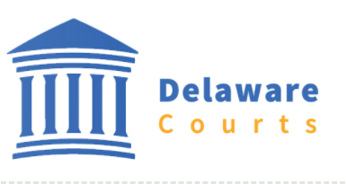
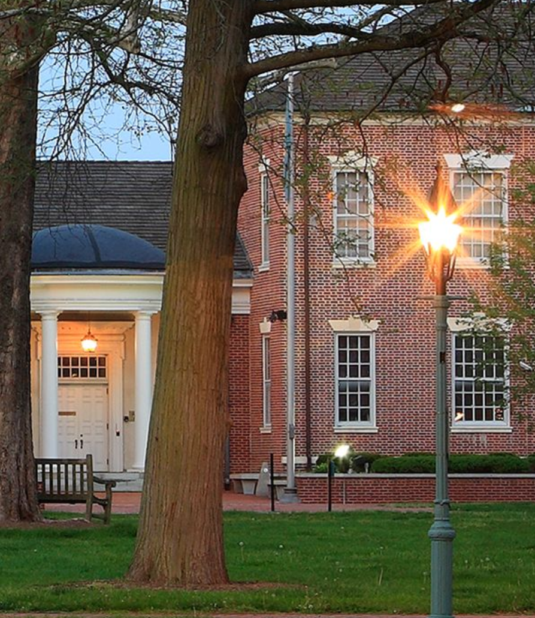
Contract Considerations: Delaware Choice of Law and Venue

Slide 26
Contract Considerations: Delaware Choice of Law and Venue
Quality of Law
Certainty of Law
Alignment with law of the state of incorporation
Familiarity/knowledge of the law
Strategic Considerations
“Delaware’s Competitive Reach” Matthew Cain, University of Notre Dame;
Steven M. Davidoff, University of Connecticut School of Law, January 8, 2011

Slide 27
Contract Considerations: Delaware Choice of Law and Venue
“Upholding freedom of contract is a fundamental policy of [Delaware]….”
“Delaware law is ‘generally supportive of choice-of-law provisions.”
The parties to any contract, agreement or other undertaking...may agree in writing that the contract, agreement or other undertaking shall be governed by or construed under the laws of this State, without regard to principles of conflict of laws, or that the laws of this State shall govern, in whole or in part, any or all of their rights, remedies, liabilities, powers and duties....
“Sometimes…the state law that would apply in the absence of a choice-of-law provision enshrines a particularly strong public policy interest, to the point that the state has determined that “contract[ing] around that public policy would be an unwholesome exercise of freedom of contract.” Under those circumstances, Delaware law recognizes a narrow exception to the enforceability of choice-of-law provisions [under the Restatement (Second) of Conflict of Laws § 187].
“A choice-of-law provision is unenforceable if its enforcement would be “contrary to a fundamental policy of a state which has a materially greater interest than the chosen state in the determination of the particular issue and which...would be the state of the applicable law in the absence of an effective choice of law by the parties….”
Swipe Acquisition Corp. v. Krauss, No. 2019-0509-PAF,
2021 WL 282642 (Del. Ch. Jan. 28, 2021)

Slide 28
Contract Considerations: Delaware Choice of Law and Venue
Title 6, section 2708(a) of the Delaware Code:
(a) The parties to any contract, agreement or other undertaking, contingent or otherwise, may agree in writing that the contract, agreement or other undertaking shall be governed by or construed under the laws of this State, without regard to principles of conflict of laws, or that the laws of this State shall govern, in whole or in part, any or all of their rights, remedies, liabilities, powers and duties if the parties, either as provided by law or in the manner specified in such writing are:
(1) Subject to the jurisdiction of the courts of, or arbitration in, Delaware; and
(2) May be served with legal process.
The foregoing shall conclusively be presumed to be a significant, material and reasonable relationship with this State and shall be enforced whether or not there are other relationships with this State….
(c) This section shall not apply to any contract, agreement or other undertaking…
(2) Involving less than $100,000.

Slide 29

Potential Drawbacks of Litigating in Delaware
The rules of evidence are less strict.
Huge expense and inconvenience to relocate your trial team to Delaware.

Slide 30

Keys to Success
You may need to move quickly in certain cases.
Hire a trial lawyer since you are more likely to go to trial.
The Court has little tolerance for protracted discovery disputes.
You will be given limited time to put on your case—things need to be extremely tight.

Slide 31

Key Takeaways
Delaware offers many advantages for corporations interested in flexibility and a sophisticated judicial system.
You may want to use Delaware in your choice of venue (for claims in equity) and choice of law provision for difficult and complex matters.

Slide 32

Questions

Slide 33


Slide 34
Contact: Chris Koa | chris@dataesquelaw.com | 206.257.9459
Paul Loh | ploh@willenken.com | 213.955.8030
Jason Wilson | jwilson@willenken.com | 213.955.8020

