Slide 1


Baker McKenzie
How To Use Electronic Signatures Effectively

Slide 2



Speakers
Lothar Determann
Andrea Tovar
Dan Puterbaugh
Partner
Palo Alto
International Commercial
Baker McKenzie
Lothar.Determann@Bakermckenzie.com
Associate
San Francisco
International Commercial
Baker McKenzie
Andrea.Tovar@Bakermckenzie.com
Director of Product, IP & Regulatory Affairs
Portland
DocuSign
Dan.Puterbaugh@docusign.com

Slide 3
Agenda
1 |  | Practical Considerations
2 |  | Legal Basics
3 |  | No Handwritten vs. Handwritten Signatures
4 |  | Notarization Process
5 |  | International Considerations
6 |  | E – Signature Essentials Checklist
Notes:
MARCELLA

Slide 4
Practical Considerations
Speed & Convenience
Additional Options to Protect Authenticity and Integrity
Cost savings & Cheaper Archiving and Retrieval
Better Evidence and Identification
Easier Search and Analysis
Scalability
Automation of Retention/ Deletion

Slide 5
Ask the Right Questions
Are electronic Signatures Effective and Binding?
Do signatures and documents meet statutory form requirements?
Are interests protected as well as with manually applied handwritten signatures?

Slide 6
Legal Form Requirements
Notarizations
California Confidentiality of Medical Information Act
C
US Copyright Act
US Federal E-SIGN Act
Court Rules

Slide 7
Legal Issues
No Handwritten Signature
1
Parties Offer and Accept at Different Times
2
Parties Are In Different Places when Offering and Accepting
3
Implied Acceptance By Conduct
4
Which law applies?
5
Unfair Contract Terms, Contracts of Adhesion
6

Slide 8
No Handwritten Signature
Traditional Written Form and Signature Requirements: Statute of Frauds, Family Law, European Privacy Laws
U.S. eSign Act and EC Electronic Commerce Directive
Burden of Proof
Digital Signatures
Unpersonal, Identity, Power of Authority

Slide 9
No Handwritten Signature
Types of e-Signatures: simple, advanced and qualified digital signature
PROs and CONs when compared to each other and paper records with handwritten signatures
record management
faxed signature pages w/o full agreement
identification and authentication of signatory
power of authority of signatory
place and time of signing
when are contracts challenged?

Slide 10
No Handwritten Signature
Use cases for e-Signatures:
mass transactions, not negotiated
sales and procurement, commercial terms
intercompany agreements
internal approvals, corporate resolutions
online sales of goods and services
subscriptions
employment

Slide 11
Handwritten Signature
Exclusions:
unilateral acts that are likely challenged, e.g., employment terminations
transactions needing government filing, approval or review if government prefers ink & paper
real estate transfers ex-USA
family law

Slide 12
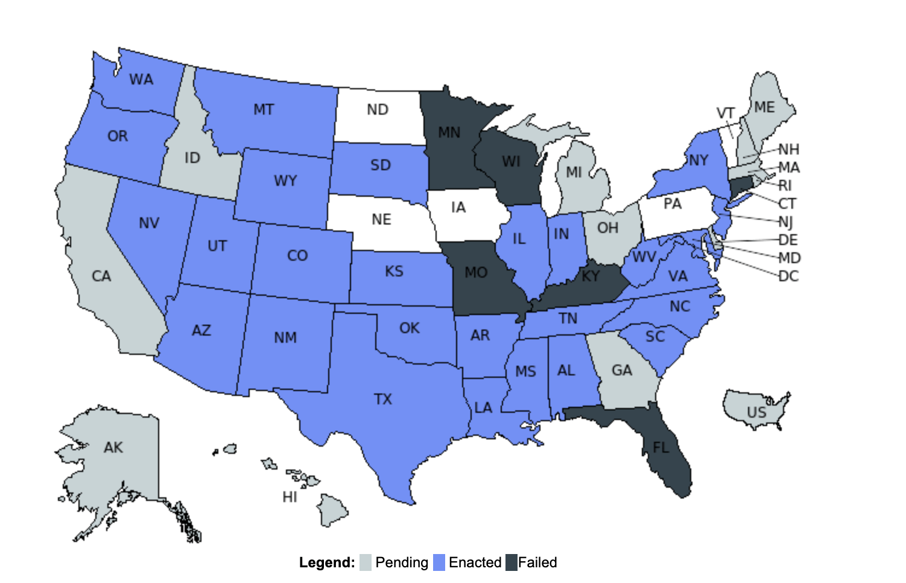
The Acceleration of Remote Online Notary
Copyright © 2021, State Net

Slide 13
The traditional notarization process…
Signers(s) and notary public meet in-person
Signer(s) fills in the fields on the paper agreement
Notary public reviews
the paper agreement
Notary public identifies the signer(s) using physical ID
Signer(s) signs the agreement
Notary public records a journal entry in a paper journal and affixes certificate
13
Notes:
In this process, I’d typically have to:
Take time out of my day to meet a notary public in person - which means I have to block off time in my calendar to travel to the notary public’s office and back
Once there, I’d manually fill out the paperwork, which depending on the document, can be lengthy, complex or confusing
I’d have to wait while the notary public manually flips through and reviews each piece of paper. If there was a mistake, then we’d have to print out the documents and start all over again
Then I’d hand over my drivers license so that they can manually confirm my identity
I’d physically sign each field on the agreement
And finally, the notary public would have to record a journal entry in their paper journal, where in some state, I might have to place my thumb on a stamp pad to record my thumbprint
As you can imagine, this traditional notarization process presents several challenges for both your organization and your signers.

Slide 14
…has several challenges for both the organization and their signers
Signers(s) and notary public meet in-person
Signer(s) fills in the fields on the paper agreement
Notary public reviews
the paper agreement
Notary public identifies the signer(s) using physical ID
Signer(s) signs the agreement
Notary public records a journal entry in a paper journal and affixes certificate
Challenges for organizations:
Risk of manual errors and not in good order (NIGO) agreements
Increased business costs due to the manual, paper-based process
Increased risk of identity fraud
Challenges for signers:
Logistical hassles and inconvenience of meeting a notary public in-person
Frustration with a heavily manual, paper-based experience
14
Notes:
For your organization, this is a manual, inefficient process that slows down the pace of doing business, increases the risk of manual errors (which can ultimately drive up costs), as well as increases the risk of identity fraud. It is also a frustrating and inconvenient experience for your signers, as they must find, schedule and visit a notary public in-person in order to have their signature verified and the document notarized. Not to mention, depending on the use case, may have to physically review and sign hefty amounts of paper.

Slide 15
The goal of RON is to make the traditional notarization process fully remote and electronic
Signers(s) and notary public meet virtually
Signer(s) fills in the fields on the electronic agreement
Notary public reviews
the electronic agreement
Notary public identifies the signer(s) remotely
Signer(s) electronically signs the agreement
Notary public records a journal entry and affixes a digital certificate
A fully digital notarization experience
Faster and more
efficient
Allows signers to sign and notarize remotely
Mitigates risk and reduces fraud
15
Notes:
Our goal is to take this traditional notarization process and transform it to be fully remote and electronic, so you and your signers can leverage a fully digital notarization experience.
This will help you:
Do business faster, more efficiently, saving you time time and money by digitizing your notarial processes and reducing the risk of manual errors
Allows your customers to sign and notarize remotely, providing them with a delightful customer experience by removing the logistical hassles of meeting a notary public in person.
Mitigate risk and reduce fraud with a robust audit trail, while using secure identity proofing technologies.

Slide 16

Advantages of Remote Online Notary
Remotely notarize documents through a secure audio-visual session
Authenticate the signer through identity verification
Provides a detailed audit trail for sender and notaries
16
Notes:
That’s where DocuSign Notary comes in. It’s the trusted way to remotely and electronically notarize documents. With Notary, you can increase the speed of conducting business and save cost and time, as you no longer have to depend on slow, inefficient and paper-based notary processes. It uses secure identity proofing technologies so you have greater confidence your signers are who they say they are, helping reduce the risk of identity fraud. The encrypted audio-visual session allows notarizations to occur remotely, which means your signers no longer have to deal with the hassles of meeting a notary public in-person. And finally, Notary provides more security options than in-person notarization sessions, with a tamper-evident Certificate of Completion, audio-visual recordings, and an electronic notary journal. All of this is built on the trusted eSignature platform, making it easy for you to send, sign and notarize critical documents, all with DocuSign.
In addition, with the Notary API, customers can automate the management of remote notarizations by managing customer-supplied pools of notaries public, managing authorization permissions regarding which users can perform remote online notarizations and by checking commision information. When paired with the existing eSignature API, customers can automate repeatable tasks specific to notarization, such as sending documents to be notarized and bulk adding notaries public within their organization. Customers can also use the eSignature and Notary APIs together to programmatically redirect their signers from their app to a notarization session and back, in order to eliminate cumbersome context switching.
Please note this initial release of Notary is available to U.S.-based customers who either employ or contract notaries public seated in supported states. Over time, Notary will also be able to support organizations who don’t supply their own notaries public.
What to know: We released the initial version of Notary in March 2021; however, this version is “limited availability,” meaning it’s only for customers who meet specific criteria and must be nominated and approved.

Slide 17
International Overview
SES, AES, QES distinctions
Electronic Signature Laws – Technical and Organizational Requirements
Government Filings
Contractual Acknowledgments
Evidence

Slide 18
E-Signature Essentials Checklist

Slide 19
✓
Is the signature or document even required?
✓
Is the signature likely to be challenged?
✓
Where would the signature be challenged?
✓
What evidence do you retain to prove validity?
✓
Which additional measures can help reduce risks?
✓
How to manage the process?
✓
What e-signature technology to use?

Slide 20
✓
Is the signature or document even required?
✓
Is the signature likely to be challenged?
✓
Where would the signature be challenged?
✓
What evidence do you retain to prove validity?
✓
Which additional measures can help reduce risks?
✓
How to manage the process?
✓
What e-signature technology to use?

Slide 21
✓
Is the signature or document even required?
✓
Is the signature likely to be challenged?
✓
Where would the signature be challenged?
✓
What evidence do you retain to prove validity?
✓
Which additional measures can help reduce risks?
✓
How to manage the process?
✓
What e-signature technology to use?

Slide 22
✓
Is the signature or document even required?
✓
Is the signature likely to be challenged?
✓
Where would the signature be challenged?
✓
What evidence do you retain to prove validity?
✓
Which additional measures can help reduce risks?
✓
How to manage the process?
✓
What e-signature technology to use?

Slide 23
✓
Is the signature or document even required?
✓
Is the signature likely to be challenged?
✓
Where would the signature be challenged?
✓
What evidence do you retain to prove validity?
✓
Which additional measures can help reduce risks?
✓
How to manage the process?
✓
What e-signature technology to use?

Slide 24
✓
Is the signature or document even required?
✓
Is the signature likely to be challenged?
✓
Where would the signature be challenged?
✓
What evidence do you retain to prove validity?
✓
Which additional measures can help reduce risks?
✓
How to manage the process?
✓
What e-signature technology to use?

Slide 25
✓
Is the signature or document even required?
✓
Is the signature likely to be challenged?
✓
Where would the signature be challenged?
✓
What evidence do you retain to prove validity?
✓
Which additional measures can help reduce risks?
✓
How to manage the process?
✓
What e-signature technology to use?

Slide 26

Questions?

Slide 27

Contact Info
Lothar Determann
Andrea Tovar
Dan Puterbaugh
Partner
Palo Alto
International Commercial
Baker McKenzie
Lothar.Determann@Bakermckenzie.com
Associate
San Francisco
International Commercial
Baker McKenzie
Andrea.Tovar@Bakermckenzie.com
Director of Product, IP & Regulatory Affairs
Portland
DocuSign
Dan.Puterbaugh@docusign.com

