Slide 1
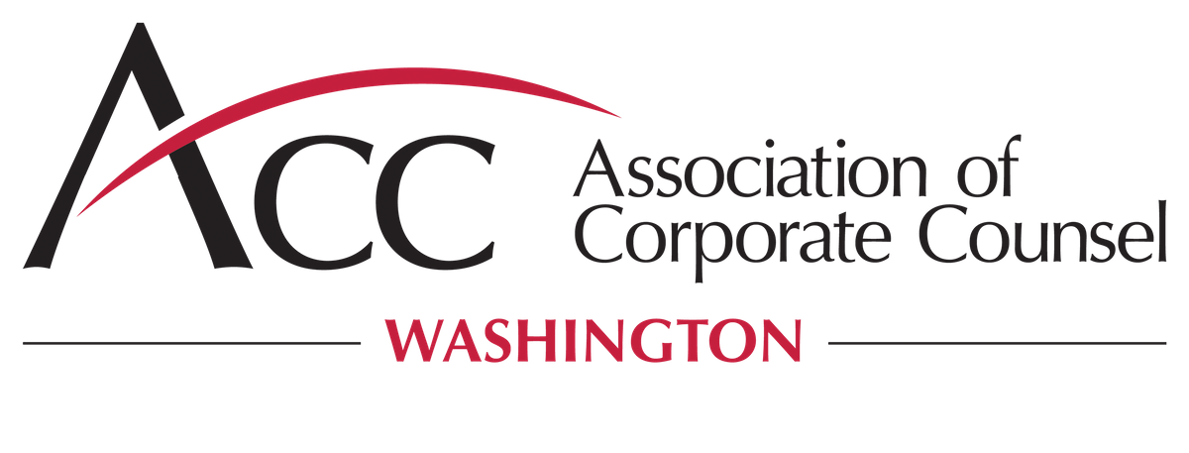
Pay the ransom? Not so fast
The intersection between OFAC, ransomware and data security incident handlings

Slide 2
Speakers
Justin Okun Senior Security Counsel Chime
Paula Barrett Co-Lead of Global Cybersecurity and Data Privacy Eversheds Sutherland
Mark Herlach US Head of International Trade Eversheds Sutherland
Sarah Paul US Head of Corporate Crime and Investigations Eversheds Sutherland

Slide 3
Agenda
Protecting against and effectively responding to a ransomware attack
OFAC implications of making or facilitating a ransomware payment to state actors, as well as other legal and practical considerations
Critical infrastructure suppliers and contributors: supply chain, trade and sanctions implications
The new Cybersecurity Executive Order and what it means for the private sector and federal contractors
US and international regulations and agencies to keep top of mind (e.g., GDPR, CCPS, CFIUS, FTC)

Slide 4
Protecting against and effectively responding to a Ransomware attack

Slide 5
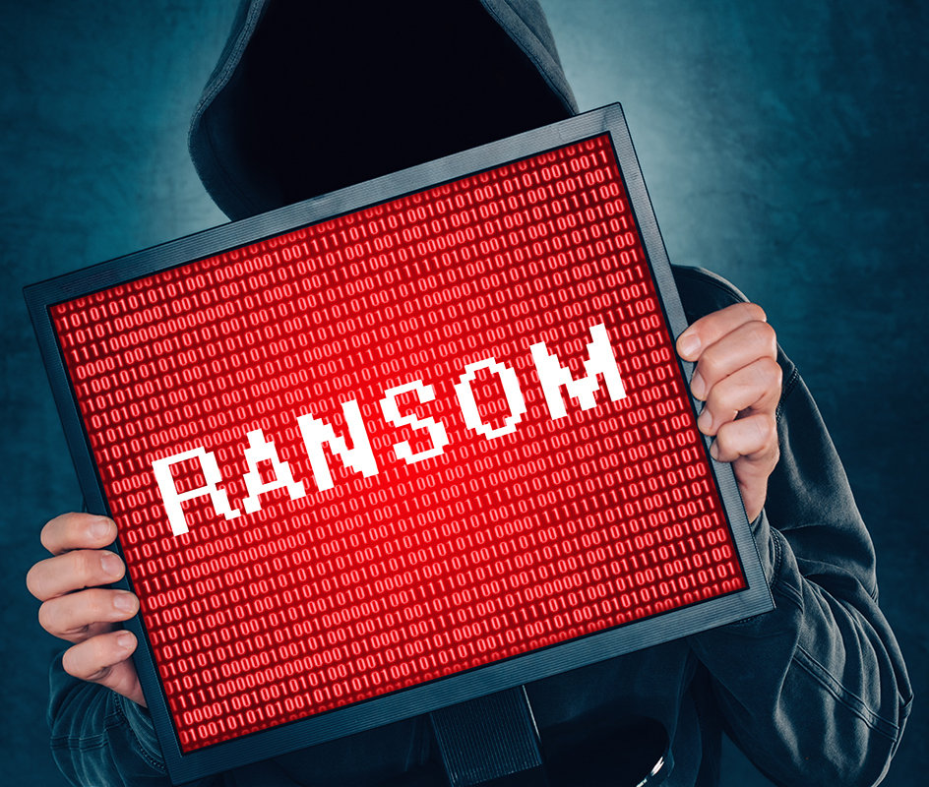
Ransomware attacks – the ABCs
What is ransomware?
A form of malicious software
Designed to block access to a company’s data or other systems
Often through encryption
What is a ransomware attack?
Hacker breaches a company’s IT infrastructure, uses ransomware to encrypt data or systems
Demands that the company pay a ransom in exchange for a decryption key
Sometimes, also threatens to publicly disclose sensitive files unless the ransom is paid
What are some possible consequences of a ransomware attack?
Can prevent the company from being able to conduct business operations, in whole or in part
Can have ripple effects on other companies or individuals
https://www.csoonline.com/article/3236183/what-is-ransomware-how-it-works-and-how-to-remove-it.html

Slide 6
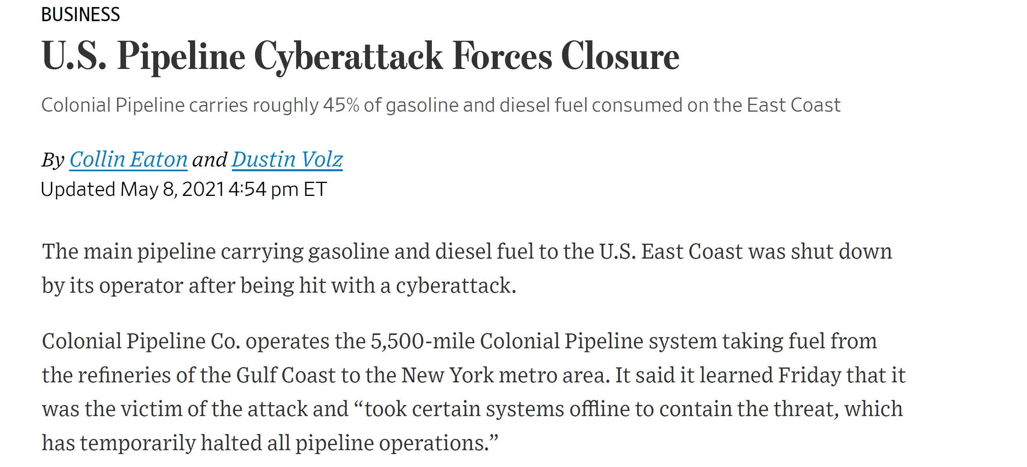
Recent ransomware attacks

Slide 7
Recent ransomware attacks

Slide 8
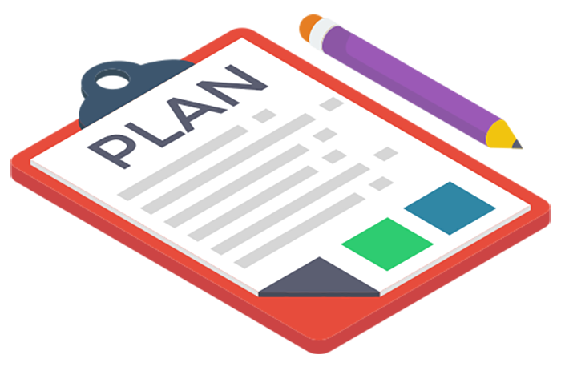
The issue with ransomware
Hope is not a plan
Instead, plan for the worst, and hope for the best
Resources about what to include in a plan are available from the Cybersecurity & Infrastructure Security Agency (CISA)
The breach, as bad as it is, may not be the worst-case scenario—that could be litigation, regulatory enforcement action and reputational damage, particularly if you pay a ransom
Cybersecurity threats, including the ransomware threat, constantly evolve
Now, both exfiltration and encryption
Next step, fabrication?
https://helpfuldigital.com/guides-templates-and-tools/how-to-develop-a-crisis-communications-plan/

Slide 9
The issue with ransomware
Ransomware is often enabled through the supply chain and greatly impacts the supply chain
Importance of cybersecurity due diligence, vendor risk management, info sharing and insurance
Increases the litigation risk
Paying ransom is not necessarily the “easy button”
It might not even work
Still need to cleanse systems and close the vulnerability
If personal data is impacted, still must report
Taxes
Sanctions and material support to terrorism restrictions

Slide 10
OFAC implications of making or facilitating a ransomware payment to state actors, as well as other legal and practical considerations

Slide 11
OFAC’s Ransomware Advisory
On October 1, 2020, the Office of Foreign Assets Control (“OFAC”) issued an advisory to highlight the sanctions risks associated with ransomware payments (the “Advisory”)
The Advisory:
Warns companies that facilitating ransomware payments risks violating OFAC regulations
Notes that ransomware payments may also embolden cyber actors to engage in future attacks
Explains that OFAC has designated numerous malicious cyber actors under its cyber-related sanctions program and other sanctions programs
States that license applications involving ransomware payments will be subject to a presumption of denial
Encourages companies to report ransomware attacks to law enforcement
Reiterates that OFAC encourages companies to implement risk-based sanctions compliance programs
In general, the Advisory makes clear that exigent circumstances do not relieve companies of their sanctions compliance obligations and emphasizes that OFAC may impose civil penalties based on strict liability

Slide 12
Takeaways from OFAC’s Ransomware Advisory
The FBI recommends against paying the ransom
Consider the real risk of sanctions violations associated with paying a ransom
Do not pin your hopes on obtaining a license involving a ransomware payment
Take steps to prevent ransomware attacks from occurring in the first place
Develop procedures for conducting sanctions due diligence of the attacker
Include this sanctions risk in your ransomware crisis plan, and make employees aware of it
Cooperate with law enforcement, both during and after a ransomware attack

Slide 13
Critical infrastructure suppliers and contributors: supply chain, trade and sanctions implications

Slide 14
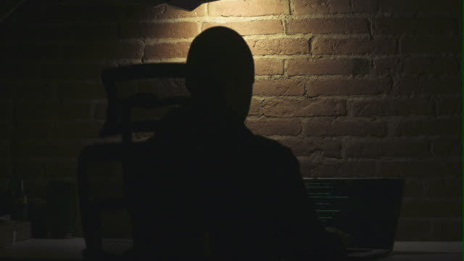
Vulnerability has many faces
Time to step back and adopt a holistic approach
Ask “What if . . . ?”
Identify choke points and potential weaknesses
Anticipate how a state actor or rogue group can gain leverage
Ransomware attacks are simply one manifestation of larger set of vulnerabilities
International trade risk has multiple dimensions
Recent US government actions illustrate breadth of the problem
Proactive steps required to manage risk
https://www.gettyimages.com/detail/video/hacker-man-typing-code-at-laptop-stock-footage/1089071324

Slide 15
Scope of critical infrastructure expanding
What is “critical” has evolved
Points of vulnerability now exist in new contexts
Defense and energy are no longer the only concerns
Critical technologies and sensitive personal data
Government controls are becoming more pervasive
Restrictions on exports of technology
Restrictions on adversaries equipment within critical infrastructure
Cheaper is not always better
Balance between commercial and national security interests
Increased scrutiny of foreign investment and access to critical technologies reflected in the new CFIUS process
Holistic approach essential to identify potential threats and develop robust systems

Slide 16
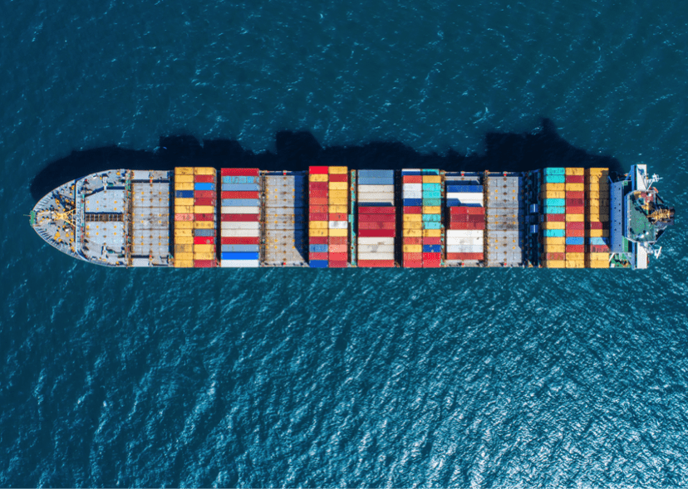
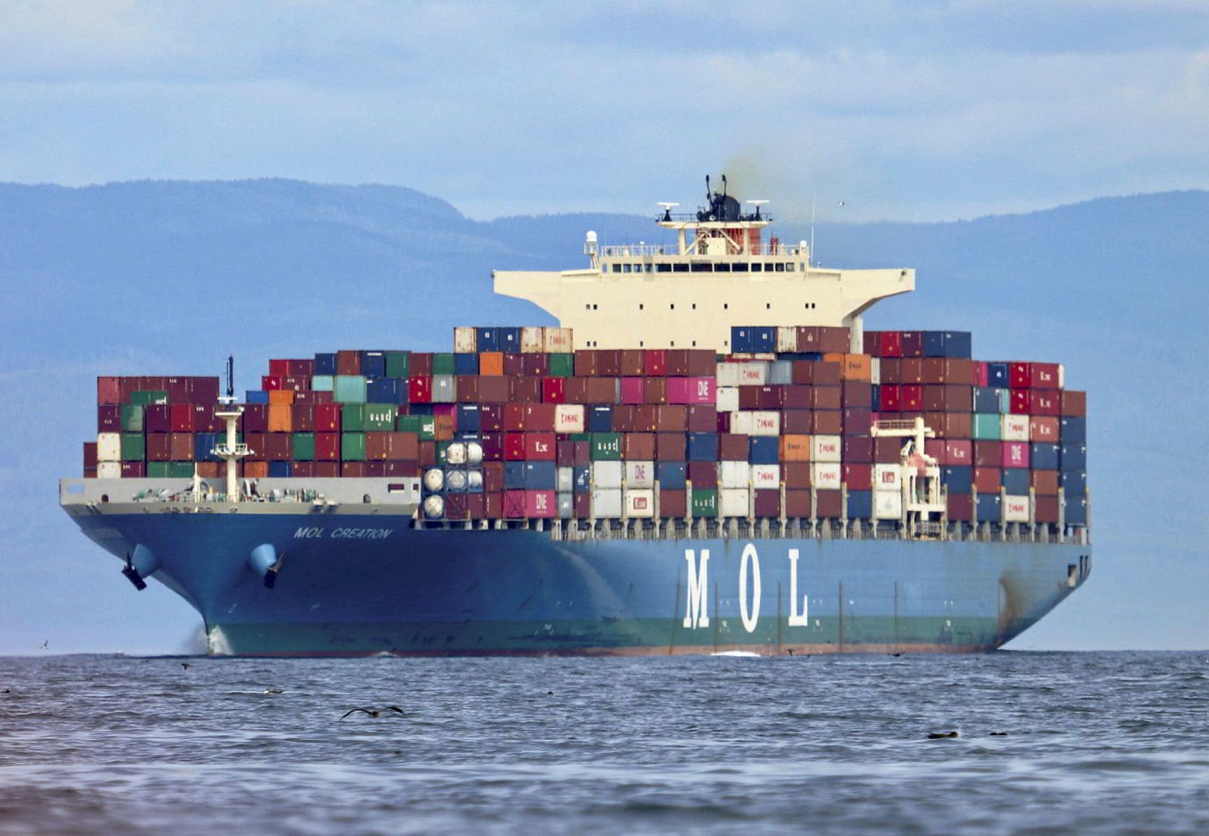
Supply chains – the demise of “just in time”
Geographic vulnerability
Dependency
Timing considerations
State Actor implications
Importance of proactive approach and ongoing risk analysis
Plan for how you will respond (or even find out about) your vendors being subject to a ransomware attack
Constructive and defensive perspectives are both important
Pros and cons of given suppliers
Hedge your bets
Monitor sanctions and other international trade developments
Rules can change overnight
Commercial opportunities for Western companies
https://www.universalcargo.com/how-much-cargo-can-the-largest-shipping-container-ship-really-hold/
https://www.rechargenews.com/transition/hydrogen-can-power-virtually-all-container-ships-crossing-the-pacific/2-1-767073

Slide 17
The new Cybersecurity Executive Order and what it means for the private sector and federal contractors

Slide 18
Cybersecurity developments
It is not legislation, but it binds federal departments and agencies, impacts federal contractors, leverages the market power of the government, and aims to lead by example
President Biden’s Executive Order on Cybersecurity – May 12, 2021
Removes barriers to threat information sharing
Implements stronger cybersecurity standards
MFA
Encryption
Software supply chain security
Cybersecurity safety review board
Standardized Incident Response Plan
End-point detection
Event log requirements
Additional recommendations for the private sector on preparing for ransomware with additional steps
White House follow-up memo – June 2, 2021
Back up and test
Update and patch promptly
Third-party pen tests
Segment networks

Slide 19
US and international regulations and agencies to keep top of mind (e.g., GDPR, CCPA, CFIUS, FTC)

Slide 20
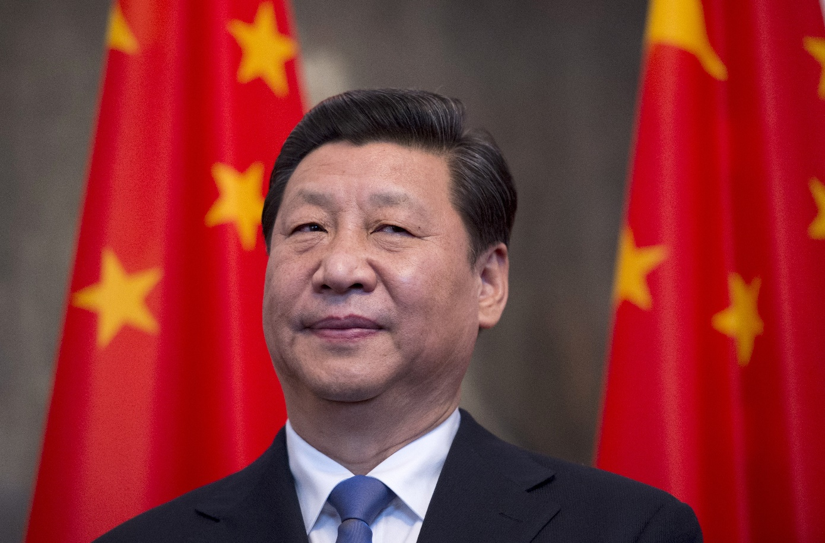
Things to keep top of mind
Increasing concern over international dependency
Pandemic demonstrated serious implications of this concern
Buy America/onshoring trend in United States
China’s efforts to become less dependent on US technology
China-US competition
Domestic control over critical infrastructure
Foreign investment restrictions on the rise globally
Access to knowledge and critical technology a new FDI focus
SOEs present particular challenges
Disruptive capabilities of state actors
Ransomware attacks just one manifestation of new challenges to “business as usual”
https://time.com/4284795/panama-papers-xi-jinping/

Slide 21
Questions?

Slide 22
Contact our speakers
Paula Barrett Co-Lead of Global Cybersecurity and Data Privacy paulabarrett@eversheds-sutherland.com +44 207 919 4638
Mark Herlach US Head of International Trade markherlach@eversheds-sutherland.com +1 202 383 0172
Sarah Paul US Head of Corporate Crime and Investigations sarahpaul@eversheds-sutherland.com +1 212 301 6587

