Slide 1


The Ethical & Pragmatic Monetization of Data
Han Santos PLLC in partnership with: Spiral Genetics | Medstreaming

Slide 2
AGENDA
Introductions
Assessing the Data you need
The Monetization Model
Data Insights & Balancing Interests
Questions to ask
Sample Contract Language

Slide 3
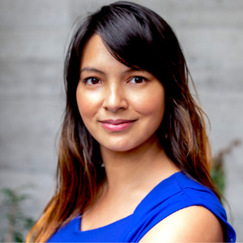
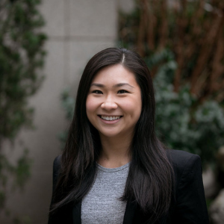


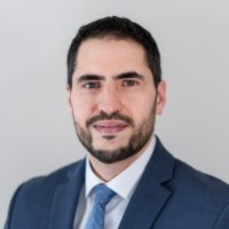
Han Santos PLLC
INTRODUCTIONS
PANELISTS
Spiral Genetics
Adina Mangubat, CEO
Gloria Steinberg, IP Transactions
Nabil Abdalla, Privacy
Shamim Mohandessi, Corporate & Securities
Medstreaming
Mohamed Khalil, General Counsel

Slide 4
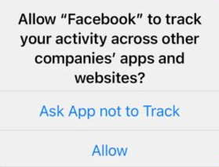

HOW DO WE VALUE DATA?
Good privacy builds reputations and opens the door to better data monetization
Engage to develop trust
Determine what data is critical to your business
Limit your personal data collection to what is necessary
App

Slide 5
Data
Data
Data Sources
Data Sources
Data Sources
Data
MONETIZATION MODEL
Contributions ------------------------> Exploitation
Database
Party A
Party B
Party C

Slide 6

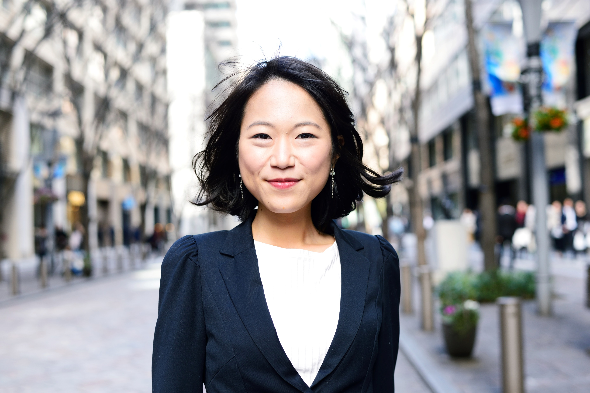
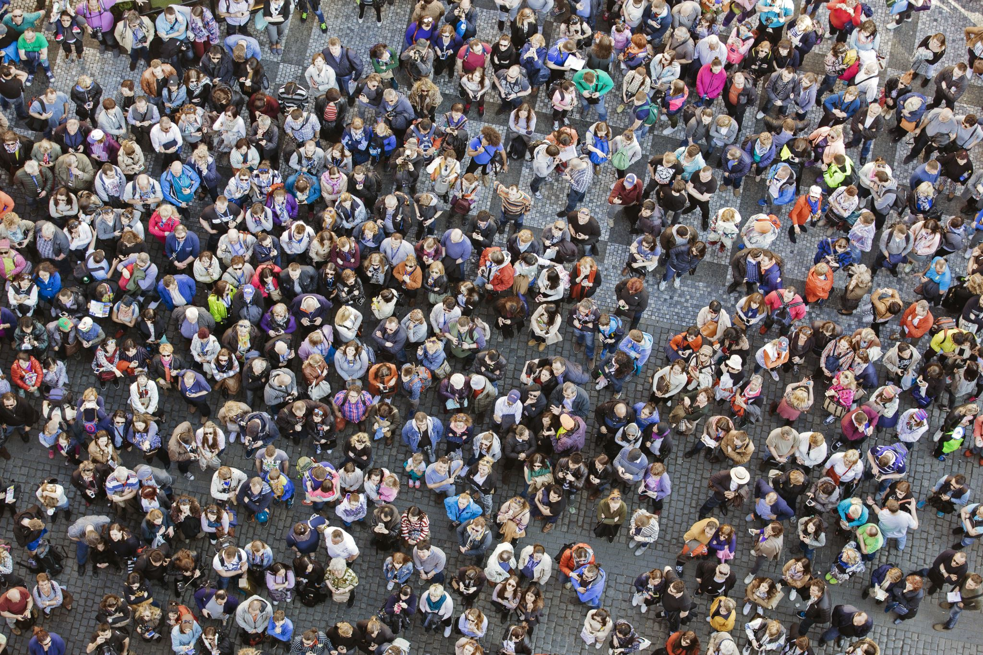

BIG DATA INSIGHTS
Individual Data
Data insights that focus on a community of people
Anonymized Data
It's not who you know, it's what you know about them
Data insights that target an individual
Community Data
Trend-based data insights
Big Data Insight
Individual Personal Data
Community-based Anonymized Data
Community-based Personal Data

Slide 7

BALANCING INTERESTS
Rights of individuals
How are we balancing those interests?
Europe: GDPR
USA State : California (CCPA), Virginia (CDPA), and now (almost) Colorado (CPA)
USA Federal: Example, HIPAA, HITECH for the Health Industry
Economic interests

Slide 8



HEALTHCARE INDUSTRY
Covered Entity
e.g., Hospital
Business Associate
e.g., Process, analyze medical data
Notes:
Questions:
Adina
To provide context to our audience:
How do you navigate patient consent and access to patient data?
Regarding biodata banks, can you walk us through the i) how you get patient consent ii) the process of Spiral defining its purpose of using the data?
Mohamed:
How does Medstreaming support covered entities?
To provide that support, Medstreaming obviously come into possession of patient health data, what mechanism do you use to authorize use of the patient health data?

Slide 9

IP ISSUES- Questions to Ask
What is the resource being shared?
Who owns the resource?
What is the purpose of sharing the database?
Who will access the database?
How may others use the resource?
How will the resource be maintained?
What product, process, or service is to be developed and/or commercialized?
Who owns the results?
Notes:
Add notes about how you want to deliver q's to A&M

Slide 10
“Dataset” means, individually and collectively, all data, records, files, content and information, in any form or format, that is made available by Licensor, its Affiliates, or its or their Personnel from or on behalf of Licensor or its Affiliates, to users of the Database which excludes the Licensee Materials and the Results.
“Database” means Licensor’s computing environment (consisting of Data, hardware, software, telecommunications systems and equipment) intended for carrying out [PURPOSE, e.g., research activities].
SAMPLE
PROVISIONS &
REPRESENTATIONS

Slide 11
SAMPLE PROVISIONS & REPRESENTATIONS (Cont.)
“Results" means any results, findings, discoveries, inventions, concepts, procedure, techniques, data or other information (including any reports, documents, software or other works) generated by the Licensee as a result of carrying out [an activity], (including, but not limited to [specific type of] data, machine learning models for [purpose]).
[OPTIONAL]
Define the scope of “Resultant Data” if there is a need to make a carve out from the Results to, for example, use the “Resultant Data” for a specific purpose or commercialize the “Resultant Data” under certain terms.

Slide 12
Thank You for Joining Us Today
Q&A
Visit us at Hansantos.com for more information
or email info@hansantos.com

