Slide 1


Diversity, Equity and Inclusion: Where We’ve Been, Where We Are and Where We Are Going
Presented by Sheryl J. Willert, Marilyn F. Sharron

Slide 2
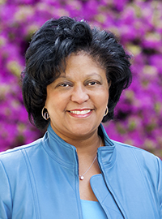
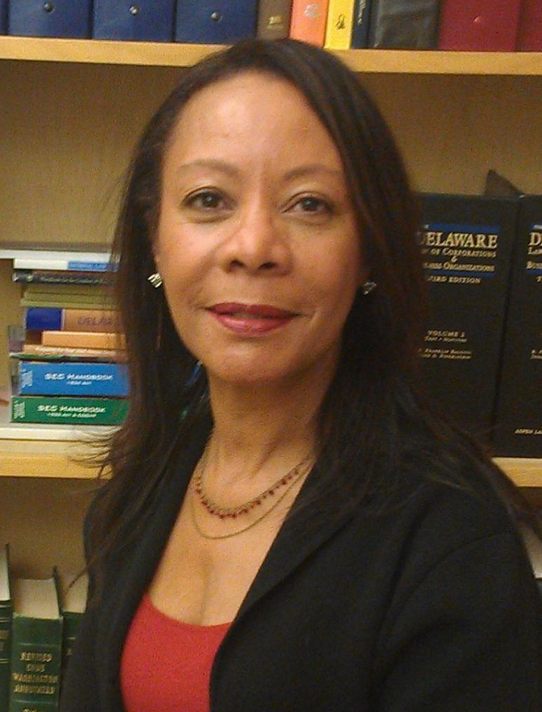

Speaker
Sheryl Willert
Member
Williams Kastner
206.628.2408 swillert@williamskastner.com
Marilyn Sharron
Assistant vice President – Senior Legal Counsel
AT&T Inc. ms2411@att.com

Slide 3
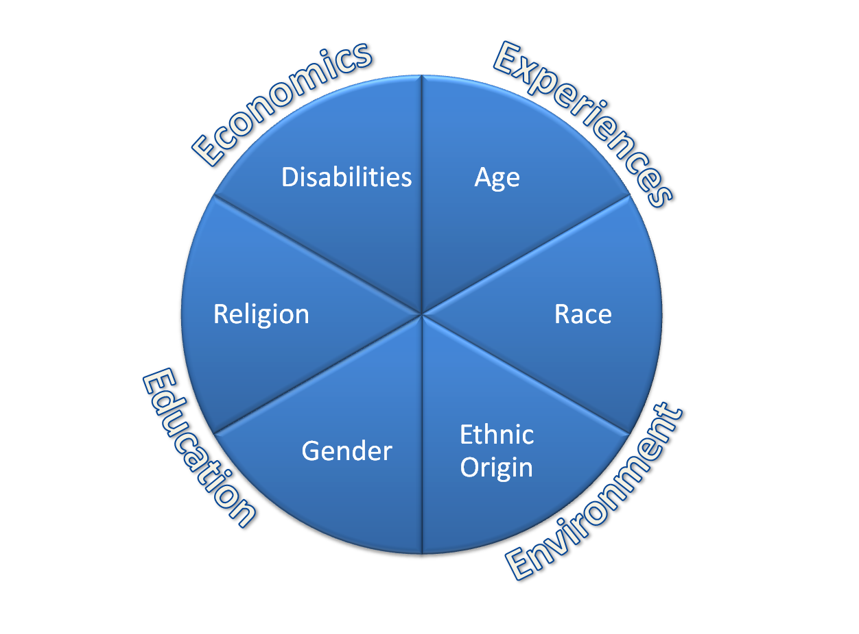

Slide 4
Getting Started
Knowledge is Power
Understanding the Demographics is Knowledge

Slide 5
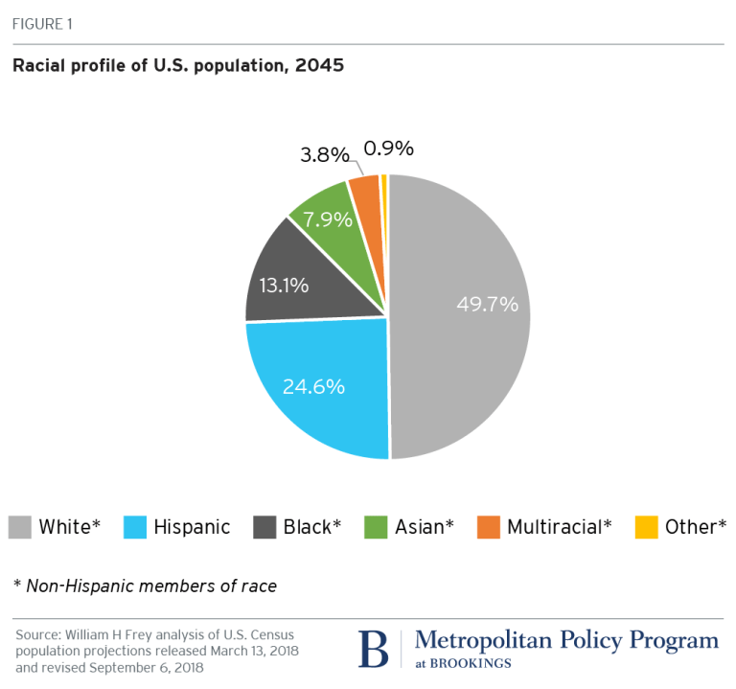
Predicted Racial Demographics of U. S.

Slide 6
US Gender Demographics
Women 50.8%
Men 49.2%
US Census 2019

Slide 7
Gender Equality In the Workplace
As of January 2020, women made up 50.04% of US workforce. (Women Overtake Men as Majority of US Workforce; Wall Street Journal, January 10, 2020)
Growth of number of women in the workplace has been slow but steady (McKinsey & Company and LeanIn.org’s Women in the Workplace 2020 study)*
*Does not reflect changes related to Covid-19.

Slide 8
Focus on Gender*
Women purchase 60% of all cars purchased in the world
Women make 80% of all health care expenditures
Women select 89% of all new banking relationships
Women buy 80% of all riding lawn mowers
Women represent the greatest buying power of any group
*Does not reflect Covid related adjustments

Slide 9
Focus on Gender: Boards of Fortune 500
1995 – women represented 9.5%
2001 – women represented 12.4%
2003 – women represented 13.6%
2007 – women represented 14.8%
2019 - women represented 20%

Slide 10
Focus on Age
Total Employed in the United States in 2019 –157,538,000
Ages 16-19: 3.3%
Ages 20-24: 9.0%
Ages 25-34: 22.7%
Ages 35-44: 21.0%
Ages 45-54: 20.3%
Ages 55-64: 17.1%
Age 65+: 6.6%

Slide 11
Focus on the LGBTQ Community
Percentage of the population not really known
Estimates range between 4.0% and 25%

Slide 12
OUR RECENT HISTORY
Has been marred by an ideology espoused by some that diversity and inclusion is rooted in the pernicious and false belief that America is an irredeemably racist and sexist country became a regular message. Consequently, it is wrong and hurting those who believe that they are being marginalized because the nation has become more diverse.

Slide 13
Changes Since January 20, 2021
Joseph R. Biden, President of the United States, has rolled back Executive Orders that enforced and reinforced efforts to solidify the ideologies intended to marginalize and refuse to recognize the historical and current treatment of historically ethnic minorities and other minorities.
See, Executive Order 13950 reversing Executive Order 13985

Slide 14
Where is the Current Focus?
How Did it Come to Be?
Is that the right focus?
If so, why?

Slide 15
Genesis of DE&I Initiatives
E Pluribus Unum
The United States Constitution
The Emancipation Proclamation
19th Amendment
Sgt. Isaac Woodward/President Truman/Judge J. Waites Waring (1940’s)
Brown v. The Board of Education (1954)
Baker v. Carr (1962)
Gray v. Sanders (1963)

Slide 16
Genesis of DE&I Initiatives Cont.
The 1964 Civil Rights Act (1964)
Voting Rights Act (1965)
Obergell v. Hodges - Gay Marriage Rights (2015)
Me Too Issues
Jan 21, 2021 Transgender Executive Order Signed by President Joseph R. Biden

Slide 17
Genesis of DE&I Contemporary Initiatives
The Voting Rights Act (1965)
Tommie Smith and John Carlos (1968); Colin Kaepernick (2016-2017)
George Floyd, Breonna Taylor, Ahmaud Arbery, Tamir Rice, and many many more
The Present

Slide 18
Where Businesses Have Come From

Slide 19
Some Businesses Have Been Ahead of Their Time

Slide 20
Diversity Is Good Policy and Good for the Bottom Line - 1995
IBM
New diversity initiative in 1995
Ethnic minority executives more than tripled
Women executives grew fivefold
52% of IBM’s Worldwide Management Council are women and ethnic minorities

Slide 21
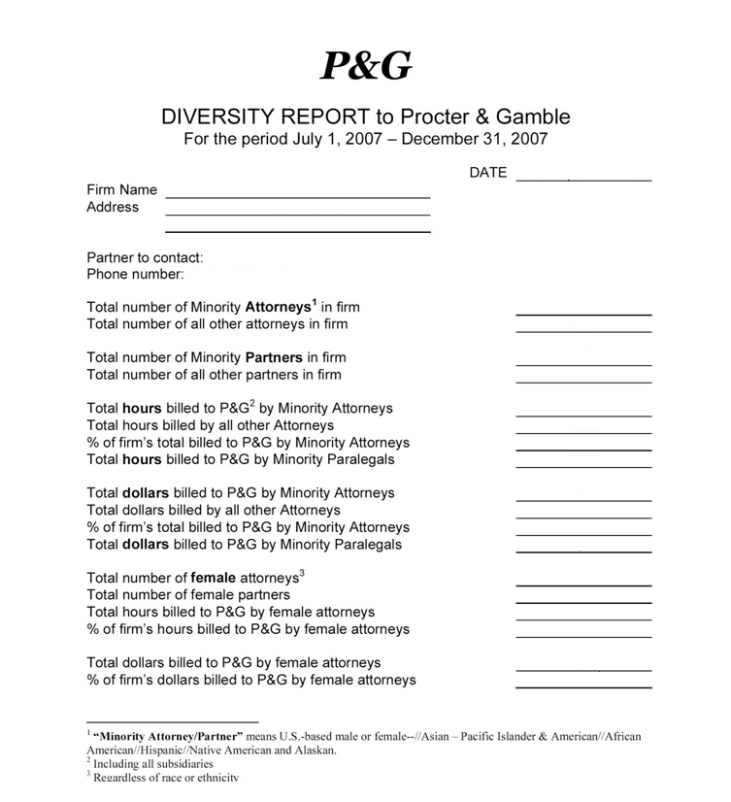

Slide 22
Where Businesses are Heading
Some of them have been trying for a long time to get it right but they keep trying!

Slide 23
Diversity as a business principle – Goldman Sachs - 2003
“For us to be successful, our men and women must reflect the diversity of the communities and cultures in which we operate... Being diverse is not optional; it is what we must be.”
(Goldman Sachs 2003)

Slide 24
Diversity as a Business Principle – Goldman Sachs - 2020
August 5, 2020: Update on Inclusion and Diversity at Goldman Sachs, Including New Aspirational Goals
Attracting and developing a diverse workforce is essential to help our firm advance sustainable economic growth and financial opportunity…

Slide 25
Diversity as a Business Principle –Goldman Sachs – 2020 cont’d
…Last year, the firm set forth aspirational goals and a comprehensive action plan to increase diverse representation at all levels and create an even stronger culture of inclusion for all of our people. The positive results we have achieved since, including more diverse representation for our 2020 campus analyst class – which comprises a majority of women for the first time, and our highest representation of Black talent in the Americas and Asian talent globally – and the Managing Director Class of 2019 – our most diverse to date – demonstrate the power of setting aspirational goals and holding ourselves accountable.

Slide 26
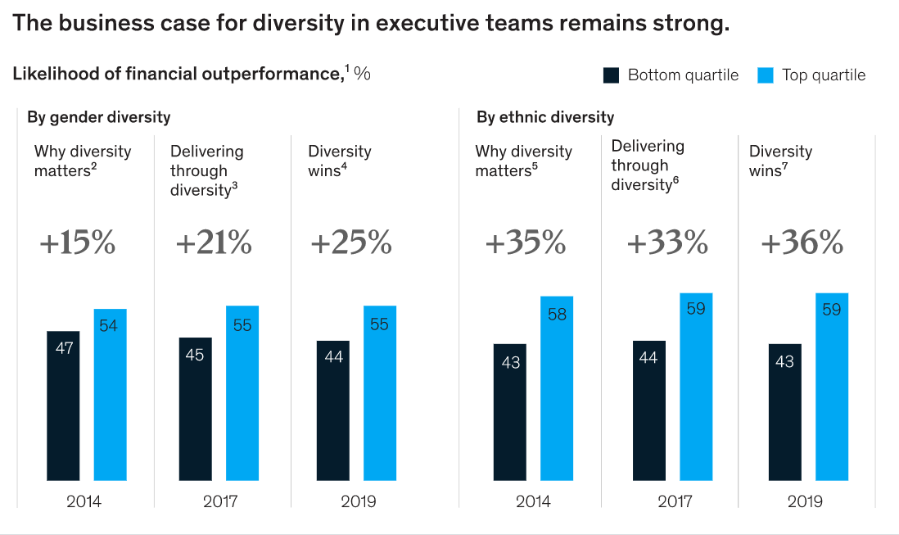
The Data Shows that Progress is Slow

Slide 27
So What Should You Do? Allyship and Accountability
What Does This Really Mean?
How Do You Implement ?

Slide 28
What does this really mean?
Make DE&I a priority and Treat it like any other business decision/priority
Hold managers and executives accountable for failures to achieve objectives
Focus on Individual and Corporate Responsibility
Establish confidential methods for reporting concerns

Slide 29
When you’re Back at Your Office Remember
“If you want to compete globally, you have to understand that 80% of the globe isn’t white and 50% isn’t male.”
-- Luke Visconti, Co-Founder of Diversity Magazine

Slide 30
Thank You

