Slide 1



VIRTUAL EMPLOYMENT INVESTIGATIONS
Navigating today’s biggest challenges
*Presented by Axiom

Slide 2
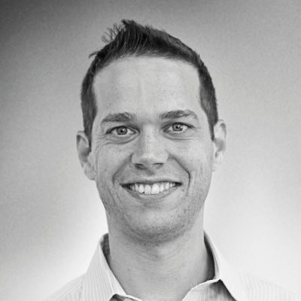
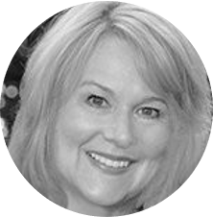

OUR PANEL
MODERATOR
DAVID FELDMAN
Director of Solutions Marketing
Axiom
LIZA RING
Labor & Employment Lawyer
Axiom

Slide 3

PROPERLY SET-UP AND RUN AN INVESTIGATIONS PROCESS, AVOIDING MISTAKES

Slide 4

Uphold the integrity of investigations while in a virtual environment

Slide 5

Build the right unbiased investigations team, leveraging internal and external resources

Slide 6
01 | A well-run investigations program, which includes investigations protocols, will pay off in the long run.
02 | Ensure that you have chosen the right investigators and that they are trained.
03 | Preserve data.
04 | Consider that unconscious bias may impact the investigation.
05 | Identify takeaways from your investigations and build them into your HR or legal processes.
06 | Virtual investigations will be part of investigations strategies in the future.
TAKEAWAYS

Slide 7
Q&A

Slide 8
Thank you FOR JOINING

