Slide 1
Membership Chair Call
January 26, 2017

Slide 2
Membership Fundamentals
Sara Miller, MBA, CAE, PMP
Senior Director, Membership Operations
s.miller@acc.com

Slide 3
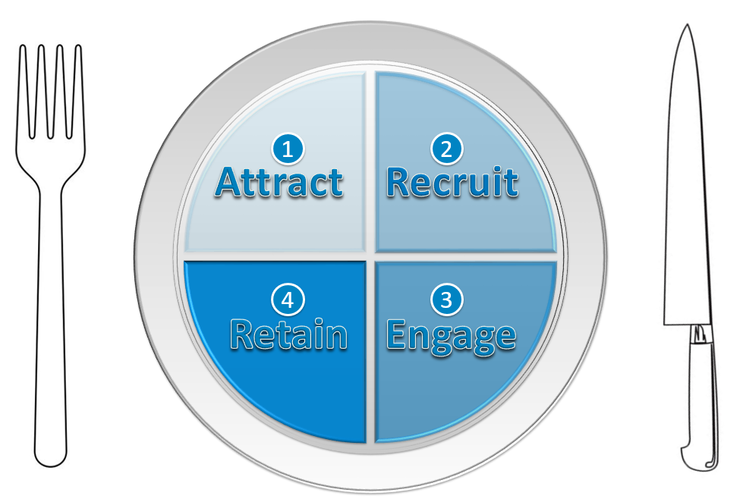
Membership: A Balanced Diet

Slide 4
Membership Sustainability and Growth
Membership is a sales cycle.
You need people in all stages to maintain (and grow!).
Don’t leave strategy to chance. Set the course for where you want to go.
  Increase # of members by ___
  Increase prospect conversion by ___
  Increase member retention by ___

Slide 5
attract: to draw by appealing to the emotions or senses, by stimulating interest, or by exciting admiration; allure; invite
http://www.dictionary.com/browse/attract
1
Attract

Slide 6
People are looking for YOU!
meetings
people
newsletters
online presence
outside speaking engagements
social media – the organization’s, your personal
customer service

Slide 7
lapsed members
current members
non-members
volunteers
Board of Directors
other organizations
media
government
others?
Who is speaking FOR your organization?
Who is speaking ABOUT your organization?

Slide 8

What are people saying?
(Don’t make assumptions.)

Slide 9
Control the Message
Find out what people are saying
Decide what you WANT people to say
Give people the “right” language
survey
secret shopper
quiz
accomplishments?
benefits?
organization’s purpose?
elevator speech
one pager
scripts
never stop updating

Slide 10
recruit: to engage in finding and attracting employees, new members, students, athletes, etc.
http://www.dictionary.com/browse/recruit
2
Recruit

Slide 11
Develop a Recruitment Campaign
Audience
Offer
Pitch
Communication Method
Tracking

Slide 12
Audience
“…whom you target with your promotion is the single biggest factor in the success or failure of your efforts.”
Membership Essentials, p. 171
“New members can be found in lots of places, but the easiest sources are people who already know your association…or know your members…”
199 Ideas: Membership Recruitment and Retention, p. 15

Slide 13
Audience: How Get the Names
Your database ($=L) | Events ($=L, H)
Donors People who request information Non-members on your mailing list Product buyers | Selected speakers Not selected speakers Non-member attendees
Referrals ($=L) | List Purchase ($=H)
Informal recommendations Formal recruitment campaigns | From like-minded organizations From organizations with similar client-base Magazine subscribers $100-$200/1,000 names

Slide 14
Offer
What should you offer in your membership recruitment package?

Slide 15
Pitch
“…the recipient should already have a cursory interest in what you have to offer; it’s the copy’s job to make the recipient an offer he/she can’t refuse.”
199 Ideas: Membership Recruitment and Retention, p. 20-21
“Understand that your campaign needs to be designed towards your list.”
199 Ideas: Membership Recruitment and Retention, p. 21

Slide 16

A “feature” is not a “benefit.”
Translate a tangible offering into how it will benefit the member.

Slide 17
Feature | Benefit
As a member, you receive 12 monthly issues of our Alert newsletter. | Our Alert newsletter gives you instant access to job critical reports.
Receive the flagship magazine of the ABC association. | ABC’s magazine tells you the real story you won’t find anywhere else.
Membership Essentials, p. 176

Slide 18
Tracking
“Perhaps the most important, but most overlooked, discipline in membership recruitment is testing and then tracking the results of marketing tests.”
Membership Essentials, p. 177

Slide 19
Develop a Recruitment Campaign
Audience
Offer
Pitch
Communication Method
Tracking
What does the prospective member do?

Slide 20
Do I know any members?
Are the members like me?
Are the members like who I want to be in 5, 10 years?
Can I see myself in this group?
Do I fit in?

Slide 21
find a job
find a better job
get (more) involved at a local level
get (more) involved at a national level
build up my resume
help resolving a problem at work
how to enter the field
learn about specific issues
get published
What do I need?

Slide 22
Will membership help me personally?
Will membership help me professionally?
What are the features of membership?
How will the features benefit me?
Am I helping my profession?
What do I get?

Slide 23
How much are dues?
Do I have to pay 100% or will my company help?
Are there other costs besides dues?
How long until I see value?
Is it worth it?
How much?

Slide 24
Did I get what was promised?
Was I welcomed into the organization?
Are they glad I’m here?
Is it worth the money?
How is it?

Slide 25

engagement: capturing the attention, affiliation and loyalty of members by giving them what they need through highly relevant value-building activities.
Membership Essentials, p. 206
engagement: the result of a person investing time and/or money with the organization in exchange for value.
Maximum Engagement, p. 3

Slide 26
The Path to Engagement
introduce
involve
engage
1
2
3
action | Introduce (ACC) to potential and existing members – who we are what we do how we help in-house counsel how we can help you
action | Highlight “entry” opportunities to get involved in the and in (ACC) activities (ACC) is making a difference join us and make a difference we know you’re busy; this won’t take all your time
action | Connect members with (ACC) opportunities based on interests and expertise; increase frequency, time commitment (ACC) is THE organization for your time, money we have what you want/need

Slide 27
Meaningful connections and experiences for your members will keep them coming back.
101 Ideas: Member Service and Engagement, p. 31
Engagement is evidence of success and provides fuel for your mission
and future growth.
Maximum Engagement, p. 4
Notes:
SARA

Slide 28
Four Steps
Brainstorm/Document all involvement/engagement opportunities.
Prioritize and decide when “engagement” begins.
Revise materials to focus on opportunities.
Move people through to higher engagement.
Notes:
SARA

Slide 29
Reach out to your stakeholders.
Have them list all engagement points across the entire organization.
  Write items on index cards.
  Request consistent information – amount of time, number of volunteers,
  internal lead, etc.
Collect index cards and organize into a master document.
  Eliminate duplicates.
  Resolve discrepancies.
Notes:
SARA

Slide 30
Attend your meeting
Write an article
Volunteer for a committee
Visit your website
Speak at your meeting
Post to an e-group
Recruit new members
Mentor new members
Read your newsletter
Notes:
SARA

Slide 31
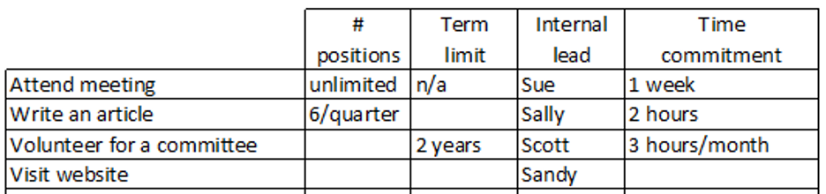
Reach out to your stakeholders.
Have them list all engagement points across the entire organization.
  Write items on index cards.
  Request consistent information – amount of time, number of volunteers,
  internal lead, etc.
Collect index cards and organize into a master document.
  Eliminate duplicates.
  Resolve discrepancies.
Notes:
SARA

Slide 32
Document all involvement/engagement opportunities.
Prioritize and decide when “engagement” begins.
Revise materials to focus on opportunities.
Move people through to higher engagement.
Notes:
SARA

Slide 33
Is an engaged member someone who…
Serves on your Executive Board/Board of Directors
Writes an article
Volunteers for a committee
Mentors new members
Attends your meeting
Reads your newsletter
Recruits other members
Speaks at your meeting
Visits your website
Notes:
SARA

Slide 34
Opportunities don’t carry the same value
(to you or the member).
Notes:
SARA

Slide 35
Prioritize opportunities. (How involve your stakeholders?)
Develop map/flowchart/cycle – any format that will help you illustrate the opportunities within your organization. (sample)
Slight modifications to the document and you can use it externally.
      Internally: Help staff, key volunteers understand priorities; allocate resources accordingly
      Externally: Show individuals (members/non-members) how they can get involved in the organization.
      3. Define “engagement” for your organization.
Notes:
SARA

Slide 36
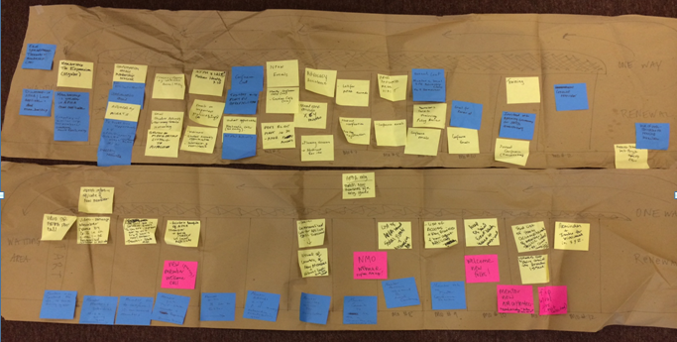

Slide 37
Document all involvement/engagement opportunities.
Prioritize and decide when “engagement” begins.
Revise materials to focus on opportunities.
Move people through to higher engagement.
Notes:
SARA

Slide 38
Research how you currently communicate opportunities.
Understand actual (current) member/non-member participation across opportunities. Use as benchmarks to gauge impact of new strategy.
Based on organizational priorities, revise materials to
  better communicate opportunities.
  highlight key opportunities.
Remember:
  Communicate to members and non-members.
  An individual’s priorities may not match the organization’s. Highlight opportunities of various time commitments, skill sets, etc.
  5. Establish metrics for measuring impact of your engagement strategy.
Notes:
SARA

Slide 39
Document all involvement/engagement opportunities.
Prioritize and decide when “engagement” begins.
Revise materials to focus on opportunities.
Move people through to higher engagement.
Notes:
SARA

Slide 40
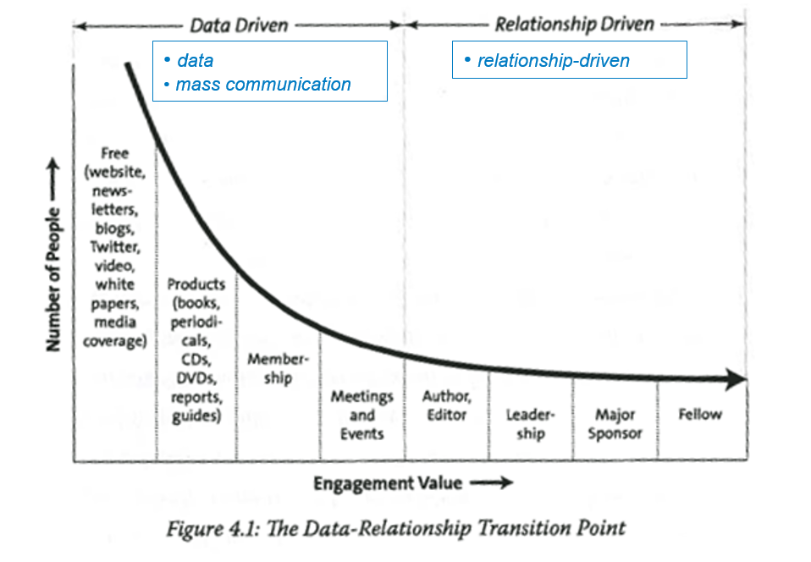
“Engagement Acceleration Curve”
Maximum Engagement, p.32

Slide 41
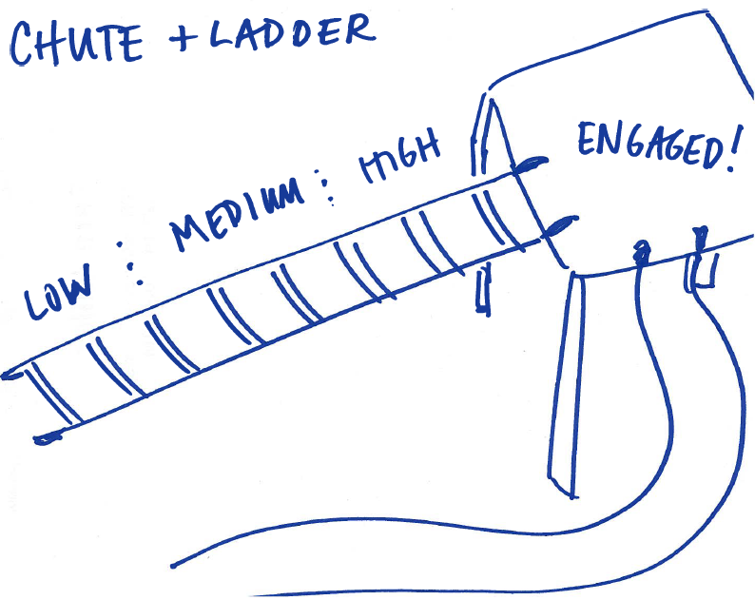
Membership Engagement

Slide 42

…it costs five to six times more to recruit a new “customer” than it does to keep an existing one.
199 Ideas: Membership Recruitment and Retention, p. 55
Any discussion of renewing members must begin with the understanding that the association needs to deliver value to members in order to keep them.
Membership Essentials, p. 182

Slide 43
Metric | Description | Formula | Example
response rate | number of prospects who responded to a marketing effort | total number of responses / total number of prospects contacted X 100 | (250/50,000) x 100 = .50%
renewal rate | number of members kept over a given period of time -- usually during a fiscal or calendar year | total number of members today (minus 12 month new members) / total number of members in previous year | (105 -15)/100 = 90%
average tenure | how long, on average, members stay with an association | calculate reciprocal of renewal rate (1 – renewal rate) 1/reciprocal = AT | 1 – .90 = .10 1 /.10 = an average tenure of 10 years
http://www.regionalassociation.org/NR/rdonlyres/41676B70-06CA-47BA-9F68-5B32AA0EEBE8/11321/TheEconomicsofMembership110906.pdf
http://www.marketinggeneral.com/blog/2010/09/10/membership-marketing-calculations-and-formulas/

Slide 44
Approximately half [of respondents who have ever dropped their association membership] indicate their reasons had more to do with career and other life changes than with the performance of the association.
Membership Essentials, p. 183

Slide 45
A renewal’s primary purpose is not to collect money; it’s to re-sell the member on your association and get them to re-join... Sometimes this is required in order to get the member to renew, and this is why many will not renew if all you do is send them a bill.
199 Ideas: Membership Recruitment and Retention, p. 63

Slide 46
It’s time for the person to renew – connect their original needs with what the association delivered over the last 12 months.
What did members want?
What has the association done?
What is the association planning to do?
“Increasing the menu of programs and services was an attempt to increase the value of belonging. The thinking was that the more an association offers with membership, the more value membership has. Wrong. Unused services have no value.
Race for Relevance, p. 11

Slide 47
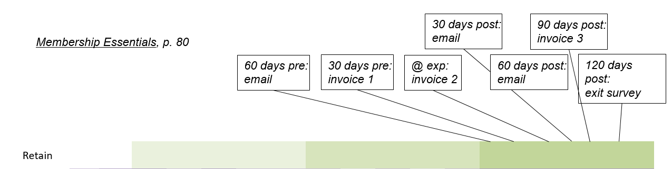

Slide 48
Thank the member for being part of your association.
Remind the member why they joined.
  If you don’t know specifics, you can probably take an educated guess based on their member type, employer, etc.
  If not, use general language that describes a broad group of members.
“The number one reason members join an association is because they believe the association will help them solve a problem.”
The End Of Membership As We Know It, p. 39

Slide 49
  Make your best case first. (Remind the member what the association has done.) The likelihood of renewal decreases significantly over time. If you are sending
    One reminder: Don’t send a 5 page letter – even though you only have one chance for the renewal. Keep the letter clean (focusing on top 3-4 programs/accomplishments). You can always include a flyer (or link to a webpage for email) with additional information.
    Multiple reminders: Identify messages and divide them across the notices. Start with most popular and then move to benefits that are high value, but to a smaller audience.
    Focus on tangible and intangible benefits.
      Results oriented? Give more numbers, hard outcomes.
      Greater good? Story-telling and first hand accounts from other members.
“The renewal communications you design should have a clear theme or story line running throughout the entire series.”
Membership Essentials, p. 185

Slide 50
It’s about the us and we. You want the member to feel like they were a part of the accomplishments AND that it would matter if the member was no longer part of the association.
Give a deadline – from vague (renew today) to specific (by x/x/xx so you can…).
“…members of all ages are likely questioning the value of membership in your association, but the youngest will continue to pose this question for the next 19 years. They demand a return on investment unlike any other generation that has come before them.”
The End Of Membership As We Know It, p. 5

Slide 51
“Meaningful connections and experiences for your members will keep them coming back.”
101 Ideas: Member Service and Engagement, p. 31
You can’t wait until the 364th day.
Notes:
SARA

Slide 52
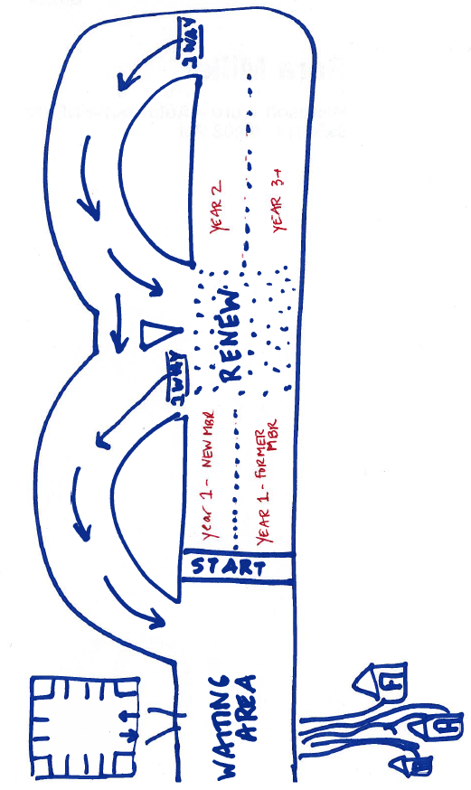

Slide 53
Retain
Involve/Engage
Recruit
Attract
Day 1
Day 365
Membership is a year-round activity.
You are always
recruiting new members
retaining existing members.

