Slide 1



California Privacy Law

Slide 2
What's new or on the horizon in California Privacy Law?
CCPA Regulations became final on August 14, 2020
CCPA New Exemptions for Medical and Health Information
California Invasion of Privacy Act – Smith v LoanMe Inc.
Anti-Spam lawsuits on the rise
CPRA Qualifies for the November Ballot

Slide 3
CPRA against CCPA and GDPR
 | CPRA | CCPA | GDPR
Data Rights | Access, Deletion (+Business Notification Duty) Portability, Say No to Sale, Rectification Limit Use of Sensitive Personal Information | Access, Deletion, Portability (Implied), Say No to Sale Non-Discrimination | Access, Deletion, Portability, Say No to Sale (Implied under right of objection), Rectification Limit Use of Sensitive Personal Information
Requires "Do Not Sell My Personal Information" Button | Yes (+Do not share personal information for cross-context behavioral advertising) | Yes | No
Service Provider Contracts | Characterize recipient as service provider or contractor, more prescriptive provisions regarding what agreements with contractors should contain, direct obligations on service providers to assist business with CPRA compliance activities | Prohibit disclosure, use, retaining or selling personal information, certification requirements, security practices | Processor requirements under Article 28 of the GDPR, SCCs 2010
Storage Limitation | Yes | No | Yes
Data Minimization | Yes | No | Yes
High Risk Processors Required to Perform Risk Assessments | Yes | No | Yes
Penalties for Stolen Email + Password | Yes | No | Yes
Right to Opt Out of Advertisers Using Geolocation | Yes | No | Yes
Covers Employees | Retroactively Extends Delay Until January 1, 2023 | Delayed Implementation Until January 1, 2021 | Yes
Dedicated Enforcement Agency/Authority | Yes | No | Yes

Slide 4
Key Action Items for CPRA Compliance
New link: New link on website would be required if company shares personal information for purposes of cross-context behavioral advertising
New Service Provider Contracts: Service provider contracts would have to address direct obligations to assist businesses with CPRA compliance activities
Revised notices: At collection companies would have to state if personal information is sold or "shared“ and retention period per category of information or "criteria"

Slide 5
Top 10 CCPA Action Items
Decide whether to sell or not to sell with key stakeholders in the company
If you decide to sell (or can't avoid selling personal information) post "do not sell my personal information link" on every website and create simple opt-out mechanism
Notify vendors and business partners not to sell (effective January 1, 2019) and update contracts to eliminate/avoid selling of personal information
Prepare privacy notices for all situations where your company collects personal information from California residents (e.g., from website visitors, employees, job candidates, contractors, and vendors) and ensure that such notices are issued to California residents at or before the point that collects their personal information
Post a privacy policy and notices in compliance with the Final Regulations of the California Attorney General
Create and pressure-test subject request mechanisms (access and deletion)
Conduct CCPA trainings
Determine whether you have to provide a “notice of financial incentive”
Update intercompany agreements
Monitor statutory amendments and enforcement actions

Slide 6
CCPA Enforcement. Any good news?
Trends
Over 40 actions as of September 1, 2020
Across several industries: Technology, Financial Institutions, Healthcare, Hospitality, Online Retail, Communications
3 main categories of non-data breach lawsuits – Unsuccessful So Far
Unfair Competition Law
Negligence Per Se Claims incorporating CCPA standards of care
Actions asserted directly under the CCPA.
Increase of appx. 30% of a lawsuit after a data breach

Slide 7
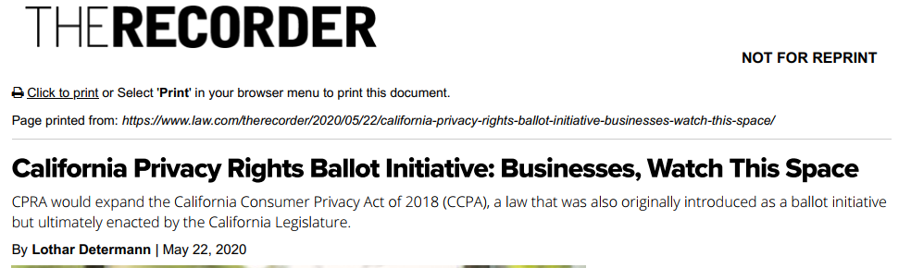



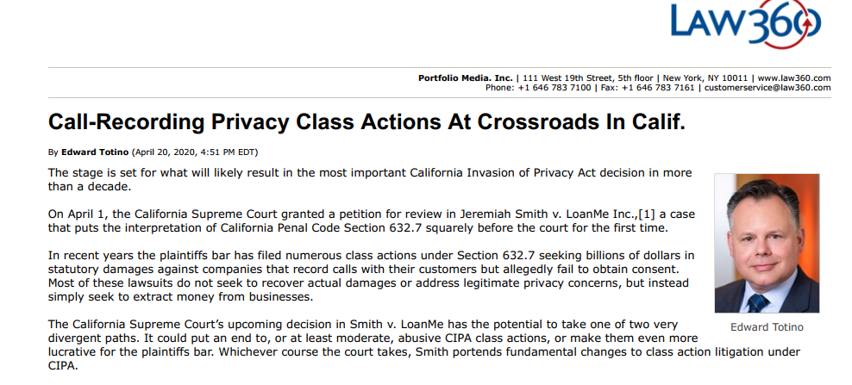
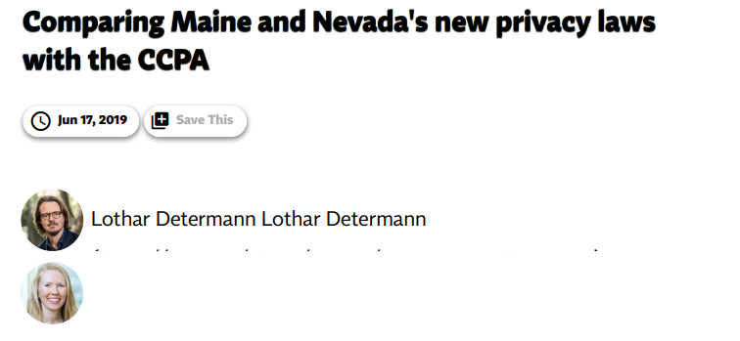
Resources
California Privacy Law
Practical Guide and Commentary
U.S. Federal and California Law
4th Edition 2020 by
Lothar Determann

Slide 8



Speakers
Lothar Determann
Principal, International Commercial
lothar.determann @bakermckenzie.com
Helena Engfeldt
Associate, International Commercial
helena.engfeldt @bakermckenzie.com
Andrea Tovar
Associate, International Commercial
andrea.tovar @bakermckenzie.com

