Slide 1
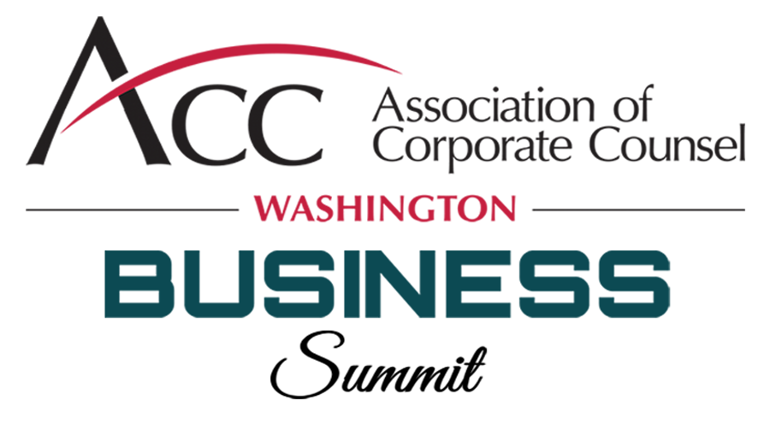
Handling Societal and Political Expression in the Workplace

Slide 2
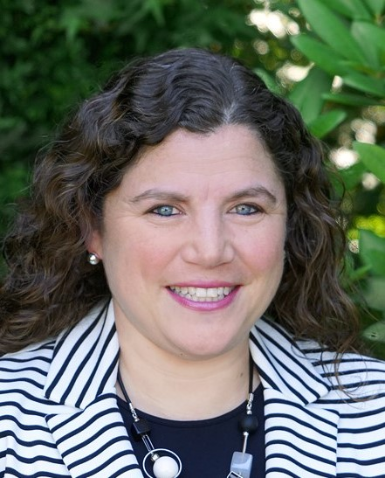
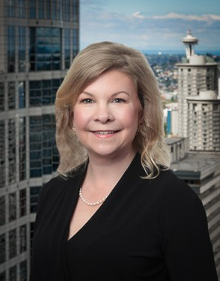
Today’s Presenters
Pamela Helman VP of Legal, MOD Pizza
Karin Jones Stoel Rives
Kirsten Koester
Stoel Rives

Slide 3
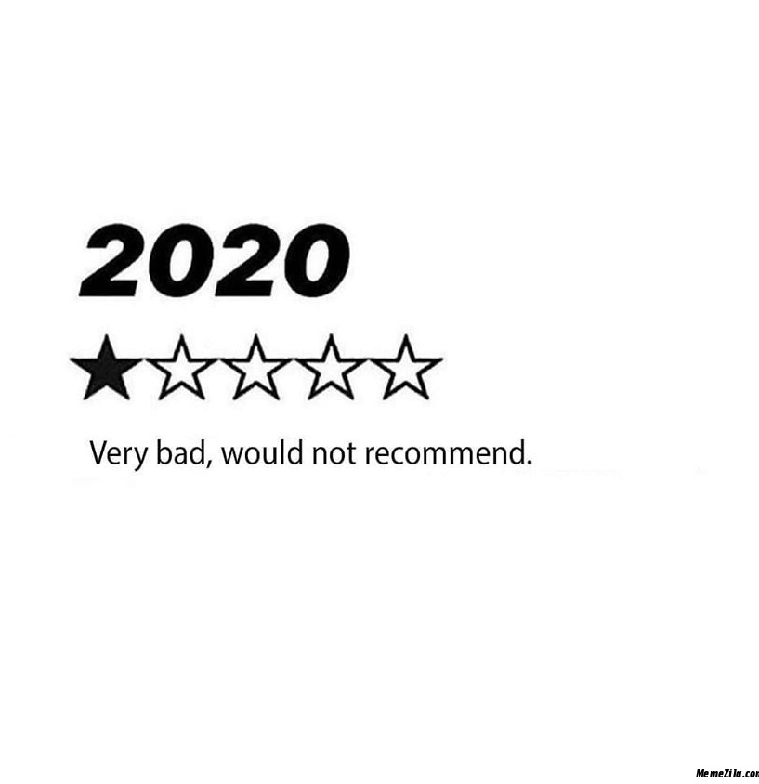

Slide 4
2020 Election Is Impacting Employees
78% discuss politics at work
47% had negative impact on performance
33% taking in more political news at work
36% avoiding co-workers based on ideology
. . . and this was way back in February!

Slide 5
Expression of Individualism in the Physical and Virtual Workplace

Slide 6
The First Amendment Myth
The First Amendment only applies to government action, not to private employers!
Depending on the circumstances, the NLRA may provide some protections for speech

Slide 7
Hypothetical
A group of employees come to work wearing apparel in support of BLM. Your company has a policy prohibiting political apparel but has previously permitted apparel supporting sports teams and LGBTQ issues.
Poll: Can you require these employees to remove their BLM apparel and discipline them if they refuse to do so?

Slide 8
Political Apparel
Employers are not required to accommodate politics in their dress codes
Okay to prohibit political messages on t-shirts, hats, masks, buttons, etc.
Any dress code should be applied consistently
Favoring or allowing one political message while prohibiting another could = trouble

Slide 9
Hypothetical
Your employee Joe isn’t hesitant to express his opinion that immigrants from Latin America shouldn’t be allowed to enter the United States or “take American jobs.” At times, he uses derogatory terms for Latin American immigrants when discussing his views. He has posted those views on social media and has also directed comments towards Latino co-workers.
Poll: Can you take action against Joe for his comments on social media and at work?

Slide 10
Laws Related to Off-Duty Conduct and Political Activity
Some states and cities have laws that prohibit employers from discriminating or retaliating based on:
Lawful off-duty conduct (e.g., Colorado)
Political activity (e.g., California)
Political ideology (e.g., Seattle, Utah)

Slide 11
The NLRB and Social Media Policies
The NLRA applies to non-union workplaces too
The NLRB shifts markedly depending on which party holds the presidency; what the law is now may be out the window in 2021 — or not
The Trump NLRB is affording employers greater leeway in handbook policies, using a “legitimate business justification” balancing test
Policies that chill employees from communicating about working terms and conditions with each other remain problematic

Slide 12
Enforcement of Anti-Discrimination and Harassment Policies
Politics can bleed over into issues related to protected classes (race, religion, sexual orientation, etc.)
Anti-discrimination/harassment policies and respectful workplace policies can and should still be enforced
Protecting employees from threats to their safety also remains important

Slide 13
Political Expression and Civic Engagement in the Workplace Setting

Slide 14
Hypothetical
Employee Anya brought a large stack of pro-choice flyers to the office. She has handed them out to co-workers and posted one on the break room bulletin board.
Poll: Can you prohibit Anya from distributing or posting the flyers?

Slide 15
Political Solicitations
Employers may prohibit political solicitations, including handouts re candidates and issues, solicitations for contributions, and solicitations for signatures
But be careful!
Non-solicitation policies should include exemptions for workplace issues protected under the NLRA
Again, consistency is key!

Slide 16
Hypothetical
You (company) are anxious for a particular initiative to pass because it will benefit your business operations. In the weeks leading up to the election, you post “Vote Yes for I-222” posters on company letterhead throughout the workplace, and managers are required to train employees on the benefits of I-222, urging them to vote for it to ensure that the company remains in business.
Poll: Is it okay for the company to promote its interest in the passage of I-222 among its employees?

Slide 17
Employer Political Pressure
Best practice: employers (including managers and supervisors) should avoid imposing political opinions on employees
Some states and cities expressly prohibit:
Retaliation against employees for failing to support a candidate or issue;
Communication of the company’s political position by management; and/or
Imposition of political opinions on subordinates
Employers cannot reimburse employees for political contributions

Slide 18
Recommended Steps to Consider
Know your laws on political expression and voting
Reiterate your policies about working time, communications, work attire, interactions, EEO, etc.
Foster an open door: be responsive to employee concerns/questions and be sensitive to potential discrimination/retaliation
Remind managers to report everything up
Remind managers to avoid political discourse and ensure they foster/maintain civility during campaign season; train them to interrupt employee conversations

Slide 19
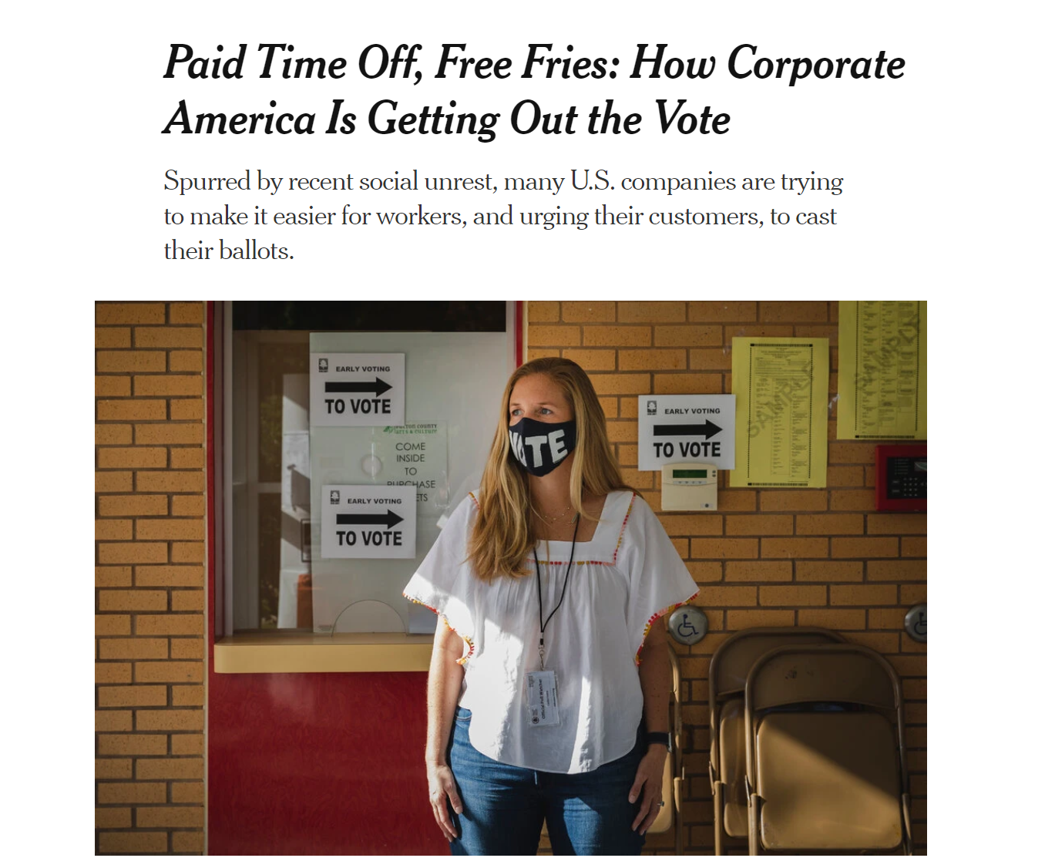
Get Out the Vote – 2020
More corporate employers are advocating for their employees to exercise their right to vote
Some are providing PTO
Amazon controversy
Neutral expression can have political overtones for some
Important to enforce non-partisan message internally and externally

Slide 20
Recommended Steps to Consider
Do not press employees to favor a particular candidate or cause
Consider controlling incoming media. Tune out what you are comfortable with. Support Nat Geo!
Etiquette for Zoom and virtual workplaces
Anticipate the 1st Amendment argument and think about your response
It ain’t over ’til it’s over — think about rescheduling some November events

Slide 21
Crisis Management – Election 2020

Slide 22
Planning for Business Continuity
Practice clear communication on various scenarios:
Employee safety
Employee availability
Public safety issues
Preparing for sustained protests and demonstrations

Slide 23
Questions?

