Slide 1


Return to Work Best Practices and Potential Pitfalls
Presented by:
Ruthie Goodboe (Pittsburgh)
Jenn Betts (Pittsburgh)
Notes:
RUTHIE

Slide 2


Speakers
Jenn Betts
Jenn.betts@ogletree.com
412-246-0153
Ruthie Goodboe
Ruthie.goodboe@ogletree.com
412-315-6044
Notes:
RUTHIE

Slide 3
Our Agenda Today
Quick recap of Pennsylvania reopening orders
Return to work planning and considerations
Refusal to work issues and best practices
Workplace leave and accommodation best practices
Reductions in force tips
Litigation issue spotting and trend analysis
Notes:
RUTHIE

Slide 4

Notes:
RUTHIE

Slide 5

Current Pennsylvania Landscape
As of June 5, 2020: 33 Pennsylvania counties are “yellow” and 34 are “green”
Key “Yellow Phase” Restrictions
  Telework must continue where feasible
  Businesses must follow PA DOH Business and Building Safety Orders
  Groups in excess of 25 prohibited
  Businesses must make employees and customers aware of PA guidance by posting and signing a COVID-19 Safety Procedures for Business Flyer”
  Must also appoint a Pandemic Safety Officer
Key “Green Phase” Restrictions
  Continued telework strongly encouraged
  Businesses must follow “updated” Business and Building Safety Requirements*
Notes:
JENN

Slide 6
Quick Overview of Business and Building Safety Requirements
Cleaning and disinfecting of high-touch areas and other areas
Establish a plan in case of a probable or confirmed case of COVID-19, including:
  Securing and decontaminating affected areas
  Identifying employees in close contact (~ 6 feet for 10 or more minutes) with a probable or confirmed positive from the period 48 hours before symptom onset through the patient’s isolation
    Asymptomatic close contacts should comply with CDC’s April 8 guidance
    Symptomatic close contacts should be sent home
    Prompt notification of close contacts
  Temperature checks pre-building entry for 100.4 degree temperature or above*
Consider staggered start/end times
Limit numbers in common areas (locker or break rooms)
Conduct meetings and trainings virtually if possible
Make sure employees have access to soap, water, and hand sanitizer
Provide masks to be worn at all times and make masks mandatory
Discourage non-essential visitors
Communicate these procedures
Notes:
JENN

Slide 7

To Mask or Not to Mask…
Does everyone really have to wear a mask? Per PA orders:
  Not necessary if a mask impedes an employee’s vision, if they have a medical condition, or if it would create an unsafe condition in which to operate equipment or execute a task
  Also unnecessary if individual is alone (e.g., driving a car, in an office alone)
  Not necessary when eating or drinking (whew!)
What about employee refusals to mask?
  Determine why an employee is refusing
  If a medical condition – evaluate whether the failure to mask will pose a health/safety risk for coworkers before you permit
Notes:
JENN

Slide 8
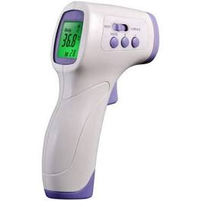
Considerations for Return to Physical Workspaces
Employee training and certification (including exposure) prior to return to work and ongoing
Temperature screening and symptom screening by employer
Daily employee self-certification as to no illness or symptoms
Avoid large gatherings and continue leveraging technology and virtual meetings
Elevator spacing and usage, with staggered start/end times or rotational staffing
Conference room closure/scheduling/distancing
Notes:
JENN

Slide 9
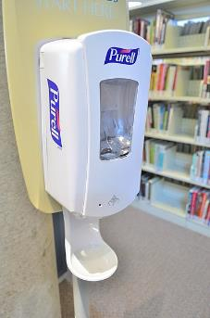
Considerations for Return to Physical Workspaces (cont.)
Common space, break room, shared storage closure/rules
Posting signage for employees to leave cabinets and shared storage units open at all times so that other employees do not need to touch handles or doors
Common supply elimination, restrictions, and cleaning (e.g., staplers)
Restricting access to common supplies (e.g., pens) and not sharing personal supplies
Restricting/tracking employee comings and goings during the day and outside meal and rest breaks
Notes:
JENN

Slide 10

Considerations for Return to Physical Workspaces (cont.)
No shared food/snacks
Enhanced cleaning and schedules, including keyboards, headsets, and high touch areas
PPE/cleaning supply considerations – what to require, permit, and how to get it
Providing gloves (latex and non-latex) for certain tasks, including sorting mail
Cubicle spacing/wall height
Notes:
JENN

Slide 11

Considerations for Return to Physical Workspaces (cont.)
Other ways to maintain social distancing throughout work areas
Potentially require masks at all times, regardless of local orders
Visitor restrictions, including pre-visit and visit questionnaires and signage
Return to work kits for employees, including a thermometer for self-monitoring, “hygiene key” for pressing buttons, hand sanitizer, and PPE prior to return
Creation of a whistleblower-like hotline for reports
Notes:
JENN

Slide 12
Considerations for Return to Physical Workspaces (cont.)
Implementing a “soft opening” consistent with state orders to phase employees back into the workspace before engaging in rotating shifts
Signed acknowledgments from employees to follow employer’s sanitization and social distancing policies
E-sign compliant electronic signatures for acknowledgments and papers
Review/revise corrective action policy for employees that do not follow implemented social distancing or sanitation rules
Use CDC posters and signage to supplement existing signage
Continued travel restrictions
Notes:
JENN

Slide 13
COVID Testing by Employers
Per EEOC Guidance issued on 4/23/20, employers may choose to administer COVID-19 testing to employees before they enter the workplace because an individual with the virus will pose a direct threat to the health of others
The testing must be done on a nondiscriminatory basis
Employers should ensure that the tests are accurate and reliable, which may be easier said than done
All COVID testing information about employees must be stored separately from their personnel files with limited access
Notes:
JENN

Slide 14
COVID Testing: Unanswered Questions
Does the EEOC’s guidance apply to COVID antibody testing?
Can employers require employees to obtain a test on their own prior to returning to work? If so, who should pay for it?
Does the EEOC’s guidance create liability for employers that are not able to procure COVID tests?
Can employers automatically terminate employees who refuse to take the COVID tests?
If employers do test, how often should they do so and who should conduct the tests?
Notes:
JENN

Slide 15
Employee Refusals to Work
Notes:
RUTHIE

Slide 16

Employee Refusals to Work
Section 5(a)(1) of the OSH Act (the “general duty clause”) requires employers to maintain a “workplace that is free from recognized hazards”
OSHA’s Personal Protective Equipment (PPE) standards (in general industry, 29 CFR 1910 Subpart I), requires using gloves, eye and face protection, and respiratory protection when job hazards warrant it
Thousands of complaints have been filed with OSHA over coronavirus safety lapses, including a lack of masks and working in close quarters
Notes:
DO YOU FEEL COMFORTABLE DOING THESE SUPER BASIC OSHA SLIDES? I CAN

Slide 17
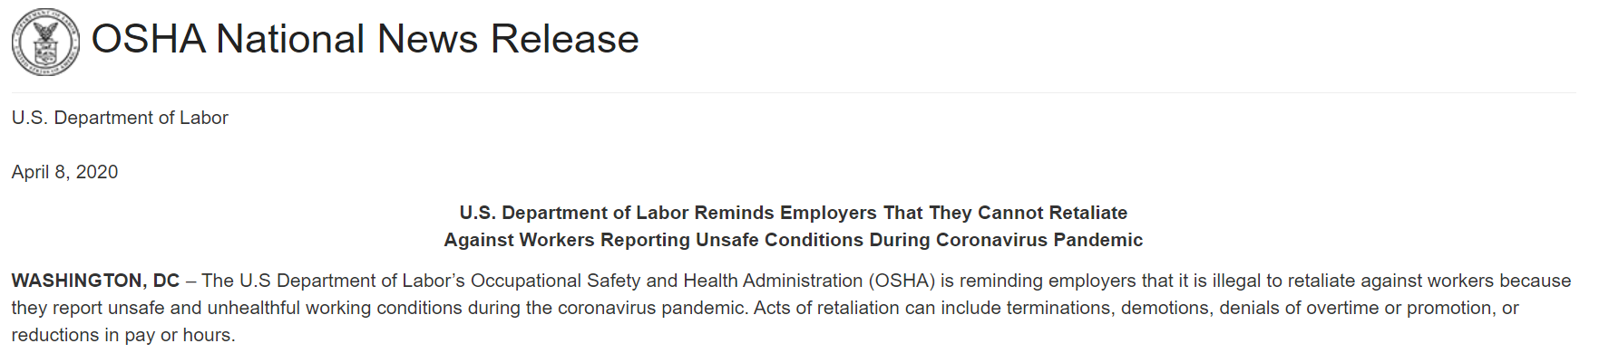
Friendly Reminder from OSHA
Notes:
SAME AS PRIOR ?

Slide 18
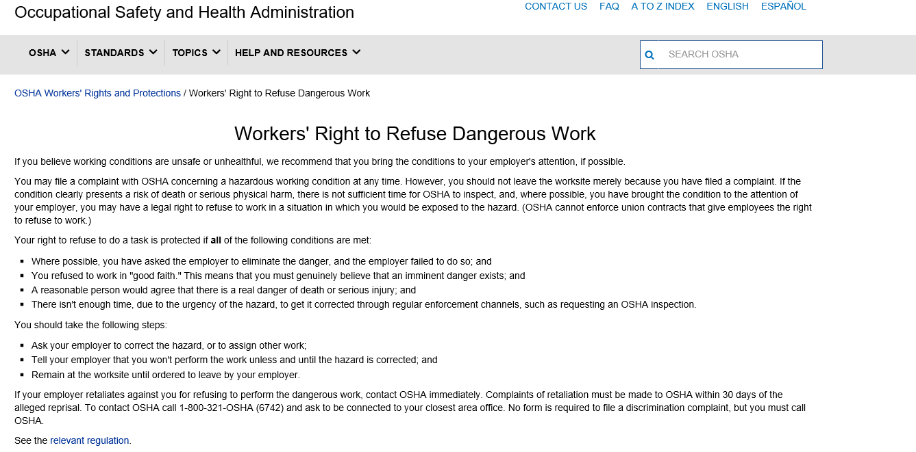
OSHA on Refusals to Work
Notes:
SAME AS PRIOR ?

Slide 19

National Labor Relations Act
Right to refuse work (strike) over working conditions believed to be unsafe or unhealthy
Mere fact that employees are engaged in collective action relating to workplace safety concerns may be sufficient to be protected
Certain conduct may lose protection of the Act
Fact employer believes sufficient measures taken or workplace deemed “safe” by government agencies may not cause loss of protection
Different analysis for unionized and non-unionized employees
Notes:
RUTHIE

Slide 20
Refusal to Work by Non-Unionized Employees
Must be concerted
No prior safety demand required
Good faith belief conditions are unsafe
  Can be “honestly mistaken”
  May turn on individual facts
Refusal to work is technically a ‘strike’
Strikers
  Can’t be fired for refusal to work
  Can be temporarily or permanently replaced
  May not be eligible for unemployment benefits
Notes:
RUTHIE

Slide 21
Refusal to Work by Unionized Employees
“No strike” provision in CBA may not prevent refusal to work/strike
  Section 502 provides safe harbor for “safety strikes”
Employees must have
  “Good faith belief”
  Supported by “objective” and “ascertainable evidence”
  Working condition is “abnormally dangerous”
Activity does not have to be “concerted”
May be temporarily, but not permanently, replaced
Notes:
RUTHIE

Slide 22

Other NLRA Considerations
Unconditional offers to return to work
True nature of strike
How working conditions are determined to be “unsafe” or “abnormally dangerous”
Employer rights
Notes:
RUTHIE

Slide 23

Best Practices for Employers
Create/update pandemic response plan
Assess the hazards to which employees may be exposed, evaluate the risk of exposure, and select, implement, and ensure workers use controls to prevent exposure
Train employees on safety measures and obtain acknowledgments
Continue to follow OSHA and CDC guidance
Adapt policies as the guidance changes, and retrain employees
Notes:
RUTHIE

Slide 24
COVID-Related Accommodation and Leave Requests
Notes:
RUTHIE TO INTRO

Slide 25
Responding to Employee Requests for Workplace Accommodations or Leaves
Step 1: Gather Necessary Information
  Confirm the basis/motivation for the request (do not assume)
  Ask whether employee has conferred with a HCP regarding their request (or if they plan to)
  Ask employee what specific job functions they believe they can perform/those they cannot perform
  Understand what workplace accommodations they seek
Step 2: Identify Applicable Laws and Policies
  Family Medical Leave Act
  Americans with Disabilities Act
  Families First Coronavirus Response Act
  Pregnancy Discrimination Act
  Age Discrimination in Employment Act
  Pennsylvania Human Relations Act
  Existing Employer Policies (e.g., Medical/personal LOA policy; Light duty/transitional duty policy; EEO/accommodation policies)
Notes:
JENN

Slide 26
Responding to Employee Requests (cont.)
Step 3: Identify Legal Obligations
  If employee is legally entitled to a leave of absence and is not open to considering workplace accommodations to remain working, move forward with leave process
  Is employee legally entitled to a reasonable accommodation?
    Employee’s request relates to a disability? YES
    Employee’s request is based solely on their age (over 65) – NO (but, they must be treated the same as similarly situated younger employees)
    Employee has a health condition that makes them vulnerable to increased risks related to COVID-19 (e.g., high blood pressure, chronic lung disease, diabetes, asthma, compromised immunities)? LIKELY
    Employee is caring for a family member with a high risk condition? NO
    Employee is nervous about risk to themselves? NO
    Employee would prefer to collect unemployment? NO
  If NO legal obligation, follow your applicable policies and treat employees as consistently as possible under the circumstances
Notes:
JENN

Slide 27
Responding to Employee Requests (cont.)
Consider:
  Consider reasonable accommodations available in employee’s current job
  Consider whether there are open/available positions for which the employee is qualified
  Consider whether a leave of absence is reasonable
Remember:
  Employers are not required to temporarily remove essential functions, but they can (proceed with caution/care in the case of the later, but this is an unprecedented situation)
  An accommodation is reasonable only if it is reasonably designed to allow employee to work and perform essential functions
  Be careful of which functions/roles you identify as essential
Notes:
JENN

Slide 28
Responding to Employee Requests (cont.)
More accommodation pointers:
  Employee is not entitled to their preferred/requested accommodation, only a reasonable accommodation. Employers can exercise their judgment and make a choice.
  Employee should be active participant in the interactive process
  If you are unsure if accommodation will work, you may need to conditionally give it a try
  Don’t forget your own policies
  Document interactive process and decisions
  Qualify all granted accommodations as temporary and based on current business needs
Notes:
JENN

Slide 29
A Quick Word About RIFs
Notes:
RUTHIE TO INTRO

Slide 30
A Quick Summary of RIF Tips
Tip 1: Train decision-makers, consider multiple decision-makers, if possible, and diversify team
Tip 2: Choose and document criteria for termination selections; lean towards objective criteria over subjective if feasible and do not deviate from criteria
Tip 3: For every phase of a RIF, consider how privilege applies; consider on the front end, not after the RIF is completed; label form documents as “privileged” before they go into use
Tip 4: Consider a statistical analysis when terminating/laying off 10 or more employees, but retaining other employees at the same location or in the same similarly situated employee group
Tip 5: Make sure you are comfortable with your severance form; if you don’t get the ADEA releases right, employees get to keep their severance and still sue you for age discrimination
Tip 6: Don’t forget about the WARN Act; it usually requires 60 days of notice in the case of a plant closing or a mass layoff
Notes:
JENN

Slide 31
Here Come the Lawsuits
Notes:
RUTHIE TO INTRO

Slide 32
Plaintiff’s Lawyers are Ready to Roll
Notes:
RUTHIE

Slide 33
National Labor and Employment Filings
Notes:
JENN

Slide 34
Emerging COVID Claims
Notes:
RUTHIE

Slide 35

Questions?

Slide 36
Thank you!
Ruthie Goodboe
Ruthie.Goodboe@Ogletree.com
Jenn Betts
Jenn.betts@Ogletree.com

