Slide 1



Modifying MSAs for IP and Privacy Provisions
Han Santos, PLLC
Nabil Abdalla
Shamim Mohandessi
Gloria Steinberg
Guest Speaker: Mohamed Khalil

Slide 2
Agenda
What are Master Service Agreements?
Utility of Master Service Agreements in Mid to Large Organizations
Common Addendums
Case Studies and Examples
Best Practices for Negotiating in Situations with Asymmetrical Bargaining Power

Slide 3
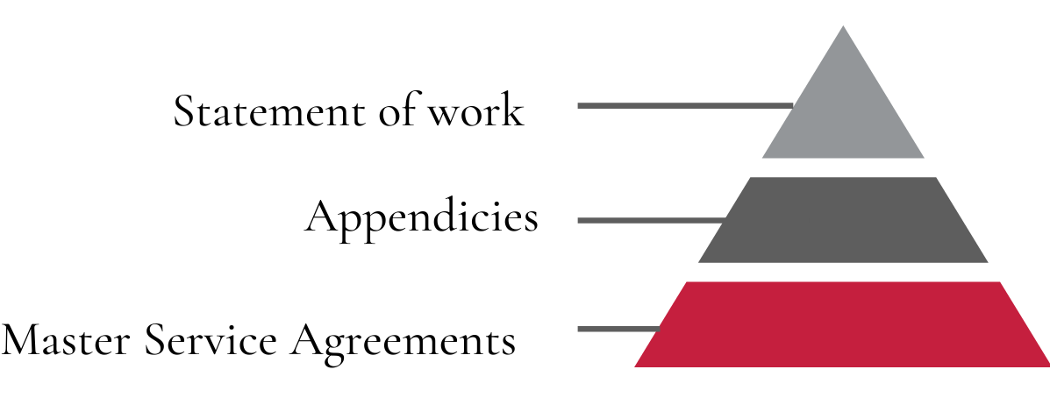
What are Master Service Agreements?
MSAs are modular agreements with appendices and addendums for specific classes of services, goods and products.

Slide 4
Utility of Master Service Agreements in Mid to Large Organizations
MSAs are generally seen as a way for mid-size and large organizations to contract with vendors, service providers and licensors in an efficient manner without negotiating individual third-party agreements.
MSAs create consistency around contracting and allow companies with high volumes of contracts to create common terms, resulting in more manageable contracts.

Slide 5
Common Appendices/Addendums in Master Service Agreements
Software Addendum
Professional Services Addendum
Cloud Addendum
Hardware Addendum
Data Management Addendum
Notes:
Software Addendum
License grant
Ownership of Work Product
Maintenance
Professional Services Addendum
Order/Obligations of Professional Service Providers
Cloud-Based Services/Hosted Services Addendum
Privacy Provisions Necessary for Cloud-Based Services
Data Security Org (DSO) and Third Party Risk Management (TPRM) Considerations
Hardware Addendum
Privacy and IP Protection of On-Prem/Off-Prem Devices
Data Management Addendum
Obligations of Data Handlers and Rights to Source Data, Ownership of Data
Ownership of Machine Learning Models Based on Data

Slide 6
Case Study #1
Background:
Company A enters into an MSA with Company B to access Company B’s research dataset comprising PII in its cloud-based research environment to carry out research analysis.
Terms:
Company A:
does not grant any software license;
maintains ownership of its ML algorithms and models; and
owns the resulting data
Company B:
grants a research license to Company A;
will maintain its research environment;
maintains the ownership of the research dataset; and
will abide by privacy provisions necessary for managing the research environment

Slide 7
Case Study #1 (continued)
Intellectual Property Ownership.
Software and Documentation. Licensee acknowledges that, as between Licensee and Licensor, Licensor owns all right, title, and interest, including all intellectual property rights, in and to the Software and Documentation, including Updates or improvements thereto.
Results. Licensor acknowledges that, as between Licensee and Licensor, Licensee owns all right, title, and interest, to the Results.
Professional Services. Company B will provide to Company A the Professional Services, including those identified in an applicable Order. Each Order will identify the relevant Professional Services. If Company B provides Professional Services in the absence of an Order and Company A accepts such Professional Services, this Agreement will apply unless otherwise mutually agreed in writing. Company B will provide all equipment, software, and supplies required to perform the Professional Services. Company B will, at no cost to Company A, promptly and satisfactorily correct any non-conforming or defective Professional Services.

Slide 8
Case Study#2
Background:
Company A, an EU corporation, operating within the EU and US, offers a mobile device application that alerts its subscribers of location-based real-time safety incidents
Company A relies on crowdsourcing among its subscriber base to provide safety alerts. User’s sign up, and if an incident it reported, all users that subscribe to receiving alerts and are within proximity to the incident, receive a notice.
Company A relies on Company B, a U.S. Corporation, to efficiently process its EU and US subscriber data
Important Points:
Company A collects EU and US subscriber personal information to facilitate incident notifications
Data collected within the EU is transferred to a U.S. company for processing
Company A owns, or upon assignment by the creator will own, all right, title, and interest in all Work Product (including all IPR in such Work Product).
Terms:
Data transfer agreements
Schrem II decision
Privacy Shield
Standard Contracts Clauses (SSCs)
Binding Corporate Rules (BCRs)
Data minimization
Data anonymization

Slide 9
Case Study #2 (continued)
Additional Background:
Company A has expanded its services to include a new contact tracing feature, which uses Bluetooth technology to keep a log of a user’s close-contact with other subscribers over a 14-day period. If one subscriber indicates on the app that they test positive to an infectious disease, then all other subscribers that came into contact with the subscriber over the 14-day period, receive an alert.
Important Point
Scope of subscriber consent (i.e. contact tracing feature only)

Slide 10
Sample Privacy/Security Clause
Access. Company B has the right to access, review, and retain Company B Data held by Company A, including all computer or other files containing Company B Data, and Company A will ensure Company B has prompt and unrestricted access to such Company B Data. Company A will provide Company B with all passwords, codes, comments, keys, and documentation necessary for such access and to use the Services.
Restrictions. Company A may collect, use, store and retain only the Company B Data expressly authorized under the applicable Order solely as necessary for Company A to perform the Professional Services in accordance with this Agreement and such Order. Company A (including its Affiliates and their Personnel) will not: (i) otherwise collect, monitor, use or retain any Company B Data; (ii) collect Company B Data by means other than those authorized in this Agreement or the applicable Order or (iii) monitor, collect, use or store any personally identifiable information other than on behalf of, and as directed by, Company B.
Security. In providing the Services, Company A will comply with Company B's Security Policy. Company A will immediately notify Company B of any security breach relating to the Services that may involve Company B's Confidential Information or Company B Data.

Slide 11
Case Study #3
Background:
Company A enters into an MSA with Company B to load Company A's software on Company C’s GPU so that Company B can develop its products using Company C’s GPU preloaded with Company A’s software that can collect certain data from IoT devices operated by Company B's customers.
Terms:
Company A:
grants a limited license to Company B;
grants rights to create derivative work to Company B;
assigns all rights to the work product to Company B; and
provides maintenance and support to Company B
Company B:
maintains ownership of the derivative work; and
provides grant back to Company A

Slide 12
Case Study #3 (continued)
License. Company A hereby grants Company B, its Affiliates, and their contractors solely for the Permitted Purposes to Company B and its Affiliates, a non-exclusive, limited, non-transferable, non-sublicensable, irrevocable right and license to install, test, use, reproduce, distribute, modify or create derivative works or improvements of the Software.
Grant-back. Company B hereby grants to Company A, its Affiliates, and their contractors a worldwide, royalty-free, a fully paid-up, irrevocable, and non-exclusive right and license to use, sell, and offer for sale the derivative works created by Company B ("Grant-Back License").
Work Product. Company B owns, or upon assignment by Company A, will own, all right, title, and interest in all Work Product and intellectual property rights thereto. To the extent that any Deliverables does not qualify as Work Product, Company A irrevocably transfers its ownership, right, and title to the Deliverables under this Agreement.
Support and Maintenance. Company A will provide to Company B the Professional Services, including support and maintenance services as identified in Exhibit A.

Slide 13
Best Practices for Negotiating in Situations with Asymmetrical Bargaining Power
Consider interplay among different provisions
Grant Back
Acceptance Criteria
Liquidated Damages
Termination
Limitations
Derivative Works
Fees
Payment Terms
License

Slide 14
Best Practices for Negotiating in Situations with Asymmetrical Bargaining Power
More leeway with work orders and other addendum
Look at the big picture
Ultimate objective of the parties and business interests
What is the bottom line

Slide 15





Question & Answer
Nabil Abdalla
Senior Associate
Nabil@hansantos.com
Shamim Mohandessi
Senior Associate
Shamim@hansantos.com
Gloria Steinberg
Senior Associate
Gloria@hansantos.com
Mohamed Khalil
Senior Corporate Counsel
Mohamed.khalil@medstreaming.com

