Slide 1
Fostering Effective Partnerships with Outside Counsel
July 2020
Toby Brown, CPMO
John Hardin, Partner
Perkins Coie

Slide 2
First: What Do We Mean By Innovation?
Not the Back Office
Some on the Business Model
e.g. New Roles
But Really - Client Delivery Model
Today’s Subject

Slide 3
Case Study: Law Firm / Client Collaboration
Understand the Client’s Problems
For Pricing and Delivery
Agree on any Solutions
Internal Risk!
Build Innovation into the Pricing
Build it into the Engagement
Include Allied Professionals
LPM, KM, Process, …

Slide 4
Same Profession – Different Support
Law Firm
(Lawyers)
Company
(Products)
Admin
HR
IT
FIN
HR
IT
FIN
Practice Mgmt.
Marketing and BD
Bus Ops
Product Mgmt.
Marketing and BD
Business Intake
Diversity
Operational Support
Legal
Pro Bono

Slide 5
Case Study: Outcome of ‘Ops’ Collaboration
Client Advantage Presentation:
How to get the most value from Law Firms
Project: Large Volume Contract Review
Identified Needs:
Cost Management
Savings and Predictability
Consistent Review
Lower the burden on in-house team
Scalability

Slide 6
The Collaborative Solution: Built into Engagement
Fixed Annual Portfolio Fee
With Scoping and Regular Reviews
Next-Gen Intake Process
Process Driven!
Expert System / Workflow
Extended into client side
Dedicated LPM Resource
Use of Alternative Staffing
Client had to be OK with this

Slide 7
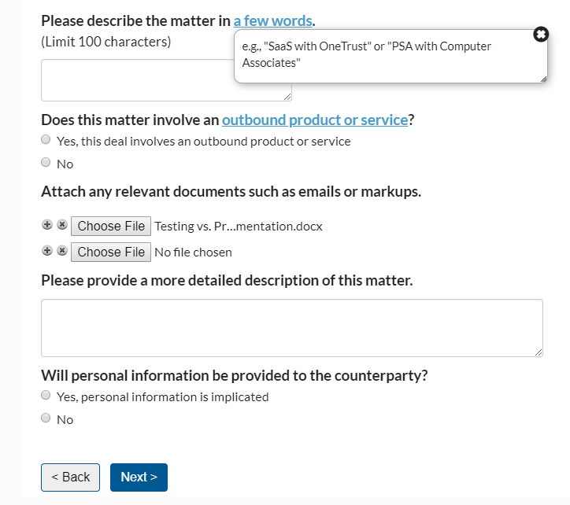
A New Matter Initiation Approach
Customized & streamlined matter intake
Refined based on regular feedback
Secure platform
Notes:
Note volume increased
Decrease in ”Friction”

Slide 8
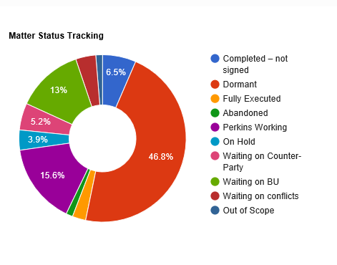
Better Matter Information
Real-time metrics & tracking
Automated notifications
Notes:
Measure Cycle-times
Value of the data

Slide 9
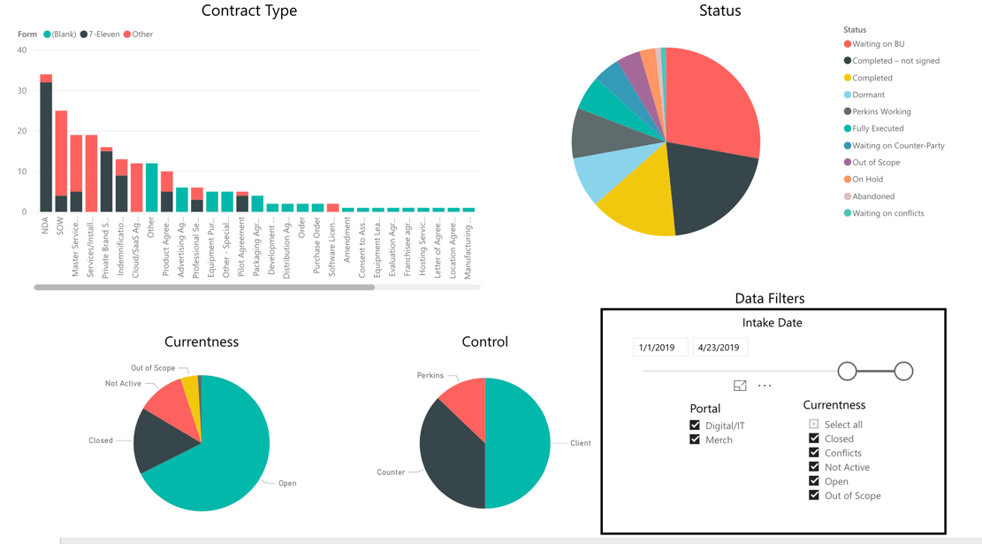
Better Matter Information
Notes:
Improve our resource scheduling capability to support hoteling and remote working
Establish a manager training program for remote workers

Slide 10
Client Outcomes
Cost Savings
Demonstrated
Faster Turn-around Times
Known Turn-around Times
Better Insights
Business Unit Impact

Slide 11
ACC Value Challenge - 2020

Slide 12
What Does The Brass Ring Look Like?
The best solutions to the legal market’s challenges will be found in partnerships between clients and their law firms.

