Slide 1
The Most Dangerous Case
Ethical Traps and Pitfalls
for In-House Counsel
Susan Kennedy, John Lawrence, and Chris Hunt June 25, 2020

Slide 2
What would you do if you had a case where…
  Your opposing party’s former employee comes to you with information that would help your case?
  In your opposing party’s document production you find a privileged memo from their lawyer about the case?
  One of your fact witnesses says they won’t testify unless you pay them?
  You find out that one of your employees withheld relevant documents or information?
  You realize one of your employees faked a key document and gave untruthful testimony?

Slide 3
Dilemma One
Communications with Opposing Party’s
Former Employees

Slide 4
POLLING QUESTION 1
Your company has recently been sued for breach of contract.
Shortly after your client is served, you receive an email from a former employee of the plaintiff company. She separated from the company under contentious circumstances and now says that she has information relevant to the lawsuit and would be willing to talk to you about it.
Can you reach out to this former employee?
You will see the polling question appear on your device. Select an answer and click the submit button.

Slide 5
Texas Rule – Communications OK
A lawyer cannot communicate regarding the subject matter of the representation with a person or entity the lawyer knows to be represented regarding that subject matter. Tex. R. Prof. Conduct 4.02.
“This Rule does not prohibit a lawyer from contacting a former employee of a represented organization or entity of a government.” Tex. R. Prof. Conduct 4.02, cmt. 4.
ABA Model Rule 4.2, comment 7, permits ex parte communications with former employees.

Slide 6
Dilemma Two
Receipt of Opposing Party’s
Privileged Documents

Slide 7
POLLING QUESTION 2
Opposing counsel’s document production contains a confidential memorandum written by opposing counsel regarding the issues and merits of the case. It is clearly privileged work product.
What obligation do you have with respect to this memo?
You will see the polling question appear on your device. Select an answer and click the submit button.

Slide 8
Informing the producing party
Texas does not require informing the producing party.
Texas ethical rules are silent regarding inadvertent disclosure. See Ethics Opinion 664 (October 2016).
“If a lawyer receives privileged materials because the opponent inadvertently produced them in discovery, the lawyer ordinarily has no duty to notify the opponent or voluntarily return the materials.” In re Meador, 968 S.W.2d 346 (Tex. 1998).
ABA Model Rule 4.4(b) and majority of jurisdictions require informing the other side.

Slide 9
Dilemma Three
Paying Fact Witnesses

Slide 10
POLLING QUESTION 3
A former employee has unique, helpful knowledge about issues in an important lawsuit for your company.
He says he is unwilling to testify without payment—he will fight any subpoena and will not do anything to prepare for the deposition.
Can you pay him?
You will see the polling question appear on your device. Select an answer and click the submit button.

Slide 11
Bribing a witness is a federal crime!
Whoever directly or indirectly, gives, offers, or promises anything of value to any person,
  for or because of the testimony under oath or affirmation given or to be given by such person as a witness upon a trial, hearing, or other proceeding,
  before any court; any committee of either House or both Houses of Congress; or any agency, commission, or officer authorized by the laws of the United States to hear evidence or take testimony;
  or for or because of such person's absence therefrom;
shall be fined under this title or imprisoned for not more than two years, or both.
The statute shall not be “construed to prohibit the payment or receipt of witness fees provided by law, or the payment, by the party upon whose behalf a witness is called and receipt by a witness, of the reasonable cost of travel and subsistence incurred and the reasonable value of time lost in attendance at any such trial, hearing, or proceeding, or in the case of expert witnesses, a reasonable fee for time spent in the preparation of such opinion, and in appearing and testifying.”
- 18 U.S.C. § 201

Slide 12
Reasonable compensation is generally permitted
Texas Professional Conduct Rule 3.04(b): You cannot pay, offer to pay, or acquiesce in the offer or payment of compensation to a witness or other entity contingent upon the content of the testimony of the witness or the outcome of the case.
But you can may advance, guarantee, or acquiesce in the payment of:
  expenses reasonably incurred by a witness in attending or testifying;
  reasonable compensation to a witness for his loss of time in attending or testifying; or
  a reasonable fee for the professional services of an expert witness.
ABA Model Rule 3.4 prohibits offering inducements to witness prohibited by law. ABA Opinion 96-402 says that payments that are clearly only to compensate for lost time are okay. Compensation can include time spent in interviews, preparing with lawyers to testify, and researching and reviewing documents.

Slide 13
Dilemma Four
Your Employee
Withholds Relevant Information

Slide 14
POLLING QUESTION 4
Your client gives evasive answers at a deposition. What responsibility do you have?
You will see the polling question appear on your device. Select an answer and click the submit button.

Slide 15
Civil Procedure rules and the courts require fair discovery responses
FRCP 30 (d)(2): “The court may impose an appropriate sanction—including the reasonable expenses and attorney's fees incurred by any party—on a person who impedes, delays, or frustrates the fair examination of the deponent.”
FRCP 37: “[A]n evasive or incomplete disclosure, answer, or response must be treated as a failure to disclose, answer, or respond.”
Texas Rule of Civil Procedure 215 is similar.
Sanctions can include instructions that matter is established against disobedient party; striking pleadings; dismissal of case; default judgment; contempt of court; payment of attorneys’ fees.
Courts also have inherent authority to issue compensatory sanctions for conduct that abuses the judicial process.

Slide 16
Ethical rules also require fair discovery responses
ABA Rule 3.4(d): “A lawyer shall not . . . fail to make reasonably diligent effort to comply with a legally proper discovery request by an opposing party.”
Texas Prof. Conduct Rule 3.04: “A lawyer shall not unlawfully obstruct another party’s access to evidence . . . or counsel or assist another person to do any such act.”
3.04 cmt. 1: “The procedure of the adversary system contemplates that the evidence in a case is to be marshalled competitively by the contending parties. Fair competition in the adversary system is secured by prohibitions against destruction or concealment of evidence, improperly influencing witnesses, obstructive tactics in discovery procedures, and the like.

Slide 17
Dilemma Five
Your Employee
Fabricated Evidence and
Gave False Testimony

Slide 18
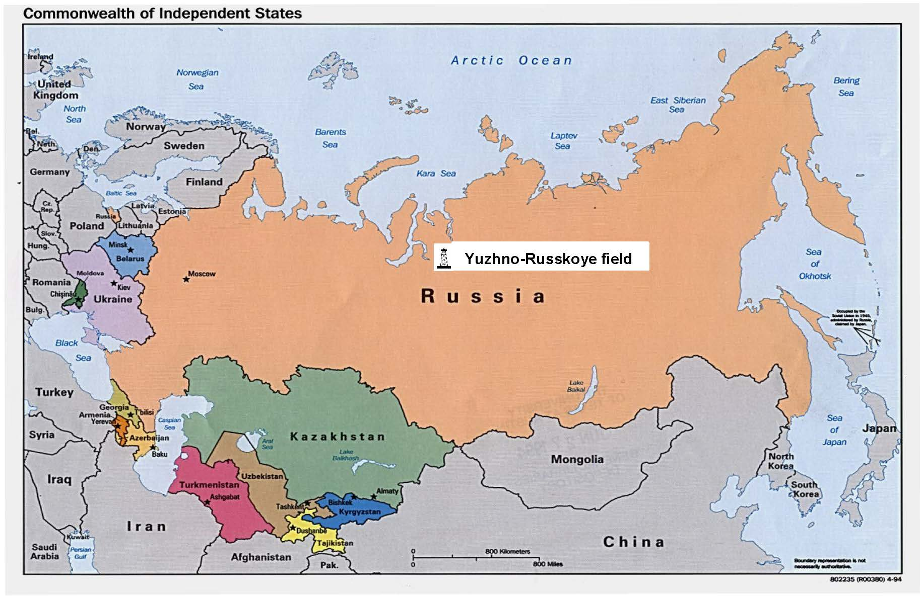

Slide 19


Slide 20
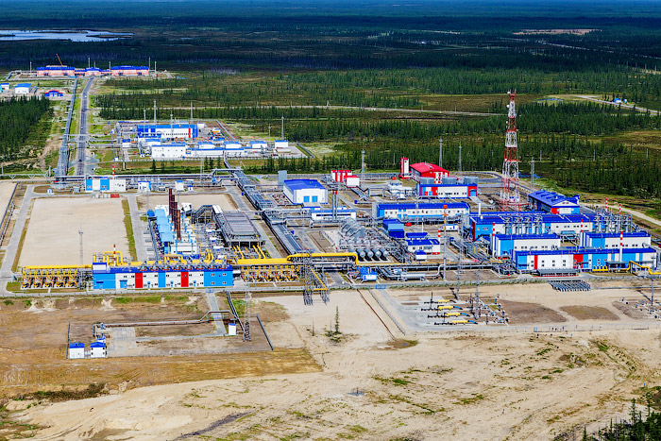

Slide 21
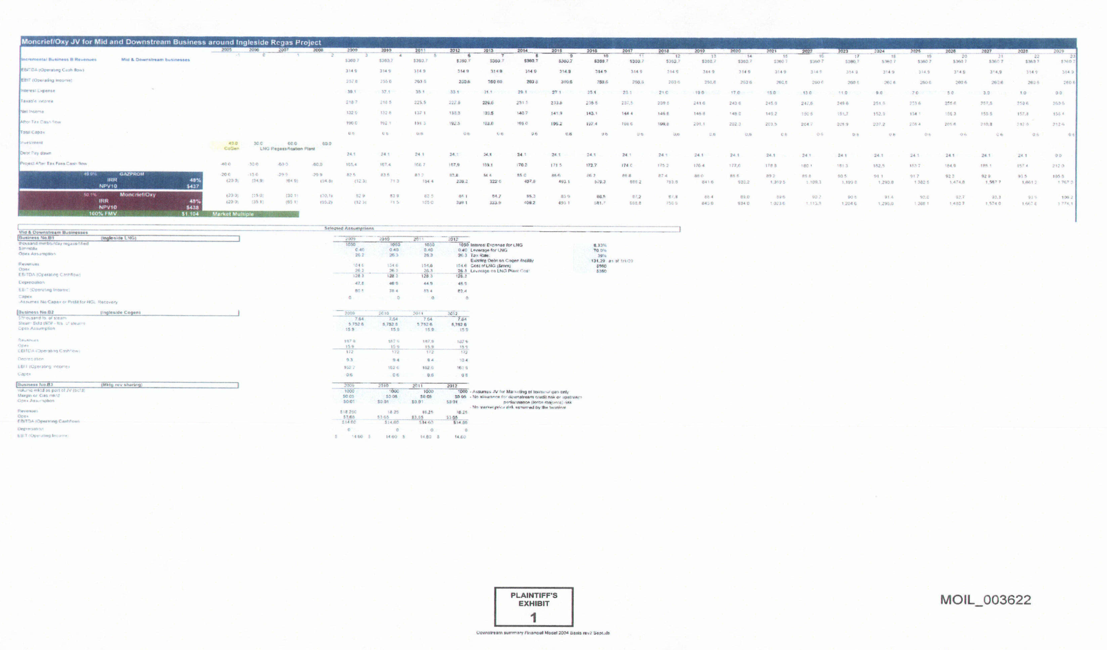
Plaintiff's Trial Exhibit 1

Slide 22
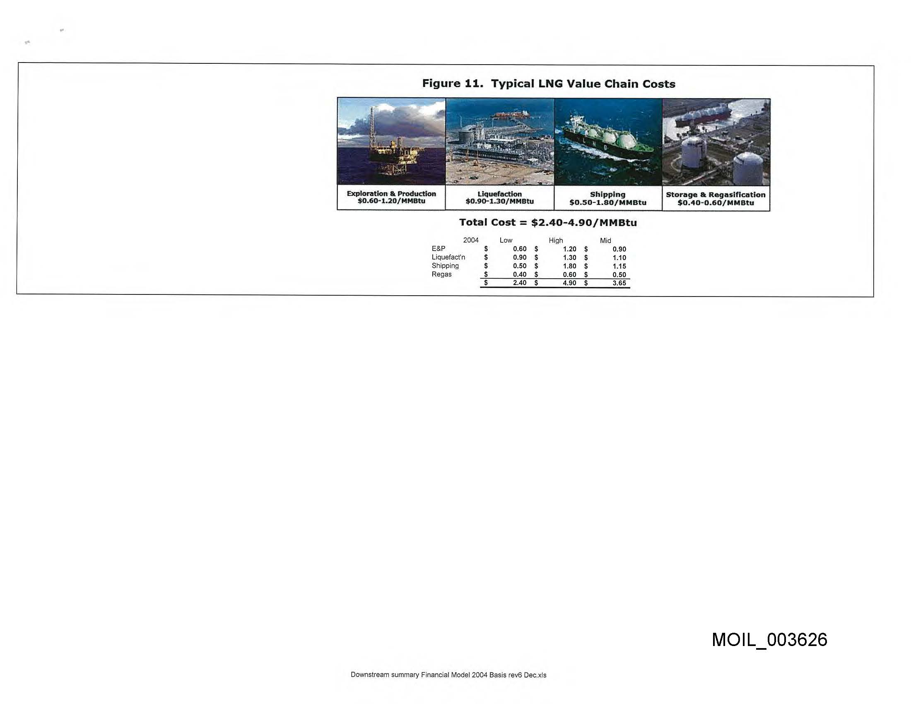

Slide 23
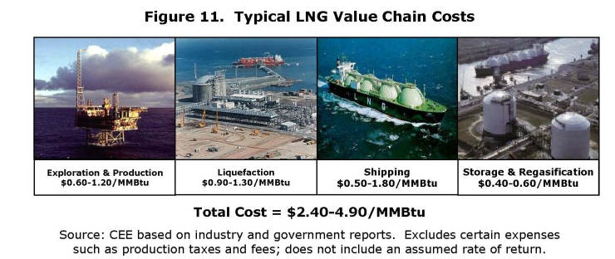

Slide 24
POLLING QUESTION 5
If you discover that your client has offered false evidence, you must:
You will see the polling question appear on your device. Select an answer and click the submit button.

Slide 25
When your client has offered false evidence:
Counsel your client to correct the false evidence or withdraw the false testimony.
  Tex. R. Prof. Conduct 3.03(b), cmts. 7-8
Disclose the true facts to the Court and the opposing side.
  Tex. R. Prof. Conduct 3.03(b), cmts. 7-8
In some cases, withdraw as counsel.
  Tex. R. Prof. Conduct 1.15(a)(1), (b)(2)

Slide 26
When the other side has offered false evidence:
Duty to Report:
  A lawyer must report a known violation of ethical rules committed by another lawyer if the violation "raises a substantial question as to that lawyer's honesty, trustworthiness or fitness as a lawyer." Tex. R. Prof. Conduct 8.03(a).
  Before reporting an alleged violation, however, Rule 8.03(a) requires that a lawyer have knowledge that another lawyer has in fact committed a violation. A report must be "based on objective facts that are likely to have evidentiary support." Tex. Comm. on Prof. Ethics Op. 520

Slide 27
Criminal Laws
      Tex. Penal Code § 37.09: Tampering with or Fabrication of Physical Evidence
        "A person commits an offense if, knowing that an investigation or official proceeding is pending or in progress, he . . . makes, presents, or uses any record, document, or thing with knowledge of its falsity and with intent to affect the course or outcome of the investigation or official proceeding." This is a third degree felony.
      Tex. Penal Code § 37.02: Perjury
        "A person commits an offense if, with intent to deceive and with knowledge of the statement’s meaning . . . he makes a false statement under oath.”

Slide 28
LBDS Holding Co. LLC v. ISOL Tech. Inc. (E.D. Tex.)
  $25 million verdict vacated after defendants discovered that plaintiff manufactured evidence and testified falsely
  Plaintiff's lawyers reported the fraud to the court and withdrew from the case
  Employee sentenced to 15 months in federal prison for perjury
Tesco Corp. v. Weatherford Int'l Inc. (S.D. Tex.)
  Patent infringement suit dismissed after judge found that plaintiff's lawyer had misled the Court
  "Not every lawyer who lies to a court will be caught, so when such deliberate and advantage-seeking untruthful conduct is uncovered, the penalty must be severe enough to act as a deterrent"

