Slide 1



Workplace Relations Risks
TIP.
To change the background image, move the grey pattern slightly to the left.
Click on the image with the right button.
Choose ‘Change Picture from File’
Change and place your image correctly
Move the grey pattern back to the center of the slide
Ducks, Roosters and Rollercoasters
Rachel Drew
16 November 2018

Slide 2
What we will cover today
ISSUES AND RISKS IN:
Correctly classifying employees
Managing unfair dismissal claims
Ensuring compliance with workplace laws

Slide 3
What we will cover today
ISSUES AND RISKS IN:
Correctly classifying employees
Managing unfair dismissal claims
Ensuring compliance with workplace laws

Slide 4
The ‘Working’ Framework
Casual
Permanent
Intern / Work Experience
Worker
Contractor
Employee of labour hire
Contractor or third party
Employees of outsourced provider

Slide 5
Misclassification Risks
Casual v Permanent
Leave entitlements
Flexible work requests
Contractor v Employee
NES entitlements
Superannuation
Employee v Third Party
NES
Notice
Redundancy
Unfair dismissal
Award entitlements
Exposure to penalties
Workers Compensation
Unfair dismissal
Unfair Dismissal
Underpayments
Accrued leave

Slide 6
Key employment questions you may be asked
Is the business exposed to an unbudgeted liability as a result of how we engage our workforce?
Is this business compliant with its Fair Work obligations?
If we adopt or continue with this approach, will we end up in the media/papers? E.g. 7-Eleven, Dominos Pizza

Slide 7
Cost of non-compliance
  What are the real risks?
  What can your business do?
Liability to repay underpaid wages and entitlements
Penalties – both corporate and individual (directors, HR personnel, General Managers, CFOs and payroll personnel)
Enforcement actions
Lost time on investigations / prosecutions and legal costs
Public reputational damage
Referral to other Government agencies such as the ATO (for underpayment of PAYG tax and/or superannuation)
    Seek advice on your industrial arrangements
    Be proactive
    Perform internal audits on controls around payroll to ensure employees are paid and accrue their correct entitlements
    Check rosters, timesheets, payroll processes, payslips
    Internal employee grievance process in place and employees are aware of it, e.g. induction, intranet
    Promote a culture compliant with workplace laws

Slide 8


Incorrect classification of employees
Distinction between independent contactor and employee?
Tests include: multi-factor test, multi-facet test, business test, control test and totality of the relationship…

Slide 9
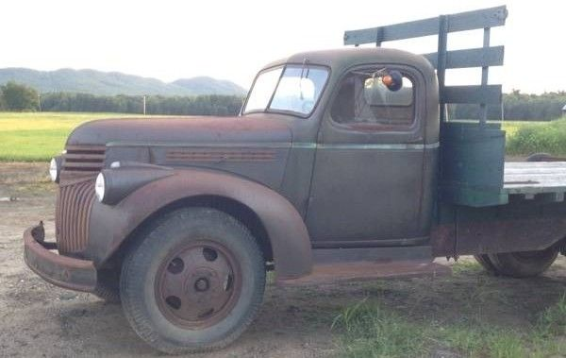
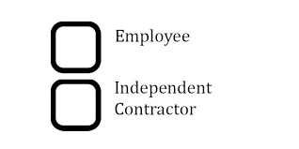

Re Porter – Summary of facts
Transport Workers’ Union elections
Union rules – had to be employed or seeking to be employed to be eligible for membership
Five candidates – all were owner drivers
Question: should the owner drivers be characterised as employees or independent contractors?

Slide 10

Re Porter – Outcome
“…the parties cannot create something which has every feature of a rooster, but call it a duck and insist that everybody else recognise it as a duck…”.
Re Porter; ex parte TWU (1989)

Slide 11

Fair Work Ombudsman v Quest South Perth Holdings Pty Ltd [2015] FCAFC 37
Quest converted employees to independent contractors
Workers continued to perform work for Quest as they had always done
Business test applied – any “entrepreneurial endeavour” on the part of the individual?

Slide 12

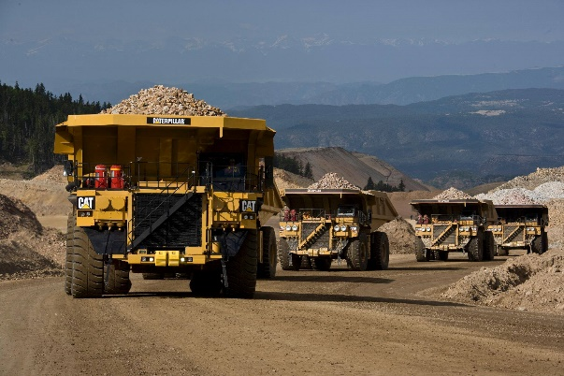
Williams v MacMahon Mining Services [2010] FCA 1321
Williams – Miner at Argyle Mine in Western Australia
Roster set in advance: two weeks on, two weeks off, 12 hours every shift, same work crew
MacMahon paid accommodation and flights
Contract stated “CASUAL”, flat rate $40.00/hour to include ‘a loading in lieu of leave entitlements’
Contract provided one hour’s notice

Slide 13

Williams v MacMahon Mining Services - Outcome
Williams work was performed according to a stable, organised and certain roster, with certainty of working hours throughout the term of employment
He was a permanent employee, not a casual worker

Slide 14


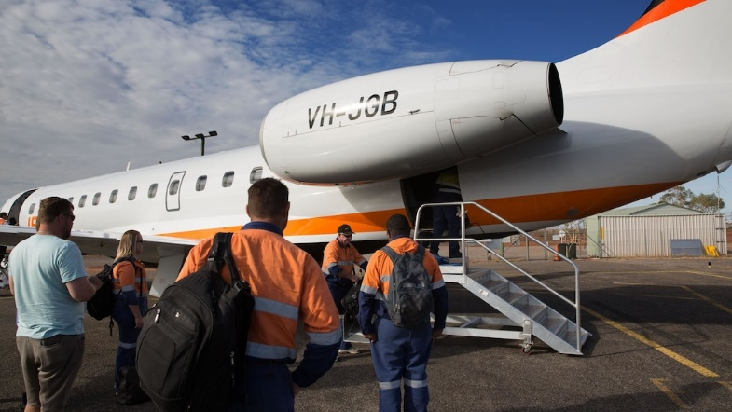
Skene v WorkPac [2018] FCAFC 131
Qld Dump-truck operator
Labour hire through WorkPac
Roster set in advance:
7 days on, 7 days off, 12.5 hours every shift, same work crew
Mine paid accommodation & flights
Contract classified Skene as casual

Slide 15
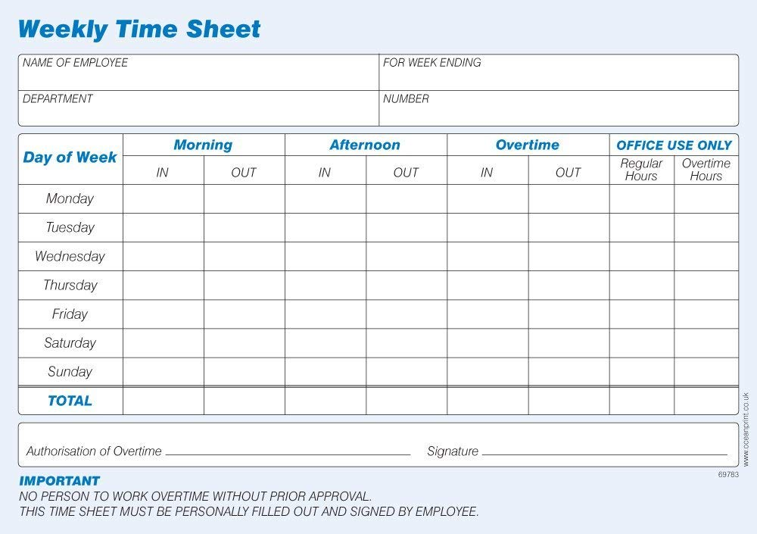

Skene v WorkPac
Skene required to submit timesheets, paid hourly
Flat rate to include ‘a loading in lieu of leave entitlements’
$50.00/hr, then $55.00/hr
Contract provided for termination by one hour’s notice

Slide 16

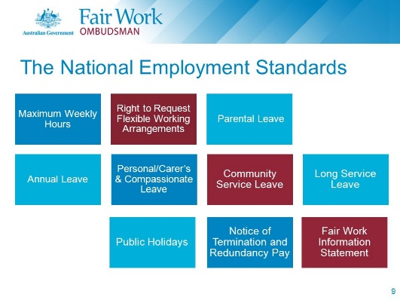
Skene v WorkPac - Outcome
First instance, Federal Circuit Court held:
  Skene was not a casual employee for the purposes of NES; but
  Skene was a casual employee within the meaning of the Enterprise Agreement
Agreement allowed WorkPac to designate an employee as a casual for the purposes of the Agreement on the commencement of their employment
As a result, Skene entitled to compensation for unpaid annual leave under NES
Primary Judge declined to award penalties, on the basis that it had closely considered the legal consequences of the employment arrangement and relied on advice of senior staff member.

Slide 17
Skene v WorkPac - Outcome
On appeal, Court considered concept of casual employment in detail, due to no definition in the Fair Work Act 2009 (Cth) (the Act) – was a permanent employee
Court held, Skene was not a casual employee and was therefore entitled to annual leave under NES
Court held, Skene was not a casual employee under the Agreement
Employer may make a claim for off-set?
Concept of ‘double dipping’ – benefits of casual loading and annual leave?
Workpac’s attempts to off-set Skene’s casual loading failed
There was no designated amount or percentage of his wages expressly attributed to the casual loading
Remitted determination of compensation and penalties to primary judge

Slide 18
What we will cover today
ISSUES AND RISKS IN:
Correctly classifying employees
Managing unfair dismissal claims
Ensuring compliance with workplace laws

Slide 19
Terminations
Be aware of contractual and other obligations to effect the decision
Ensure the Decision Maker has the appropriate delegation and authorisation
Document the process – evidence chain later if needed
Implications of termination on the business – Any risks from departing employee?
Confidential information, client contact, access to IT systems
Timing and notice – worked out/handover or paid in lieu

Slide 20

Tips: Unfair dismissal
West v Holcim (Australia) Pty Ltd [2017] FWC 2346
Employee dismissed on the basis that he had engaged in dangerous and reckless behaviour.
He allowed a casual labour hire employee, who had no experienced or training in crane operation, to operate a crane and then failed to report a near miss incident in which another employee was almost struck.
FWC ordered that West be reinstated after considering the evidence before them that he had engaged in such conduct before and suffered no reprimand or warnings.
Critical that employers ensure they address misconduct when it arises, each and every time.
Regardless of how clear the misconduct may be, without evidence to provide that an employee was aware that their actions constitute a breach of policy or misconduct, a failure to address the situation may provide evidence that such conduct was acceptable.

Slide 21


Tips: Unfair dismissal
Walker v Salvation Army (NSW) Property Tryst t/as The Salvation Army – Salvos Stores [2017] FWC 32
Employee alleged to have stolen money from the cash register. Evidence of this was CCTV footage.
Salvation Army dismissed employee without providing her the opportunity to adequately view or respond to the footage.
FWC held that due to the employers failure to provide the employee with the opportunity to view or respond to the footage their actions constituted unfair dismissal.
Salvation Army ordered to pay $22,405 to the employee.
Importance of ensuring an employee is awarded procedural fairness throughout disciplinary processes, prior to making a decision, as a failure to do so may see any response made to the allegations as insufficient.

Slide 22
What we will cover today
ISSUES AND RISKS IN:
Correctly classifying employees
Managing unfair dismissal claims
Ensuring compliance with workplace laws

Slide 23
FWO – moving up the chain
Top-Tier Entity
Franchisee
Workers
Payroll Entity
Workers
Financing entity
Sub-Contractor
Sub-Contractor
Workers

Slide 24
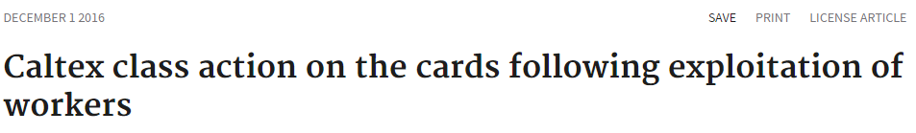
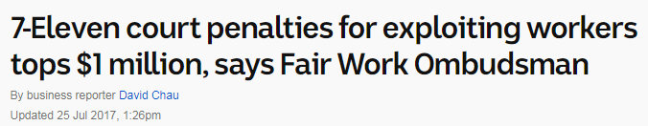



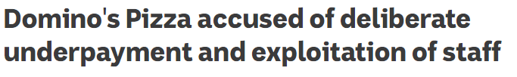

ISSUE
Overview
Fair Work Amendment (Protecting Vulnerable Workers) Act 2017 (Cth)
Labour Hire Licensing Act 2017 (Qld)
Work Health and Safety and Other Legislation Amendment Act 2017 (Qld)

Slide 25
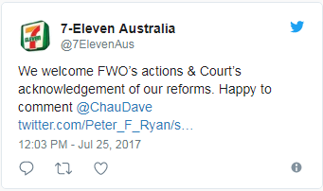
Exploitation of workers: case study
Overview
Fair Work Amendment (Protecting Vulnerable Workers) Act 2017 (Cth)
Labour Hire Licensing Act 2017 (Qld)
Work Health and Safety and Other Legislation Amendment Act 2017 (Qld)
7-Eleven operators across Australia have been penalised for short-changing workers and falsifying records to conceal underpayments
Former franchisee of 7-Eleven store in Brisbane’s West End has been ordered to pay $28,000 in penalties, and his corporate enterprise to pay $140,000
Found that franchisee underpaid one worker $13,962 in 13 months, and paid some workers as low as $13/hr
Franchisee also made false and misleading entries into
payroll system and provided false records to the Fair
Work Ombudsman
Source: http://www.abc.net.au/news/2017-07-25/7-eleven-court-penalties-now-top-1-million/8740706

Slide 26
Fair Work Amendment (Protecting Vulnerable Workers) Act 2017 (Cth)
Overview
Fair Work Amendment (Protecting Vulnerable Workers) Act 2017 (Cth)
Labour Hire Licensing Act 2017 (Qld)
Work Health and Safety and Other Legislation Amendment Act 2017 (Qld)
Key Amendments
Introduces higher scale of penalties for “serious contraventions” of prescribed, payment-related workplace laws
E.g. civil penalties will increase from 60 penalty units up to 600 w/ max. penalties of $630,000 for corporate entities and $126,000 for individuals
Holding franchisors and companies responsible for underpayments by their franchisees/subsidiaries when they “knew” or “ought to have known” of the breaches and failed to take reasonable steps to prevent them
However the Act does not absolve franchisees or subsidiaries of their responsibility under workplace laws

Slide 27
What does this mean for business?
Overview
Fair Work Amendment (Protecting Vulnerable Workers) Act 2017 (Cth)
Labour Hire Licensing Act 2017 (Qld)
Work Health and Safety and Other Legislation Amendment Act 2017 (Qld)
Company wide compliance system for the networks
    This may include audits, periodic training, developing online questionnaires and checklists for business units
This will be particularly relevant when constructing a “reasonable steps” defence, as franchisors/companies will be held to be liable when they “knew” or “ought to have known” and failed to take reasonable steps to prevent the breach

Slide 28
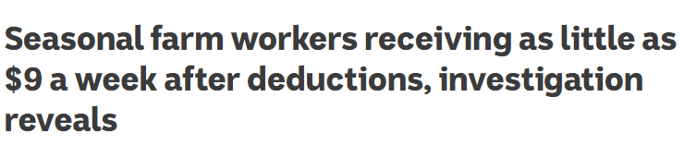
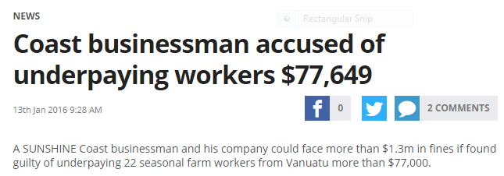
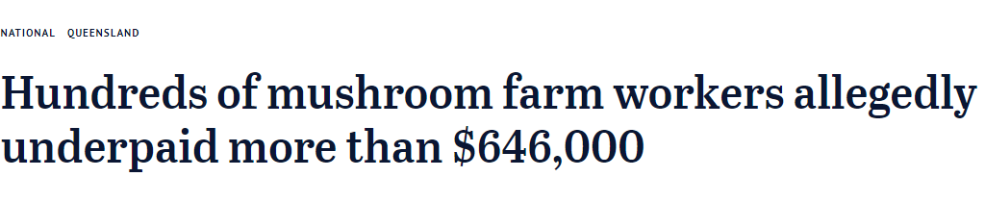
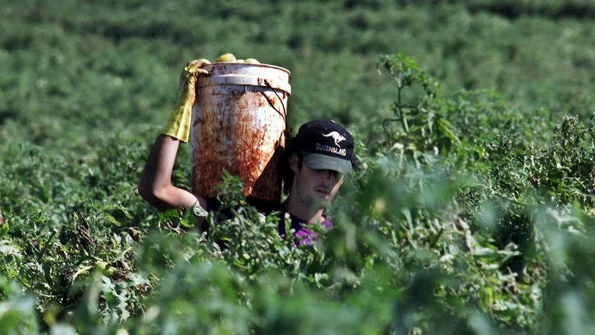
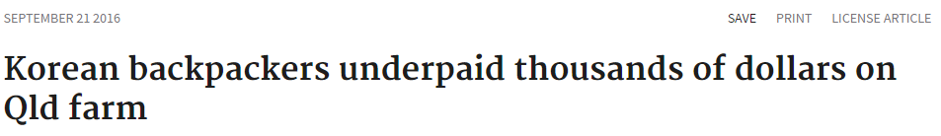
ISSUE
Overview
Fair Work Amendment (Protecting Vulnerable Workers) Act 2017 (Cth)
Labour Hire Licensing Act 2017 (Qld)
Work Health and Safety and Other Legislation Amendment Act 2017 (Qld)

Slide 29
Exploitation of workers: case study
Overview
Fair Work Amendment (Protecting Vulnerable Workers) Act 2017 (Cth)
Labour Hire Licensing Act 2017 (Qld)
Work Health and Safety and Other Legislation Amendment Act 2017 (Qld)
Seasonal farm workers from Vanuatu were employed to pick fruit and vegetables
Terms of workers’ employment agreement stipulated workers to receive minimum 30 hours a week of work, with wages totalling approx. $500 ea
Workers only received sporadic employment
Workers forced to work entire days harvesting without food, drink or pay
Workers forced to live in isolated, transient accommodation

Slide 30
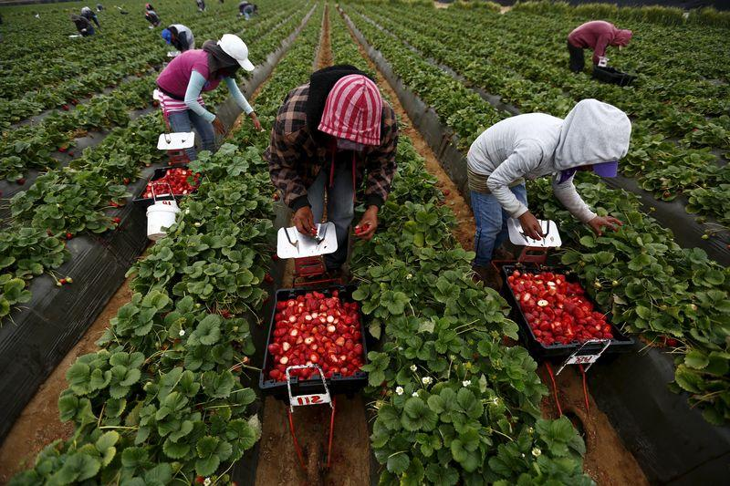

Legislative response
Overview
Fair Work Amendment (Protecting Vulnerable Workers) Act 2017 (Cth)
Labour Hire Licensing Act 2017 (Qld)
Work Health and Safety and Other Legislation Amendment Act 2017 (Qld)
Queensland Government on 25 May 2017 proposed the Labour Hire Licensing Act 2017 (QLD)
Bill intended to “clean up” the labour hire sector and protect vulnerable workers by establishing a mandatory business licensing scheme for the labour hire industry
Passed by Parliament on 8 September 2017

Slide 31
Labour Hire Licensing Act 2017 (Qld)
Overview
Fair Work Amendment (Protecting Vulnerable Workers) Act 2017 (Cth)
Labour Hire Licensing Act 2017 (Qld)
Work Health and Safety and Other Legislation Amendment Act 2017 (Qld)
Key Amendments
All labour hire providers now required to be licensed
This means labour hire providers will need to:
  Pass a fit and proper person test to establish financial viability and legislative compliance
      This includes assessment on character and history of compliance with relevant laws, whether they can demonstrate capacity for future compliance
  Labour hire providers required to report regularly on operations, including providing accurate employee details (who, what, where, how)
  Pay licence fee depending on size of company (small, medium, large)

Slide 32
What does this mean for Queensland businesses?
Overview
Fair Work Amendment (Protecting Vulnerable Workers) Act 2017 (Cth)
Labour Hire Licensing Act 2017 (Qld)
Work Health and Safety and Other Legislation Amendment Act 2017 (Qld)
  Queensland businesses that utilise labour hire workers should now implement management protocols to safeguard themselves under the new legislation
    E.g. businesses should seek assurances in any contractual arrangements with labour hire providers to ensure they are meeting the new licence requirements

Slide 33
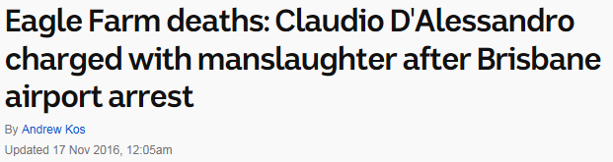

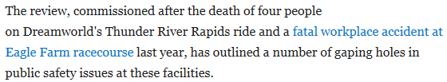
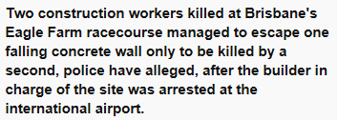

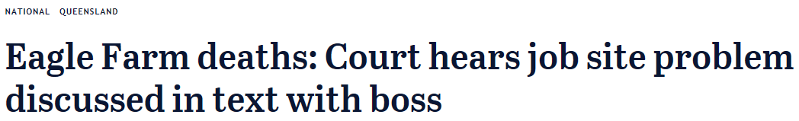

ISSUE
Overview
Fair Work Amendment (Protecting Vulnerable Workers) Act 2017 (Cth)
Labour Hire Licensing Act 2017 (Qld)
Work Health and Safety and Other Legislation Amendment Act 2017 (Qld)

Slide 34
WH&S incidents: case study
Overview
Fair Work Amendment (Protecting Vulnerable Workers) Act 2017 (Cth)
Labour Hire Licensing Act 2017 (Qld)
Work Health and Safety and Other Legislation Amendment Act 2017 (Qld)
Dreamworld →
    Four patrons were killed on the “Thunder River Rapids” ride when their raft collided with another raft near a large conveyor belt at the end of the ride
Eagle Farm →
    Two construction workers were killed at Brisbane’s Eagle Farm racecourse when two concrete walls “failed” and simultaneously collapsed on top of each other due to poor installation procedures

Slide 35
Legislative response
Overview
Fair Work Amendment (Protecting Vulnerable Workers) Act 2017 (Cth)
Labour Hire Licensing Act 2017 (Qld)
Work Health and Safety and Other Legislation Amendment Act 2017 (Qld)
Work Health and Safety and Oher Legislation Amendment Bill 2017 (Qld) – August 2017
The Bill proposed to introduced the new criminal offence of “industrial manslaughter” into the Work Health and Safety Act 2011 (Qld)
This was recommended in the final report from the independent “Best Practice Review of Workplace Health and Safety in Queensland”, which was also undertaken subsequent to the Dreamworld and Eagle Farm incidents
Coronial Inquest still running…

Slide 36
Work Health and Safety and Other Legislation Amendment Act 2017 (Qld)
Overview
Fair Work Amendment (Protecting Vulnerable Workers) Act 2017 (Cth)
Labour Hire Licensing Act 2017 (Qld)
Work Health and Safety and Other Legislation Amendment Act 2017 (Qld)
Key Amendments – Introduction of “industrial manslaughter”
34C Industrial manslaughter—person conducting business or undertaking
A person conducting a business or undertaking commits an offence if—
(a) a worker dies in the course of carrying out work for the business or undertaking………….; and
(b) the person’s conduct causes the death of the worker; and
(c) the person is negligent about causing the death of the worker by the conduct.
Maximum penalty—
for an individual—20 years imprisonment; or
for a body corporate—100,000 penalty units.

Slide 37
Work Health and Safety and Other Legislation Amendment Act 2017 (Qld) cont…
Overview
Fair Work Amendment (Protecting Vulnerable Workers) Act 2017 (Cth)
Labour Hire Licensing Act 2017 (Qld)
Work Health and Safety and Other Legislation Amendment Act 2017 (Qld)
34D Industrial manslaughter—senior officer
A senior officer of a person who carries out a business or undertaking commits an offence if—
a worker— (i)dies in the course of carrying out work for the business or undertaking…………..; and
the senior officer’s conduct causes the death of the worker; and
the senior officer is negligent about causing the death of the worker by the conduct.
Maximum penalty—20 years imprisonment.

Slide 38
Thank you
Disclaimer
The information in this publication is of a general nature and is not intended to address the circumstances of any particular individual or entity. Although we endeavour to provide accurate and timely information, we do not guarantee that the information in this publication is accurate at the date it is received or that it will continue to be accurate in the future. We are not responsible for the information of any source to which a link is provided or reference is made and exclude all liability in connection with use of these sources.

Slide 39




Social Media
#morethanalawyer
#byinhouse
#NatCon18

